Slide 1
UBER DATA ANALYSIS USING PYTHON Presenters Geeta Priyanka Harsh Hundiwala Heena Khan Parul Thakral Suvajit Chakrabarty

Slide 2
Python
Open Source and free to install
High-level programming language
Interpreted language
Code Readability
Multiple programming paradigms
Comprehensive and large standard library

Slide 3
Input Output in Python
By using input function
Eg: a = int(input())
Basic way to do output is the print statement
Eg:print("The sum of the three numbers is {}".format(d))

Slide 4
Data Types in Python
Numbers
Lists
Strings
Tuples
Dictionary
Dataframes (pandas)
Arrays (Numpy)

Slide 5
Control Structures in Python
Conditional Execution: if , if-else, if-elif-else,
and nested if
Repetitive Execution: For, While, Nested loops
Others: break, continue

Slide 6
Problem Statement
Uber Technologies, Inc. is a transportation network company and a pioneer in the shared economy business.
Dataset Used: Uber/Lyft datasets that document transactions from April 2014 to September 2014
Problem: Predicting Future Uber/Lyft popularity regions using K-means Clustering Algorithm.

Slide 7
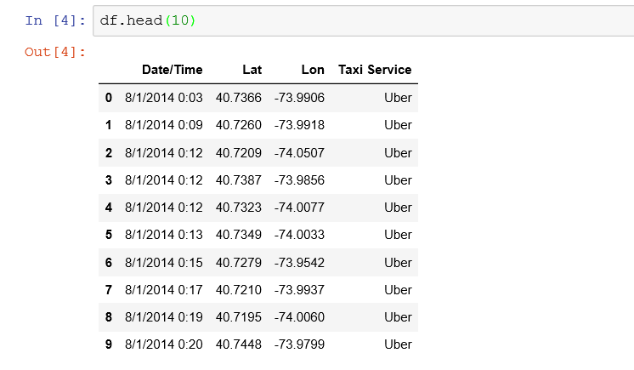
Steps involved in Predictions
Data Exploration

Slide 8
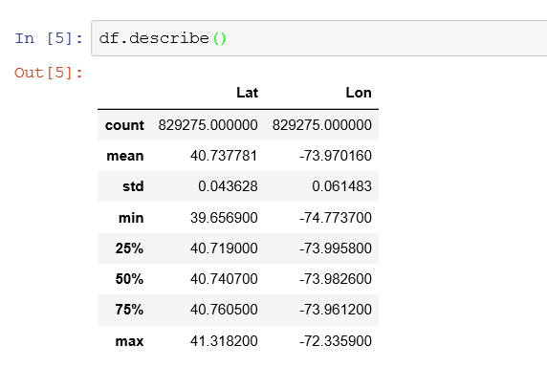
Data Pre-processing
Cleaning Empty Data
Converting locations from address to longitude and latitude.

Slide 9
Building a Predictive Model
Using Skicit-Learn Library
K-means is one of the oldest and most commonly used clustering algorithms. It is a prototype based clustering technique defining the prototype in terms of a centroid which is considered to be the mean of a group of points and is applicable to objects in a continuous n-dimensional space.

Slide 10
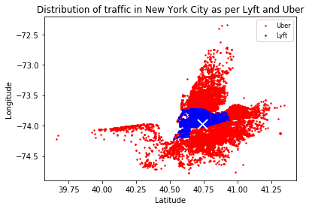
Traffic Distribution

Slide 11
Results
Our Data Analysis was successful in predicting the regions where Uber and Lyft are popular. This helps Uber/Lyft drivers to recognise the potential locations where probability of getting rides is more.
This also helps Uber/Lyft Organizations to predict where the popularity of their service is low, so that they can work on promotional offers based on location.

Slide 12
Strength and Weakness of Python
Strengths
Open Source Language
Extensive Support Libraries
Integration Feature
Easy-to-use
Weakness
Run time errors
Difficulty in using other languages
Low Security
No type Safety

Slide 13
Thank You

