Slide 1

Drain Filter Service: Visual Guide
With photos, a chart and a process diagram

Slide 2


Know the machine
The drain filter is behind the small cover at the bottom right.
Notes:
Point out where the drain filter cover is: bottom right on front loaders.

Slide 3
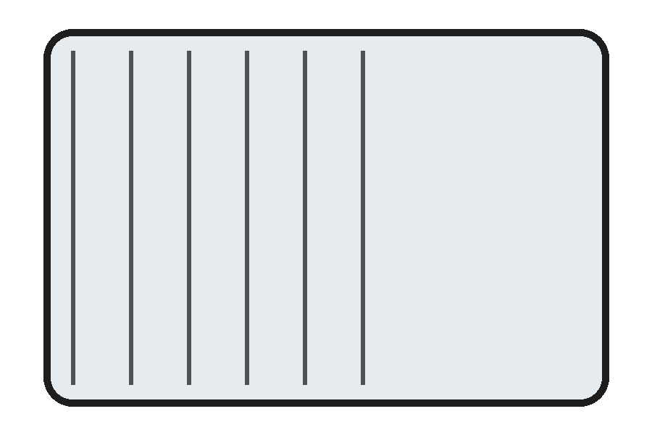
The filter up close
Filter with debris trap
Notes:
Lint, coins and hair pins are the usual culprits.

Slide 4
Drain complaints by cause
Notes:
Half of all drain complaints are a blocked filter.

Slide 5
The 4-step process
Unplug
Drain
Clean
Refit & test
Notes:
Always unplug first, then drain, clean, refit and test.

Slide 6
Recap: the filter
Notes:
Same close-up as before, reused.

