Slide 1
Visual computing and mixed reality
Assignment 1
Shruthi Kura(101516439)
Naveena Katpally(101551664)

Slide 2
TASK 1
Write a MATLAB script which reads, converts a color image into grayscale image, and performs the histogram equalization on the grayscale one. Note that you are not allowed to use histeq, instead you have to implement a function to do histogram equalization. Do find some examples where histogram equalization achieves the worse results. Please discuss the pros and cons of histogram equalization method.

Slide 3
HISTOGRAM
Histogram is the graphical representation of data, it have bars that represent frequency of occurring of data in the whole data set.
Histogram of an image shows frequency of pixels intensity values. In an image histogram, the x axis shows the gray level intensities and the y axis shows the frequency of these intensities.
The left side of the horizontal axis represents the black and dark areas, the middle represents medium grey and the right hand side represents light and pure white areas.

Slide 4
Histograms can also be taken of color images - either individual histograms of red, green and blue channels can be taken, or a 3-D histogram can be produced, with the three axes representing the red, blue and green channels, and brightness at each point representing the pixel count.
Uses:
The histogram is used for brightness purposes. It has wide application in image brightness. Not only in brightness ,but histograms are also used in adjusting contrast of an image.
Another important use of histogram is to equalize an image.

Slide 5
Histogram equalization
Histogram equalization is a technique for adjusting image intensities to enhance contrast.
It transform the intensity values so that the intensities can be better distributed on the histogram.
It may not increase the contrast in every case.
In this the gray level values are may or may not be same as that of the input histogram image.

Slide 6
Steps:
Reading the color image and converting the color image to gray scale image.
Find the max value of image ,size of image and total number of pixels.
Histogram equalization can be obtained by finding
1) Probability function of the image.
2) Cumulative distribution of the image
3) Multiplying cumulative distribution values with (graylevel-1) values.
4) Round off to nearest value.

Slide 7
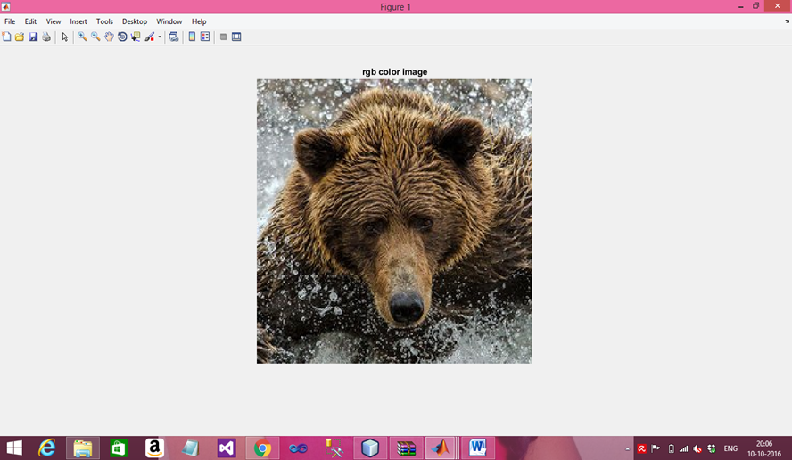
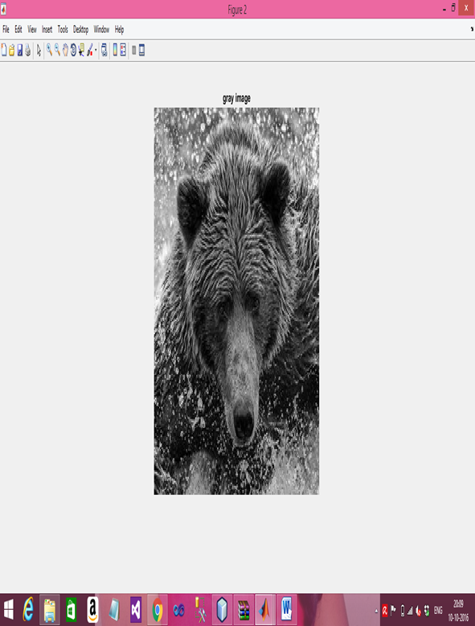
Output
Figure 2: gray scale image
Figure 1: original image

Slide 8
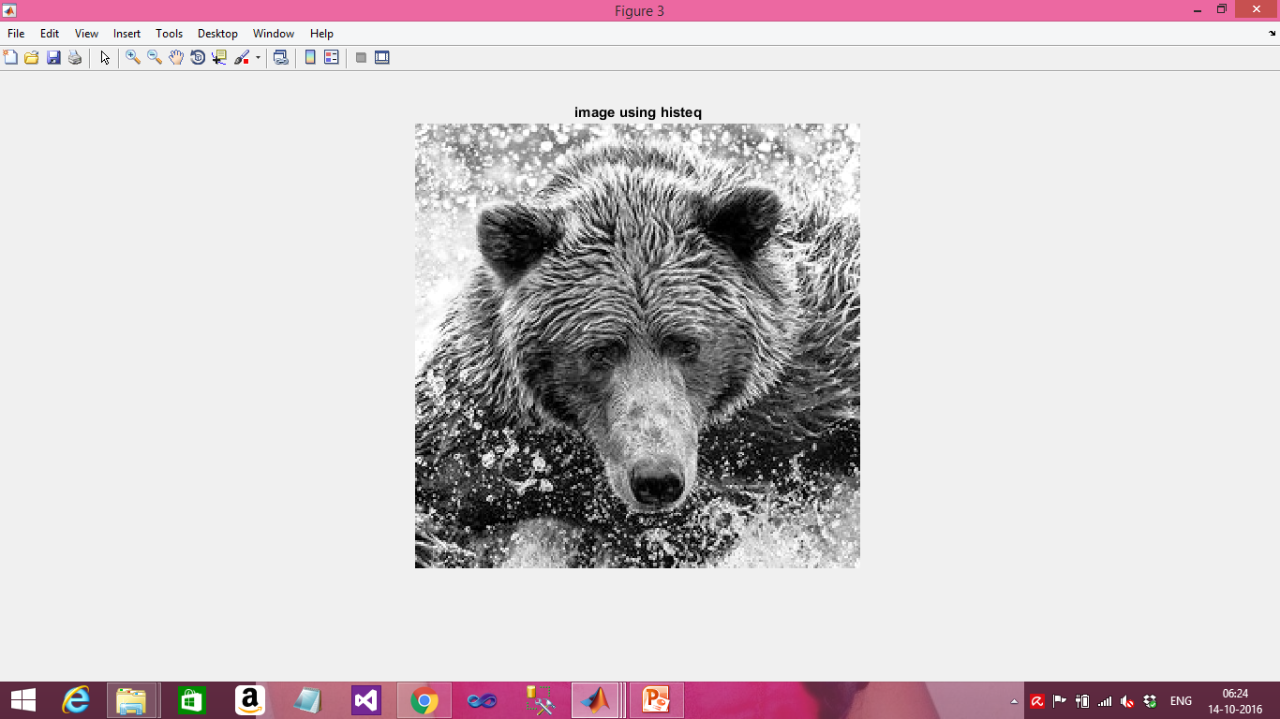
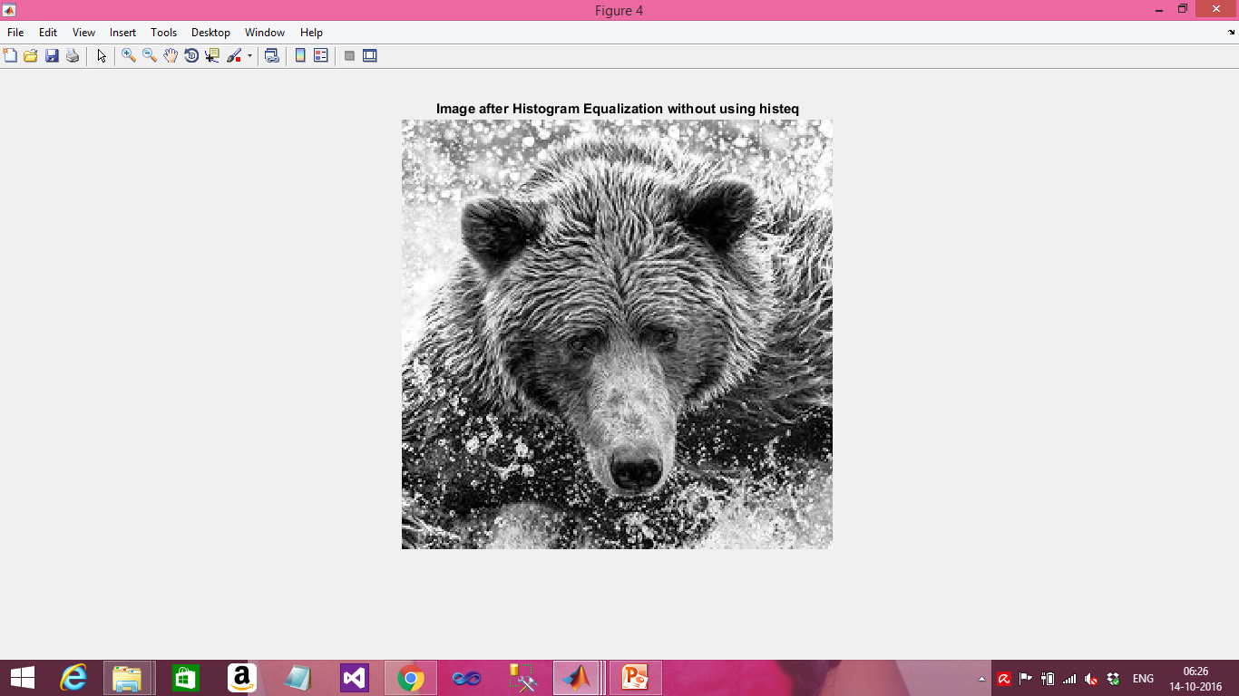
Histogram equalization of an image using histeq( );
Histogram equalization of an image without using histeq( );

Slide 9
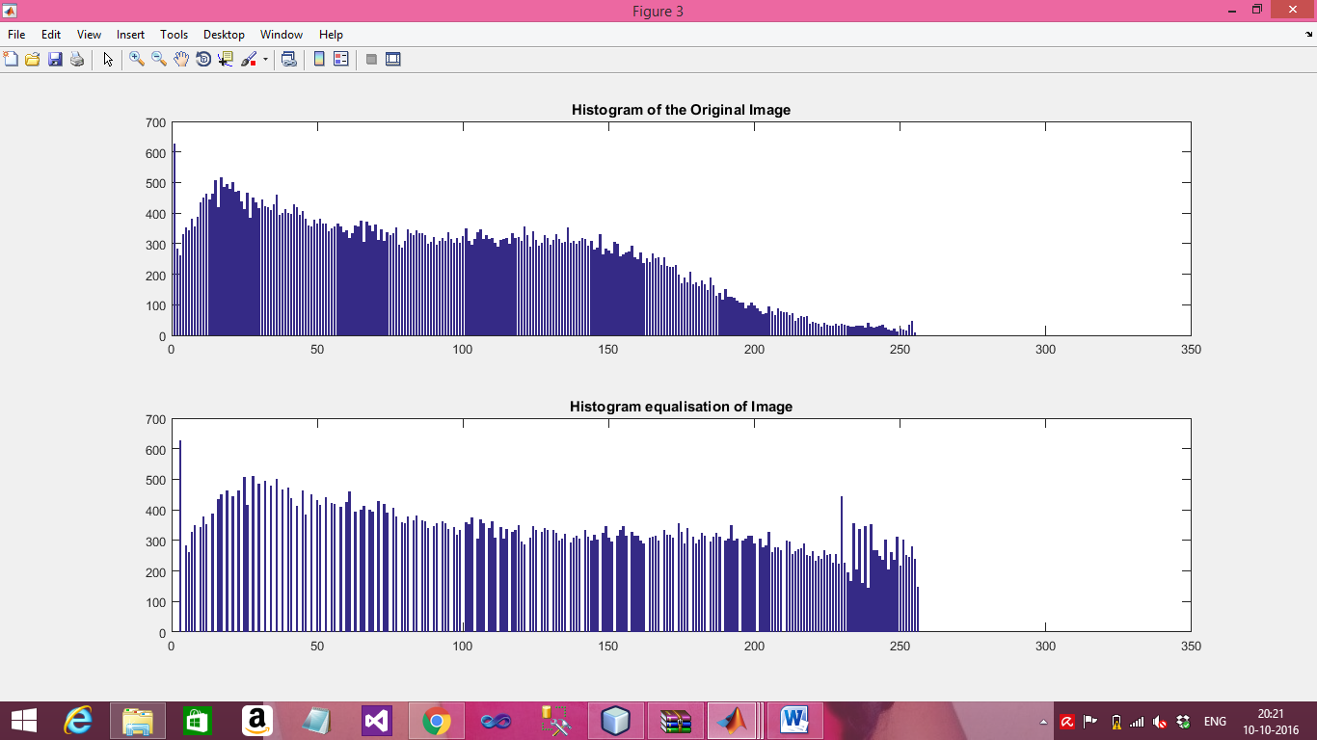
Histograms diagram

Slide 10
Pros :
Histogram equalization will work the best when applied to images with much higher color depth.
Histogram equalization is used to increase the contrast of image.
Cons:
Histogram equalization can produce undesirable effects when applied to images with low color intensity.
Histograms are not unique. It is indiscriminate.
If there are gray values that are physically far apart from each other in the Image, then this method fails.

Slide 11
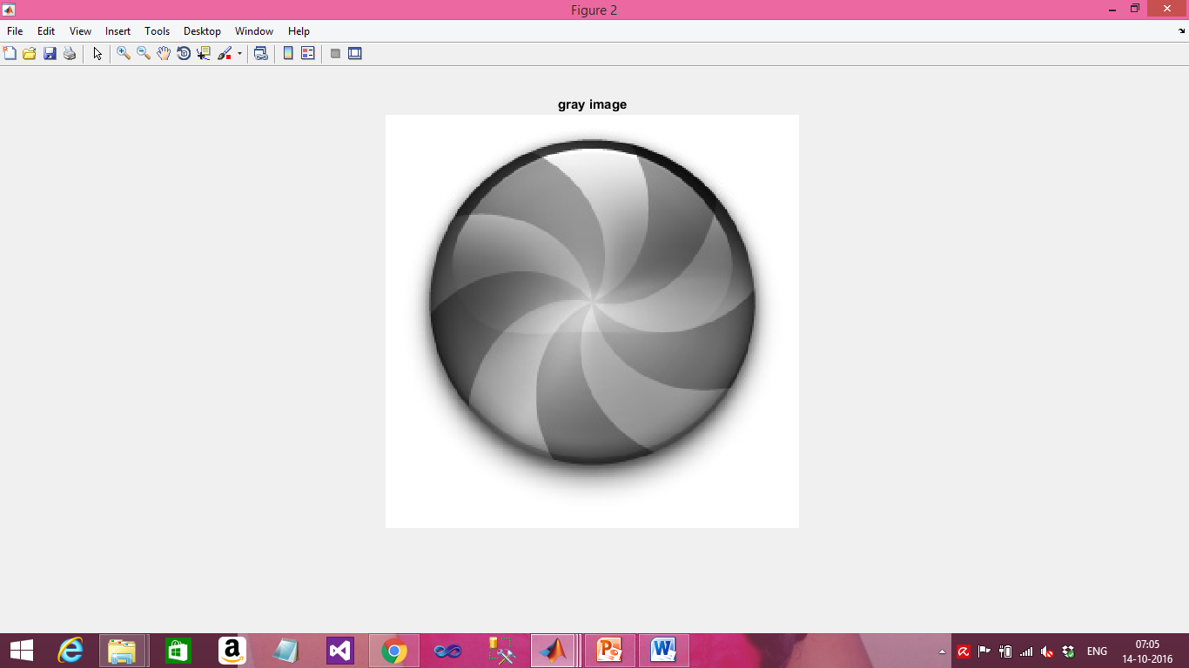
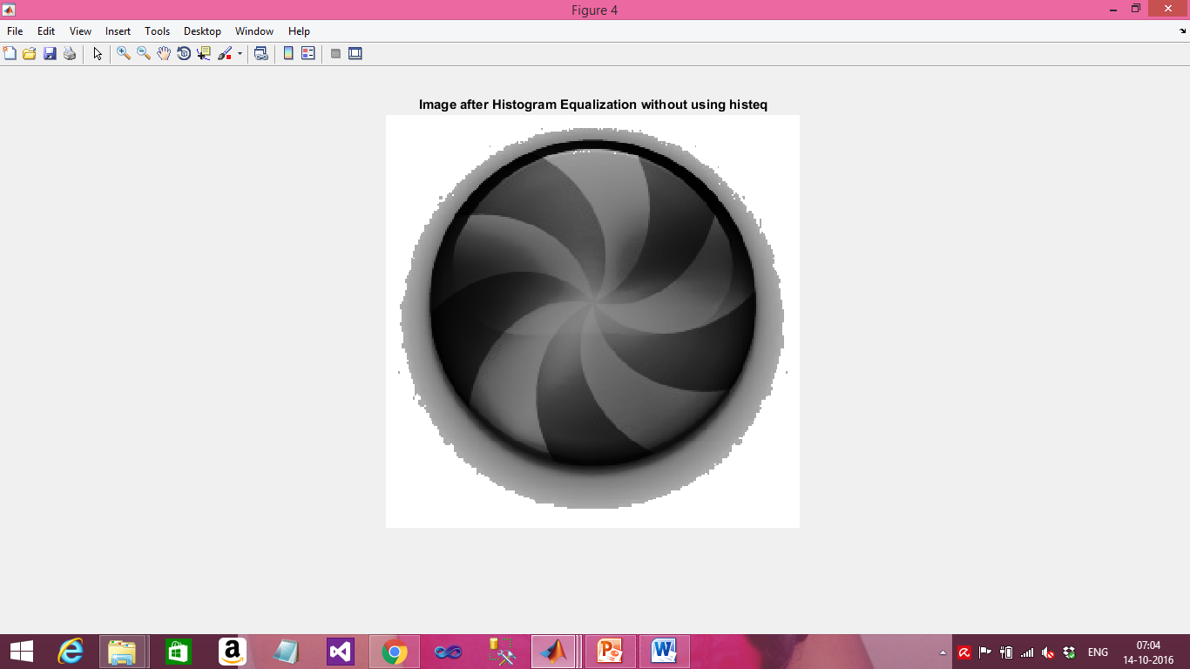
Gray image
Histogram Equalization image

Slide 12
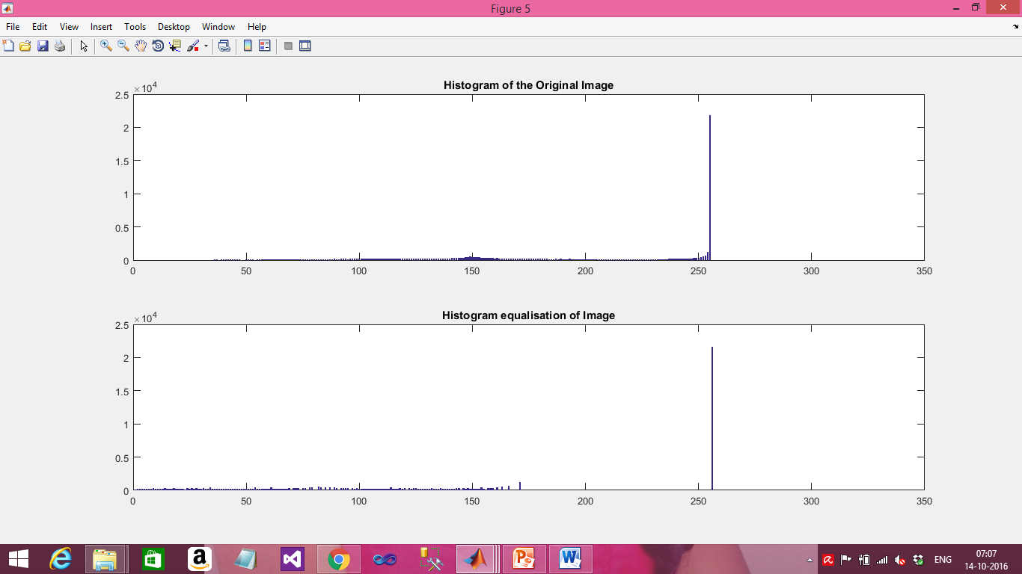
Histogram bars

Slide 13
TASK 2
Write a MATLAB script which reads, converts a color image into grayscale image, and performs min, max and median filtering on the grayscale image. Please discuss/elaborate on each filtering method (min, max, and median).

Slide 14
Image Filtering
Image Filtering is a technique for modifying or enhancing an image.
Image processing operations are implemented with filtering includes smoothing, sharpening and edge enhancement.
Filtering is an neighbourhood operation, in which the value of any given pixel in the output image is determined by applying some algorithm to the values of pixel in the neighbourhood of corresponding input pixels.

Slide 15
MEDIAN FILTERING :
The Median Filter replaces the central pixel value with its median value.
It can remove noise from an image without significantly reducing the sharpness of the image.
It preserve the edges and avoid excessive smoothening.
MINIMUM FILTERING :
The Minimum filter enhances dark values in the image by increasing its area.
That darkest pixel then becomes the new pixel value at the center of the window.

Slide 16
In this background of an image is viewed as the image look more darker.
MAX FILTERING:
Max filter is used to find the brightest points in an image, and gives the maximum value of the window.
In this foreground of an image is viewed.
Min, Max and Median are non linear filters ,they are used for denoising.

Slide 17
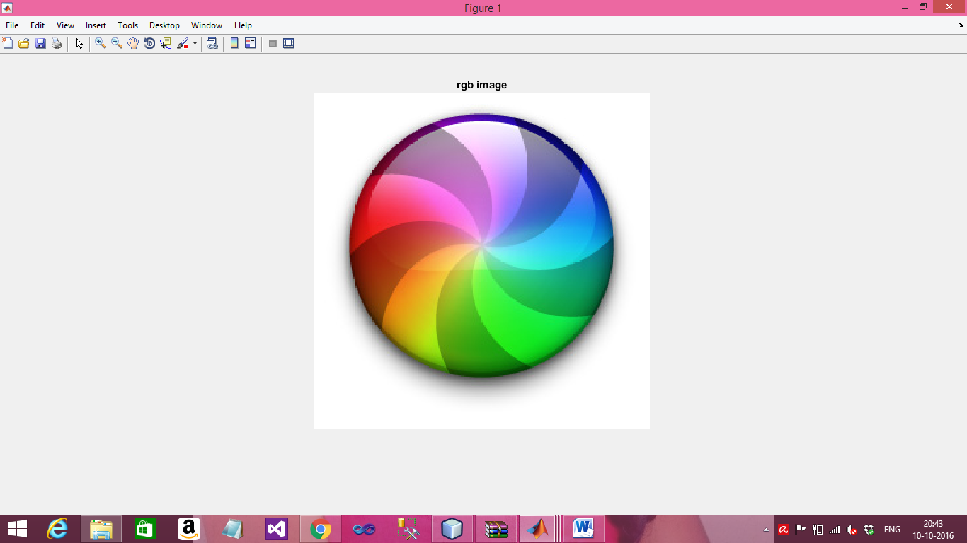
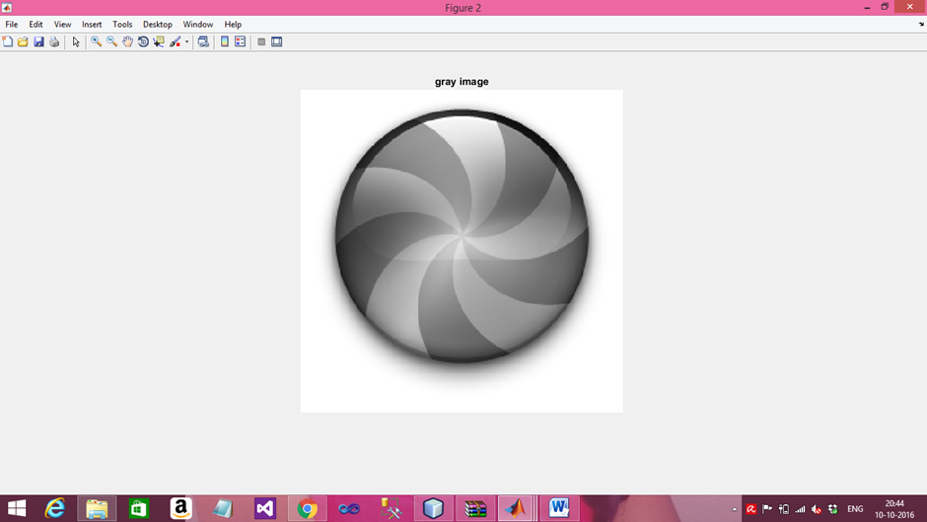
Input image:

Slide 18

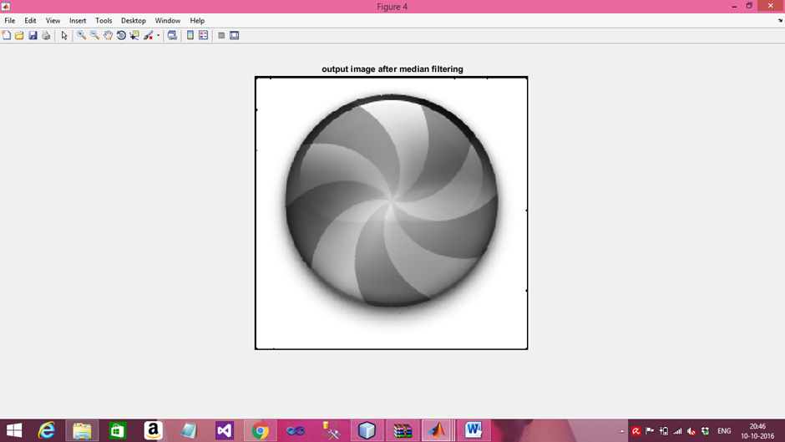
Applying noise to the image:
image=imnoise(image,'salt & pepper',0.05);
Denoise image or median image

Slide 19
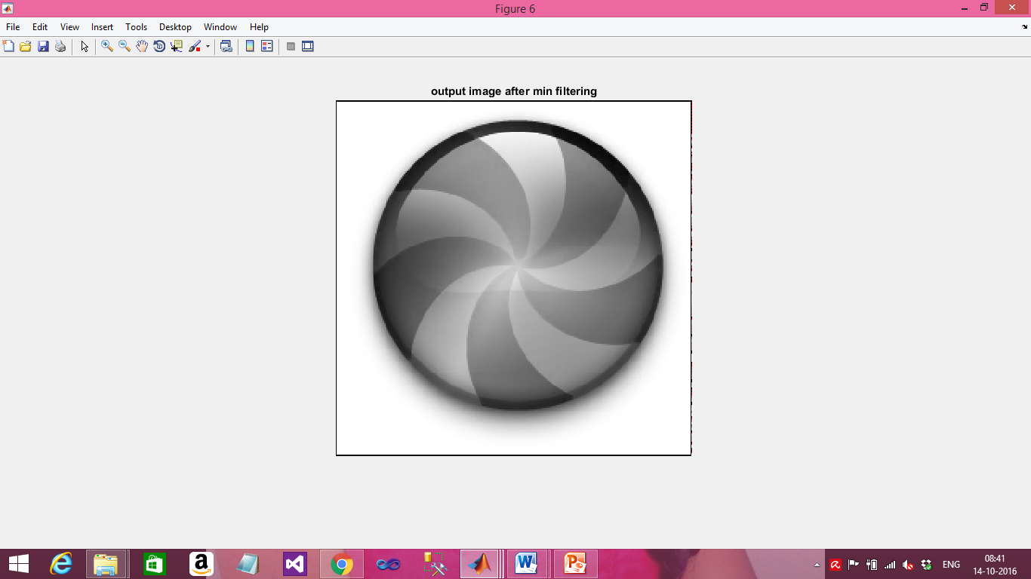
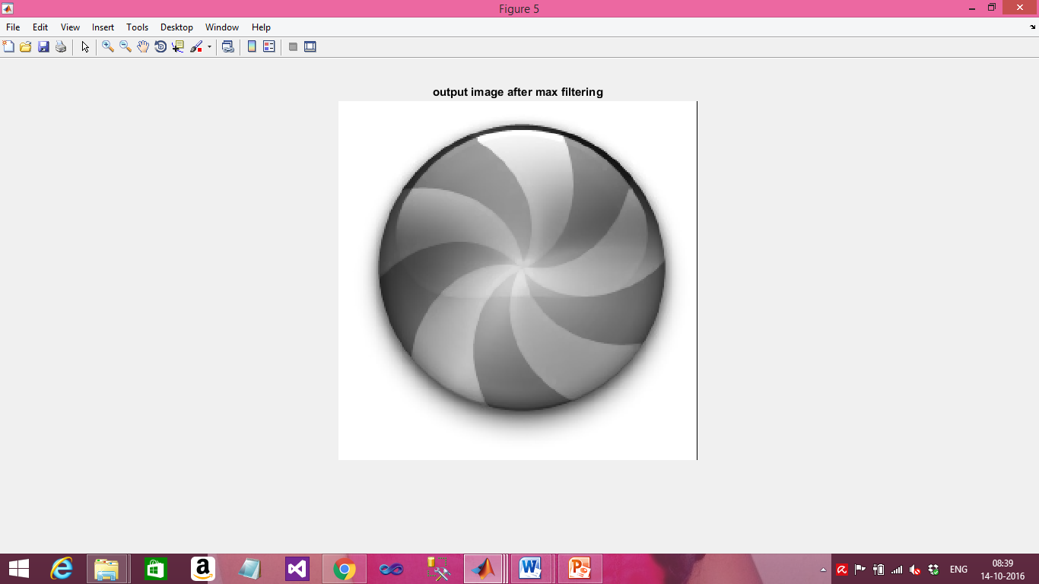
Image after applying Min filter
Image after applying Max filter

