Slide 1
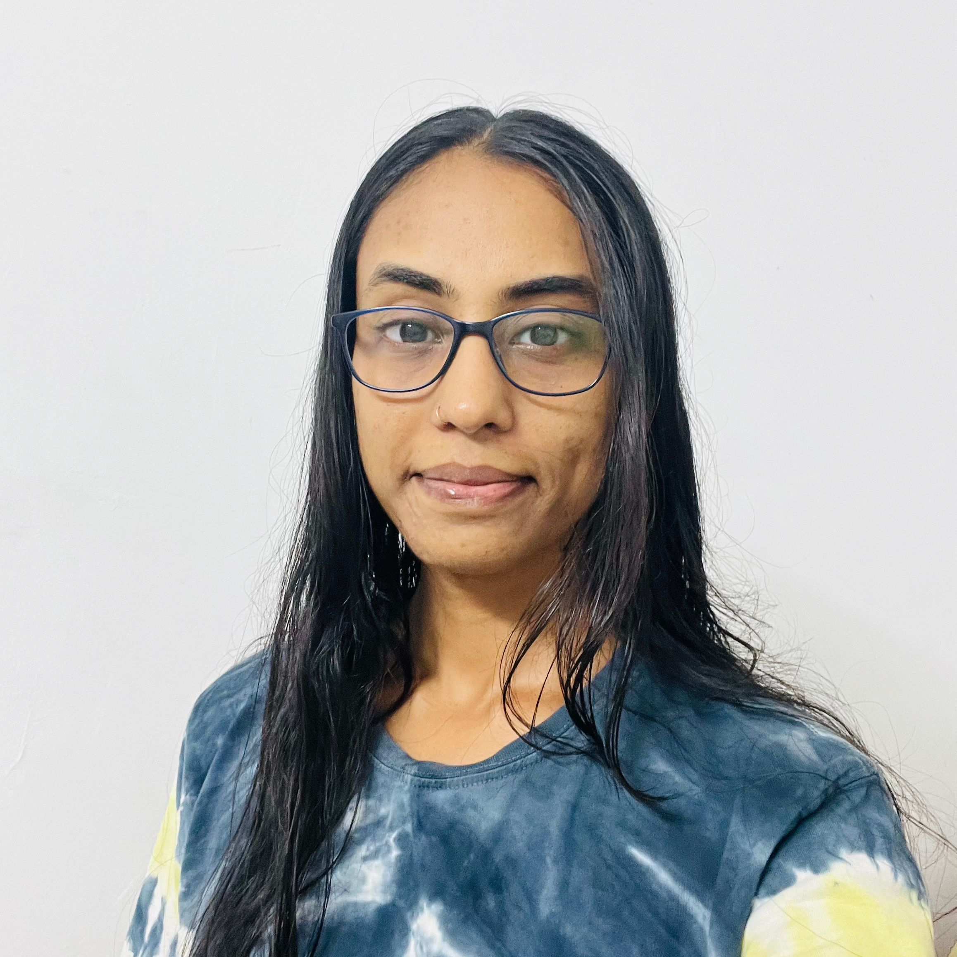
Heena Bhatti
Quality Engineering Analyst
EXPERIENCE
Email id: heena.bhatti@infosys.com
Quality Engineering analyst
(11/2024 - Present)
Infosys Limited
SUMMARY
I have a total 5.8 years of Manual Testing Experience and 3.2 years of Experience in Automation testing using Selenium web driver with Java, Maven Build, Jenkins CI/CD, TDD, TestNG and BDD cucumber. Basic Knowledge of the Test Complete tool from Microsoft. In my Software Testing field, I have made to significant contribution to my organization’s growth. To be a good learner who would apply the knowledge gained (tools and technologies) from past academic Projects and Job experiences.
Learning (Android) Mobile automation , Espresso Framework , Kotlin
Software Quality Assurance Executive
(10/2020 - 07/2024)
TUV SUD South Asia Pvt Ltd
Managing multiple projects including Laboratory Auditing and E-Commerce, and utilizing tools like Selenium with Java, GIT, Automation Framework like BDD cucumber and project management tool TFS .experience in various testing types such as Functional, Non-Functional , Smoke testing , Re-Testing , Regression Testing , Integration Testing.
Software Quality Engineer Executive
(03/2020 - 09/2020) Rich Minds Pvt Ltd
I have worked on manual testing, Early testing, Functional testing, Smoke testing. Writing Test cases, Reporting Bugs and giving suggestions to the Team. Review, Verify Business requirement Documents and communicate with the Developer team for more enhancement of documents
Software Quality Assurance Executive
(11/2018 - 04/2020)
Svaapta-it-ally Pvt Ltd
CERTIFICATION
ISTQB foundation level Certified®
Value Profile
Actively attended weekly knowledge-sharing sessions with QA members, Work on API testing using Postman and performance testing using JMeter. Work on Mobile testing, cross-browser testing, GUI testing for assigned projects. Actively participated in weekly HR activities, learning sessions for selenium, JMeter, cross-browser testing, etc. Attend Daily Stand up meetings/calls, and weekly status update meetings.
Always strive to be a very good team member. Always try to maintain a Positive attitude.
Education
SKILLS
Degree: Bachelor of Engineering in Information Technology
Institution: Parul Institute of Technology
Year: 2013 - 2017
CGPA: 7.57
Bug and Project Management tools, Programming Languages, Frameworks
Tools: Mantis, Test link, Jira, Bugzilla, TFS, DevOps, Basics of JMeter, Eclipse, NetBeans, Jenkins CI/CD, Maven Build tool, Git
Languages: Core Java, Knowledge of Bootstrap4, CSS3, HTML5, XML, Jason
WebDriver: Selenium with Java
Frameworks: TDD, TestNG, BDD Cucumber

