Slide 1

Data Warehouse and Mining
CSC603
Introduction to Data Warehouse and Dimensional modelling
Muhammed Salman Shamsi
Assistant Professor
Department of Computer Engg

Slide 2
Module Outcome
Course Outcome
Gain knowledge about basic concepts of Machine Learning

Slide 3
Outline
Introduction to Strategic Information
Need for Strategic Information,
Features of Data Warehouse,
Data warehouses versus Data Marts,
Top-down versus Bottom-up approach.
Data warehouse architecture,
Metadata
E-R modelling versus Dimensional Modelling, I
Information Package Diagram
STAR schema
Snowflake Schema
Fact Constellation Schema
Factless Fact tables, Update to the dimension tables,
Aggregate fact tables.

Slide 4
Disclaimer
All the materials used in this presentation belongs to the respective authors mentioned in reference section.
This presentation is to only help the students community of Mumbai University for the subject of Data Warehouse & Mining and is for private circulation only.
I neither claim this material or use it for commercial purpose.
This presentation is purely for education purpose.

Slide 5
Outline
Introduction to Strategic Information
Need for Strategic Information,
Features of Data Warehouse,
Data warehouses versus Data Marts
Top-down versus Bottom-up approach.
Data warehouse architecture,
Metadata
E-R modelling versus Dimensional Modelling, I
Information Package Diagram
STAR schema
Snowflake Schema
Fact Constellation Schema
Factless Fact tables, Update to the dimension tables,
Aggregate fact tables.

Slide 6
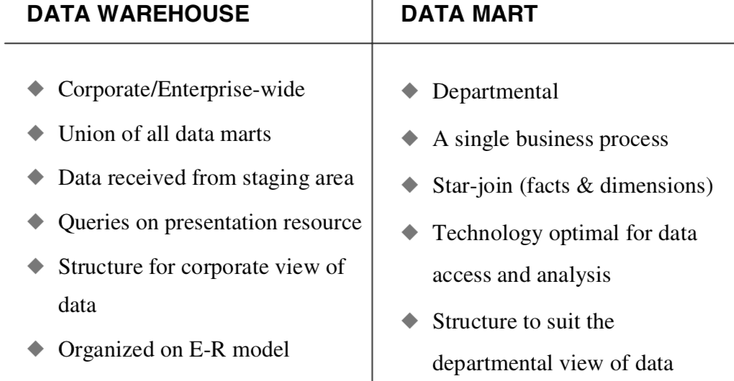
Data warehouse Vs Data Mart

Slide 7
Data Mart
A data mart is a logical subset of the complete data ware- house, a sort of pie-wedge of the whole data warehouse.
A data warehouse, therefore, is a conformed union of all data marts.
Individual data marts are targeted to particular business groups in the enterprise, but the collection of all the data marts form an integrated whole, called the enterprise data warehouse.

Slide 8
Outline
Introduction to Strategic Information
Need for Strategic Information,
Features of Data Warehouse,
Data warehouses versus Data Marts
Top-down versus Bottom-up approach.
Data warehouse architecture,
Metadata
E-R modelling versus Dimensional Modelling, I
Information Package Diagram
STAR schema
Snowflake Schema
Fact Constellation Schema
Factless Fact tables, Update to the dimension tables,
Aggregate fact tables.

Slide 9
Top-Down Approach - Advantages
A truly corporate effort, an enterprise view of data
Inherently architected—not a union of disparate data marts May see quick results if implemented with iterations
Single, central storage of data about the content
Centralized rules and control
May see quick results if implemented with iterations

Slide 10
Top-Down Approach - Disadvantages
Takes longer to build even with an iterative method
High exposure/risk to failure
Needs high level of cross-functional skills
High outlay without proof of concept.

Slide 11
Bottom-Up Approach - Advantages
Faster and easier implementation of manageable pieces
Favorable return on investment and proof of concept
Less risk of failure
Inherently incremental; can schedule important data marts first
Allows project team to learn and grow

Slide 12
Bottom-Up Approach - Disadvantages
Each data mart has its own narrow view of data
Permeates redundant data in every data mart
Perpetuates inconsistent and irreconcilable data
Proliferates unmanageable interfaces

Slide 13
Outline
Introduction to Strategic Information
Need for Strategic Information
Features of Data Warehouse
Data warehouses versus Data Marts
Top-down versus Bottom-up approach.
Data warehouse architecture
Metadata
E-R modelling versus Dimensional Modelling, I
Information Package Diagram
STAR schema
Snowflake Schema
Fact Constellation Schema
Factless Fact tables, Update to the dimension tables
Aggregate fact tables.

Slide 14
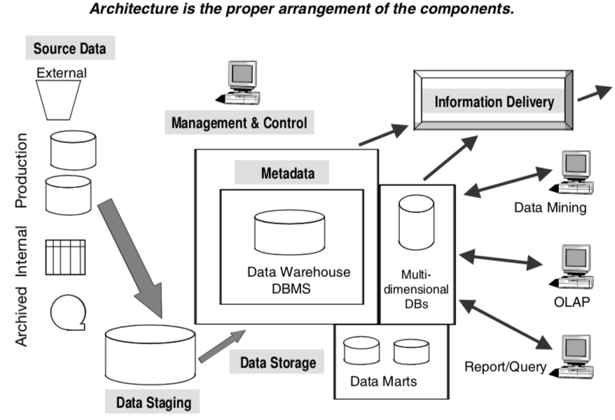
Data warehouse Architecture
Fig: Data warehouse building blocks or components

Slide 15
Outline
Introduction to Strategic Information
Need for Strategic Information
Features of Data Warehouse
Data warehouses versus Data Marts
Top-down versus Bottom-up approach.
Data warehouse architecture
Metadata
E-R modelling versus Dimensional Modelling, I
Information Package Diagram
STAR schema
Snowflake Schema
Fact Constellation Schema
Factless Fact tables, Update to the dimension tables
Aggregate fact tables.

Slide 16
Metadata
Metadata in a data warehouse is similar to the data dictionary or the data catalog in a database management system.
The metadata component is the data about the data in the data warehouse.

Slide 17
Types of Metadata
Operational Metadata. In selecting data from the source (operational) systems for the data warehouse, you split records, combine parts of records from different source files, and deal with multiple coding schemes and field lengths. Operational metadata contain all of this information about the operational data sources.
Extraction and Transformation Metadata. It contain data about the extraction of data from the source systems, namely, the extraction frequencies, extraction methods, and business rules for the data extraction. Also, this category of metadata contains information about all the data transform`ations that take place in the data staging area.
End-User Metadata. The end-user metadata is the navigational map of the data ware- house. It enables the end-users to find information from the data warehouse.

Slide 18
Outline
Introduction to Strategic Information
Need for Strategic Information
Features of Data Warehouse
Data warehouses versus Data Marts
Top-down versus Bottom-up approach.
Data warehouse architecture
Metadata
E-R modelling versus Dimensional Modelling
Information Package Diagram
STAR schema
Snowflake Schema
Fact Constellation Schema
Factless Fact tables, Update to the dimension tables
Aggregate fact tables.

Slide 19
Dimensional Modeling
A Dimensional Model is a database structure that is optimized for online queries and Data Warehousing tools. It is comprised of "fact" and "dimension" tables.
A "fact" is a numeric value that a business wishes to count or sum. A "dimension" is essentially an entry point for getting at the facts. Dimensions are things of interest to the business.
Dimensional Models are designed for reading, summarizing and analyzing numeric information, whereas Relational Models are optimized for adding and maintaining data using real-time operational systems.

Slide 20
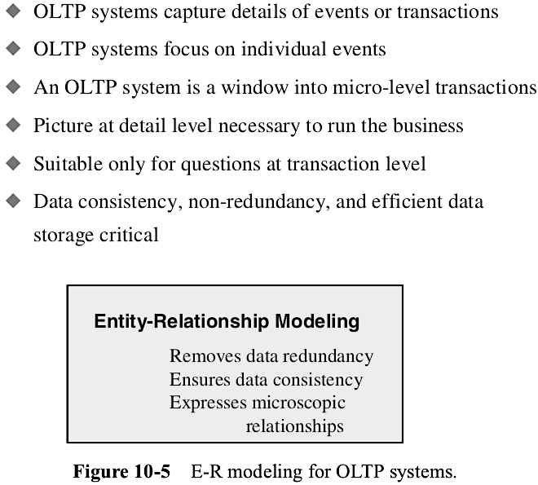
E-R modelling versus Dimensional Modelling

Slide 21
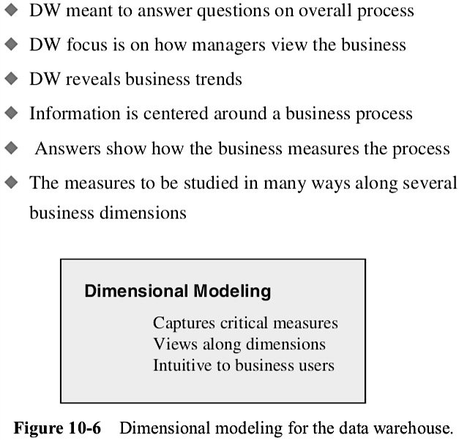
E-R modelling versus Dimensional Modelling

Slide 22
Outline
Introduction to Strategic Information
Need for Strategic Information
Features of Data Warehouse
Data warehouses versus Data Marts
Top-down versus Bottom-up approach.
Data warehouse architecture
Metadata
E-R modelling versus Dimensional Modelling
Information Package Diagram
STAR schema
Snowflake Schema
Fact Constellation Schema
Factless Fact tables, Update to the dimension tables
Aggregate fact tables.

Slide 23
Information Package Diagram
In information package diagram defines the relationships between subject matter and key performance measures.
The information package diagram has a highly targeted purpose, providing a focused scope for user requirements.
Because information package diagrams target what the users want, they are effective in facilitating communication between the technical staff and the users, indicating any inconsistencies between the requirements and what the data warehouse will deliver.

Slide 24
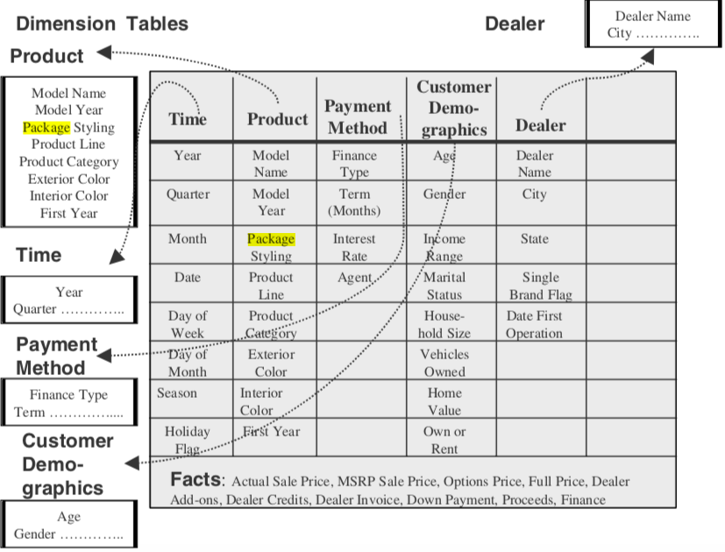

Slide 25
Outline
Introduction to Strategic Information
Need for Strategic Information
Features of Data Warehouse
Data warehouses versus Data Marts
Top-down versus Bottom-up approach.
Data warehouse architecture
Metadata
E-R modelling versus Dimensional Modelling
Information Package Diagram
STAR schema
Snowflake Schema
Fact Constellation Schema
Factless Fact tables, Update to the dimension tables
Aggregate fact tables.

Slide 26
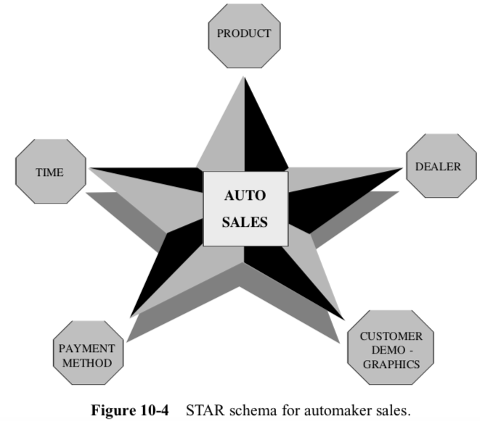
Star Schema

Slide 27
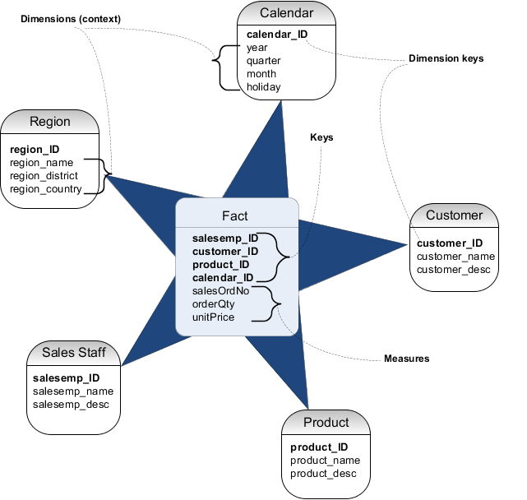

Slide 28
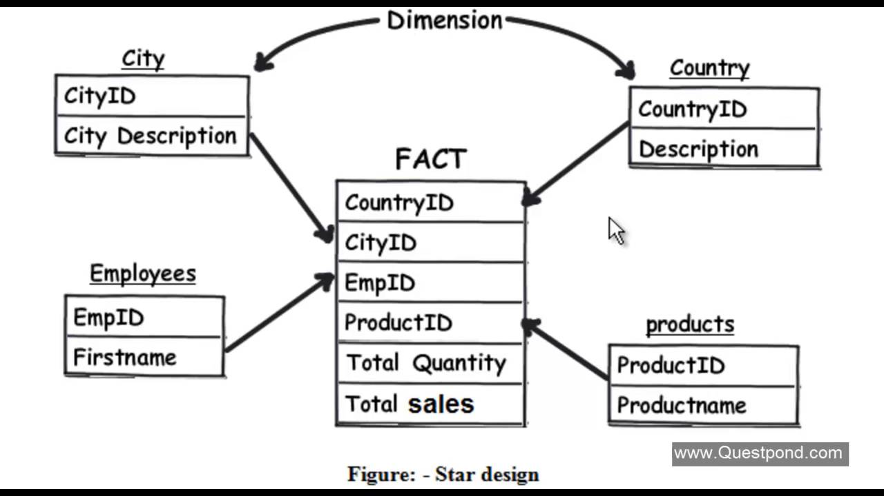
Star Schema

Slide 29
Outline
Introduction to Strategic Information
Need for Strategic Information
Features of Data Warehouse
Data warehouses versus Data Marts
Top-down versus Bottom-up approach.
Data warehouse architecture
Metadata
E-R modelling versus Dimensional Modelling
Information Package Diagram
STAR schema
Snowflake Schema
Fact Constellation Schema
Factless Fact tables, Update to the dimension tables
Aggregate fact tables.

Slide 30
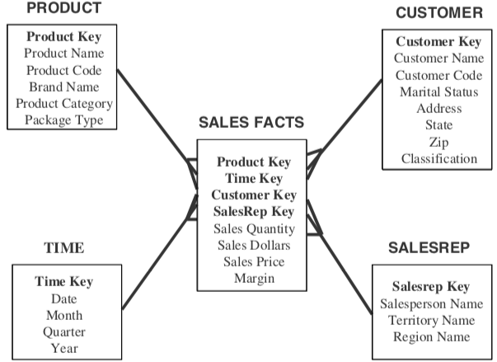
“Snowflaking” is a method of normalizing the dimension tables in a STAR schema. When you completely normalize all the dimension tables, the resultant structure resembles a snowflake with the fact table in the middle. First, let us consider a simple STAR schema for sales in a manufacturing company.

Slide 31
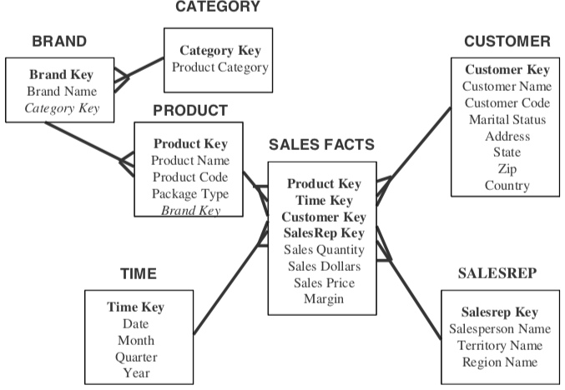
Snowflake Schema

Slide 32
Outline
Introduction to Strategic Information
Need for Strategic Information
Features of Data Warehouse
Data warehouses versus Data Marts
Top-down versus Bottom-up approach.
Data warehouse architecture
Metadata
E-R modelling versus Dimensional Modelling
Information Package Diagram
STAR schema
Snowflake Schema
Fact Constellation Schema
Factless Fact tables, Update to the dimension tables
Aggregate fact tables.

Slide 33
Fact Constellation Schema
It is a collection of multiple fact tables sharing dimension tables, viewed as a collection of stars.
It can be seen as an extension of the star schema.
It is also known as galaxy schema

Slide 34
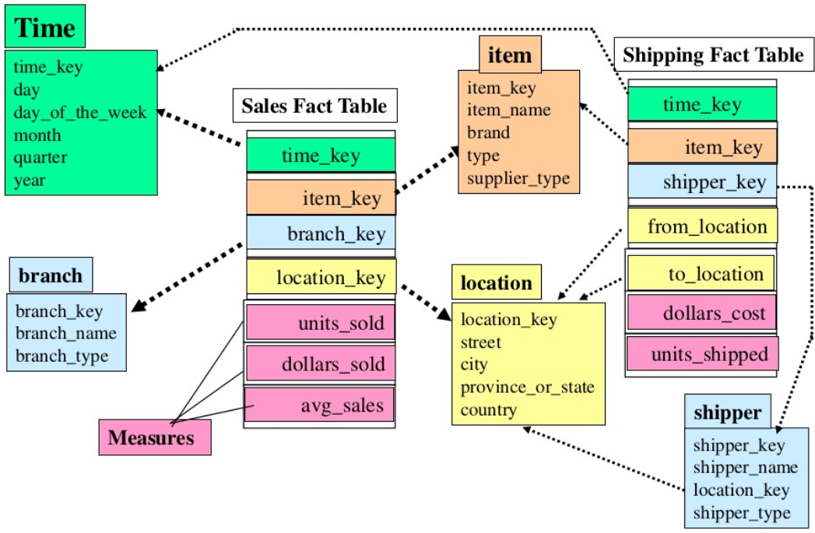
Fact Constellation Schema

Slide 35
Outline
Introduction to Strategic Information
Need for Strategic Information
Features of Data Warehouse
Data warehouses versus Data Marts
Top-down versus Bottom-up approach.
Data warehouse architecture
Metadata
E-R modelling versus Dimensional Modelling
Information Package Diagram
STAR schema
Snowflake Schema
Fact Constellation Schema
Factless Fact tables, Update to the dimension tables
Aggregate fact tables.

Slide 36
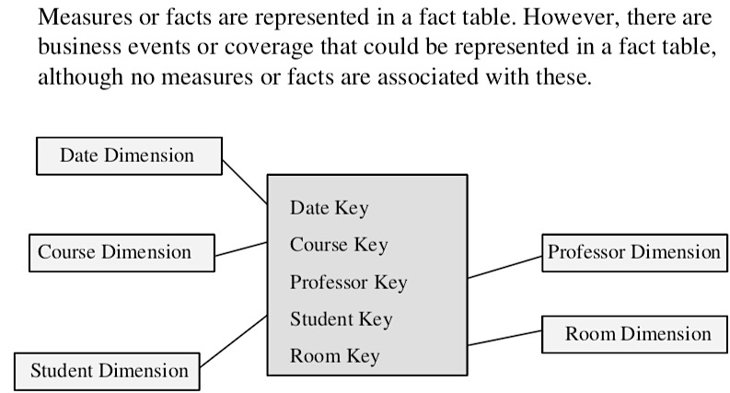
Factless Fact Table

Slide 37
Updates to the dimension table
Slowly Changing Dimensions
Type 1 Changes: Correction of Errors (Ex: Name VS Martial Status)
Nature of Type 1 Changes
Usually, the changes relate to correction of errors in source systems
Sometimes the change in the source system has no significance
The old value in the source system needs to be discarded
The change in the source system need not be preserved in the data warehouse

Slide 38
Applying Type 1 Changes to the Data Warehouse
Overwrite the attribute value in the dimension table row with the new value
The old value of the attribute is not preserved
No other changes are made in the dimension table row
The key of this dimension table or any other key values are not affected
This type is easiest to implement
Type 2 Changes: Preservation of History
Nature of Type 2 Changes
They usually relate to true changes in source systems
There is a need to preserve history in the data warehouse
This type of change partitions the history in the data warehouse
Every change for the same attribute must be preserved

Slide 39
Applying Type 2 Changes to the Data Warehouse
Add a new dimension table row with the new value of the changed attribute
An effective date field may be included in the dimension table
There are no changes to the original row in the dimension table
The key of the original row is not affected
The new row is inserted with a new surrogate key
Type 3 Changes: Tentative Soft Revisions
Nature of Type 3 Changes
They usually relate to “soft” or tentative changes in the source systems
There is a need to keep track of history with old and new values of the changed attribute
They are used to compare performances across the transition They provide the ability to track forward and backward

Slide 40
Applying Type 3 Changes to the Data Warehouse
Add an “old” field in the dimension table for the affected attribute
Push down the existing value of the attribute from the “current” field to the “old” field
Keep the new value of the attribute in the “current” field
Also, you may add a “current” effective date field for the attribute
The key of the row is not affected
No new dimension row is needed
The existing queries will seamlessly switch to the “current” value
Any queries that need to use the “old” value must be revised accordingly
The technique works best for one “soft” change at a time
If there is a succession of changes, more sophisticated techniques must be devised

Slide 41
Outline
Introduction to Strategic Information
Need for Strategic Information
Features of Data Warehouse
Data warehouses versus Data Marts
Top-down versus Bottom-up approach.
Data warehouse architecture
Metadata
E-R modelling versus Dimensional Modelling
Information Package Diagram
STAR schema
Snowflake Schema
Fact Constellation Schema
Factless Fact tables, Update to the dimension tables
Aggregate fact tables.

