Slide 1


Intelligent Object Detection and Interactive Surveillance
Aldel Education Trust’s
St. John College of Engineering and Management, Palghar
NAAC Accredited with Grade A+
Department of Information Technology
Sushma Kumbhar [EU1204038]
Akash Patel [EU1204003]
Heenal Patel [EU1204021]
Ms.Shraddha More| Assistant Professor
November 8, 2023

Slide 2
Contents
Abstract
Introduction
Literature Review
Problem Statement
Scope
Proposed System (Block diagram)
Proposed Solution
Block Diagram
Flowchart
Conclusion
‹#›

Slide 3
Abstract
Introducing a cutting-edge Security and Surveillance System that uses advanced machine learning to improve security. It combines various functions to make security measures better. The system's core capabilities include accurate face detection and recognition through deep learning algorithms, enabling enhanced access control and identity verification. Additionally, it offers continuous people detection and real-time headcounting, vital for crowd management and occupancy monitoring. Swift motion detection capabilities identify sudden movements, enabling the system to promptly flag suspicious activities or unauthorized access. Further, the system differentiates between authorized and unauthorized individuals, triggering immediate alarms or notifications in the case of security breaches. Beyond detection, our system goes a step further by executing intelligent tasks such as immediate alerts to security personnel or law enforcement, automated access control based on facial recognition. It also provides anomaly detection, analyzing movement patterns and behaviors to identify potential threats, and offers comprehensive reporting for post-incident analysis and regulatory compliance.
‹#›

Slide 4
Introduction
Object detection is a fundamental task in computer vision that involves the identification and localization of multiple objects within an image or video frame. This process comprises two key steps: localization and classification. During localization, the system determines the precise location of objects by drawing bounding boxes around them. Following this, in the classification step, each localized object is assigned a label or category, such as "car," "person," or "dog," based on its characteristics. Object detection relies heavily on deep learning techniques, particularly Convolutional Neural Networks (CNNs), which are trained on extensive datasets containing labeled images. This training allows these models to learn intricate patterns and features associated with various objects. Object detection finds applications in diverse fields, including autonomous vehicles for pedestrian and traffic sign recognition, security systems for intruder detection, retail for inventory management and customer analytics, medical imaging for anomaly identification, and robotics for environmental interaction and task execution. In summary, object detection is a pivotal technology that empowers machines to comprehend and engage with their visual surroundings, offering invaluable contributions across numerous industries.

Slide 5
Literature Review
No. | Paper Title | Author Names | Conclusion | Research Gaps
1 | A Real-time Border Surveillance System using Deep Learning and Edge Computing (Base Paper) | Dang-Khoa Luong-Huu,Tan-An Ngo,Huy-Tan Thai, Kim-Hung Le | Border Edge system, based on MobileNet architecture, provides real-time border surveillance ,efficiently detecting unauthorized access for countering illegal cross-border activities. | Lack of specific methodologies for model pruning while maintaining accuracy. .
2. | Object Detection using Machine Learning Technique | Praahas Amin, Anushree B. S., Bhavana B. Shetty, Kavya K., Likitha Shetty | It introduces a real-time object detection system employing YOLO algorithm, achieving efficient bounding box prediction and classification for images/videos, showcasing enhanced accuracy and speed. | Absence of validation plans for diverse indoor environments, especially in homes.
3. | Real-time Object Detection using Deep Learning for helping People with Visual Impairments | M. Terreran, A. G. Tramontano, J. C. Lock, S. Ghidoni and N. Bellotto, | It assesses lightweight object detection models for real-time use in Electronic Travel Aids for visually impaired users, introducing the L-CAS Office dataset to validate models in real-world scenarios. | Absence of validation plans for diverse indoor environments, especially in homes.
4. | The Object Detection Based on Deep Learning | Cong Tang, Yunsong Feng, Xing Yang, Chao Zheng, Yuanpu Zhou | The paper thoroughly dissects and compares deep learning-based object detection models like R-CNN,, Faster R-CNN, YOLO, and SSD. | It does not introduce new techniques, approaches, or experimental findings
‹#›

Slide 6
Literature Review
No. | Paper Title | Author Names | Conclusion | Research Gaps
5. | Object Detection using Deep Learning | Pranita Jadhav, Vrushali Koli, Priyanka Shinde, Dr. M.M. Pawar | The paper focuses on explaining framework designs, model principles, and performance evaluations | it lacks a thorough exploration of innovative solutions to practical limitations and challenges.
6. | Real-Time Object Detection with Yolo | Geethapriya. S, N. Duraimurugan, S.P. Chokkalingam | Implemented Yolo algorithm to detect object | it predicts fewer false positives in background areas.
7. | Object Detection through Modified YOLO Neural Network | Tanvir Ahmad , Yinglong Ma , Muhammad Yahya, Belal Ahmad, Shah Nazir , Amin ul Haq | It modifies the YOLOv1 architecture, leading to enhanced detection performance. | It lacks a specific roadmap or detailed approach for creating a benchmark dataset
8. | Object Recognition Using Deep Learning | Rohini Goel, Avinash Sharma, and Rajiv Kapoor | The paper presents a recent survey of deep learning for object recognition, comparing it favorably to traditional methods, and suggests potential future research directions. | It Lacks effectiveness of the Deep Residual Conv-Deconv Network with Adaptive Profiles (APs) and estimation profiles for robust
‹#›

Slide 7
Literature Review
No. | Paper Title | Author Names | Conclusion | Research Gaps
9. | Small Objects Detection in Satellite Images Using Deep Learning | A. Mansour, W. M. Hussein and E. Said | Optimizing object size in high-resolution satellite images improves detection accuracy without significant processing time increase, emphasizing the importance of training quality and applicability across image types. | challenges in applying the technique to various image types.
10. | Real-Time Deep Learning- Based Object Detection Framework | William Tarimo, Moustafa M Sabra | Compared different Object detection algorithm | It has less accuracy
11. | Object Detection in Deep Surveillance | Narina Thakur, Preeti Nagrath, Rachna Jain, Dharmender Saini, Nitika Sharma, D. Jude Hemanth | The research concludes that Yolov5 outperforms other models with a notable 61% precision and 44% F-measure. | The study lacks an in-depth examination of how the proposed approach tackles challenges unique to high-end surveillance applications.
12. | Intelligent monitoring of indoor surveillance video based on deep learning | Yun-Xia Liu, Yang Yang, Aijun Shi, Peng Jigang, Liu Haowe | Implemented monitoring system for home surveillance | The research lacks empirical validation and scalability assessment in real-world surveillance scenarios.
‹#›

Slide 8
Literature Review
No. | Paper Title | Author Names | Conclusion | Research Gaps
13. | Smart Surveillance and Tracking System using Resnet and Tesseract-OCR | C. Sonavane, P. Kulkarni, O. Podey and P. Rewane | Face and object detection, as well as vehicle number plate recognition, | lack of empirical validation in diverse real-world environments.
14. | Simulation of Object Detection Algorithms for Video Surveillance Applications | Mohana and H. V. Ravish Aradhya | The study finds that adjusting parameters in the Gaussian mixture model improves object detection. The Local Binary Pattern algorithm reduces false alarms and proves reliable for the dataset. | Finite changes in object detection
15. | Real-Time Abnormal Object Detection for Video Surveillance in Smart Cities | Palash Yuvraj Ingle and Young-Gab Kim | The study introduces an MSD-CNN model for efficient detection of guns and knives in public areas through video surveillance. | deploying the model on edge devices, enhancing real-time computation, and diversifying camera testing conditions.
‹#›

Slide 9
Problem Statement
In the domain of security and surveillance, there is a pressing need for a comprehensive solution that augments conventional camera systems with real-time object detection capabilities . The primary challenges include the lack of automated intelligence in surveillance systems, leading to delayed incident response and the cumbersome process of accessing and analyzing surveillance footage manually. This project aims to bridge these gaps by implementing YOLO-NAS for object detection and other algorithm for face detection and recognition, motion detection, intruder detection, people counting, providing an automatic, secure, and intelligent surveillance solution that significantly enhances security operations and responsiveness while simplifying the footage analysis process

Slide 10
Scope
The project scope includes the development and implementation of state-of-the-art deep learning models for face detection and recognition.
Integration of YOLO-NAS for real-time and highly accurate object detection in security and surveillance applications.
The project will encompass the creation of specialized algorithms for intruder detection, distinguishing between authorized and unauthorized individuals.
These models will enable the system to accurately identify individuals, providing access control and identity verification in secure environments.
The system will be designed to process data in real-time, ensuring swift detection and response to security events
The project scope extends to integrating the detection algorithms with alerting and notification systems. This integration will enable immediate alerts to be sent to security personnel or law enforcement agencies when security threats are detected.

Slide 11
Proposed System
Our proposed advanced Security and Surveillance System addresses the limitations faced by traditional camera-based surveillance systems, ushering in a new era of security and surveillance. By leveraging state-of-the-art machine learning techniques, particularly object detection, this system offers intelligent, real-time security enhancements.The integration of object detection technology allows the system to differentiate between authorized and unauthorized individuals accurately. By combining this capability with robust facial recognition, we ensure precise identity verification and access control, thus minimizing false alarms and improving security. Additionally, the system's object detection features provide efficient motion detection, reducing false positives and enhancing reliability. Real-time data processing capabilities enable swift responses, while behavior analysis ensures early anomaly detection. Furthermore, the system optimizes resource usage, reducing energy consumption in commercial and public spaces. With seamless integration into existing security infrastructure, our advanced Security and Surveillance System not only rectifies the shortcomings of traditional systems but also paves the way for a safer and more secure environment, making it a game-changer in the field of security and surveillance.
‹#›

Slide 12
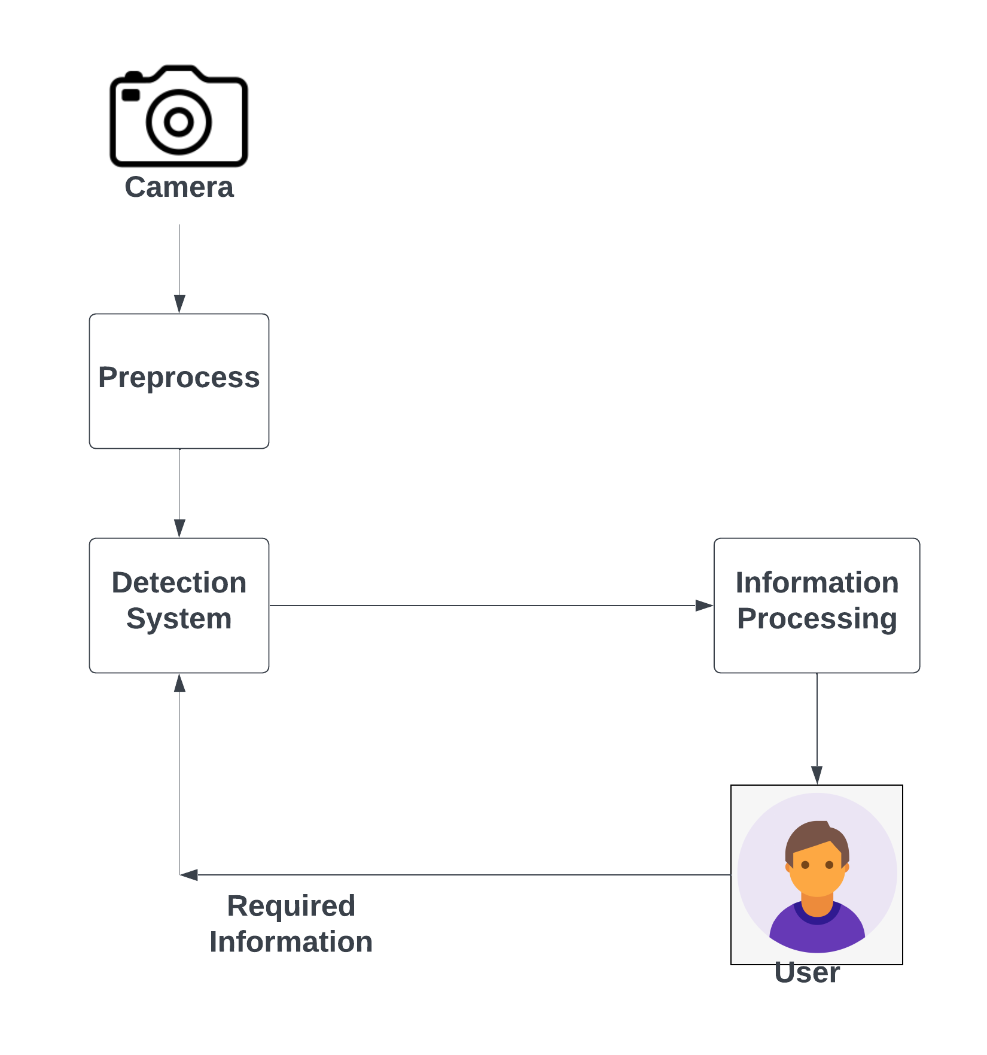
Block Diagram
Fig 1 (Block Diagram)

Slide 13
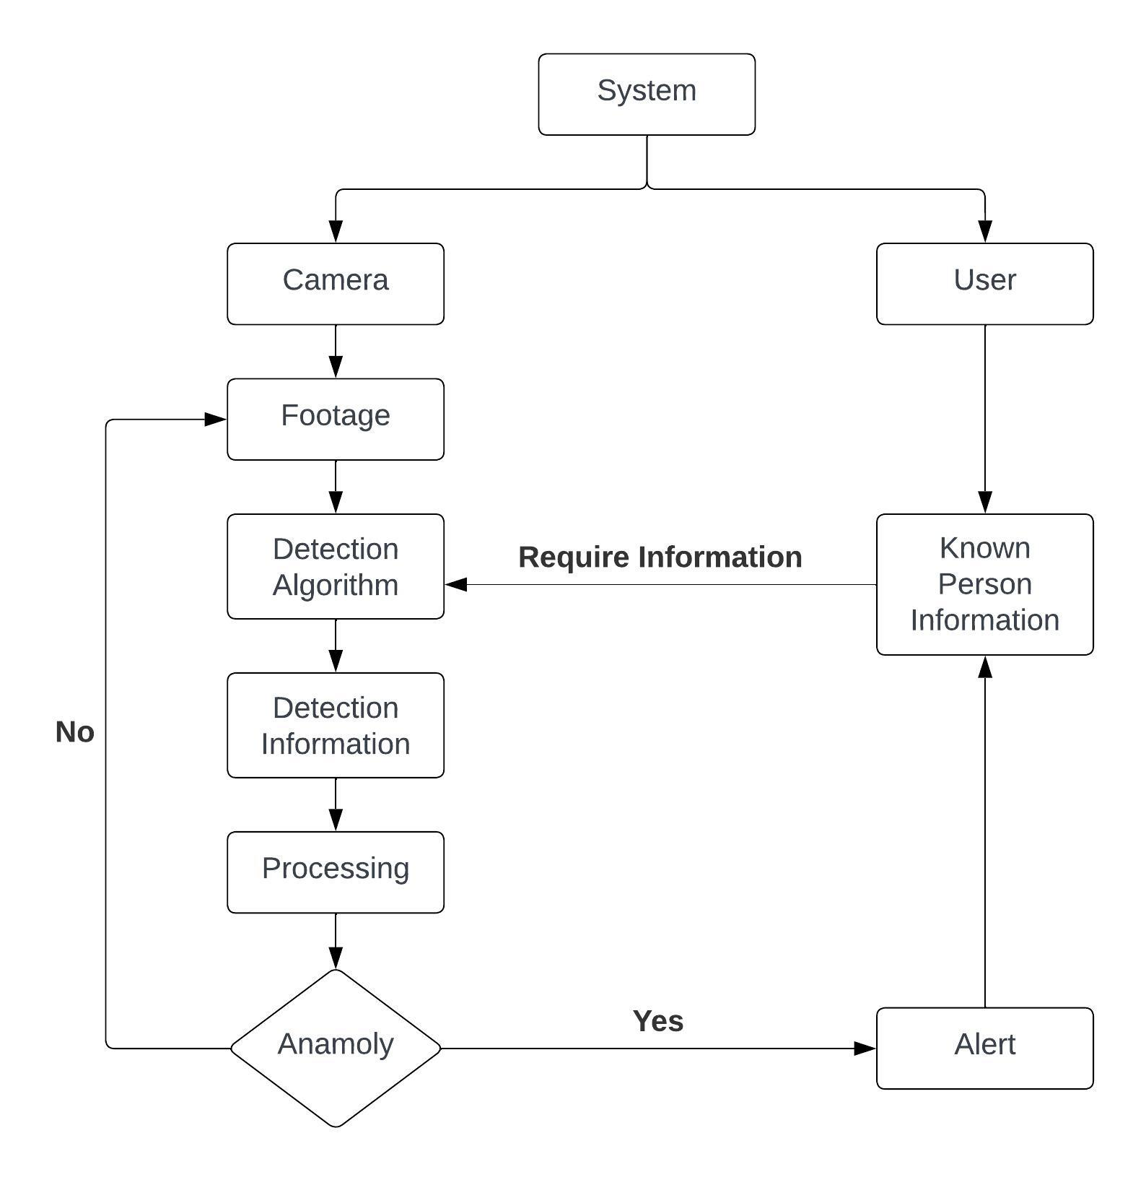
Flow Chart
Fig 2(Flowchart)

Slide 14
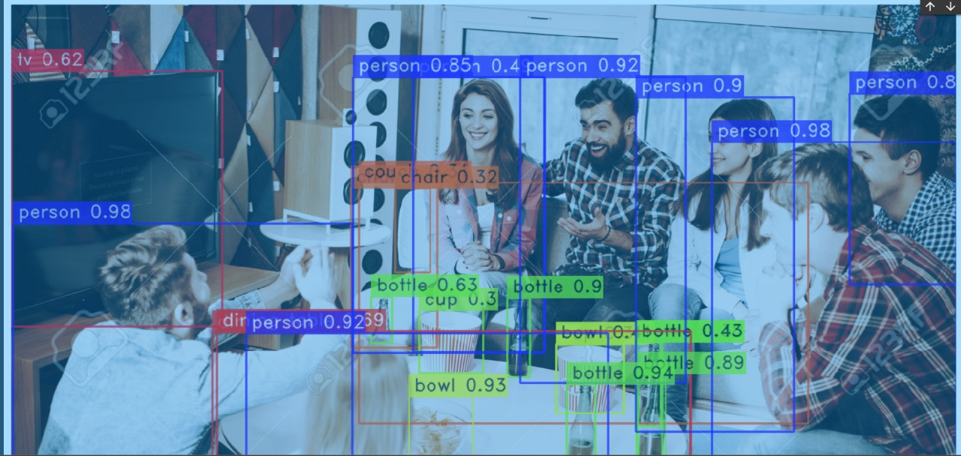
Screenshots of Output with Description
Following is the output of the object detection model which is able to detect any object in the images and videos.It will help to detect any object in the real time Footage in the camera
Fig 3(Object Detection Model)

Slide 15
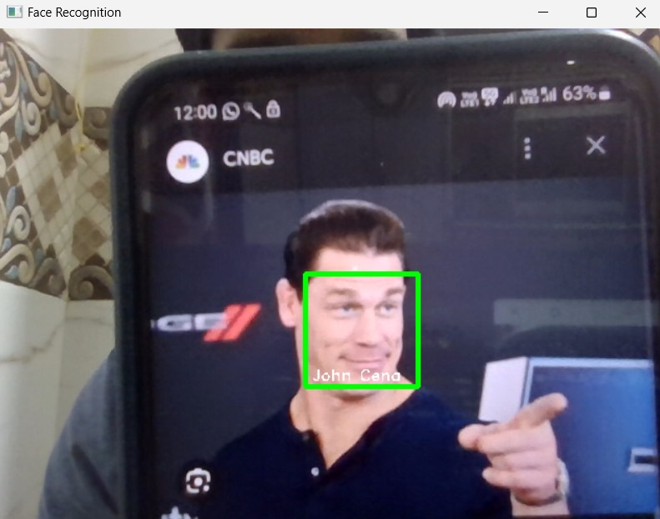
Screenshots of Output with Description
Following is the 2 output of Face detection & Face Recognition model which is able to detect multiple faces of the person in real time footage. It will help to know about the identification of Person
Fig 4(Face Detection Model)

Slide 16
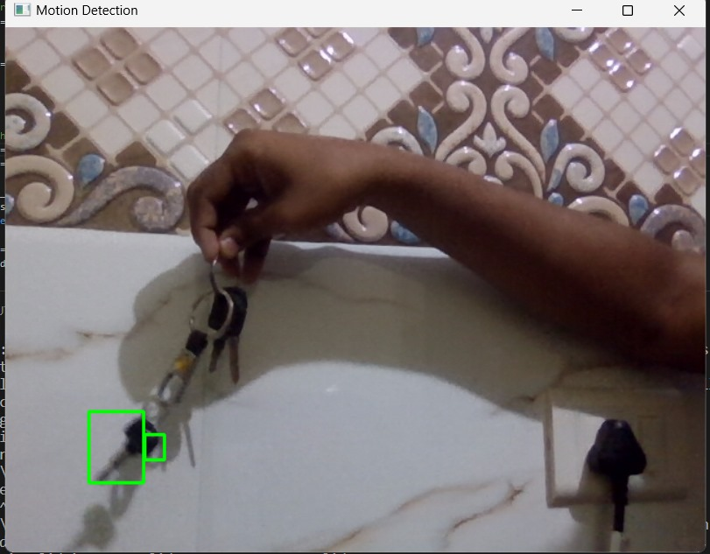
Screenshots of Output with Description
Following is the output of Motion detection model which is able to detect the motion of any object in real time. It will help to detect any unusual activity based on some criteria.
Fig 5 (Motion Detection Model)

Slide 17
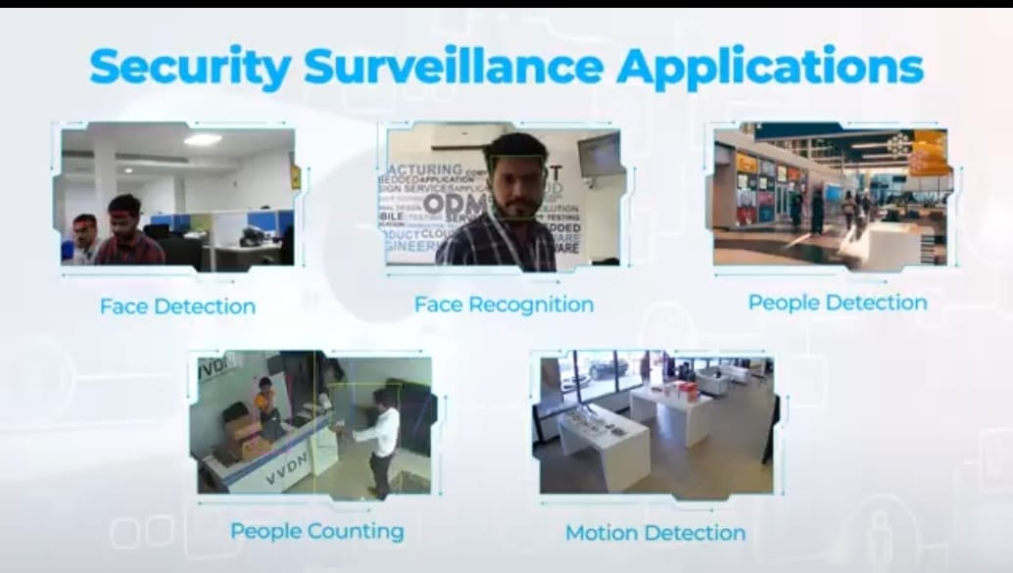
Functions
Fig 6 (Applications)

Slide 18
Conclusion
In conclusion, our advanced Security and Surveillance System, powered by cutting-edge machine learning techniques and object detection technology, redefines security by addressing the limitations of traditional camera systems. With precise identification, real-time alerts, and resource optimization, it offers a comprehensive solution for a safer and more secure environment, marking a significant step forward in modern security and surveillance.
‹#›

Slide 19
Thank You !!!
‹#›

Slide 20
Q & A
‹#›

