Slide 1
Intuit Case Study

Slide 2
Professional Experience
I have 9 years of experience in agile technology. I have worked in ecommerce, financial, insurance & media domain.
Technologies:
Frameworks:
Java 8, J2EE, Adobe experience manager, AEMaaCS, Sling, OSGI, Servlets, Springboot, microservices Netflix OSS, Sping framework, Struts, node js, Design patterns, GA-GTM, Kafka, Apache Spark(basic)
Frontend: html, css, sightly(HTL), java script, Angular js(1.x), jade
DB: NoSQL(MongoDB), Oracle, MySQL
Cloud: AWS, azure api gateway
Devops: docker, Jenkins, pipeline, cloudformation

Slide 3
Project-1 Replatform of episerver to AEM
We are creating platform for manufacturing website of 60+ brands.
Creating common and reusable codebase and functionalities.
It is B2B & B2C website.
For B2B, I did integration wit Metalocator interface.
For B2C, customers can purchase from website. As commerce we have integrated AEM with AEM commerce cloud i.e. magento via CIF framework. It has lots of module like login, logout, checkout funnel.
We have created components, templates to make presentation layer and added governance on top of it as it is used by multiple vendors.
For leads, we are using DCRM and order management is done by magento and connect softwares.
Technologies: AEM as cloud, sling, REST, microservices, Java -8,11, React, Apache solr, dispatcher, fastly CDN, Bulk import tools, Oracle DAM, Agility PIM, Swagger apis, design patterns, kafka

Slide 4
Professional Achievements
As lead, I am exposed directly in front of client. I am playing a role of technical architect cum lead cum developer. I am responsible to deliver project end to end.
Due to this, I got the opportunity to showcase everything in front of client and I travelled twice.
I created complete architectural low and high level diagrams and delivered 2-3 projects independently.
I took the initiative to create accelerator project so that it saves time for the company as soon as we get new project engagements. I also create independent modules that can be integrated with aem and other projects smoothly.
I pitched in front of client to get complete commerce and non-commerce integrations in our business and that improved long term relationship with client and we got more business in current project.
Also client is relying on us for delivering and making live other brands.

Slide 5
An inventory management system
the process by which you track your goods throughout your entire supply chain, from purchasing to production to end sales.
Ebooks is SaaS software already exists, but it is customer pain point for those who sell for multiple websites.
In next slides, I have added high level architectures to solve this problem.

Slide 6
Inventory as System
Inventory has products and raw materials available to sell.
We need to create database driven microservices like Reservation service which will reserve the products added by customers in their cart.
One stock api would be required to maintain stocks of all products and raw sellable products. After order place, stock of particular product goes down.
Need to inform warehouse for all products that are going out of stock. This can be done by pub-sub queue mechanism system. We can kafka or bus system so that each microservice can listen and consume required event.

Slide 7
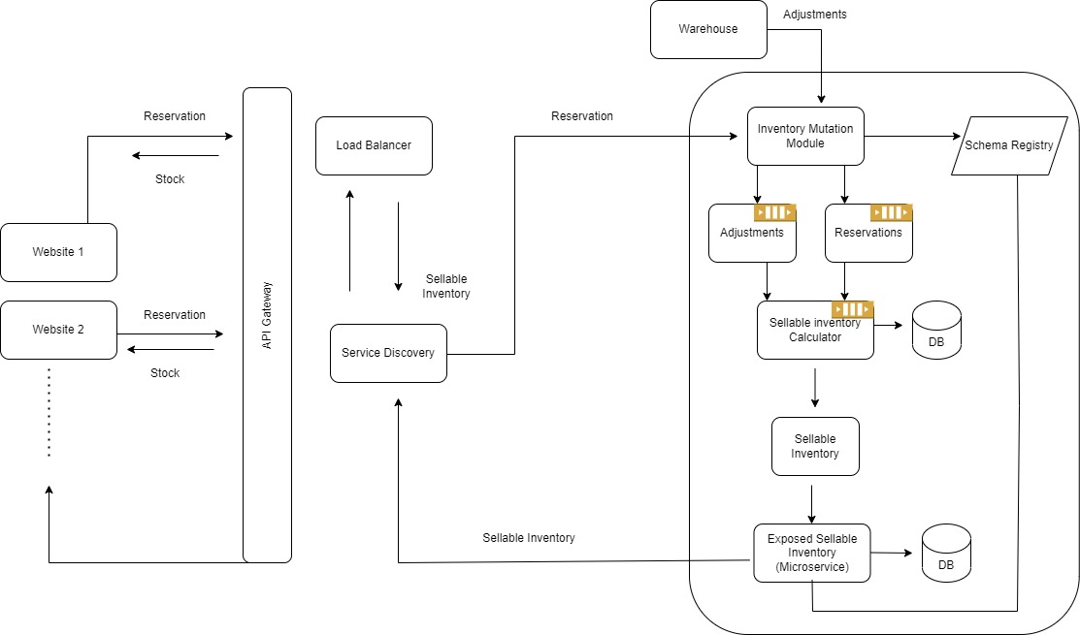
INVENTORY_ADJUSTMENT
The sellable-inventory-service is the query side of the CQRS. The Microservice takes the sellable inventory events from the sellable inventory topic and persists them into its DB(Cassandra) store.
Kafka topics:
INVENTORY_ADJUSTMENT
INVENTORY_RESERVATION

Slide 8
Inventory Mutation Module
Command part of the CQRS pattern. There are two operations that it handles:
Adjustments - Warehouse updates of inventory quantities. These are increments to availability of inventory
Reservations - Decrements to inventory as it gets sold on website

Slide 9
Design patterns
Saga Design pattern of “Orchestration” based. An orchestrator (object) tells the participants what local transactions to execute.
It enables an application to maintain data consistency across multiple services.
Database per system design.

Slide 10
Classes:
String: Id
Integer: Quantity
String:location
warehouse
MkgDate
ExpDate
String: ProductId
Integer: Quantity
List<RawMaterials
>
Productdate date
Stock
Add()
Delete()
Edit()
Exit()
View()
String: ProductId
Double: Price
Productdate
product
productPrice
String: Id
Integer: Quantity
productdate
RawMaterials
Date: date
Int:number
stockId
products
Viewstock()
Cancel()
stock
Inheritance
String: ProductId
Integer: Quantity
productType

