Slide 1
EMOTION_BASED MUSIC PLAYER USING PYTHON AND CV2

Slide 2
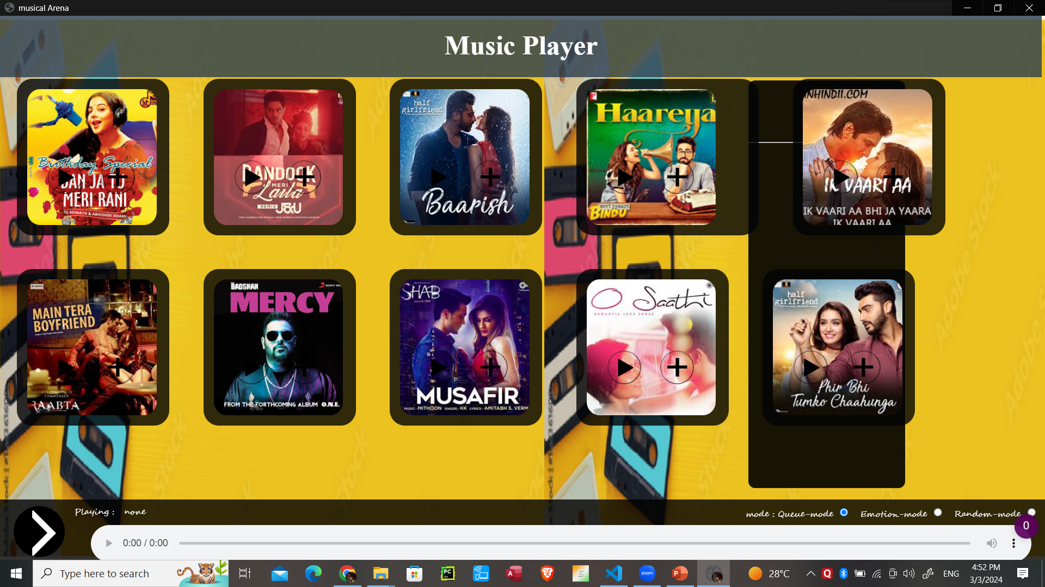
Today, we're excited to introduce you to our groundbreaking project that merges technology with emotion recognition to create a unique music player experience. By harnessing the power of Python and OpenCV, we've developed a system that understands and responds to human emotions, providing a personalized music playlist tailored to the user's mood.

Slide 3
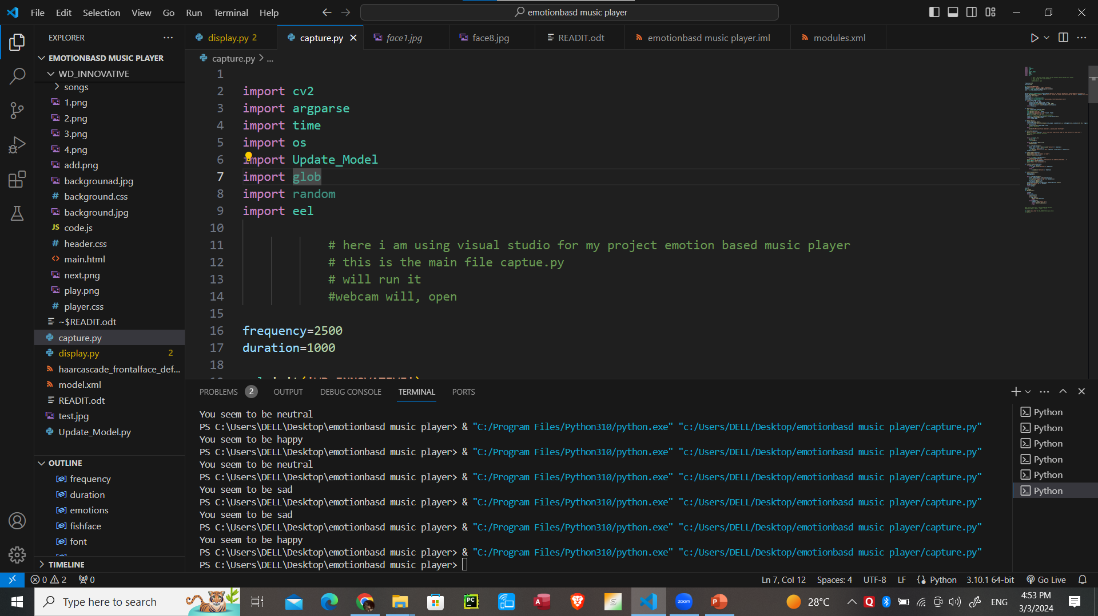
Capture.py (main code)

Slide 4
OBJECTIVE: Our objective with this project is to explore the intersection of music, emotion, and technology. By leveraging computer vision techniques through OpenCV, we aim to detect facial expressions and translate them into emotional states. This data is then used to curate a playlist that aligns with the user's current emotional state.

Slide 5
Why Emotion-Based Music Player? Traditional music players offer limited personalization options. Emotions play a significant role in our music preferences and experiences. By incorporating emotion recognition, we can enhance user engagement and satisfaction. This technology has potential applications in various fields, including entertainment, mental health, and human-computer interaction.

Slide 6
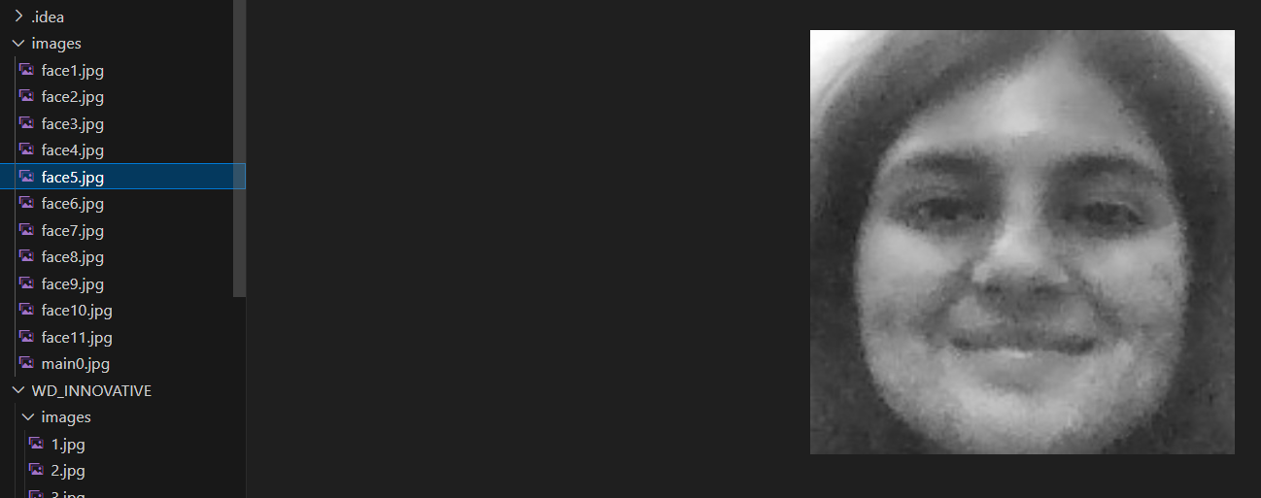
Test results

Slide 7
How It Works? Facial Expression Detection: Utilizing OpenCV, we analyze live or recorded video input to detect facial landmarks and expressions. Emotion Recognition: Through machine learning algorithms, we classify these facial expressions into specific emotional states such as happiness, sadness, anger, etc. Playlist Generation: Based on the detected emotion, the system retrieves music tracks from a pre-defined database or streaming service that corresponds to the identified emotional state. User Interaction: Users have the option to provide feedback on the selected tracks, enabling the system to learn and adapt to their preferences over time.

Slide 8
Conclusion In conclusion, our Emotion-Based Music Player represents a significant advancement in the field of human-computer interaction and emotional computing. By combining Python programming with OpenCV's computer vision capabilities, we've created a system that not only understands human emotions but also responds to them in a meaningful way through music. We believe this technology has the potential to revolutionize how we experience and interact with music in various aspects of our lives.

Slide 9

here webcam captured the sad expression and emoji is displayed according to it
Here we also have three modes
queue-mode
Emotion-mode
Rando-mode

Slide 10
