Slide 1
SPARK
Presented by,
HEENA SALIM SHAIKH

Slide 2
What is Spark:-
An open-source
Fast in-memory
Big data processing
Distributed general-purpose cluster-computing framework.
Developed at the University of California, Berkeley's AMPLab in 2009. The Spark codebase was later donated to the Apache Software Foundation.
Stable release: v2.4.0 / November 2, 2018; 3 months ago

Slide 3
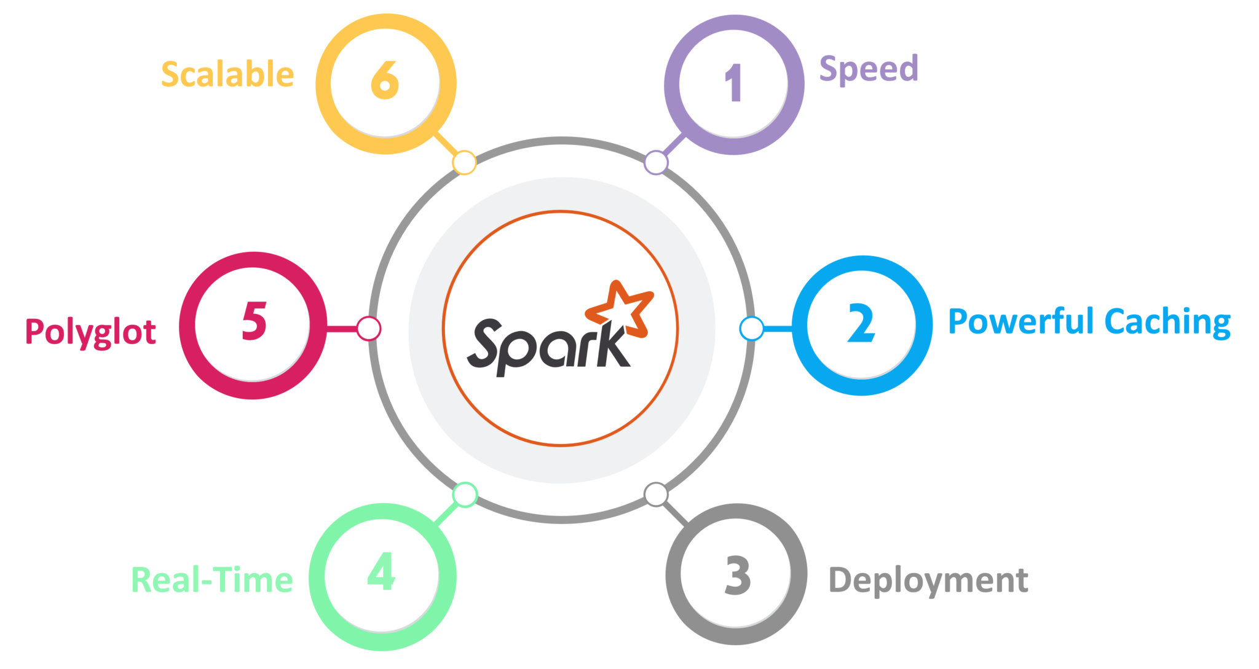

Slide 4

Advantages of the spark:-
Speed – Spark runs up to 100 times faster than Hadoop MapReduce for large-scale data processing. It is also able to achieve this speed through controlled partitioning.
What is Partitioning?
Partitioning is distributing the data across the multiple nodes in order to reduce the network I/O operations load. We can perform the partitioning by two ways.
1: Hash Partitioning
2: Range Partitioning

Slide 5
Employee Database:-
Employee_id | Employee_Name | Salary | Blood_Group
4 | Heena | 90000 | A+
6 | Ankita | 50000 | B+
11 | Preeta | 40000 | O+
17 | Satendra | 100000 | A+
31 | Sourabh | 70000 | B+
98 | Venu | 80000 | B+
100 | Lokesh | 200000 | O+
314 | Shrey | 60000 | A+

Slide 6
1: Hash partitioning with number of partitions < Number of Cores
No of Partitions = 1
Partition No= HashCode (4) %1 = 0
Partitoon No= HashCode (6) %1 = 0
Partition No= HashCode (11) %1 = 0
Partition No= HashCode (17) %1 = 0
Partition No= HashCode (31) %1 = 0
Partition No= HashCode (98) %1 = 0
Partition No= HashCode (100) %1 = 0
Partition No= HashCode (314) %1 = 0
CORE -0 CORE -1 CORE -2 CORE -3
6,Ankita,50000,B+
31,Sourabh,70000,B+ 100,Lokesh,200000O+ 4,Heena,90000,A+
17,Satendra,100000,A+
98,Venu,80000,B+
314,Shrey,60000,A+
11,Preeta,40000,O+

Slide 7
2.Hash partitioning with number of partitions = Number of Cores
No of Partitions = 4
Partition No= HashCode (4) %4 = 0
Partition No= HashCode (6) %4 = 2
Partition No= HashCode (11) %4 = 3
Partition No= HashCode (17) %4 = 1
Partition No= HashCode (31) %4 = 3
Partition No= HashCode (98) %4 = 2
Partition No= HashCode (100) %4 = 0
Partition No= HashCode (314) %4 = 0
CORE -0 CORE -1 CORE -2 CORE -3
4,Heena,90000,A+
100,Lokesh,200000,O+
314,Shrey,60000,A+
17,Satendra,100000,A+
6,Ankita,50000,B+
98,Venu,80000,B+
11,Preeta,40000,O+
31,Sourabh,70000,B+

Slide 8
3:Hash partitioning with number of partitions > Number of Cores
No of Partitions = 8
Partition No= HashCode (4) %8 = 1
Partition No= HashCode (6) %8 = 6
Partition No= HashCode (11) %8 = 3
Partition No= HashCode (17) %8 = 1
Partition No= HashCode (31) %8 = 7
Partition No= HashCode (98) %8 = 2
Partition No= HashCode (100) %8 = 4
Partition No= HashCode (314) %8 = 2
6,Ankita,50000,B+ 4th partition
Next Iteration:-
31,Sourabh,70000,B+ 100,Lokesh,200000,O+
CORE -0 CORE -1 CORE -2 CORE -3
98,Venu,80000,B+
314,Shrey,60000,A+
11,Preeta,40000,O+
6 th partition
4,Heena,90000,A+
17,Satendra,100000,A+
7 th partition

Slide 9
2.Powerful Caching and Persistence-
Simple programming layer provides powerful caching and disk persistence capabilities.
1. Cache Type-
MEMORY_ONLY:
Data is cached in memory only in non-serialized format.
2. Persistence Types:-
MEMORY_ONLY:
Data is cached in memory in non-serialized format.
MEMORY_AND_DISK:
Data is cached in memory. If enough memory is not available, evicted blocks from memory are serialized to disk. This mode of operation is recommended when re-evaluation is expensive.
DISK_ONLY:
Data is cached on disk only in serialized format.

Slide 10
3.Explanation of the memory Caching with the help of example
Scala Code:-
val sparkconf = new SparkConf().setMaster(“local”).setAppName(“The File Caching Application”);
var sc = new SparkContext(sparkconf);
var files = sc.parallelize(“C:\\files_collections\\idrp_collect_history.txt”); :-Transformation
var w = files.flatMap( w => w.splitBy(“|”)); :-Transformation.
.cache()
Println(“Count of the w is “ + w) :-Action
Println(“File content is” + w.count ); :-Action
Println(“Take top 5 elements ”+ w.take(5)) :-Action
sc.stop();
w
In-Memory Cache
Heena
Is
Spark
Hadoop
and
Java
developer

Slide 11






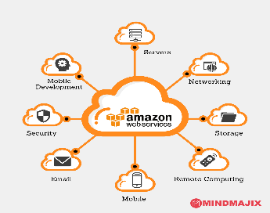
3:Deployment –
It can be deployed through Mesos, Hadoop via YARN, or Spark’s own cluster manager.

Slide 12





4.Polyglot-
Spark provides high-level APIs in Java, Scala, Python, and R. Spark code can be written in any of these four languages. It also provides a shell in Scala and Python.

Slide 13



5. Real-Time-
It offers Real-time computation & low latency because of in-memory computation.
6: Scalable –
It has scalable engine.
7: Easy Programming :-
Programming in the spark is easy.
It handle the work using the delegate concept
It have 100 operators to handle the work on different types of the data.

Slide 14

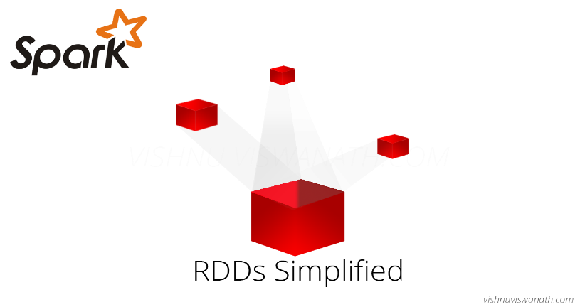




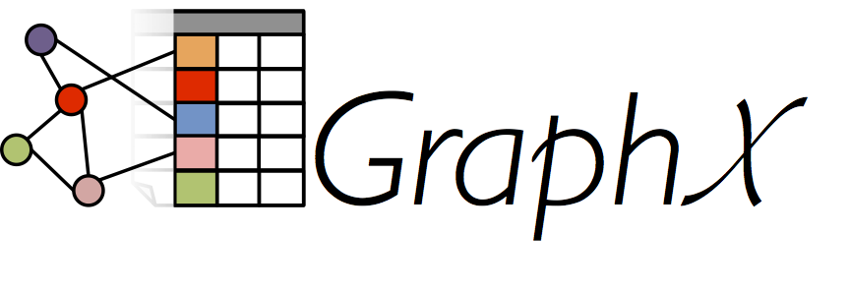
Spark-EcoSystem
Core
RDD :Resilient Distiributed Dataset
Spark-Core
Spark-Streaming
Spark-SQL
Spark-GraphX
Machine -Learning
R

Slide 15
Spark can handle:-
RDD for smaller workload.
SparkSQL for SQL workloads
Spark Streaming for Streaming data
And Machine learning
Hence, Spark can handle structured , semi-structured , un-structured data.

Slide 16
Disadvantages of the spark
Expensive:-
In-memory capability can become a bottleneck when we want cost-efficient processing of big data as keeping data in memory is quite expensive, the memory consumption is very high.
Not purely Real Time:-
No Support for Real-time Processing
In Spark Streaming, the arriving live stream of data is divided into batches of the pre-defined interval, and each batch of data is treated like Spark Resilient Distributed Database (RDDs). Then these RDDs are processed using the operations like map, reduce, join etc. The result of these operations is returned in batches. Thus, it is not real time processing but Spark is near real-time processing of live data. Micro-batch processing takes place in Spark Streaming.
Latency
Apache Spark has higher latency as compared to Apache Flink.

Slide 17
No File Management System and Manual Optimization
The Spark job requires to be manually optimized and is adequate to specific datasets.(If we want to partition and cache in Spark to be correct, it should be controlled manually.)
Back pressure is build up of data:-
At an input-output when the buffer is full and not able to receive the additional incoming data. No data is transferred until the buffer is empty. Apache Spark is not capable of handling pressure implicitly rather it is done manually.These are some of the major pros and cons of Apache Spark.
We can overcome these limitations of Spark by using Apache Flink – 4G of Big Data.

Slide 18
Spark Architecture:-
Worker
Executer
Worker
Executer
Cluster Manager
Driver
SparkContext
Worker
Executer
Worker
Executer

Slide 19
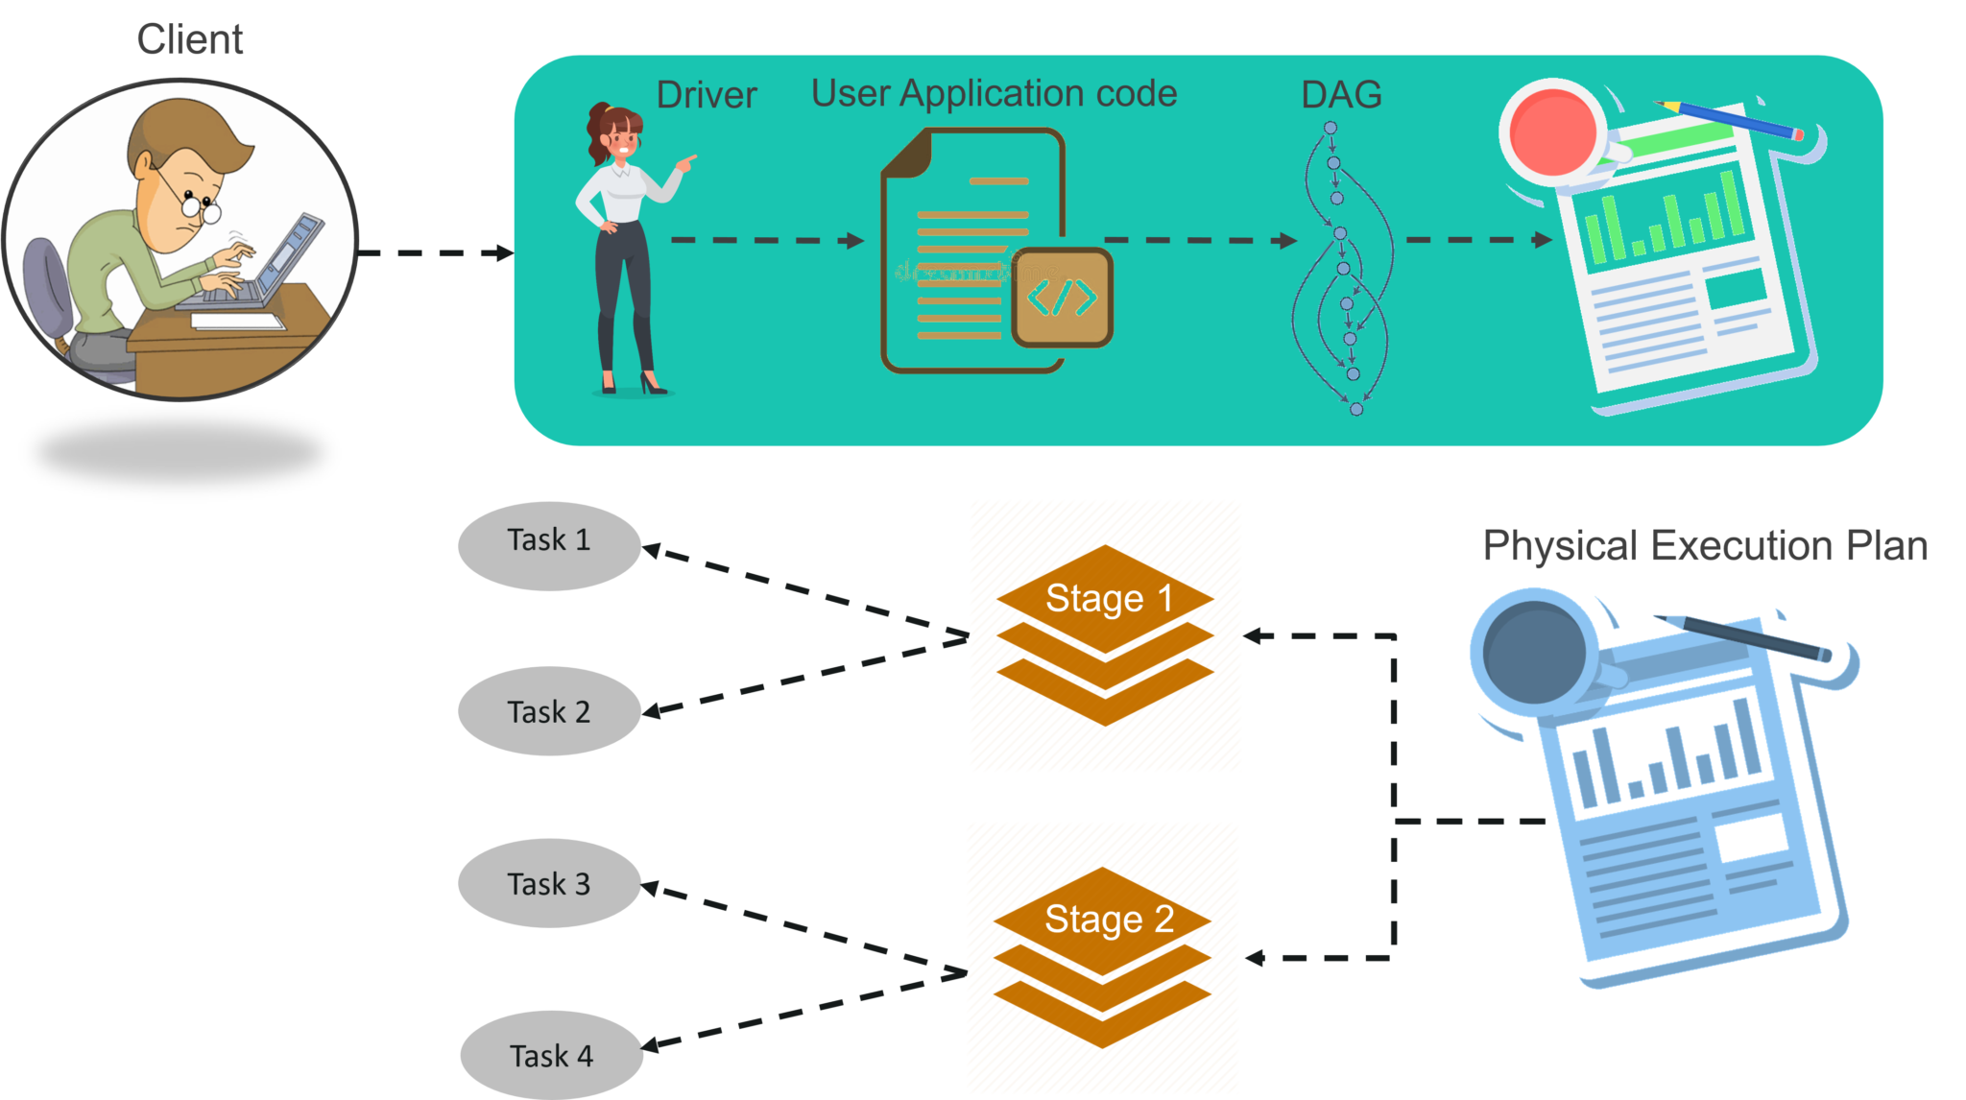
Workflow of Spark Architecture
Driver Activities

Slide 20
Workflow of Spark Architecture
Inside the driver program, the first thing you do is, you create a Spark Context. Assume that the Spark context is a gateway to all the Spark functionalities. It is similar to your database connection. Any command you execute in your database goes through the database connection. Likewise, anything you do on Spark goes through Spark context.
Now, this Spark context works with the cluster manager to manage various jobs. The driver program & Spark context takes care of the job execution within the cluster. A job is split into multiple tasks which are distributed over the worker node. Anytime an RDD is created in Spark context, it can be distributed across various nodes and can be cached there.
Worker nodes are the slave nodes whose job is to basically execute the tasks. These tasks are then executed on the partitioned RDDs in the worker node and hence returns back the result to the Spark Context.
Spark Context takes the job, breaks the job in tasks and distribute them to the worker nodes. These tasks work on the partitioned RDD, perform operations, collect the results and return to the main Spark Context.
If you increase the number of workers, then you can divide jobs into more partitions and execute them parallelly over multiple systems. It will be a lot faster.
With the increase in the number of workers, memory size will also increase & you can cache the jobs to execute it faster.

Slide 21
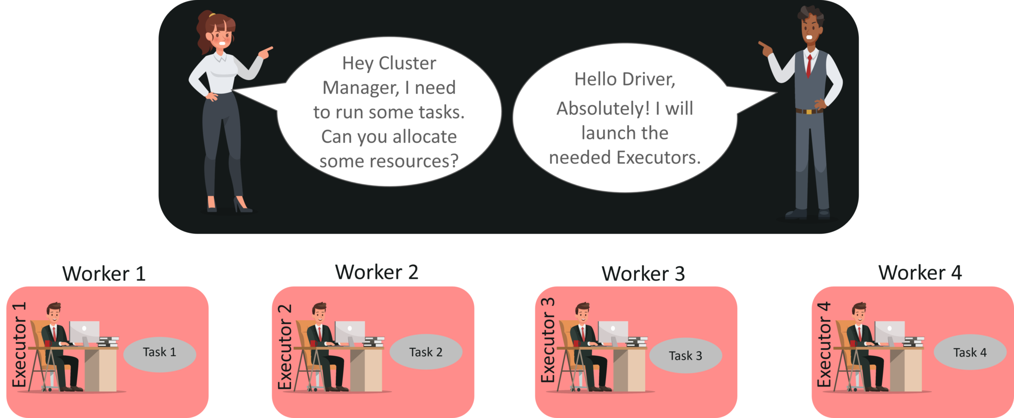
Cluster
Manager Activities
Workflow of Spark Architecture

Slide 22
Workflow of Spark Architecture
STEP 1: The client submits spark user application code. When an application code is submitted, the driver implicitly converts user code that contains transformations and actions into a logically directed acyclic graph called DAG. At this stage, it also performs optimizations such as pipelining transformations.
STEP 2: After that, it converts the logical graph called DAG into physical execution plan with many stages. After converting into a physical execution plan, it creates physical execution units called tasks under each stage. Then the tasks are bundled and sent to the cluster.
STEP 3: Now the driver talks to the cluster manager and negotiates the resources. Cluster manager launches executors in worker nodes on behalf of the driver. At this point, the driver will send the tasks to the executors based on data placement. When executors start, they register themselves with drivers. So, the driver will have a complete view of executors that are executing the task.
STEP 4: During the course of execution of tasks, driver program will monitor the set of executors that runs.Driver node also schedules future tasks based on data placement.
This was all about Spark Architecture. Now, let’s get a hand’s on the working of a Spark shell.

Slide 23
Use of the spark in real time industries.
With each passing day the requirements of enterprises increases and therefore there is a need for a faster and more efficient form of processing data. Most of the data is in unstructured format and it is coming in thick and fast as streaming data.
Banking –
More and more banksare increasingly adopting Spark platforms to analyze and access social media profiles, emails, call recordings, compliant logs, forum discussions to garner insights which can aid them take correct business decisions for credit risk assessment, customer segmentation and targeted advertising.
Alibaba Taobao –
uses Spark to analyse hundreds of petabytes of data on its ecommerce platform.Plethora of merchants interact with this e commerce platform. These interactions represent a large graph and Machine Learning processing on this data.
eBay –
uses Apache Spark to provide targeted offers, enhance customer experience, and to optimize the overall performance. Apache Spark engine is leveraged at eBay through Hadoop YARN.YARN manages all the cluster resources to run generic tasks. EBay spark users leverage the Hadoop clusters in the range of 2000 nodes, 20,000 cores and 100TB of RAM through YARN.

Slide 24
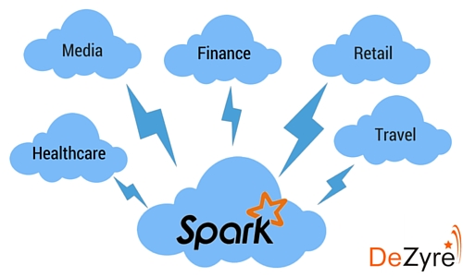
Industries

Slide 25
However, more than 3,000 companies are using Apache Spark nowadays, since, Apache Spark is considered as a 3G for the big data
Microsoft
IBM
Amazond. Yahoo!
Conviva
Netflix
Pinterest
Oracle
Hortonworks
Cisco
Verizon
Visa
Databricks
Amazon
Accenture PLC
Paxata
DataStax, Inc.
UC Berkeley AMPLab
TripAdvisor
Samsung Research America
Shopify
Premise
Quantifind
Radius Intelligence
OpenTable
Hitachi Solutions
The Hive
IBM Almadena
eBay!

Slide 26
PanTera
Peerialism
PlanBMedia
PredicitionIo
Quantifind
Radius Intelligence
Real Impact Analytics
RocketFuel
RONDHUIT
Sailthru
Samsung Research America
Shopify
Simba Technologies
Sinnia
SK Telecom
Agile Lab
Alibaba Taobao
Alluxio
Alpine Data Labs
AsiaInfo
Atigeo
Big Industries -
Conviva –Credit Karma
Databricks
eBay Inc.

Slide 27

Any Questions??

Slide 28

Thank You ☺

