Slide 1
CSS - Day 2 CSS Selectors and Flexbox

Slide 2
Do it yourself…

Slide 3
Exercise 1:
Create an HTML with 3 inline links using anchor tag.
Set the background-color to "lightblue" for elements with a "target" attribute.
Set the background-color to "lightblue" for elements with an attribute like: target="_blank"
Exercise 2:
Create an HTML with 5 or 6 img elements.
When assigning value to title attribute make sure atleast to img tags have the word “red” in it.
Set a border with the color "red", around elements with a "title" attribute containing the word "red

Slide 4
Exercise 3:
Create an html that has following elements:
Input(text, checkbox), Anchor, <p>, <h>,
Set the background color for visited and unvisited links to "lightblue", and the background color for the hover and active link states to "yellow".
Set the background color of <input> elements that are in focus (clicked or active), to “any color of your choice".
Set the background color of <p> elements, that are the second from last child of any element, to "lightblue"

Slide 5
Exercise4:
Create an html with below body content :
<div>
<p>This is a paragraph inside a div element.</p>
<p>This is another paragraph inside a div element.</p>
<span><p>This a paragraph inside a span element, inside a div element.</p></span>
</div>
<p>This is a paragraph, not inside a div element.</p>
<p>This is another paragraph, not inside a div element.</p>
Change the color of all <p> elements, that are descendants of <div> elements, to "red".
Change the color of all <p> elements, that are immediate children of <div> elements, to “blue".
Change the color of <p> elements, that are the siblings of a <div> element, to “grey".

Slide 6
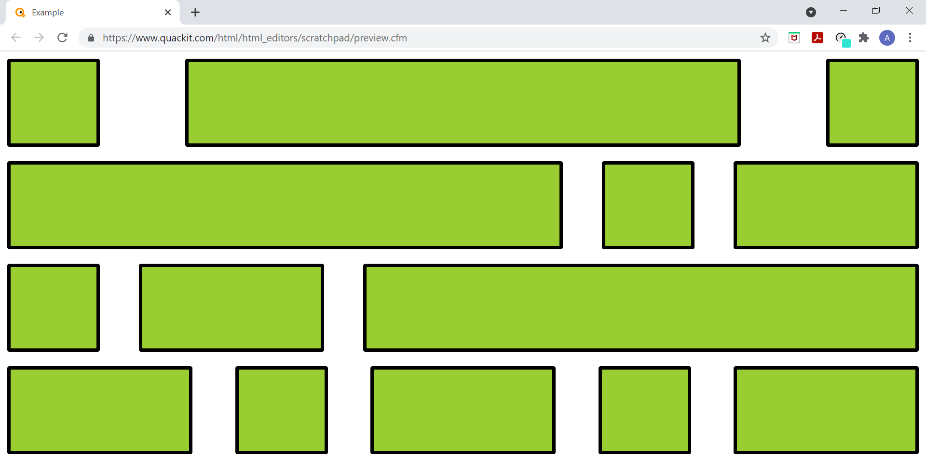
Exercise 5:
Using flexbox create the
Boxes as shown in the picture

Slide 7
Exercise 6
Use flexbox and fine tune your hotel menu card.
Exercise 7:
Use css selectors and flex box to fine tune your college application.

Slide 8
All the best !!!

