Slide 1
Agenda
AUTOSAR Introduction
AUTOSAR Vision
AUTOSAR Concept
AUTOSAR ECU Software Architecture
AUTOSAR Benefits
AUTOSAR Layered Software Architecture

Slide 2
AUTOSAR Introduction
AUTOSAR (AUTmotive Open System ARchitecture) is a revolutionary milestone in the development of Automotive E/E Systems. The development partnership established by leading OEM’s and Suppliers had defined an open reference architecture for ECU software.
The idea behind AUTOSAR initiative is found in 2003 by Automotive OEM’s and Suppliers to avoid re-developing of similar software components.

Slide 3





















































AUTOSAR Partners and Members
12 Development Members
9 Core Partners
66 Associate Members
6 Attendees
48 Premium Members
General OEM’s
Generics Tier1’s
General Software
Tools & Services
Semicon’s

Slide 4
AUTOSAR Introduction Continued
Provides a conceptual layered software architecture
Provides mapping of the identified BSW modules to software layers
Automotive ECUs having the following properties can adapt to AUTOSAR
Strong interaction with hardware (sensors and actuators)
Connection to vehicle network via CAN, LIN, FlexRay or Ethernet
Microcontrollers from 16 to 32 bit
Real Time Operating System
Extensibility
Modules can be added or the functionality of existing ones can be extended,
but their configuration has to be considered in the Basic SW configuration
process
Complex drivers can easily be added

Slide 5
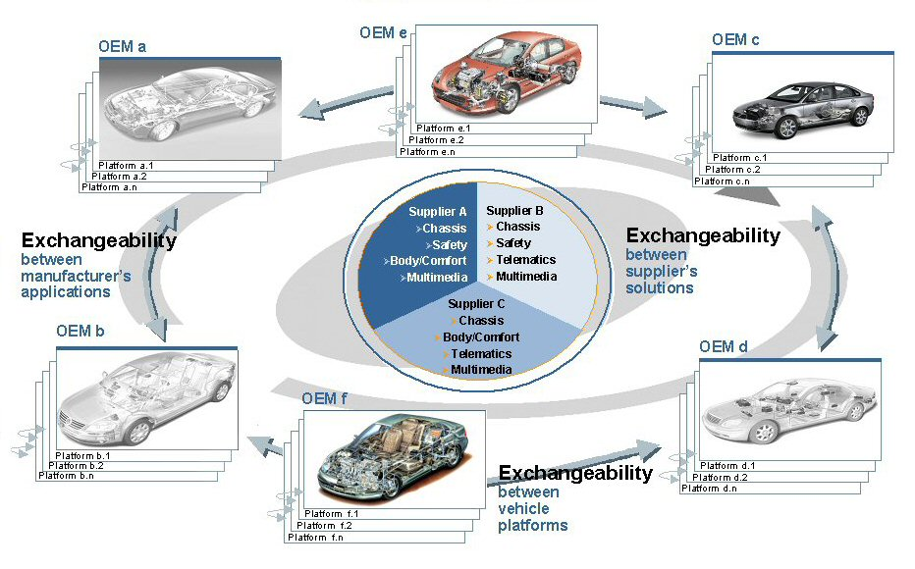
AUTOSAR– Vision
AUTOSAR vision is an improved complexity management of highly Integrated E/E architectures through an increased Reuse and Exchangeability of SW Modules between OEMs and suppliers.
Exchangeability between
Suppliers Solutions
Exchangeability between
Vehicle Platforms
Manufacture’s Applications
OEM A
Platform A.1
Platform A.n
Suppliers
Chassis
Safety
OEM B
Telematics
Multimedia
OEM C
Platform B.1
Platform B.n
Platform C.1
Platform C.n

Slide 6
AUTOSAR Concepts
Architecture
Software architecture including a complete Basic or
Environmental Software Stack for ECUs –AUTOSAR Basic Software
Methodology
Exchange formats or description templates to enable a
Seamless Configuration process of BSW stack
and the Integration of application software in ECU’s and it
includes even the methodology how to use this framework.
Interfaces
Specification of Interfaces of typical Automotive
Applications from all domains in terms of syntax and semantics

Slide 7
AUTOSAR – ECU Software Architecture
Application
Software
Component
Actuator
Software
Component
Sensor
Software
Component
Application
Software
Component
AUTOSAR Software
AUTOSAR Interface
AUTOSAR Interface
AUTOSAR Interface
AUTOSAR Interface
AUTOSAR layer model offers…
Modular Components with defined interfaces
Hardware Independent Software layer
Transferability of modules
Decoupled Basic Software and Application Components using RTE
..............
AUTOSAR Runtime Environment (RTE)
Standardized Interface
Standardized AUTOSAR Interface
Standardized Interface
AUTOSAR Interface
AUTOSAR Interface
Operating
System
Services
Communication
ECU
Abstraction
Complex
Device
Drivers
Standardized Interface
Standardized Interface
Standardized Interface
Standardized Inteface
Standardized Interface
Basic Software
Microcontroller Abstraction
AUTOSAR Interface
ECU-Hardware
Standardized AUTOSAR Interface
Standardized Interface

Slide 8
AUTOSAR – ECU Software Architecture Continuation
AUTOSAR Interface:
An "AUTOSAR Interface" defines the information exchanged between software components and/or BSW modules.
Standardized AUTOSAR Interface:
A "Standardized AUTOSAR Interface" is an "AUTOSAR Interface" whose syntax and semantics are standardized in AUTOSAR. The "Standardized AUTOSAR Interfaces" are typically used to define AUTOSAR Services, which are standardized services provided by the AUTOSAR Basic Software to the application Software-Components.
Standardized Interface:
“Standardized Interfaces" are typically used between software-modules which are always on the same ECU.

Slide 9
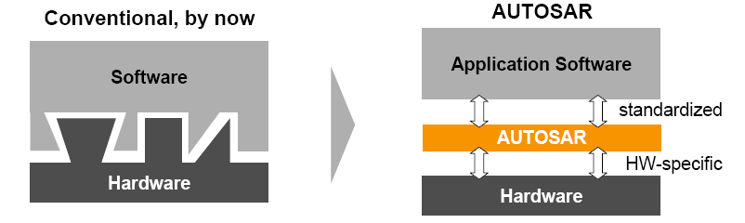
Change in Automotive Development
Hardware- and software will be widely independent of each other.
Development processes will be simplified.
This reduces development time and costs.
Reuse of software increases at OEM as well as at suppliers.
This enhances also quality and efficiency.

Slide 10
AUTOSAR Layered Software Architecture
The Layered Software Architecture describes the software architecture of AUTOSAR:
➢it describes in an top-down approach the hierarchical structure of AUTOSAR software and
➢maps the Basic Software Modules to software layers and
➢shows their relationship.
AUTOSAR extensibility
The AUTOSAR Software Architecture is a generic approach:
➢Standard modules can be extended in functionality, while still being compliant,
still, their configuration has to be considered in the automatic Basic SW configuration process!
➢non-standard modules can be integrated into AUTOSAR-based systems as Complex Drivers and
➢further layers cannot be added.

Slide 11
Generic Layered Architecture
Generic layered architecture allows two different systems to communicate despite of their core architecture (hardware or software)
Layered architecture provides standard methodology to design flexible, robust and interoperable architecture
Application
Middleware
OS + Device Drivers
Hardware

Slide 12
Overview of Software Layers : Top View
The AUTOSAR Architecture distinguishes on the highest abstraction level between three software layers : Application, Runtime Environment and Basic Software which run on a Microcontroller.
Application Layer
Runtime Environment (RTE)
Basic Software (BSW)
Microcontroller

Slide 13
Overview of Software Layers : Coarse View
APPLICATION LAYER
RUN TIME ENVIRONMENT
SERVICES LAYER
COMPLEX DRIVERS
ECU ABSTRACTION LAYER
MICROCONTROLLER ABSTRACTION LAYER
MICROCONTROLLER

Slide 14
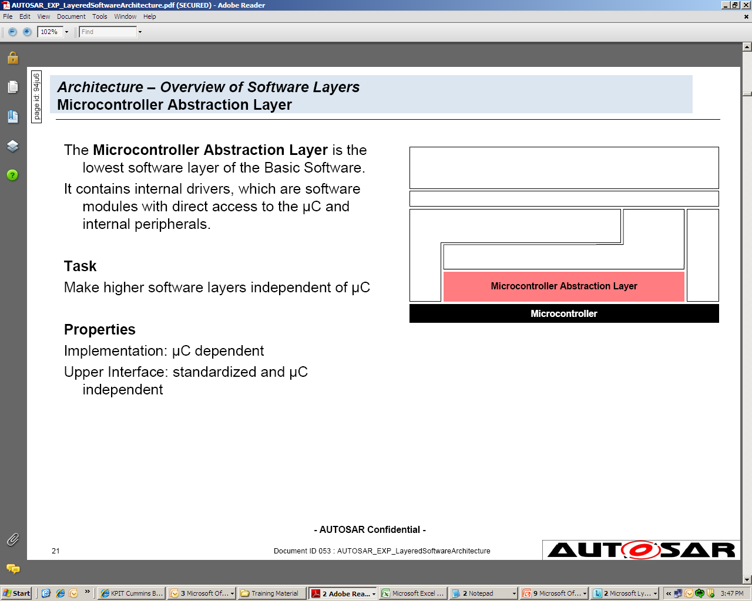
Microcontroller Abstraction Layer
The Microcontroller Abstraction Layer is the lowest software layer of the Basic Software.
It contains internal drivers, which are software modules with direct access to the microcontroller and internal peripherals.
Task
Make higher software layers independent of microcontroller

Slide 15
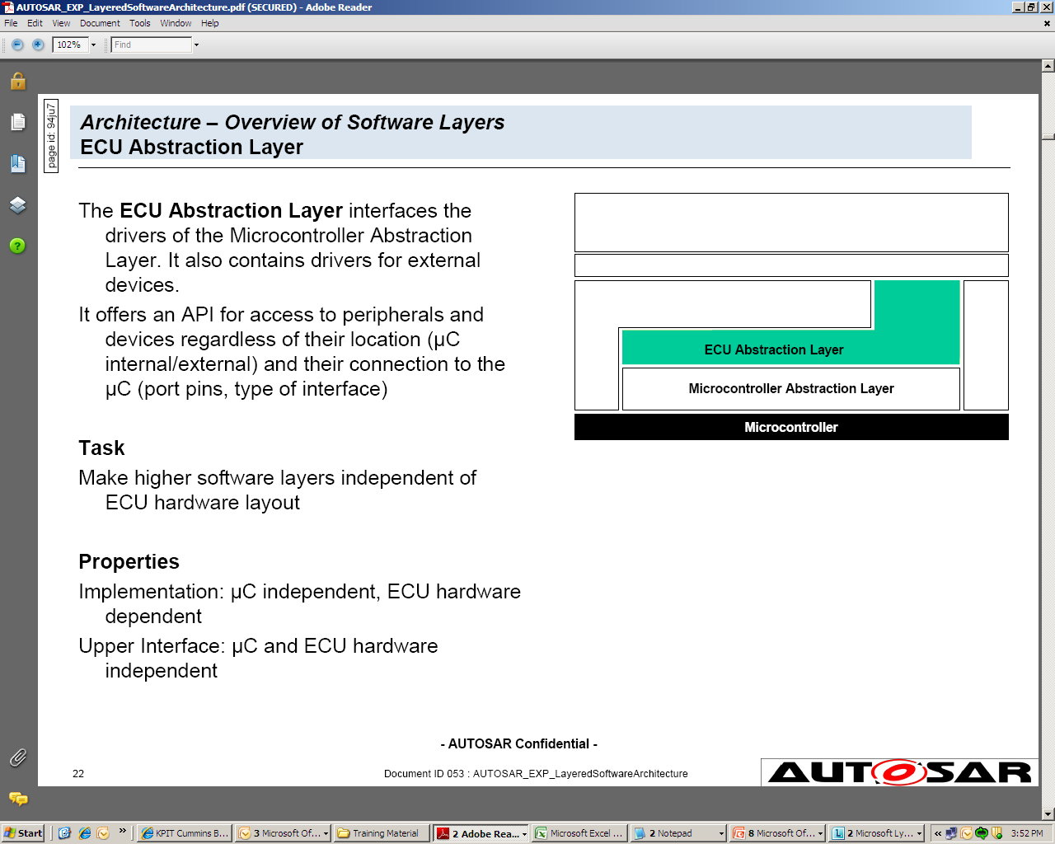
ECU Abstraction Layer
The ECU Abstraction Layer interfaces the drivers of the Microcontroller Abstraction Layer. It also contains drivers for external devices.
It offers an API for access to peripherals and devices regardless of their location (μC internal/external) and their connection to the μC (port pins, type of interface)
Task
Make higher software layers independent of ECU hardware layout

Slide 16
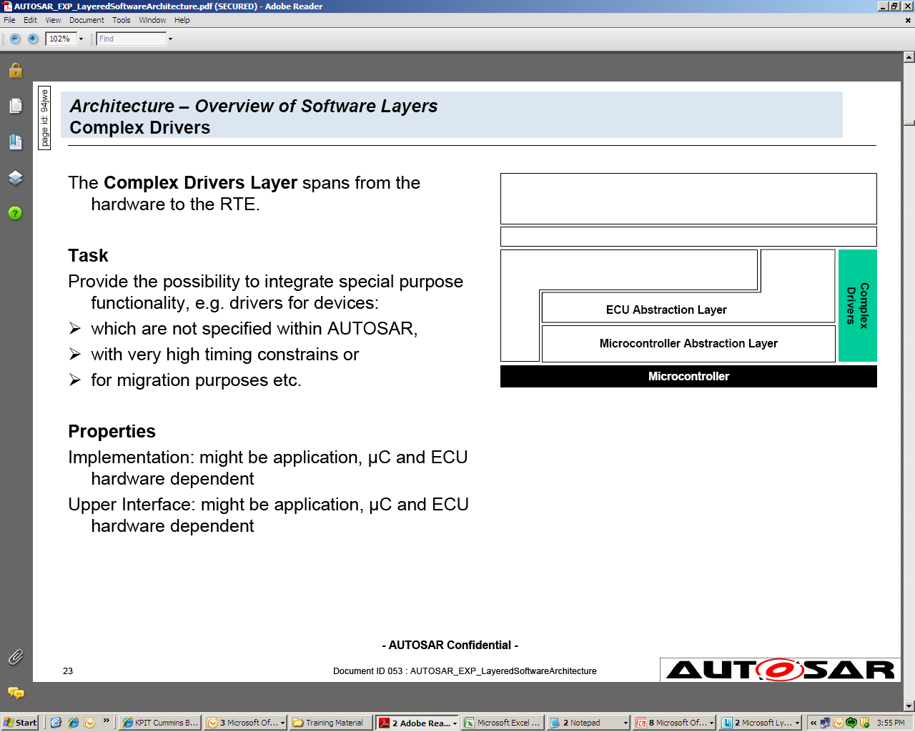
Complex Drivers
The Complex Drivers Layer spans from the hardware to the RTE.
It offers an API for access to peripherals and devices regardless of their location (μC internal/external) and their connection to the μC (port pins, type of interface)
Task
Provide the possibility to integrate special purpose functionality, e.g. drivers for devices:
which are not specified within AUTOSAR,
with very high timing constrains or
for migration purposes etc.

Slide 17
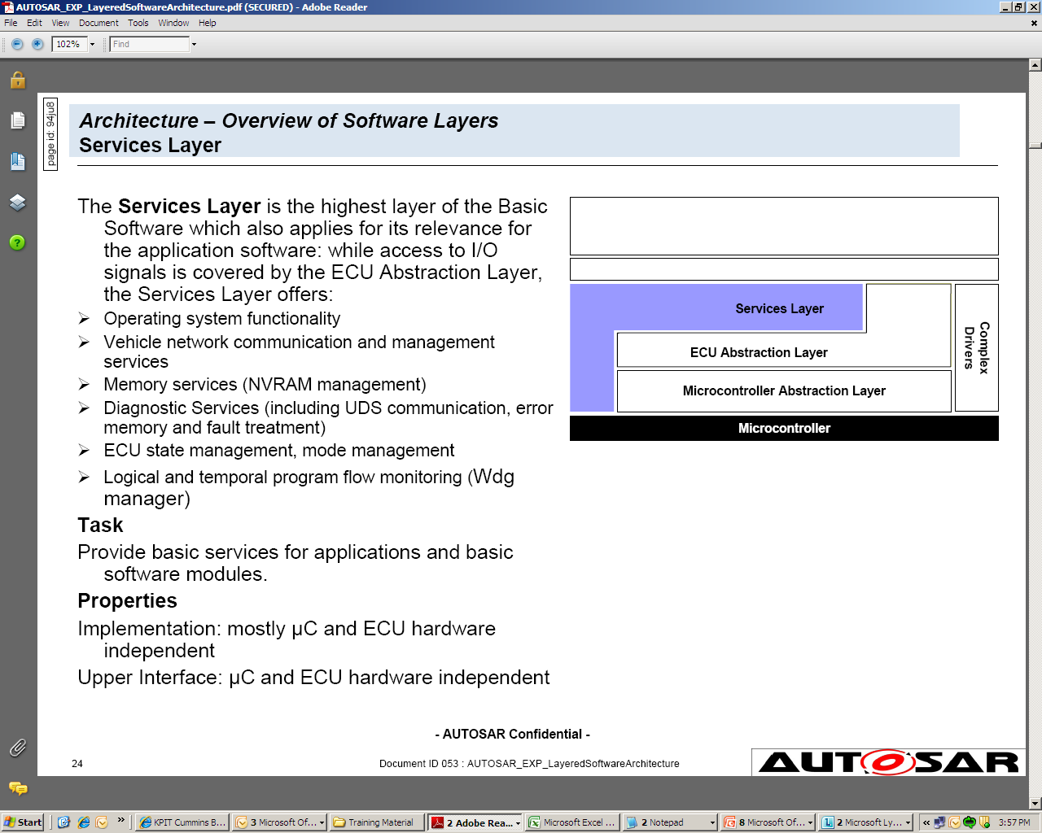
Services Layer
The Services Layer is the highest layer of the Basic Software which also applies for its relevance for the application software: while access to I/O signals is covered by the ECU Abstraction Layer, the Services Layer offers
Operating system functionality
Vehicle network communication and management services
Memory services (NVRAM management)
Diagnostic Services (including UDS communication, error memory and fault treatment)
ECU state management, mode management
Logical and temporal program flow monitoring (Wdg manager)
Task
Provide basic services for applications
and basic software modules.

Slide 18
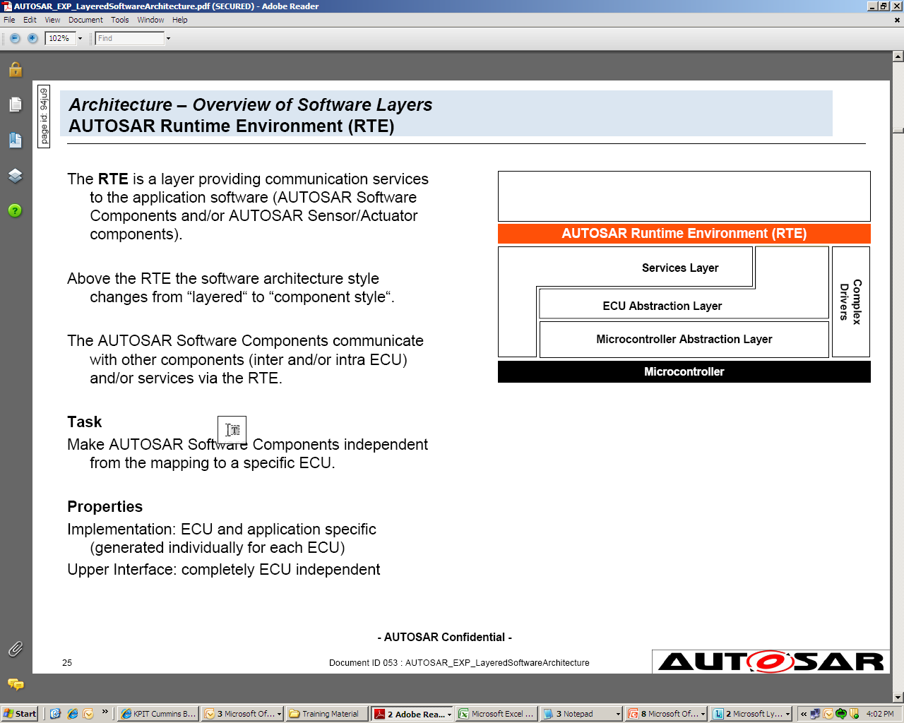
Runtime Environment (RTE)
The RTE is a layer providing communication services to the application software (AUTOSAR Software Components and/or AUTOSAR Sensor/Actuator components).
Above the RTE the software architecture style changes from “layered“ to “component style“.
The AUTOSAR Software Components communicate with other components (inter and/or intra ECU) and/or services via the RTE.
Task
Make AUTOSAR Software Components independent from the mapping to a specific ECU.

Slide 19
Application Layer and RTE
RTE is a layer providing communication services to the application software
AUTOSAR Software Components communicate with other components (inter
and/or intra ECU) and/or services via the RTE
Application Layer
Actuator
Software
Component
Sensor
Software
Component
RTE
Basic Software
Interfaces to (e.g.)
I/O HW Abstraction (access to I/O signals)
Memory Services (access to calibration data)
System Services (access to Error Manager)

Slide 20
Overview of Software Layers : Detailed View
Application Layer
AUTOSAR Runtime Environment (RTE)
System Services
Memory Services
Communication Services
I/O Hardware Abstraction
Complex
Drivers
Onboard Device Abstraction
Memory Hardware Abstraction
Communication Hardware Abstraction
Microcontroller Drivers
Memory Drivers
Communication Drivers
I/O Drivers
Microcontroller

Slide 21
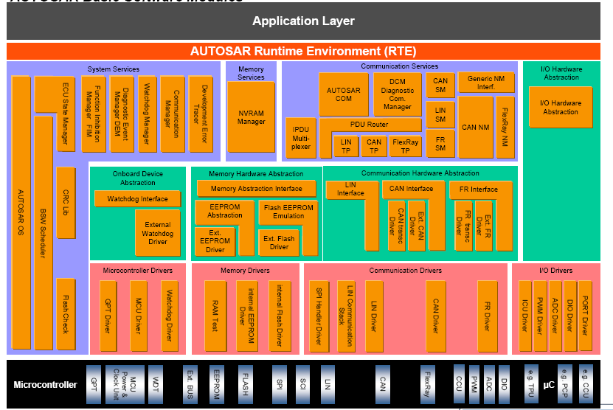
Overall Basic Software Architecture

Slide 22
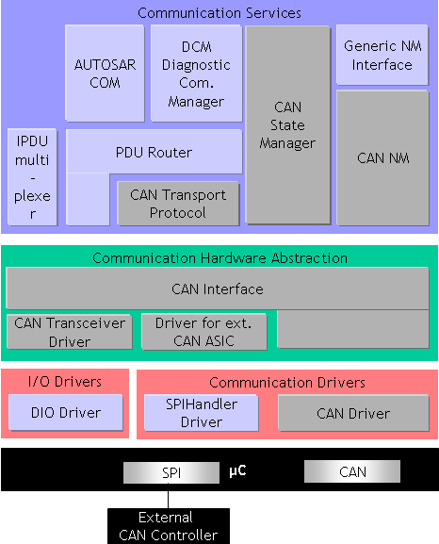
Communication Stack - CAN
AUTOSAR COM, PDU Router, IPDUM, Generic NM Interface and Diagnostic Communication Manager are the same for all vehicle network systems
A signal gateway is part of AUTOSAR COM to route signals
PDU (frame) based Gateway is part of PDU Router
IPDU multiplexing provides the possibility to add information to enable multiplexing of I-PDUs (different contents but same IDs)
Generic NM Interface contains only a dispatcher
CAN NM is specific for CAN networks & will be instantiated per CAN vehicle network system
CAN State Manager handles the Start and Stop communication on CAN bus

Slide 23
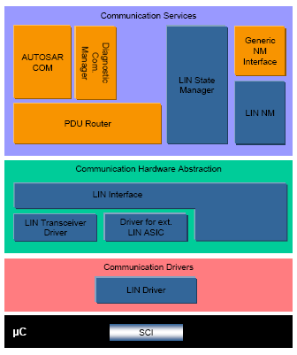
Communication Stack – LIN
A LIN 2.1 compliant communication stack with
Schedule table manager for transmitting LIN frames and to handle requests to switch to other schedule tables
Transport protocol, used for diagnostics
A Wakeup and Sleep Interface

Slide 24
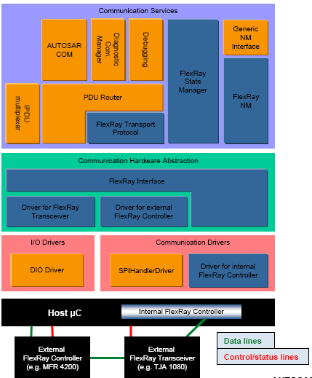
Communication Stack – FlexRay

