Slide 1
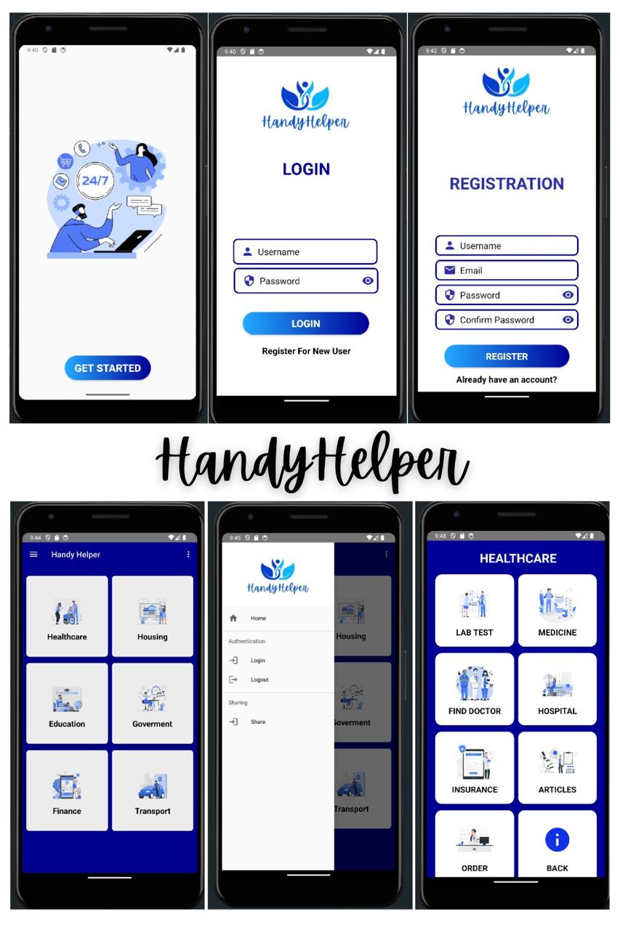

“HandyHelper”
Your Everyday Solution for Life's Everyday Needs

Slide 2

Problem Statement
PS-2 : “Integrated common services to common people”
In today's fast-paced world, people often struggle to find reliable and convenient access to essential services. From healthcare and education to housing and transportation, the fragmented nature of these services can be overwhelming and time- consuming. HandyHelper is a comprehensive service platform that aims to provide a wide range of essential services to the common people, all in one convenient and accessible app. From Education and Healthcare to Housing, Transportation, Government, and Financial services. HandyHelper streamlines access to the resources and support that individuals and families need to thrive in their daily lives.

Slide 3
A Unique Idea (Brief Solution)
HandyHelper is designed to be a one-stop solution for a diverse range of services, including Education, Healthcare, Housing, Transportation, Government services, and Finance.
By integrating common services into a single, user-friendly platform. This integration eliminates the need to navigate multiple platforms or providers, simplifying access and streamlining the user experience.
By integrating common services into a single, user-friendly platform, HandyHelper aims to simplify the process and empower individuals to take control of their lives.
HandyHelper's user-friendly mobile app interface allow users to access services anytime, anywhere, enabling them to manage their daily tasks and responsibilities with ease and efficiency.
1). Education
School Information: Information on local educational institutions, admission processes, and academic calendars and their necessary details.
2). Healthcare
Appointment Booking: Facility to book appointments with doctors and healthcare providers.
Medical Records: Secure storage and retrieval of personal medical records.
Health Tips: Regular updates on health tips, vaccination schedules, and wellness programs
3). Housing
Property Listings: Access to rental and purchase listings for homes and apartments.
Housing Services: Information on home Grocery, Restaurants, Caters, Packers, Community, Electrician, Painter, Carpenter services.

Slide 4
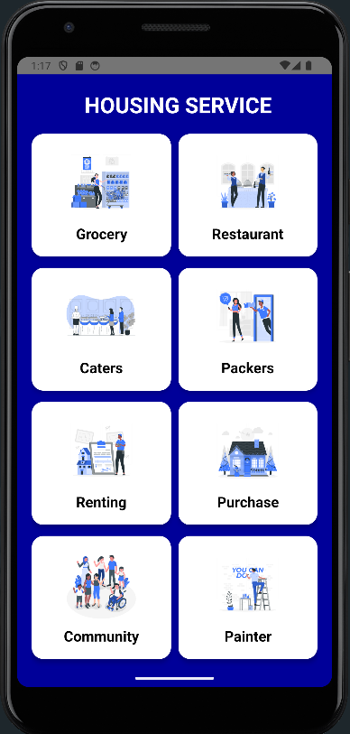
Key Features of HandyHelper
1). Centralized Access to Services
The app serves as a single gateway to various public services, access to a wide range of essential services all in one convenient platform.
2). Appointment Scheduling
Ability to easily schedule appointments and manage bookings for various services, streamlining the process and saving time.
3). Improved Service Delivery
By digitizing public services, the app enhances efficiency and reduces bureaucratic delays and a unified platform can provide a more seamless and cohesive user experience, increasing user satisfaction and engagement by taking less time.
4). Increased Transparency and Accountability
The app has the potential to reach a broader audience, including those in remote or underserved areas who may not have easy access to these services via internet.
5). Digital Inclusion
Designed to be user-friendly and easy for people with varying levels of digital literacy.
6). Cost Efficiency
Reduces operational costs by streamlining service delivery and cutting down on physical paperwork and also by reducing the need for multiple subscriptions and accounts, the App can help users save money.

Slide 5
The HandyHelper App Process Flow
Registration or Login
1
Users can easily Register and Login for the HandyHelper platform, providing basic information to create their account and can access the services.
2
Service Selection
Users can select the specific services they require, ranging from Healthcare to Education, Housing and beyond.
Appointment Booking
3
Users can conveniently schedule appointments for their selected services like lab, book a Doctor etc. through the app's intuitive interface.
4
Place order
Secure and seamless order placing options allow users to order medicine and lab test at their door step and handle all their services and orders within the HandyHelper platform.

Slide 6
HandyHelper App Architecture
User Interface (UI)
The front-end of the app, responsible for user interaction and display of logo, images, services or products and their information. This layer is designed to be user-friendly, intuitive, and accessible to all.
Backend Services
Provides the core functionality of the app, processing user requests, managing data, and responding to the services as per the user requirement. This layer ensures the app's performance and reliability.
Data Layer
Stores and manages all the data used by the app, including user information, service details, and order history. This layer ensures data integrity and security.
Database
Connects the app to data stored and provides the access of data to authenticated user for their services. This layer allows the app to access and utilize a wide range of functionality

Slide 7
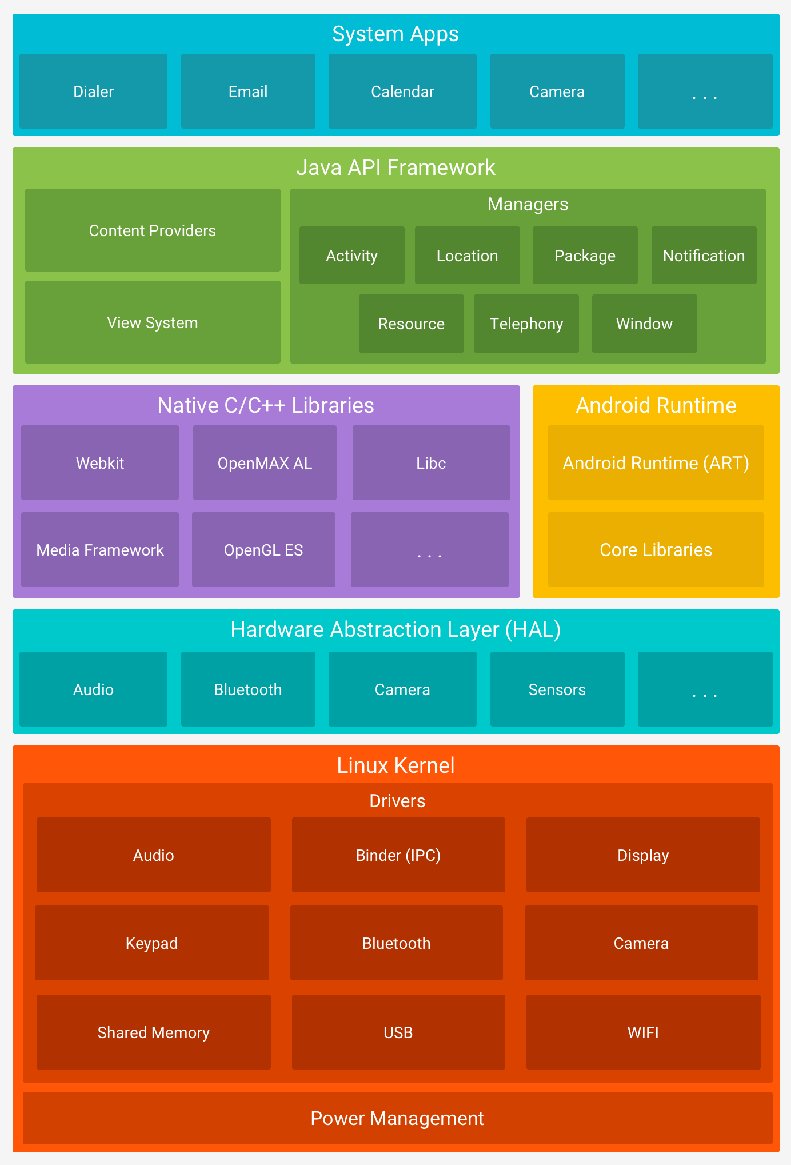

Slide 8
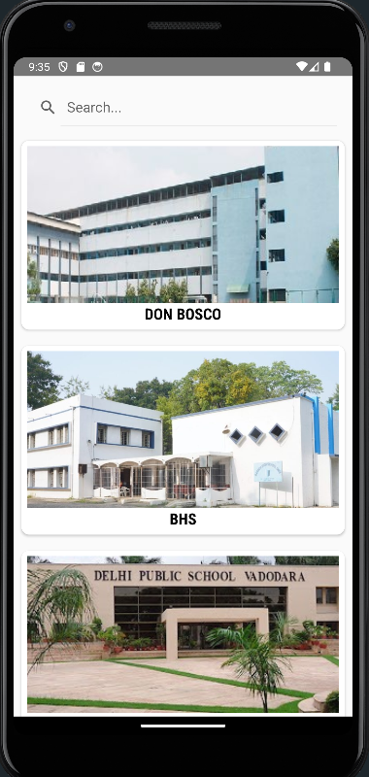



Tools and Technology Used
Android Studio
The HandyHelper app is developed using Android Studio, the official Integrated Development Environment (IDE) for Android app development, ensuring seamless integration and optimization for the Android platform.
Java
The app is primarily built using the Java programming language, a robust and widely-adopted language for Android app development, providing a stable and reliable foundation for the platform.
Database Integration
The app integrates with databases to securely store user data and preferences, enabling personalized recommendations and a seamless user experience.

Slide 9
Team Member and Contribution & Team Name - “Learning League”
Heer Patel [Team Leader] | Project Manager and created other Documents need for Submission | Defined the projects map, plan with timelines, milestones, and deliverables and ensured that the app met the needs of its target users. Coordinated team meetings and facilitated communication between team members. Created Diagrams and the needed images, flowcharts and gathered needed information for Presentation.
Bansari Patel | UI/UX Designer Lead Developer | Designed the user interface and user experience to ensure a seamless and intuitive user experience for Education and Housing Module. Designed the Logo and theme of the app Responsible for the overall architecture and development of the Education and Housing Module. Did research and Created report on the App.
Jainil Patel | UI/UX Designer Lead Developer | Designed the user interface and user experience to ensure a seamless and intuitive user experience for Healthcare Module. Responsible for the overall architecture and development of the Healthcare Module. Did the database connectivity and developed the login and register activity with authentication and validation.
Aayushi Singhala | Data Analyst and Market analyst | Collected and analyzed user data to identify trends and opportunities for improvement. Researched on the competitors and app existing in the market and gathered details about the project.

Slide 10
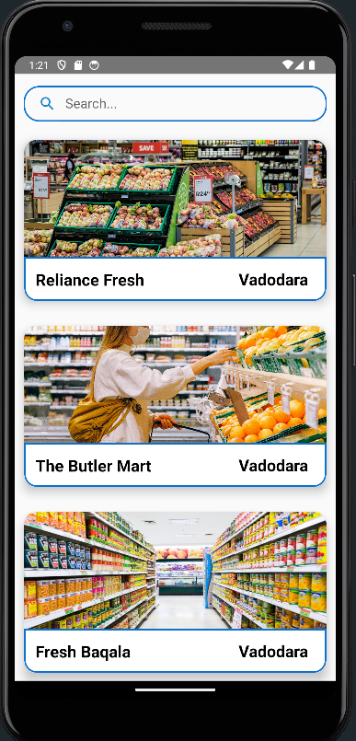
Conclusion
The Integrated Common Services called “HandyHelper” project has been a valuable learning experience, providing extensive insights into the Android development process. The project achieved its primary objectives of integrating essential services into a single platform, offering a user-friendly and secure app. While the current system has some limitations, these present opportunities for future enhancements. HandyHelper is committed to continuously expanding service offerings, improving performance, and increasing user engagement, integrating new providers and solutions to meet the evolving needs of its users. This will ensure the platform remains a comprehensive and indispensable resource for managing daily life.
This project not only contributes to the field of mobile app development but also highlights the importance of collaboration, user-centric design, and continuous improvement in creating impactful technological solutions.

