Slide 1
Startup Finder for Investors
Team Hack-o-holics:
Krunal Dabhi
Dev Chaurasia
Heeral Dedhia
Charmi Savla

Slide 2


Slide 3
Problem Identification and Definition
Investors need a social media and repository bot which indexes the potential startup ideas in a database.
A news feed scraper to trace the activities of the projects.
A CRM Style dashboard for the projects added to watch list.
So, we are aiming to make a cost-efficient and human-friendly EasyInvest Portal for investors to explore potential startup ideas according to his interests.

Slide 4
Features of EasyInvest
social media and repository bot which indexes the potential startup ideas in a database.
A news feed scraper must be used to trace the activities of the projects.
A CRM Style dashboard for the projects added to watch list.

Slide 5
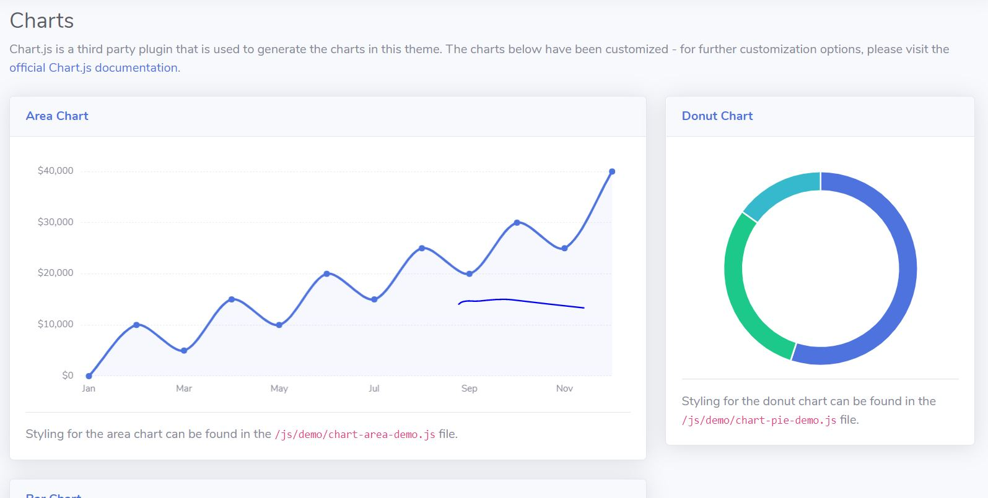
Scope
An investor can search through different types of startups.
He can see the name of the startup , the idea of the startup, the investment required by the startups, the money spent by them on different parts of their projects.

Slide 6
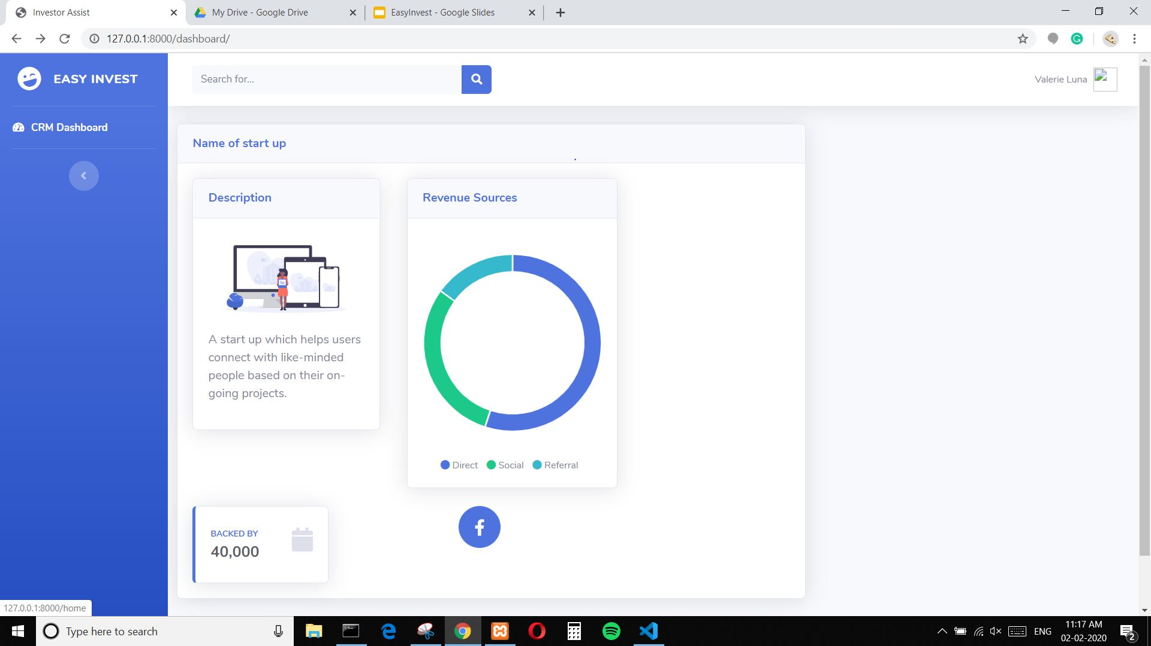
Scope (contd..)
These above stats will be shown on a CRM based dashboard

Slide 7
System Overview
This web portal will be used for eliminating the middlemen and it directly scrapes the web for probable startups and with their respective categories.
The investors can wishlist the startups they like and will be provided with the details f the startups they wishlisted.

Slide 8
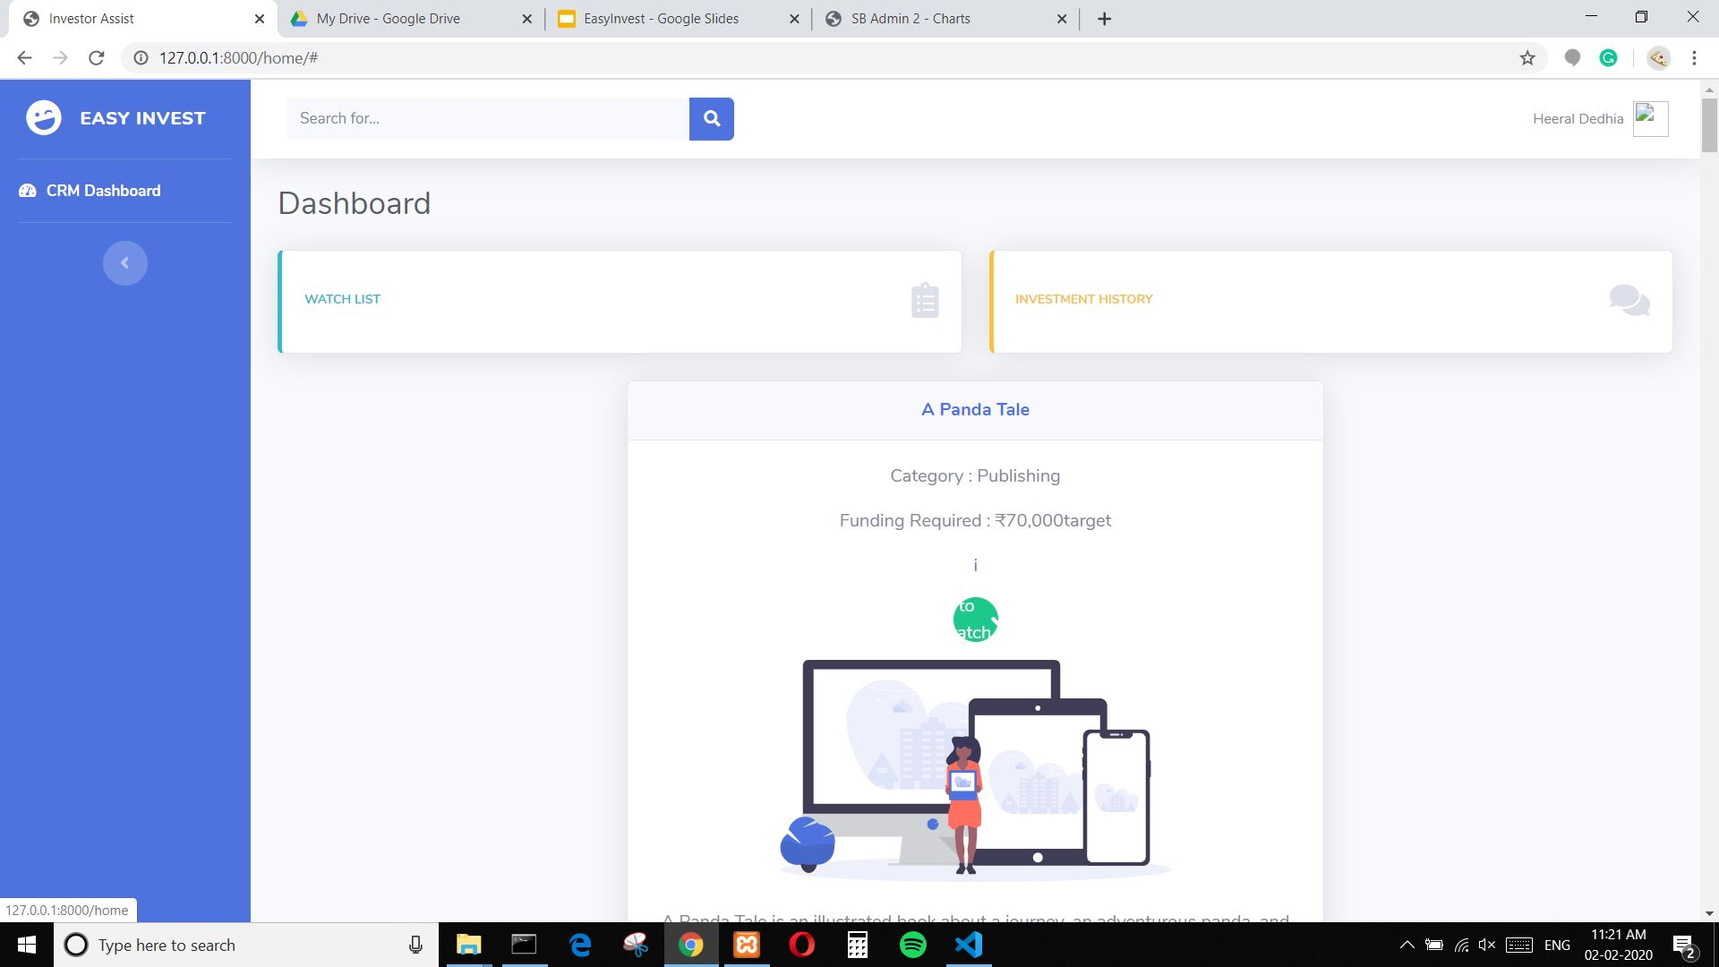

Slide 9
System consists of following 3 main modules:
The repository and social media bot to provide the investors about the informations about the startups.
The CRM dashboard to show about the startups wishlisted by the investors
The login page where the investor is logged in with us.

Slide 10
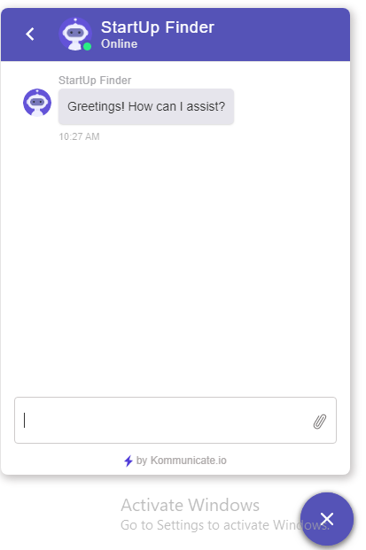
Future scope
A chatbot can be implemented, through which the investors can interact with the web portal efficiently.
A repository bot can be made which is used to extract the project status.

Slide 11
Implementation
The code was implemented in the Django framework with Mysql as the database.
The data was web scraped using Selenium webdriver in Python.
Chatbot was implemented using Dialogflow and Firebase database.
We also explored the LinkedIn Statistics API to scrape details from LinkedIn profiles of companies and founders of start-ups.

Slide 12
THANK YOU

