Slide 1
INSTAGRAM USER ENGAGEMENT ANALYSIS
What Our Data Tells Us About Engagement, Retention & Growth
POOJA HEERA | 22/08/2026
Data Analytics Team • Marketing Insights Review

Slide 2
What We'll Cover
A data-driven look at how our users really behave
01
The Dataset
Scale and quality of the data behind this analysis
02
Two Hidden User Tiers
Every user falls into one of two very different network roles
03
Where Engagement Really Comes From
A small group of users drives a disproportionate share of activity
04
Hashtags: Popular vs. High-Performing
The most-used hashtag isn't the best-performing one
05
Recommendations & KPIs to Track
Segment-specific actions and the dashboard to monitor them
Instagram User Engagement Analysis
2

Slide 3
The Dataset at a Glance
One snapshot of our Instagram-style platform
100
257
8,782
Users
Posts
Likes
7,488
7,623
21
Comments
Follow Relationships
Hashtags Tracked
Instagram User Engagement Analysis
3

Slide 4
We Verified the Data First
Before drawing conclusions, we confirmed the numbers can be trusted
✓
No missing usernames
✓
No duplicate user accounts
✓
No missing image URLs on posts
✓
No missing comment text
✓
No duplicate like records
✓
No duplicate hashtag names
Result: 6 out of 6 data-quality checks passed. The numbers in this presentation are built on a clean foundation.
Instagram User Engagement Analysis
4

Slide 5
Our Users Fall Into Two Very Different Tiers
The follow network splits the user base almost perfectly in two
77 users
23 users
“Community” accounts
“Influencer” accounts
Follow ~99 other users each (nearly everyone on the platform)
Have about 76 followers each
Generate essentially all of the platform's likes and comments
Follow 0 other users — they never follow back
Have about 77 followers each
Never like or comment on anyone else's content
Instagram User Engagement Analysis
5

Slide 6
Not All “Influencer” Accounts Are Equal
The 23 influencer-tier accounts split into two very different groups
10 users
13 users
Active Creators
Ghost Accounts
Post regularly (5 to 12 posts each)
Are literally our top 10 accounts for total engagement
Drive nearly a third of all platform engagement
Have 0 posts — they've never shared any content
Still carry ~77 followers each, likely from early sign-up momentum
Contribute zero engagement in either direction
Instagram User Engagement Analysis
6

Slide 7
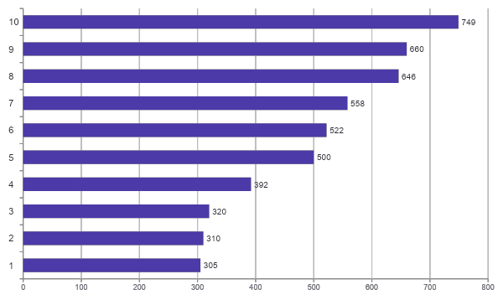
Engagement Is Highly Concentrated
Our top 10 creators (10% of users) drive 30% of all platform engagement
30.5%
of all platform engagement
comes from just these 10 users
4,962
combined likes + comments
out of 16,270 total
Instagram User Engagement Analysis
7

Slide 8
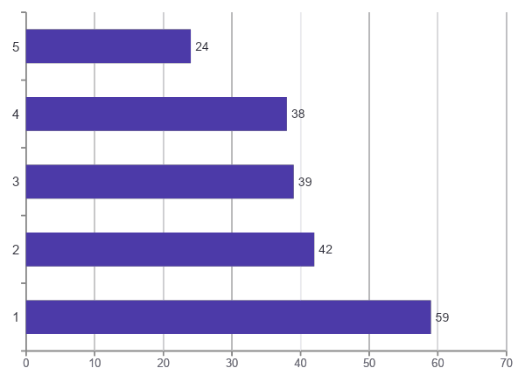
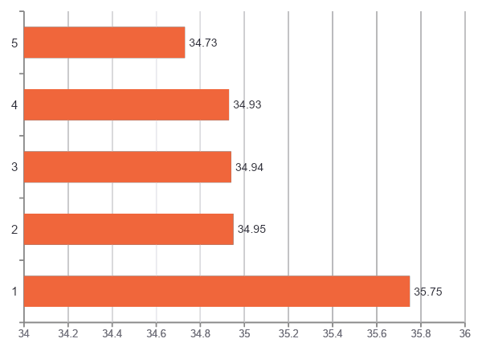
Popular Hashtags Aren't Always the Best-Performing
Usage volume and engagement quality tell two different stories
Most-Used Hashtags
Highest Average Likes per Post
Instagram User Engagement Analysis
8

Slide 9
Four Segments, Four Different Strategies
Turning these patterns into a targeting plan
Active Creators
Ghost Accounts
10 users
13 users
Offer creator perks, early feature access, or revenue-sharing on sponsored posts
Send a re-engagement nudge — they already have an audience waiting
Community Accounts
Hashtag Campaigns
77 users
Top 5 tags
Reward consistent engagement with recognition or small incentives
Prioritize ad creative around high-performing tags, not just popular ones
Instagram User Engagement Analysis
9

Slide 10
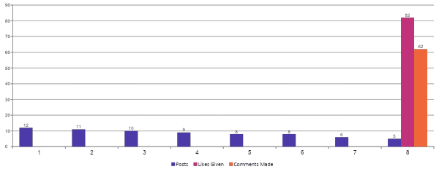
User Activity Levels Vary Widely
Posts, likes given, and comments made, per user (top 8 by post count)
The heaviest posters give almost no likes or comments back — this is the “Active Creator” pattern from earlier: post-only, engage-never.
Instagram User Engagement Analysis
10

Slide 11
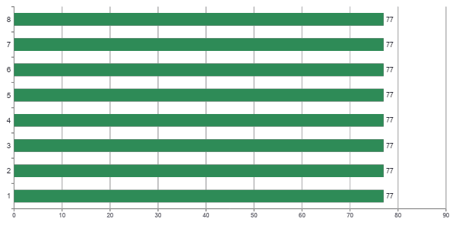
Follower Counts Barely Vary
Top 8 users by follower count (all tied at 77)
Unlike engagement, follower count doesn't discriminate between users in this dataset — which is exactly why the influencer shortlist (slide 6) is built on engagement, not followers.
Instagram User Engagement Analysis
11

Slide 12
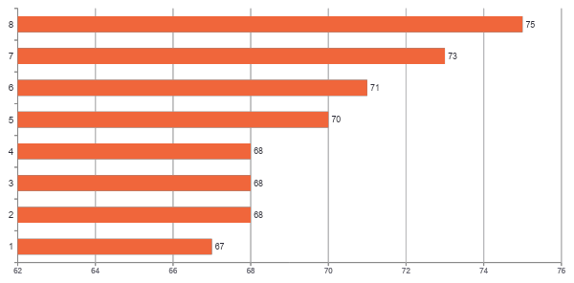
Some Rarely-Posting Users Get Outsized Engagement
Top 8 users by average engagement per post
Most of these users have posted only once — quality leaders, not volume leaders. A different reward strategy than the top-10-by-total-engagement group.
Instagram User Engagement Analysis
12

Slide 13
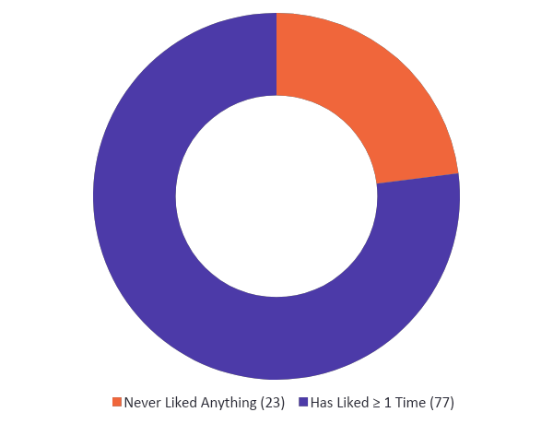
Nearly a Quarter of Users Have Never Liked a Post
Engaged vs. never-engaged split, platform-wide
These same 23 users also never comment and never follow anyone — a fully silent segment, not just partially active.
Instagram User Engagement Analysis
13

Slide 14
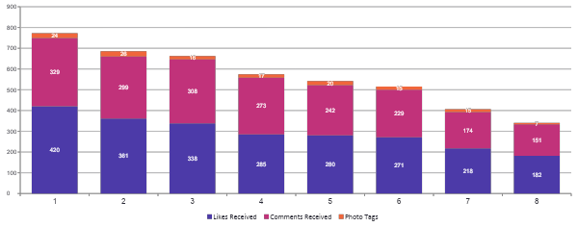
Likes, Comments & Tags Per User
Top 8 users by likes received — stacked totals
Instagram User Engagement Analysis
14

Slide 15
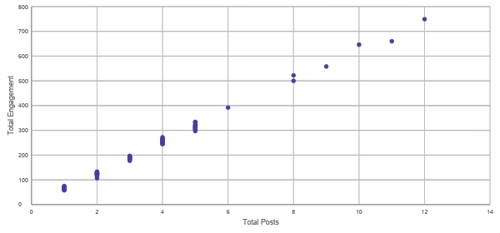
Posts vs. Total Engagement, All Users
Checking for a correlation between how much someone posts and how much engagement they get
Instagram User Engagement Analysis
15

Slide 16
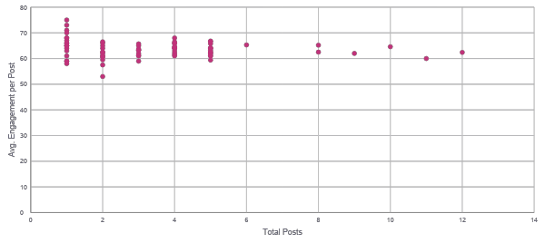
Volume vs. Quality: Two Kinds of “Loyal” Users
Total posts vs. average engagement per post, all users
The cluster at top-left (1 post, 70+ avg) are quality leaders like Meggie_Doyle; the point at far-right (12 posts, ~62 avg) is Eveline95, the volume leader.
Instagram User Engagement Analysis
16

Slide 17
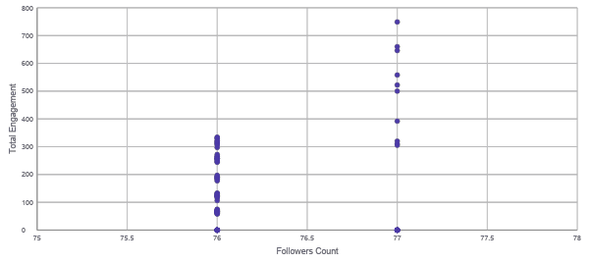
Followers vs. Engagement: Finding Real Influencers
Follower count alone barely separates users — engagement does
Nearly everyone sits at 76–77 followers regardless of engagement — the vertical spread (engagement) is the only real differentiator here.
Instagram User Engagement Analysis
17

Slide 18
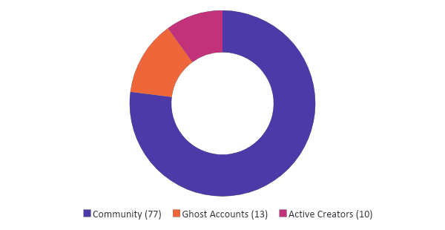
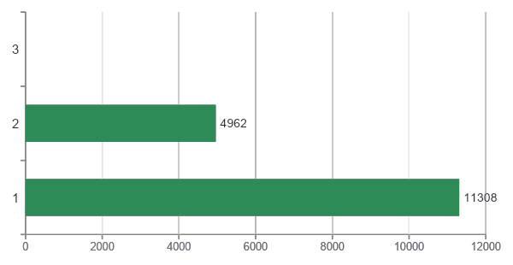
Recommended KPI Dashboard
What we'd track going forward, based on this analysis
User Base by Segment
Engagement Contributed by Segment
Growth & Reach
Engagement
Activation Risk
Content Strategy
Total users · posts · follow relationships · follower/following ratio
Total likes + comments · avg engagement/post · top-10 users' share of engagement
% users who never liked · % "ghost" accounts (followers, zero posts)
Top hashtags by usage vs. by avg likes · % posts with ≥ 1 tag
Instagram User Engagement Analysis
18

Slide 19
What We'd Need to Go Further
Being transparent about the current data's limits
No content-type field
We can't yet compare photos vs. videos vs. reels — the posts table doesn't distinguish them.
Add a media_type column going forward
No demographic data
Age, location, and gender aren't captured, so we can't segment campaigns by audience profile.
Capture demographics with proper user consent
No ad performance data
Impressions, clicks, and conversions aren't tracked, so we can't measure campaign ROI directly.
Integrate ad-platform data with engagement data
Timestamps not historical
Activity dates in this snapshot don't reflect real posting history, limiting time-based trend analysis.
Preserve real historical timestamps in production
Instagram User Engagement Analysis
19

Slide 20
Thank You
22/Aug/2026
Pooja Heera

