Slide 1
Behavioural Design Patterns:
Iterator
Sanketh B Prabhu

Slide 2
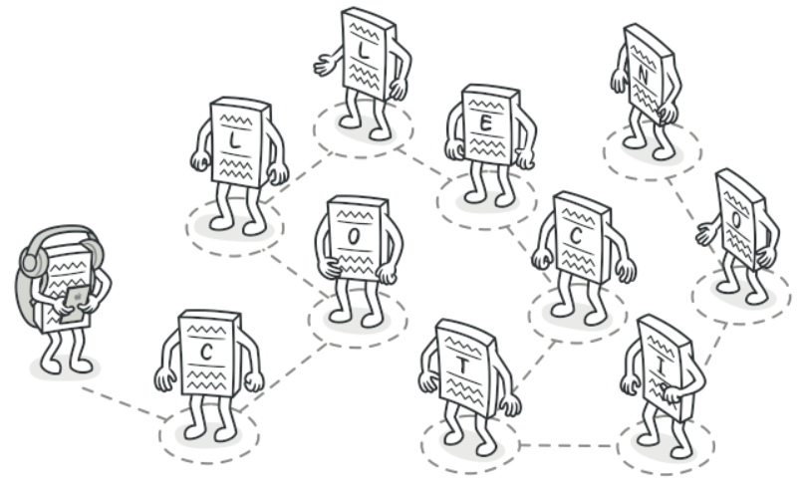
Iterator
Iterator is a behavioral design pattern that lets you traverse elements of a collection without exposing its underlying representation
Courtesy: https://refactoring.guru/design-patterns/iterator

Slide 3
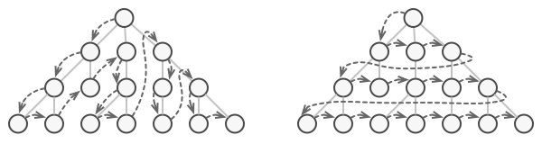
Iterator(Contd.)
Most collections store their elements in simple lists. However, some of them are based on stacks, trees, graphs and other complex data structures
Adding more traversal algorithms to the collection gradually blurs efficient data storage
Collections provide different ways of accessing their elements, hence the code has to be coupled the specific collection classes
Courtesy: https://refactoring.guru/design-patterns/iterator

Slide 4
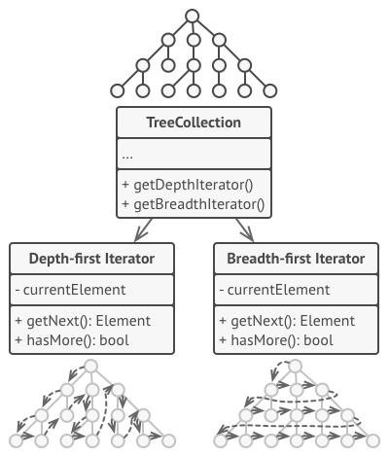
Iterator(Contd.)
Iterator pattern extracts the traversal behavior of a collection into a separate object called an iterator
Iterators implement various traversal algorithms
Several iterator objects can traverse the same collection at the same time
Iterator object encapsulates all of the traversal details, such as the current position and how many elements are left till the end.
Courtesy: https://refactoring.guru/design-patterns/iterator

Slide 5
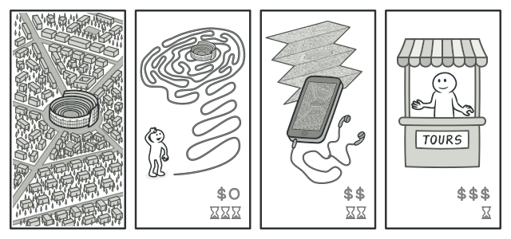
Iterator Real-World Analogy
Courtesy: https://refactoring.guru/design-patterns/iterator

Slide 6
Iterator Applicability
When the collection has a complex data structure under the hood, but its complexity has to be hidden from clients
To reduce duplication of the traversal code across the app
When the code should traverse different data structures or when types of these structures are unknown beforehand
Courtesy: https://refactoring.guru/design-patterns/iterator

Slide 7
Iterator Advantages and Disadvantages
Advantages | Disadvantages
Single Responsibility Principle | Applying the pattern can be an overkill if the app only works with simple collections
Open/Closed Principle | Using an iterator may be less efficient than going through elements of some specialized collections directly
Iteration over the same collection in parallel can be donel because each iterator object contains its own iteration state
An iteration can be delayed and continued when needed
Courtesy: https://refactoring.guru/design-patterns/iterator

Slide 8
References
[1] https://refactoring.guru/design-patterns
[2] https://sourcemaking.com/design_patterns
[3] https://www.geeksforgeeks.org/

Slide 9
Thank You.

