Slide 1
Behavioural Design Patterns:
Mediator
Sanketh B Prabhu

Slide 2
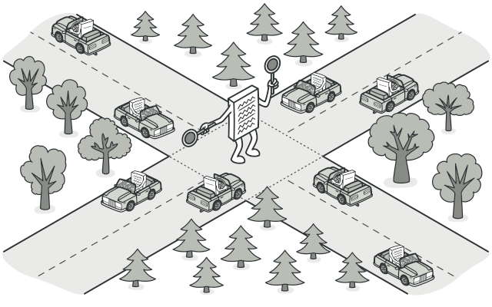
Mediator
Mediator reduces chaotic dependencies between objects. The pattern restricts direct communications between the objects and forces them to collaborate only via a mediator object.
Courtesy: https://refactoring.guru/design-patterns/mediator

Slide 3
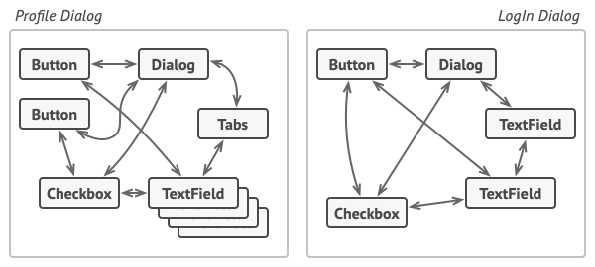
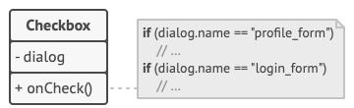
Mediator(Contd.)
Relations between elements of the user interface can become chaotic as the application evolves
Elements can have lots of relations with other elements. Hence, changes to some elements may affect the others
Courtesy: https://refactoring.guru/design-patterns/mediator

Slide 4
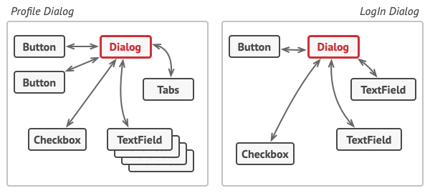
Mediator(Contd.)
All direct communication between the components which is to be made independent of each other must be ceased. Instead, these components must collaborate indirectly, by calling a special mediator object that redirects the calls to appropriate components
The elements should communicate indirectly, via the mediator object
Mediator pattern encapsulates a complex web of relations between various objects inside a single mediator object
Courtesy: https://refactoring.guru/design-patterns/mediator

Slide 5
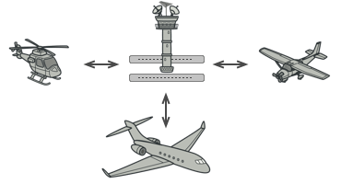
Mediator Real-World Analogy
Courtesy: https://refactoring.guru/design-patterns/mediator

Slide 6
Mediator Applicability
When it’s hard to change some of the classes because they are tightly coupled to a bunch of other classes
When one can’t reuse a component in a different program because it’s too dependent on other components
When tons of component subclasses are to be created just to reuse some basic behavior in various contexts
Courtesy: https://refactoring.guru/design-patterns/mediator

Slide 7
Mediator Advantages and Disadvantages
Advantages | Disadvantages
Single Responsibility Principle | Over time a mediator can evolve into a God Object
Open/Closed Principle
Reduction of coupling between various components of a program
Easy reusability of individual components
Courtesy: https://refactoring.guru/design-patterns/mediator

Slide 8
References
[1] https://refactoring.guru/design-patterns
[2] https://sourcemaking.com/design_patterns
[3] https://www.geeksforgeeks.org/

Slide 9
Thank You.

