Slide 1

IT Trends
Heer Joshi
July 1, 2024

Slide 2

OUTLINE
Executive Summary
Introduction
Methodology
Results
Visualizations - Charts
Dashboard
Discussion
Findings & Implications
Conclusion
Appendix

Slide 3

EXECUTIVE SUMMARY
Current Technology Usage Trend
Language
Database
Platform
Web Frame
Desired Technology Usage Trend
Language
Database
Platform
Web Frame
Demographics Survey
Country & Gender Difference

Slide 4

INTRODUCTION
Analyze Current Trends in Technology
Purpose of this Analysis
Identify top skills in programming languages, databases, platforms, and web frames
Identify future skills requirements
Identify human resource gap in the industry
Audience for this presentation
Programmers
IT Industry Leader
Computer Science Students

Slide 5

METHODOLOGY
Data Wrangling
GitHub job postings API using Python
Programming Languages annual salary
Stack Overflow Developer 2019 survey
Data Cleaning, Data Exploration
Excel
Python
Data Visualization
IBM Cognos
Tableau
Presentation

Slide 6
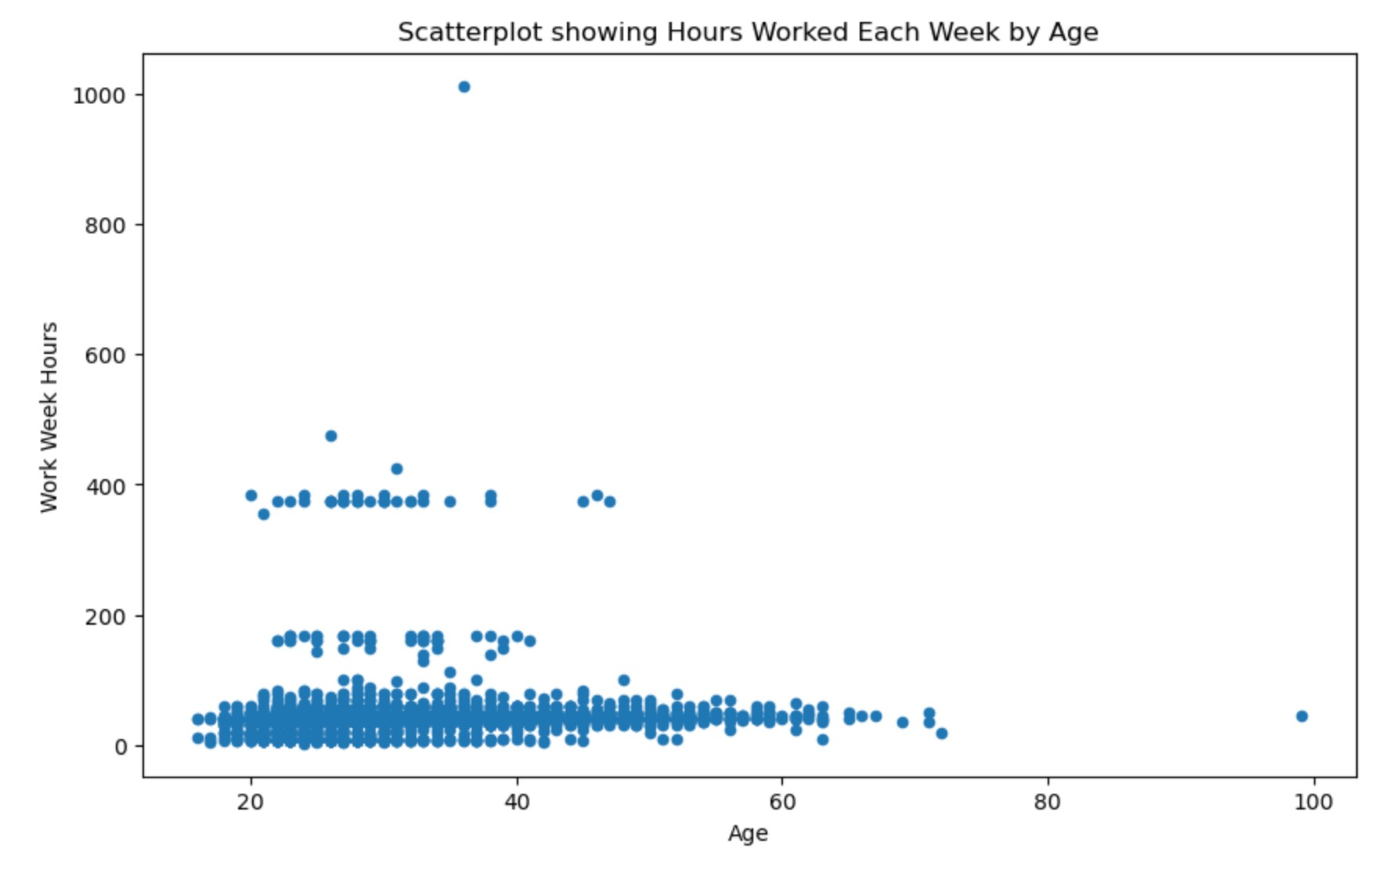
RESULTS

Slide 7
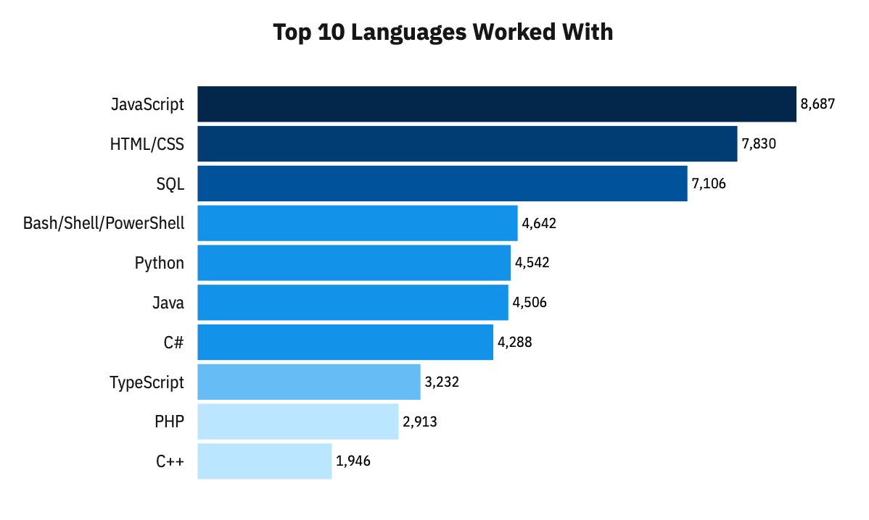
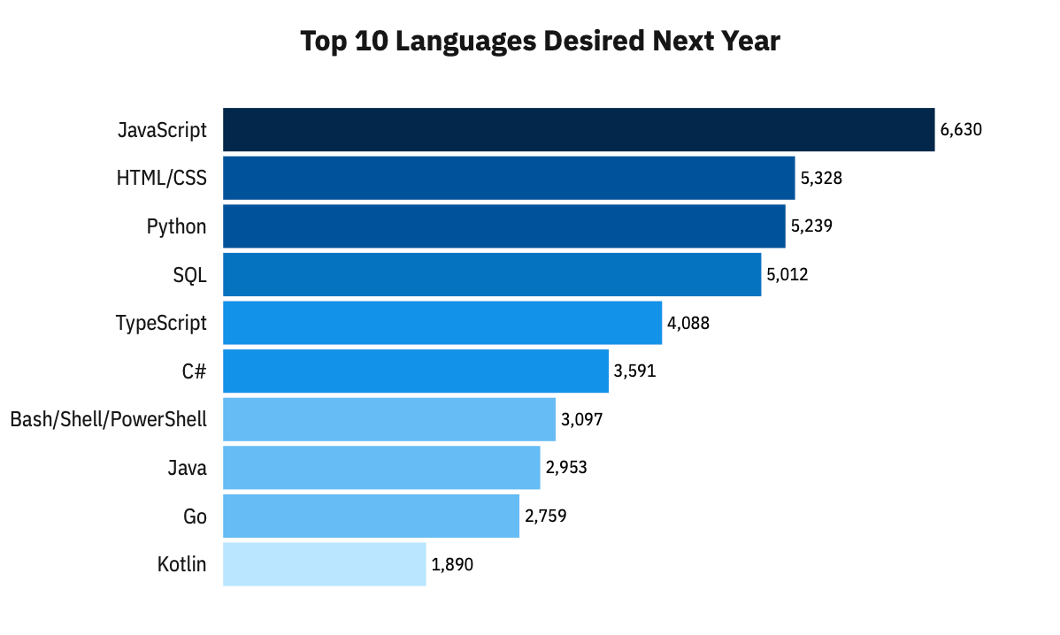
PROGRAMMING LANGUAGE TRENDS

Slide 8
FINDINGS & IMPLICATIONS
Findings Implications
JavaScript is currently the most used programming language throughout the world
Python and TypeScript are becoming more popular
HTML, CSS and SQL are still among the top programming languages
Web Development and Developers are still in high demand
JavaScript, HTML, and TypeScript are essential to learn for web developers
Python is highly desired, as it’s the primary language used for AI development and ML

Slide 9
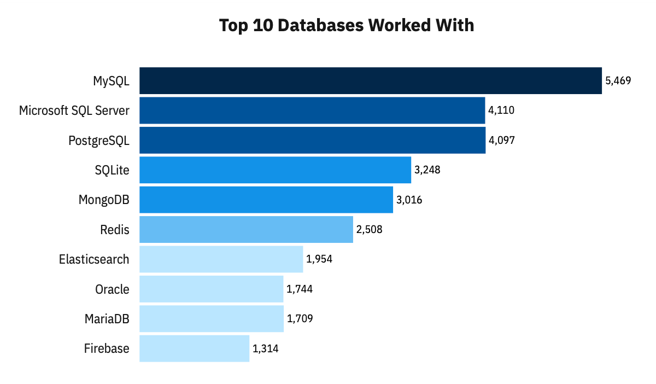
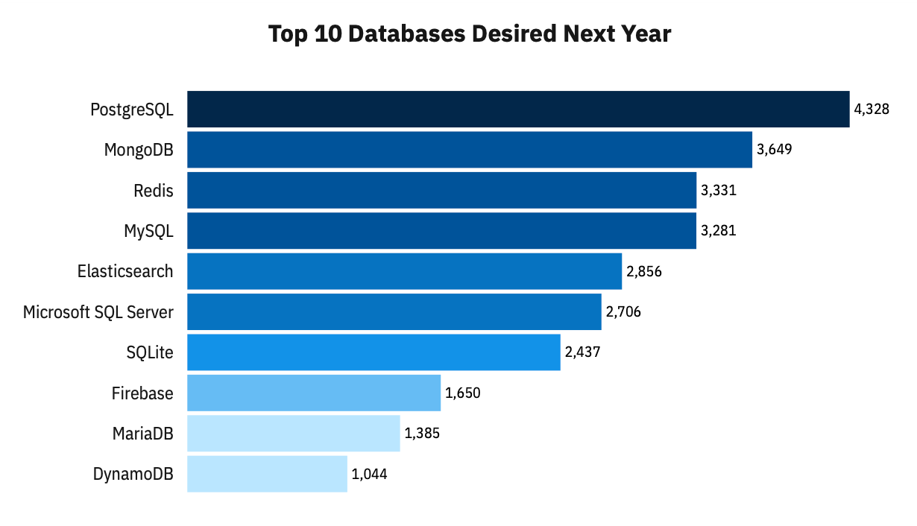
DATABASE TRENDS

Slide 10
FINDINGS & IMPLICATIONS
Findings Implications
MySQL is currently the most used database used in the world
Microsoft SQL Server is still used by a lot of companies
MongoDB and Redis are the most popular NoSQL Databases
Open-source databases such as MySQL are still preferred
Software development and Big Data technology still use SQL
NoSQL databases will have a significant impact on the future of relational databases

Slide 11

DASHBOARD
Link to read-only version of IBM Cognos dashboard
https://github.com/heerjoshi/IBM_CognosAnalytics_CapstoneProject

Slide 12
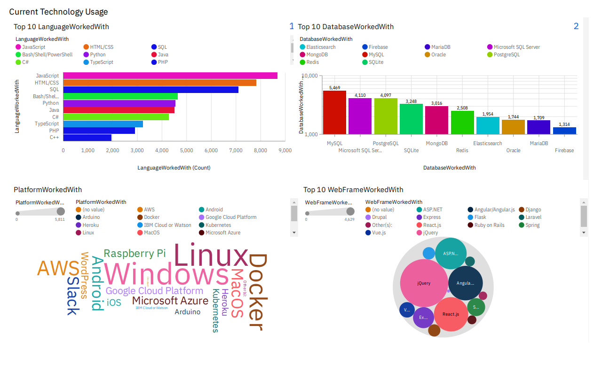
Current Technology Usage

Slide 13
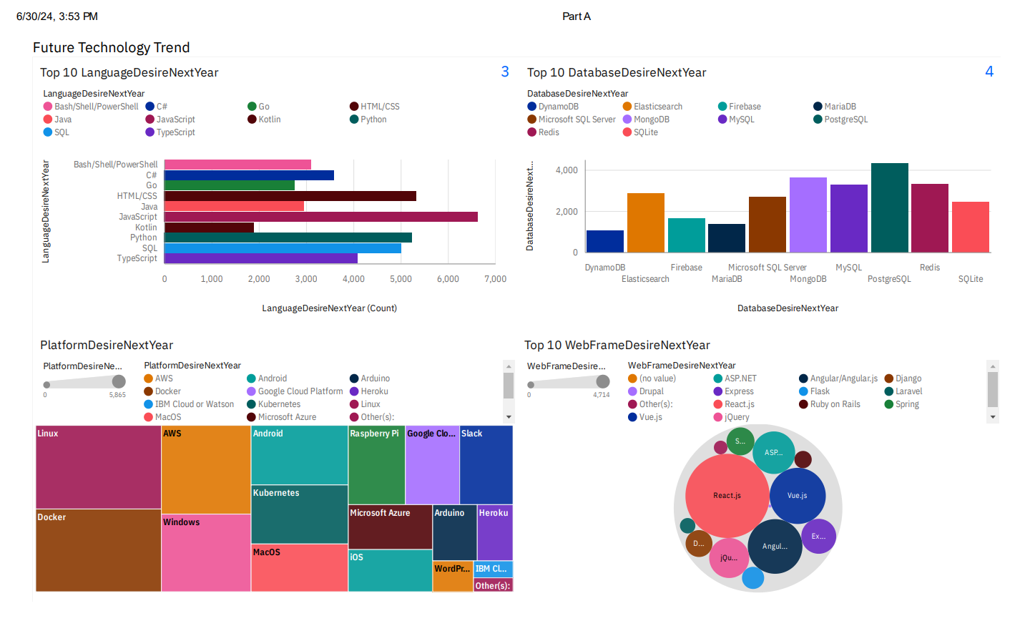
Future Technology Trends

Slide 14
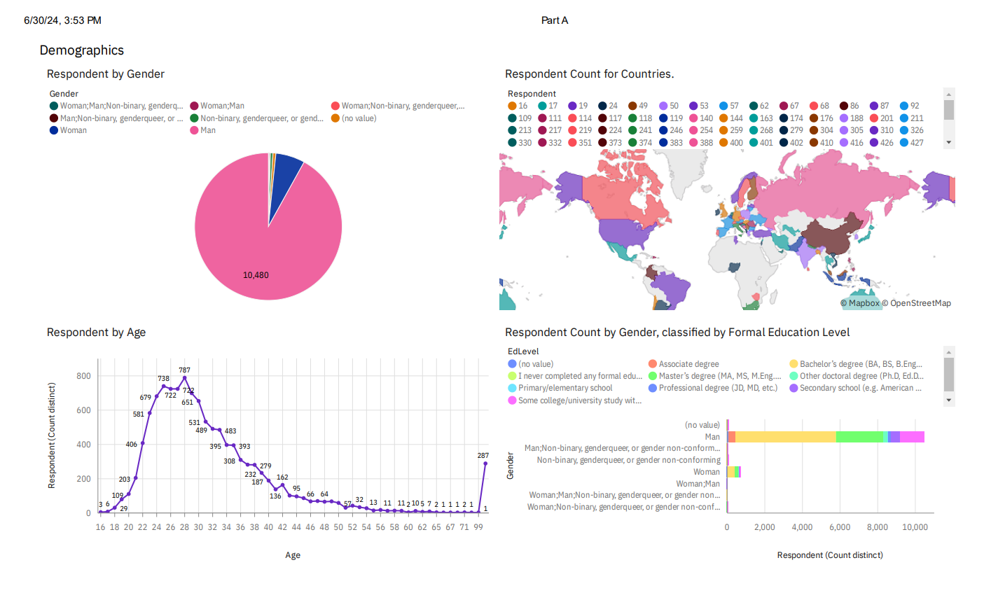
Demographics

Slide 15
DISCUSSION
Technology Usage
Current Trends
Future Trends
Discrimination in the IT Industry
Gender
Age
Education

Slide 16
OVERALL FINDINGS & IMPLICATIONS
Findings Implications
IT usage trends change every year
Most of the top technology in the world located in the USA
There is extreme Gender and Age discrimination in the IT industry
Only 6.5% Developers are Female
Programmers should always follow the latest technology trends
More countries should have access and exposure to new technology
Gender and Age should never be an issue when it comes to the use of technology

Slide 17

CONCLUSION
JavaScript is still the most used of all programming languages
The findings underscore the dynamic nature of programming and the critical role of technology in driving innovation across various industries
Database systems are essential to meet the demands of modern applications
Understanding of programming has become diverse

Slide 18

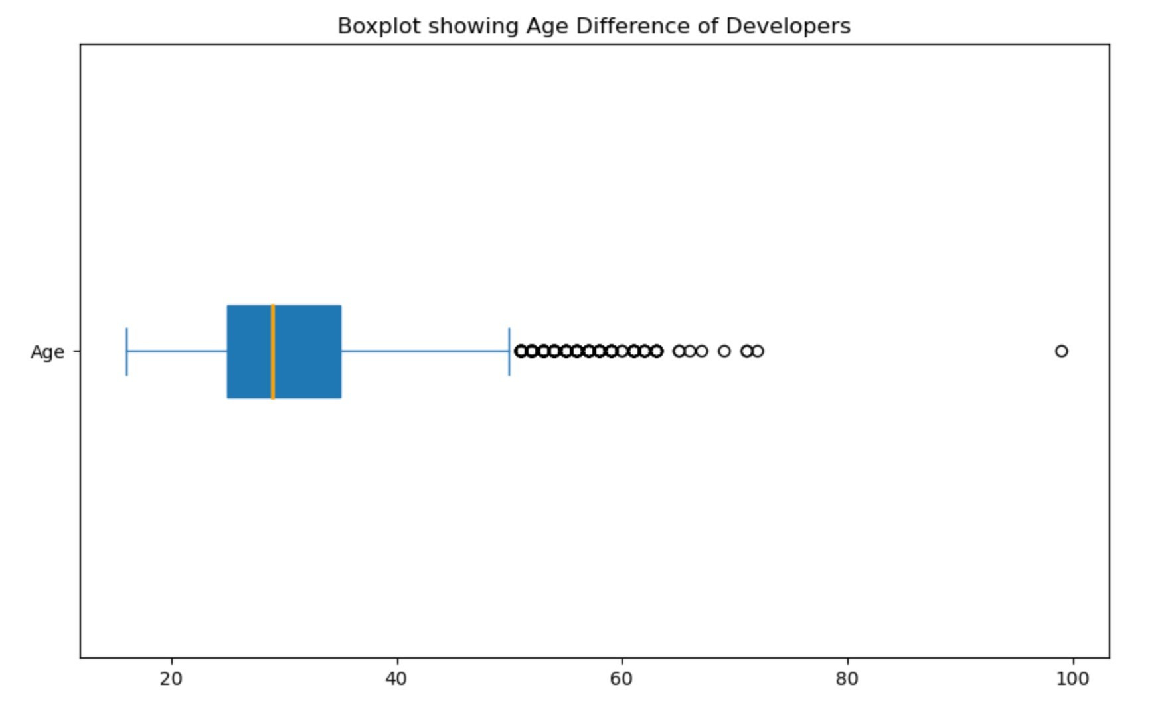
APPENDIX

Slide 19
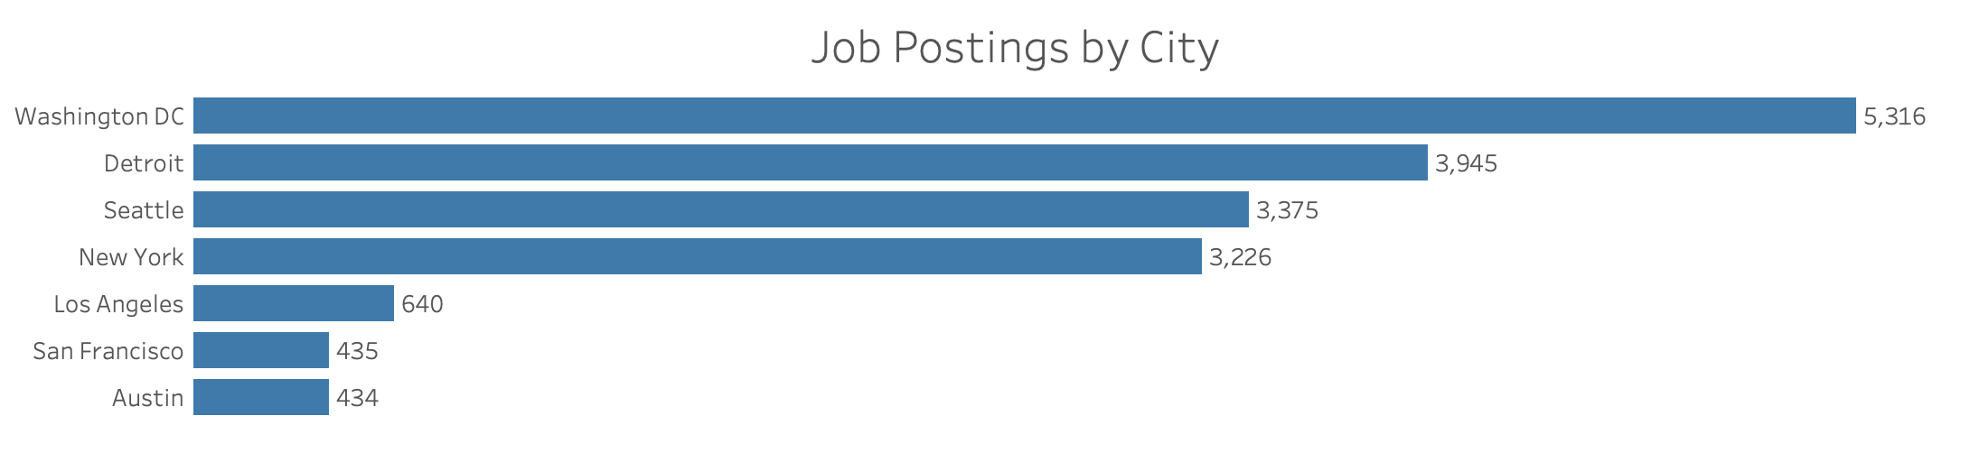
JOB POSTINGS: City

Slide 20
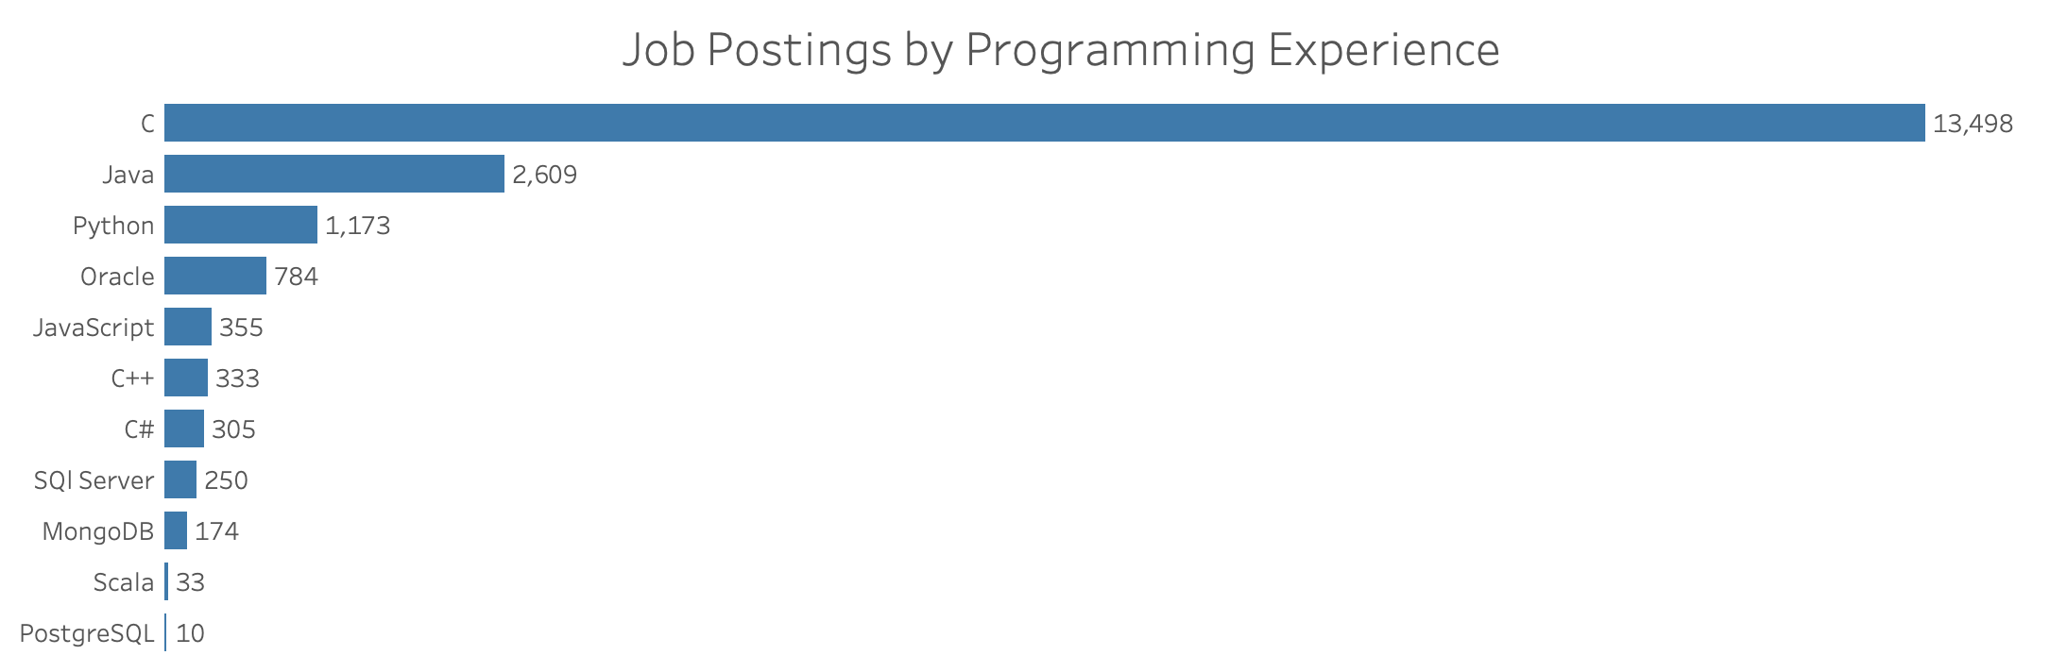
JOB POSTINGS: Experience

Slide 21
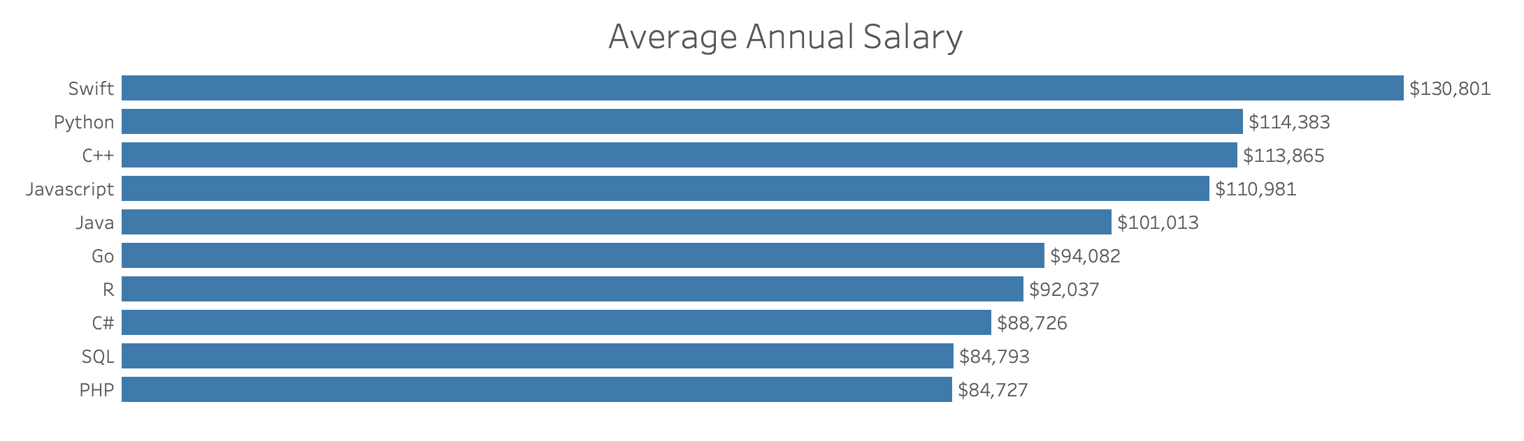
POPULAR LANGUAGES

Slide 22
Age vs Hours Worked Each Week

