Slide 1

Python Project
on
Impact of Election Results on Stock Market
By Heer Joshi (23060242034)
Shubham Prakash (23060242102)
Semester - III
Symbiosis School of Economics
Senapati Bapat Rd, Pune, Maharashtra, India - 411004

Slide 2
INTRODUCTION
India's elections are a key display of democracy that significantly affect the nation's economic environment. The stock market is one of the first places to reflect these changes, making it an intriguing area of study for political analysts, economists, and investors.
The stock market reacts immediately to election outcomes. A stable, pro-business government can boost investor confidence, leading to a surge in stock prices, while uncertainty from a hung parliament or unclear policies can cause market fluctuations and nervousness.
The market is driven not only by the fundamentals of election outcomes but also by investor expectations leading up to the results. Sentiment plays a critical role, causing stock price fluctuations as traders speculate on potential future events and policies.

Slide 3
Literature Review
We reviewed four key papers focusing on the impact of political events, particularly elections, on stock market behavior. These studies provided valuable insights into the use of event study methodology and the broader implications of political outcomes on investor sentiment and market performance.
Previous studies, such as Deva et al. (2015) and Prakash & Padmasree (2020), established the event study methodology as a reliable approach for assessing the effect of elections on stock prices, particularly through the analysis of Abnormal Returns (AR) and Cumulative Abnormal Returns (CAR).
Research highlights the significant role elections play in shaping investor sentiment. Political outcomes often lead to sharp fluctuations in stock prices, with sectors such as infrastructure, finance, and energy showing varying degrees of sensitivity to pro-business or regulatory policies.
Studies emphasized how investor sentiment, influenced by exit polls and political forecasts, can drive short-term market reactions. This is particularly evident in the sharp changes in AR seen around election dates, as documented in prior research.
In addition to political events, the literature also explored the role of global economic conditions and sector-specific challenges that interact with political changes to shape market behavior. These factors are crucial for understanding why some sectors react more strongly than others during elections.

Slide 4
OBJECTIVES OF THE STUDY
The primary goal is to assess the impact of the Indian general elections on the stock prices of certain firms. The study will concentrate on two major election events: the general elections occurred in May 2014 and May 2019.
The event study approach will be used to assess the stock market's reaction to the election results, with the goal of discovering any substantial anomalous returns around the event dates.
By incorporating firms from diverse industries such as IT, pharmaceuticals, banking, power, and steel, the research attempts to evaluate the stock market's response to the election outcomes across different sectors of India.
The research will use statistical tests, such as the t-test, to establish the significance of the abnormal returns recorded within the event window, resulting in a more thorough understanding of the market's reaction.

Slide 5
DATA SOURCE
1. Selection of Stocks and Benchmark Index:
The study focuses on a sample of ten prominent companies listed on the National Stock Exchange (NSE) of India. The selected companies are:
Wipro Ltd (WIPRO.NS)
Tata Steel Ltd (TATASTEEL.NS)
Tata Motors Ltd (TATAMOTORS.NS)
Tata Motors DVR Ordinary (TATAMTRDVR.NS)
Tata Consultancy Services Ltd (TCS.NS)
Sun Pharmaceutical Industries Ltd (SUNPHARMA.NS)
State Bank of India (SBIN.NS)
Power Grid Corporation of India Ltd (POWERGRID.NS)
Oil and Natural Gas Corporation Ltd (ONGC.NS)
NTPC Ltd (NTPC.NS)

Slide 6

The Nifty 50 index (^NSEI) is used as the benchmark index to represent the overall market performance.
2. Event Dates:
Two significant political events, the Indian general elections held on May 16, 2014, and May 23, 2019, are chosen as event dates for this study.
3. Data Source:
Daily adjusted closing prices of the selected stocks and the Nifty 50 index are obtained from Yahoo Finance for the period from January 1, 2013, to December 31, 2020. This data range allows for a comprehensive estimation and event window.
Return Calculation:
Daily stock returns and Nifty 50 index returns are calculated using the formula:

Slide 7

RESEARCH METHODOLOGY
The event research approach is used to determine the influence of election outcomes on the stock prices of specific firms. An event window of 21 days is employed, which includes 10 days prior to the event, the event day, and 10 days following the event. In addition, the market model is estimated 100 days before the event window.
Maket Model Estimation:
The market model is estimated using the Ordinary Least Squares (OLS) regression technique. The intercept (alpha) and slope (beta) coefficients are obtained by regressing stock returns on market returns. The following proposed model is used:
Where:
Rit = Return of stock i at time t
Rmt = Return of the market index (Nifty 50) at time t
αi​ = Intercept term
βi= Slope coefficient (measures stock's sensitivity to market)
ϵit = Error term

Slide 8

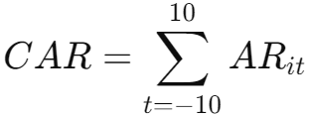
Abnormal Returns:
Abnormal returns (AR) are computed as the difference between actual stock returns and the projected returns forecasted by the market model during the event window:
Cumulative Abnormal Returns (CAR) are calculated by summing up the abnormal returns over the event window:
The mean anomalous returns during the event window are tested using a t-test to see if they deviate substantially from zero. To ascertain the statistical significance of the findings, the t-statistic and p-value are computed.

Slide 9
DATA ANALYSIS AND INTERPRETATION
The study employs an event study methodology to assess the impact of the Indian General Elections in 2014 and 2019 on the stock prices of prominent companies, focusing on the significance and magnitude of changes in stock returns.
By analyzing AR and CAR, the study isolates the impact of political events from normal market fluctuations, providing insights into short-term investor reactions and long-term sentiment shifts.
Elections significantly influence stock prices as they shape government policies that affect various sectors. A pro-business government can enhance investor confidence, while political uncertainty may lead to increased market volatility.
The Nifty 50 index serves as a benchmark for assessing individual stock performance against broader market trends, allowing for a clearer understanding of the abnormal returns caused specifically by the election events.

Slide 10
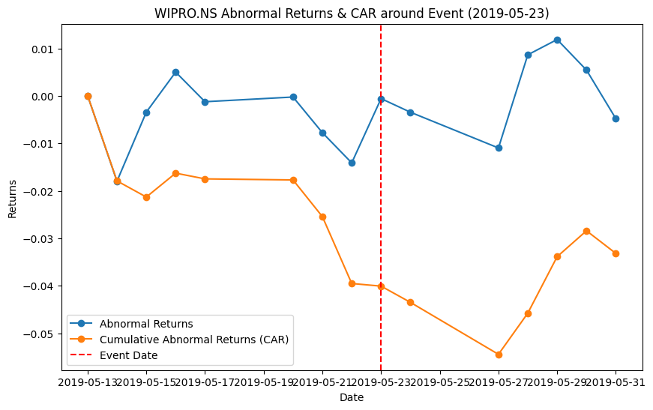
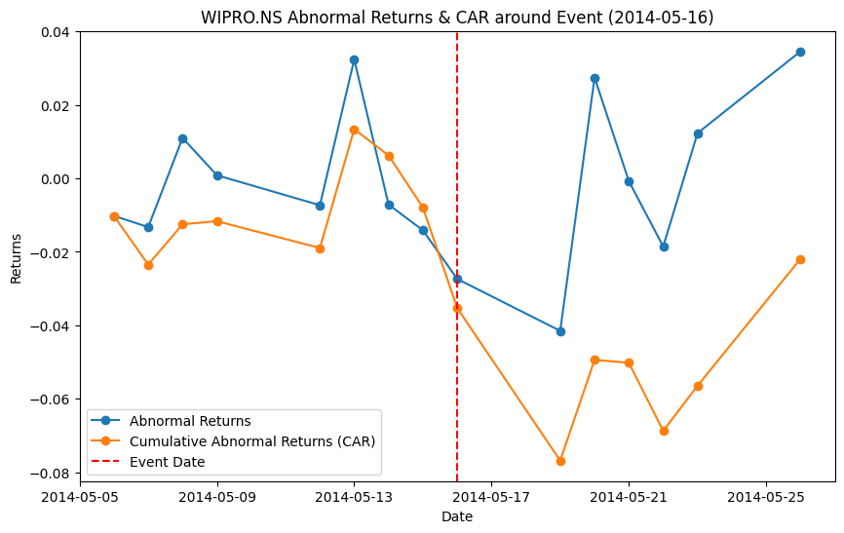
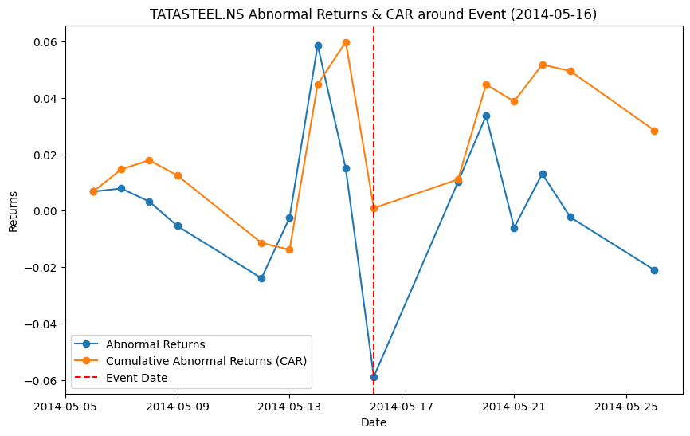
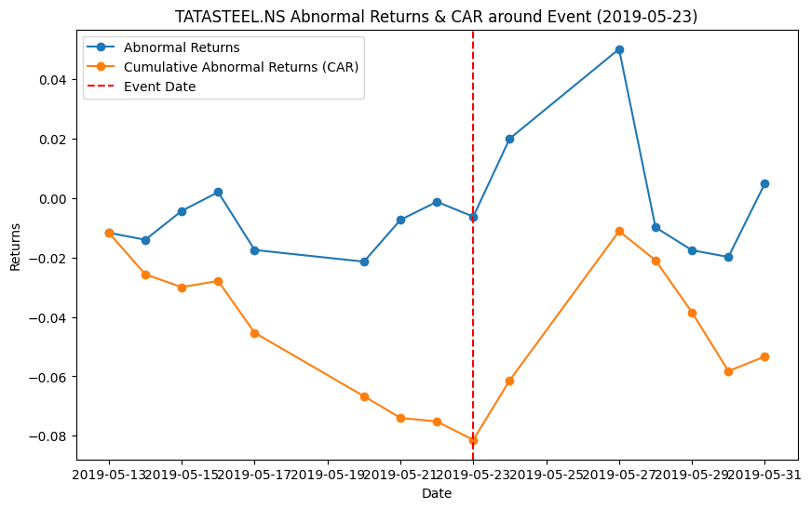
Abnormal Returns and CAR of Wipro & Tata Steel in FY 2014,2019

Slide 11
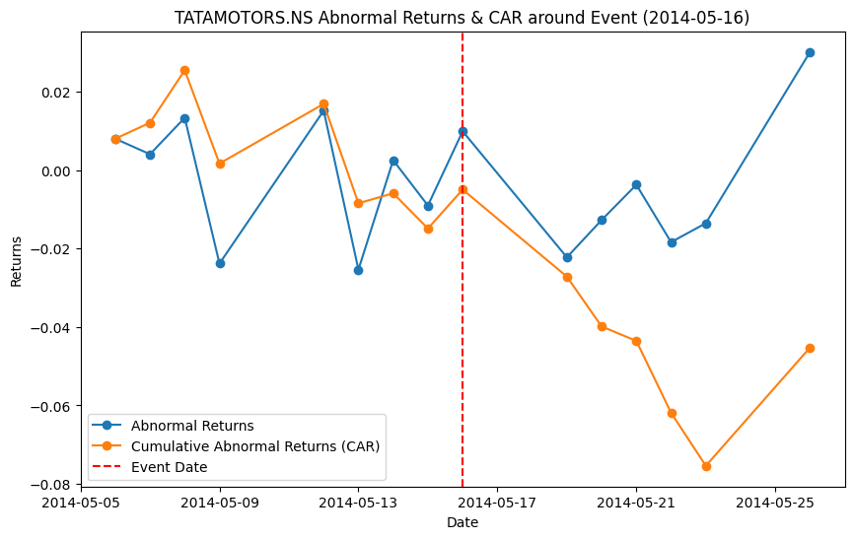
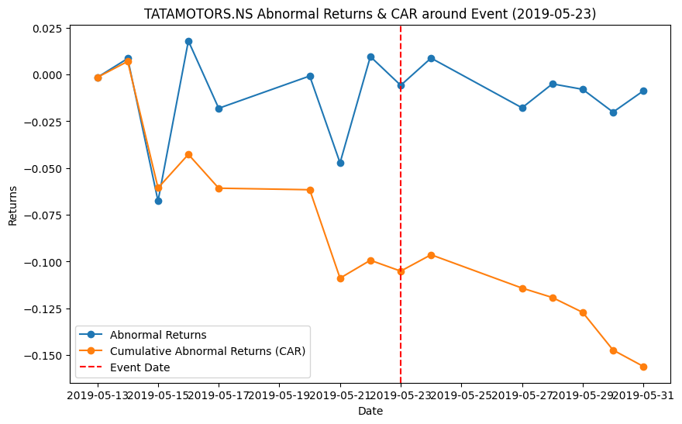
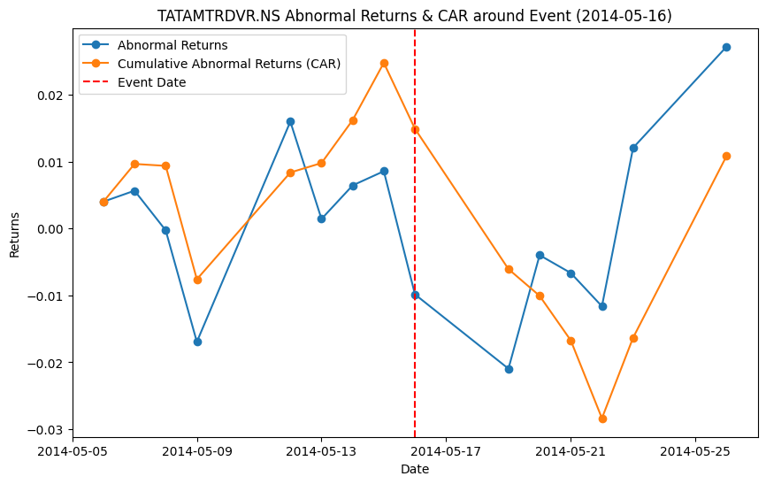
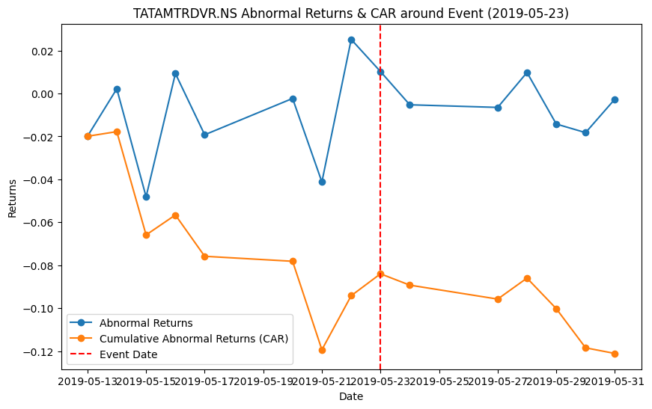
Abnormal Returns and CAR of Tata Motors & Tata Motors DVR in FY 2014,2019

Slide 12
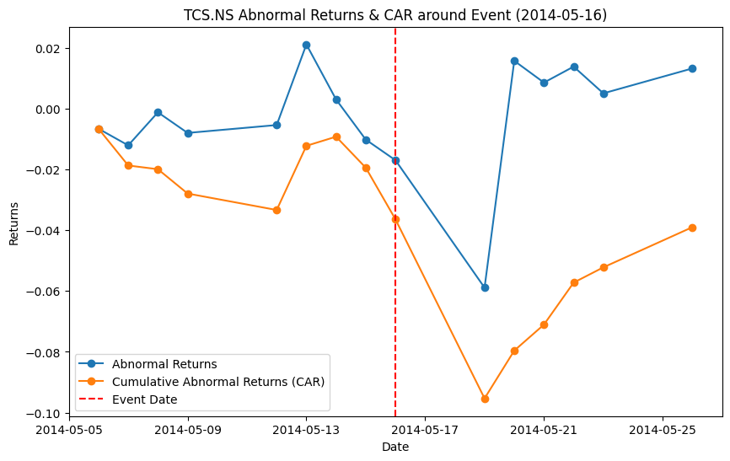
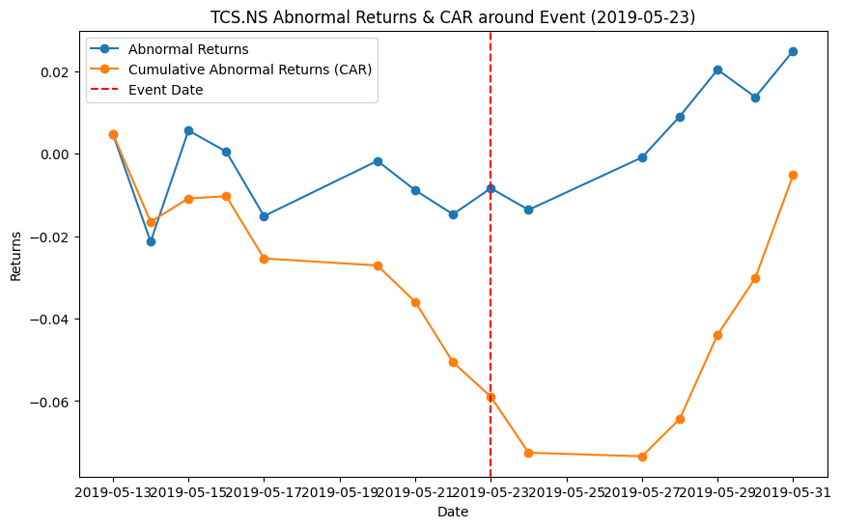
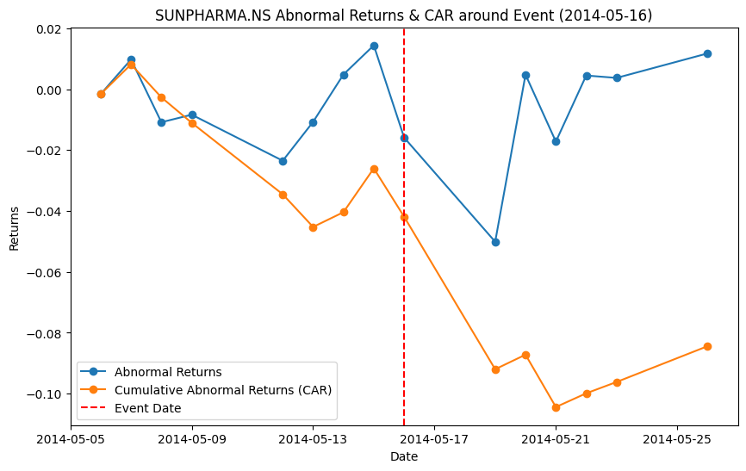
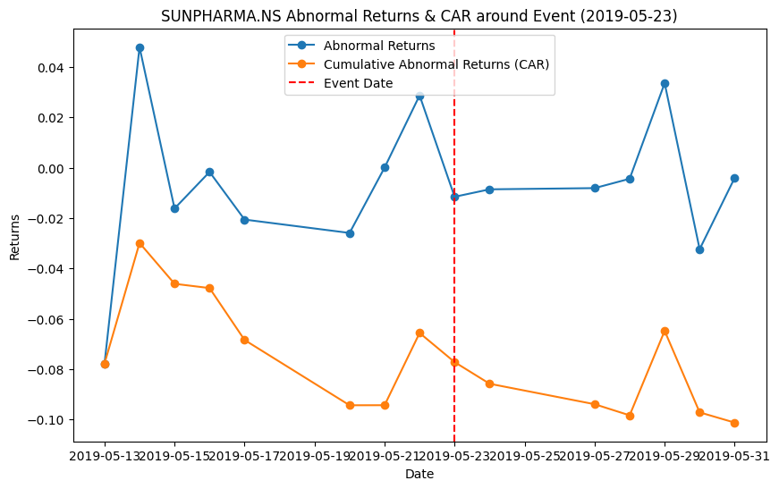
Abnormal Returns and CAR of TCS & Sun Pharma in FY 2014,2019
9

Slide 13
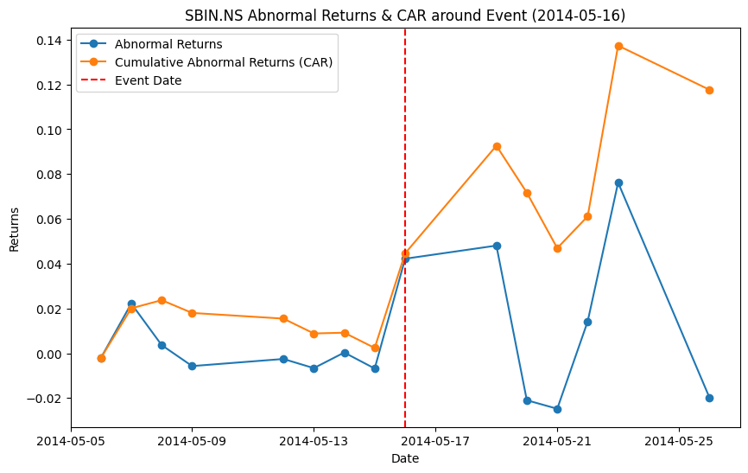
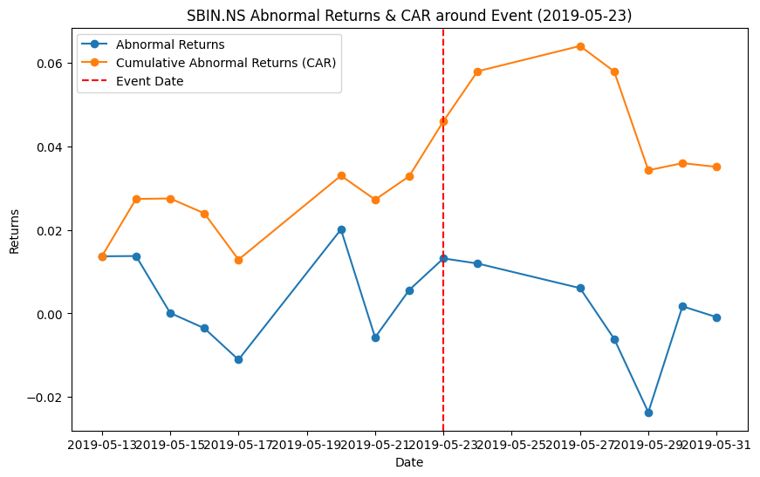
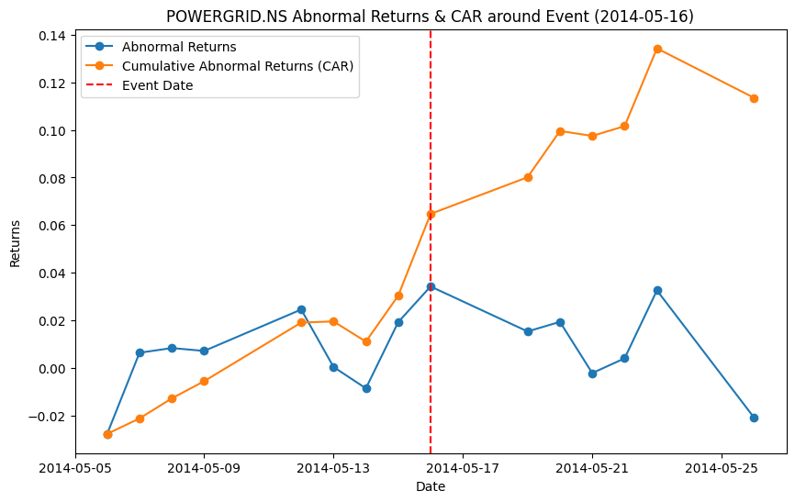
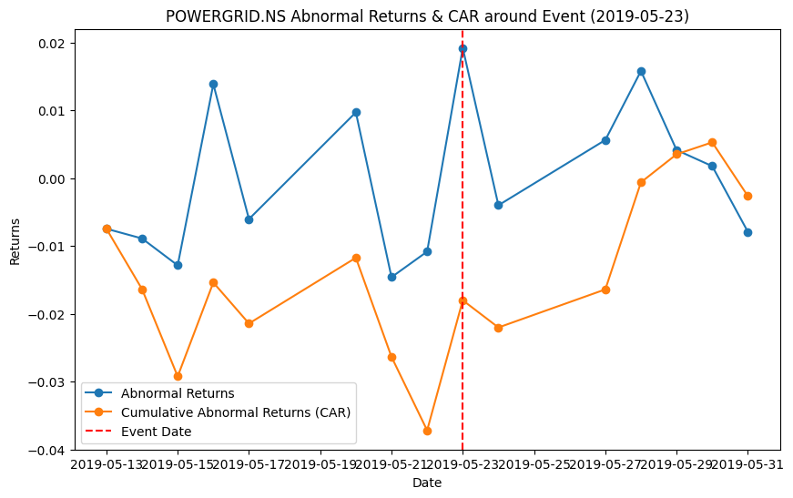
Abnormal Returns and CAR of SBIN & Powergrid in FY 2014,2019

Slide 14
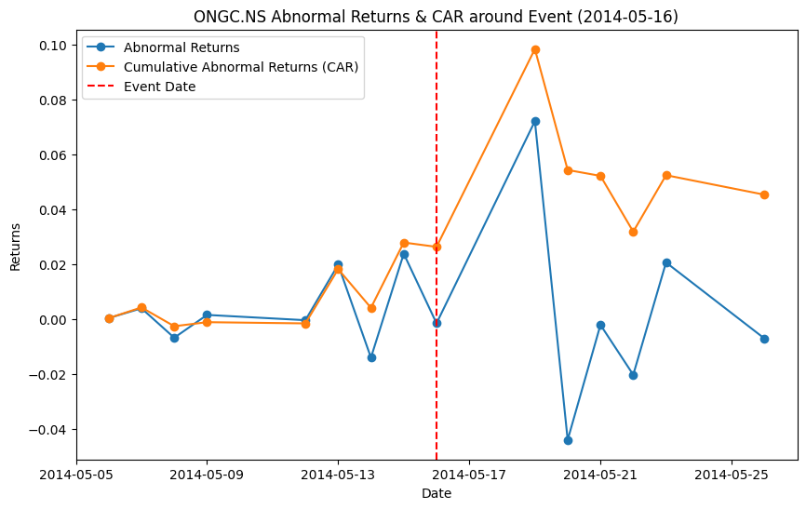
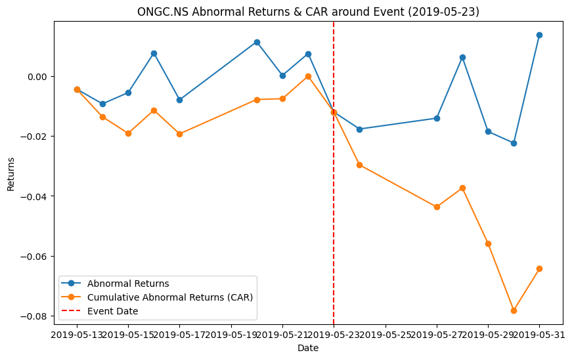
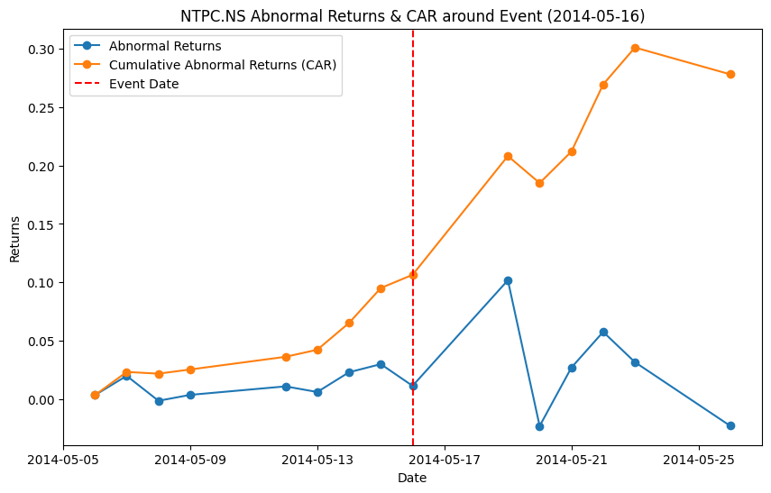
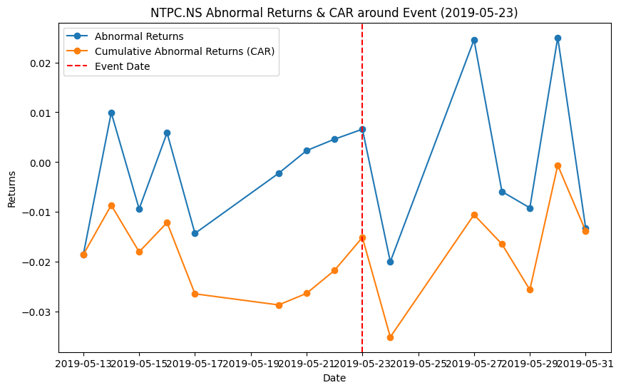
Abnormal Returns and CAR of ONGC & NTPC in FY 2014,2019

Slide 15
Company | 2014 T-statistic (P-value) | 2019 T-statistic (P-value)
WIPRO.RS | -0.26(0.80) | -1.04(0.32)
TATASTEEL.RS | 0.28(0.78) | -0.75(0.47)
TATAMOTORS.NS | -0.70(0.49) | -1.8(0.09)
TATAMTRDVR.NS | 0.22(0.83) | -1.6(0.13)
TCS.NS | -0.52(0.61) | -0.10(0.92)
SUNPHARMA.NS | -1.30(0.22) | -0.88(0.39)
SBIN.NS | 1.07(0.30) | 0.79(0.44)
POWERGRID.NS | 1.65(0.12) | -0.06(0.95)
ONGC.NS | 0.46(0.65) | -1.43(0.18)
NTPC.NS | 2.32(0.03) | -0.25(0.80)

Slide 16
CONCLUSION
The findings of this study emphasize that political events, such as elections, are significant drivers of market behavior, influencing both short-term and long-term investor decisions across different sectors.
The report highlights how different sectors reacted variably to the election outcomes, suggesting that investors should consider sector-specific dynamics when evaluating the impact of political changes on stock performance.
The analysis illustrates the critical role of investor sentiment and market confidence in shaping stock prices, particularly how expectations can lead to sharp movements in AR and CAR around election events.
Investors are encouraged to remain proactive and consider political forecasts and election outcomes in their investment strategies, as these factors can create both opportunities for profit and risks of volatility.
The report concludes with a recommendation for future research to delve deeper into the relationship between political events and market reactions, potentially incorporating qualitative factors such as investor sentiment analysis and international influences on local markets.

Slide 17
THANK YOU

