Slide 1
Sensor Networks Lab
Glenn Daneels, Carmen Delgado, Jeroen Famaey
Notes:
1

Slide 2
Previous assignment

Slide 3
What was your first assignment?
Obligatory reads:
Vilajosana, Xavier, et al. "IETF 6TiSCH: A Tutorial." IEEE Communications Surveys & Tutorials (2019).
Duquennoy, Simon, et al. ”TSCH and 6TiSCH for Contiki: Challenges, design and evaluation." 2017 13th International Conference on Distributed Computing in Sensor Systems (DCOSS). IEEE, 2017.
Papers are available on Blackboard
→ You want to learn more? See http://scholar.google.be and look for keywords such TSCH, 6TiSCH, RPL, Contiki, 6top, etc.

Slide 4
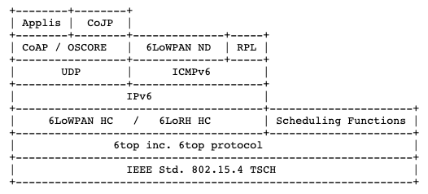
6TiSCH
Source: https://tools.ietf.org/html/draft-ietf-6tisch-architecture-26

Slide 5
TSCH

Slide 6
What was your first assignment?
Get to know the firmware:
https://github.com/contiki-ng
Obligatory: Set up Contiki-NG on your system:
https://github.com/contiki-ng/contiki-ng/wiki#setting-up-contiki-ng
Get to know the hardware:
https://github.com/contiki-ng/contiki-ng/wiki/Platform-zoul
Obligatory: Get the “Hello, World!” Example running
https://github.com/contiki-ng/contiki-ng/wiki/Tutorial:-Hello,-World!
Make sure that you get it running as a native node at the very least
Also try to run it on the Zolertia nodes
Not a problem if it doesn’t work yet

Slide 7
What was your first assignment?
Get to know the firmware:
https://github.com/contiki-ng
Obligatory: Set up Contiki-NG on your system:
https://github.com/contiki-ng/contiki-ng/wiki#setting-up-contiki-ng
Get to know the hardware:
https://github.com/contiki-ng/contiki-ng/wiki/Platform-zoul
Obligatory: Get the “Hello, World!” Example running
https://github.com/contiki-ng/contiki-ng/wiki/Tutorial:-Hello,-World!
Make sure that you get it running as a native node at the very least
Also try to run it on the Zolertia nodes
Not a problem if it doesn’t work yet
→ Problems with a component of the toolchain? Try the Docker image!

Slide 8
New assignment (see Blackboard)

Slide 9
Metrics

Slide 10
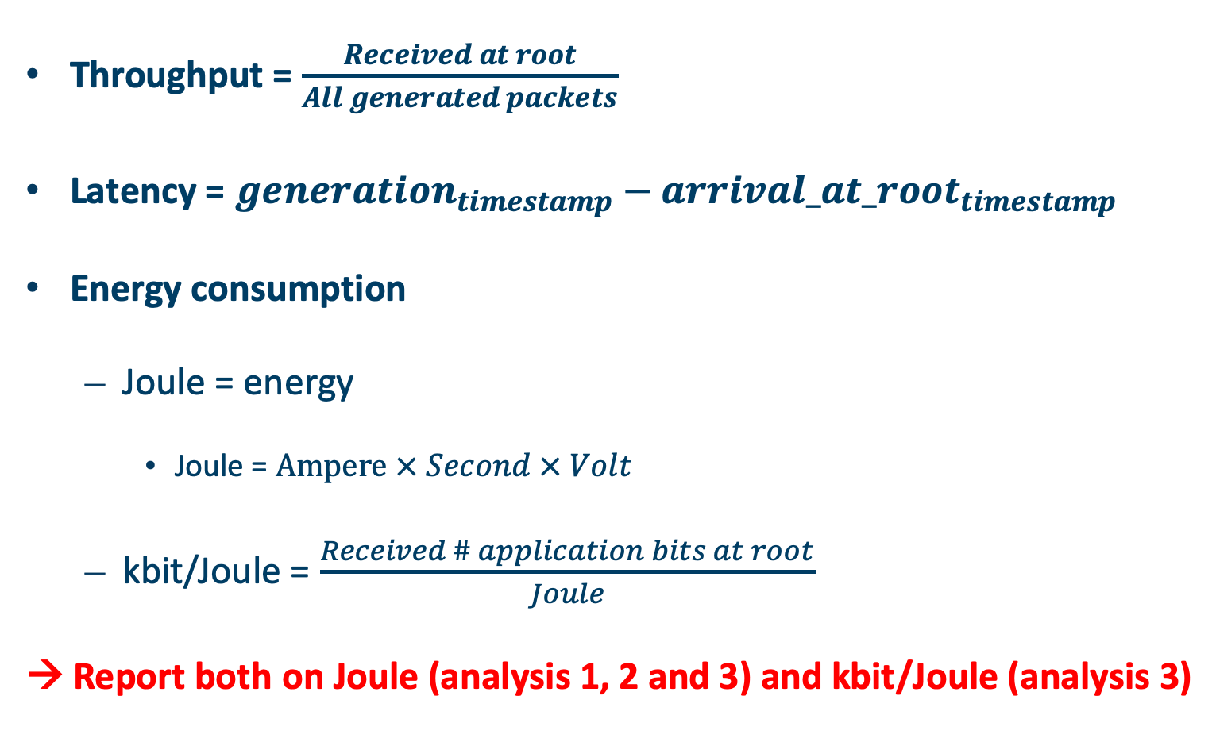
Metrics
Throughput = $\frac{Received at root}{All generated packets}$
Latency = ${generation}_{timestamp}−{arrival_at_root}_{timestamp}$
Energy consumption
Joule = energy
Joule = $Ampere × Second × Volt$
kbit/Joule = $\frac{Received \# application bits at root}{Joule}$
→ Report both on Joule (analysis 1, 2 and 3) and kbit/Joule (analysis 3)

Slide 11
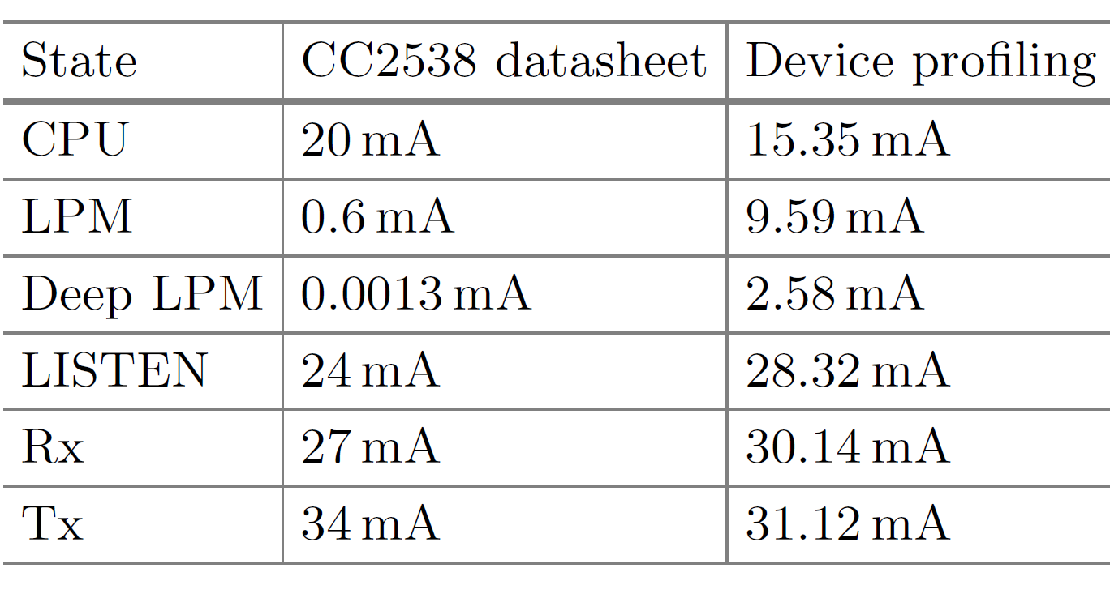
Current consumption values

Slide 12
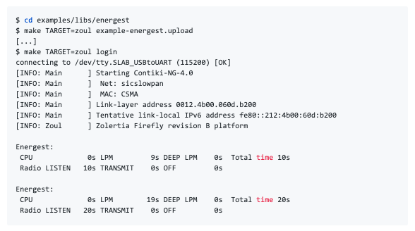
Energest
https://github.com/contiki-ng/contiki-ng/wiki/Tutorial:-Energy-monitoring

Slide 13
Report (see slides Blackboard)

Slide 14
Questions ?
?

