Slide 1
How to do a thesis/internship at IDLab
Practical details, writing and presenting
G. Daneels

Slide 2
Outline
Practical details How to write a thesis? How to present? How to write a paper?

Slide 3
Outline
Practical details How to write a thesis? How to present? How to write a paper?

Slide 4
How to write a thesis?
Knowing what a thesis text should contain.

Slide 5
Outline
Fundamentals of writing
Structure of a thesis
Plagiarism
General writing tips

Slide 6
Outline
Fundamentals of writing
Structure of a thesis
Plagiarism
General writing tips

Slide 7
Fundamentals of writing
Start early
Structuring a thesis
Plagiarism
General writing tips

Slide 8
Writing takes a long time, start early
Writing should be:
concise
non-redundant
clear
consistent
This takes time
Start early
Re-iterate

Slide 9
Write concisely
Look for shorter ways to make your point
No
The access point that supports Wi-Fi is expected to send packets with a lot of data to all the neighbors that are close-by.
Yes
The Wi-Fi access point should send large datapackets to its close-by neighbors.

Slide 10
Write non-redundantly
Only repeat your main message
Check your text for repeated information How? Re-iterate!
Check your sentences for redundant words (write concisely).
No: Here, we will summarize very briefly… Yes: We will summarize…

Slide 11
Be consistent
Use the same terminology, acronyms, structure and verb tense throughout your text
Examples
If you used IEEE 802.11 initially, do not change to Wi-Fi. Avoid confusion.
If you started italicizing definitions, do this throughout the whole text.
Use a guideline to know which verb tense you should use: http://services.unimelb.edu.au/__data/assets/pdf_file/0009/471294/Using_tenses_in_scientific_writing_Update_051112.pdf

Slide 12
Outline
Fundamentals of writing
Structure of a thesis
Plagiarism
General writing tips

Slide 13
Structure of a thesis
Abstract Introduction
Background and related work
Chapters on contributions
Conclusions and future work

Slide 14
Abstract
What is the problem you are trying to solve?
Your contribution
Major findings (quantitative results, trends, …)
Summary of your conclusions

Slide 15
Introduction
What is the problem you are trying to solve?
Why is it important that you solve this problem?
Where exactly is your work situated in the field?
What is your contribution? What is the added value?
Make this very clear! Put it in bold?
How is your solution different from other solutions (briefly)? (Describe what is coming in the next sections)

Slide 16
Background and related work
Explain the specific topic you are working on
Define the terminology
Compare your work to previous work and explain how it is different

Slide 17
Contribution chapters
Explain the reader what you did and how
Give enough details on the algorithm or solution so your work can be replicated
Motivate and justify decisions that you made
If not, for sure the jury will ask you during your presentation
Describe your experiment set up and results in detail
Explain the scenarios you want to tackle
Compare to baselines (other work) Describe how you will evaluate it Explain the results

Slide 18
Conclusion and future work
State very clearly your take-away message
This is the message your reader MUST remember after reading your thesis book
Highlight your main contributions
Your solution (algorithm, …) but also the results
Briefly describe the next possible steps

Slide 19
Outline
Fundamentals of writing
Structure of a thesis
Plagiarism
General writing tips

Slide 20
Plagiarism
DO. NOT. COPY.
The consequences are severe.
List all the work you have used in your text in your bibliography
Yes
Einstein et al. show that relativity is hard [6].
\citeauthor{xxx} show that relativity is hard \cite{xxx}.
Yes Previous work showed that relativity is hard [6-8].
No
[6] shows that
! Do not use the citation as a subject

Slide 21
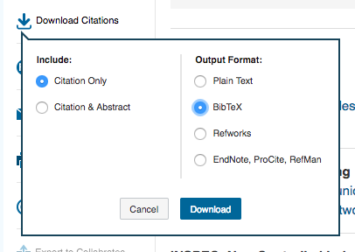
Bibliography
Format
Use BibTeX + IEEE format
Search for your paper in the IEEE Xplore Digital Library and “Download citations”:

Slide 22
Outline
Fundamentals of writing
Structure of a thesis
Plagiarism
General writing tips

Slide 23
General writing tips
Start early! Re-iterate!
Prefer the “we” format Yes: We measured the RSSI values
No: The author of this paper measured the RSSI (Maybe: I measured the RSSI)

Slide 24
General writing tips
Start early! Re-iterate!
Avoid subjective statements I think that I believe that
Do not forget the articles
No: That is Wi-Fi station.
Yes: That is a Wi-Fi station.

Slide 25
General writing tips
Start early! Re-iterate!
Avoid long blocks of text Use figures or tables to split up your text.
! If you show a graph, name your axes.
Avoid empty sections
Title of section 6
[here should be some text introducing the next section]
Subtitle of section 6.1

Slide 26
General writing tips
Avoid the passive voice if possible
No: It is shown by the experiment that … Yes: The experiment shows
No: The example is used to illustrate … Yes: The example illustrates
Avoid using abbreviations
No: The experiment doesn’t show
Yes: The experiment does not show
Use a spelling checker Texmaker packages, Word, your mom, your girlfriend

Slide 27
General writing tips
Learn the difference between e.g. and i.e. e.g. = for example
i.e. = that is
Learn the difference between its and it’s its = possessive
it’s = it is
Learn the difference between between and among between two entities
among more than two entities

Slide 28
Outline
Practical details How to write a thesis? How to present? How to write a paper?

Slide 29
How to present?
Knowing how to explain your work.

Slide 30
Outline
Slides tips
Presentation structure
Improve readibility
Be visual Speaking tips

Slide 31
Outline
Slides tips
Presentation structure
Improve readibility
Be visual Speaking tips

Slide 32
Slides tips
Making slides takes time
Slides need a lot of re-iteration
Do not start the day before the presentation
Think about the structure of the presentation

Slide 33
Outline
Slides tips
Presentation structure
Improve readibility
Be visual Speaking tips

Slide 34
Presentation content
Goal: give thesis’ most important aspects
Goal: focus on the big picture
Goal: sell your take-away message Everyone should know your take-away message at the end

Slide 35
Presentation structure
Structure is similar to thesis, you should cover:
Problem statement What is the problem?
Motivation Why would/should you solve it?
Related work How did other people solve it (and how does it compare)?
Contribution How did you solve it?

Slide 36
Presentation structure
(cont’d) Structure is similar to thesis, you should cover:
Results What is your experiment setup, your results? How does your contribution compare?
Conclusions and future work What are the main conclusions from your thesis? What is your take-away message? What can you do next?

Slide 37
Presentation results
Explain the experiment set-up
Explain what the experiment represents
Describe the results (how they should be interpreted) Name the x and y axis! Explain the results (motivate the results) Explain how they compare to other work

Slide 38
Presentation wrap-up
Do not stop abruptly Think about your conclusions and future work Repeat the take away message Cycle back to your introduction

Slide 39
Outline
Slides tips
Presentation structure
Improve readibility
Be visual Speaking tips

Slide 40
Improve readibility
Avoid large blocks of texts
Reading takes up a lot of time
The audience needs to listen to you and your message
Use keywords that support your message
! Avoid a lot of bullet points per slide (4x4 rule)

Slide 41
Improve readibility
Fill your slide
Avoid large empty spaces in your slide
Use larger space between your bullet points
Use a slightly larger fontsize if necessary

Slide 42
Improve readibility
Use colors/highlights in your text
Highlight the important keywords
Highlight what you are talking about
Different colors for different text

Slide 43
Long-Term Evolution (LTE)
Long-Term Evolution (LTE) is a standard for high-speed wireless communication for mobile phones and data terminals. It is based on the GSM/EDGE and UMTS/HSPA network technologies, increasing the capacity and speed using a different radio interface together with core network improvements.[1][2] The standard is developed by the 3GPP (3rd Generation Partnership Project) and is specified in its Release 8 document series, with minor enhancements described in Release 9. Y LTE is the upgrade same for carriers with both GSM/UMTS networks and CDMA2000 networks. The different LTE frequencies and bands used in different countries will mean that only multi-band phones will be able to use LTE in all countries where it is supported.

Slide 44
Long-Term Evolution (LTE)
High-speed wireless communication
Mobile phones and data terminals
Develop by 3GPP
Different LTE frequencies in different countries

Slide 45
Long-Term Evolution (LTE)
High-speed wireless communication
Mobile phones and data terminals
Develop by 3GPP
Different LTE frequencies in different countries
[UNUSED SPACE]

Slide 46
Long-Term Evolution (LTE)
High-speed wireless communication
Mobile phones and data terminals
Develop by 3GPP
Different LTE frequencies in different countries

Slide 47
Long-Term Evolution (LTE)
High-speed wireless communication
Mobile phones and data terminals
Develop by 3GPP
Different LTE frequencies in different countries
Larger line spacing

Slide 48
Long-Term Evolution (LTE)
High-speed wireless communication
Mobile phones and data terminals
Develop by 3GPP
Different LTE frequencies in different countries
Asia: 2100 MHz
North America: 1900

Slide 49
Long-Term Evolution (LTE)
High-speed wireless communication
Mobile phones and data terminals
Develop by 3GPP
Different LTE frequencies in different countries
Asia: 2100 MHz
North America: 1900
What I am talking about
Different color for subinformation

Slide 50
(do not overdo it)

Slide 51
Outline
Slides tips
Presentation structure
Improve readibility
Be visual Speaking tips

Slide 52
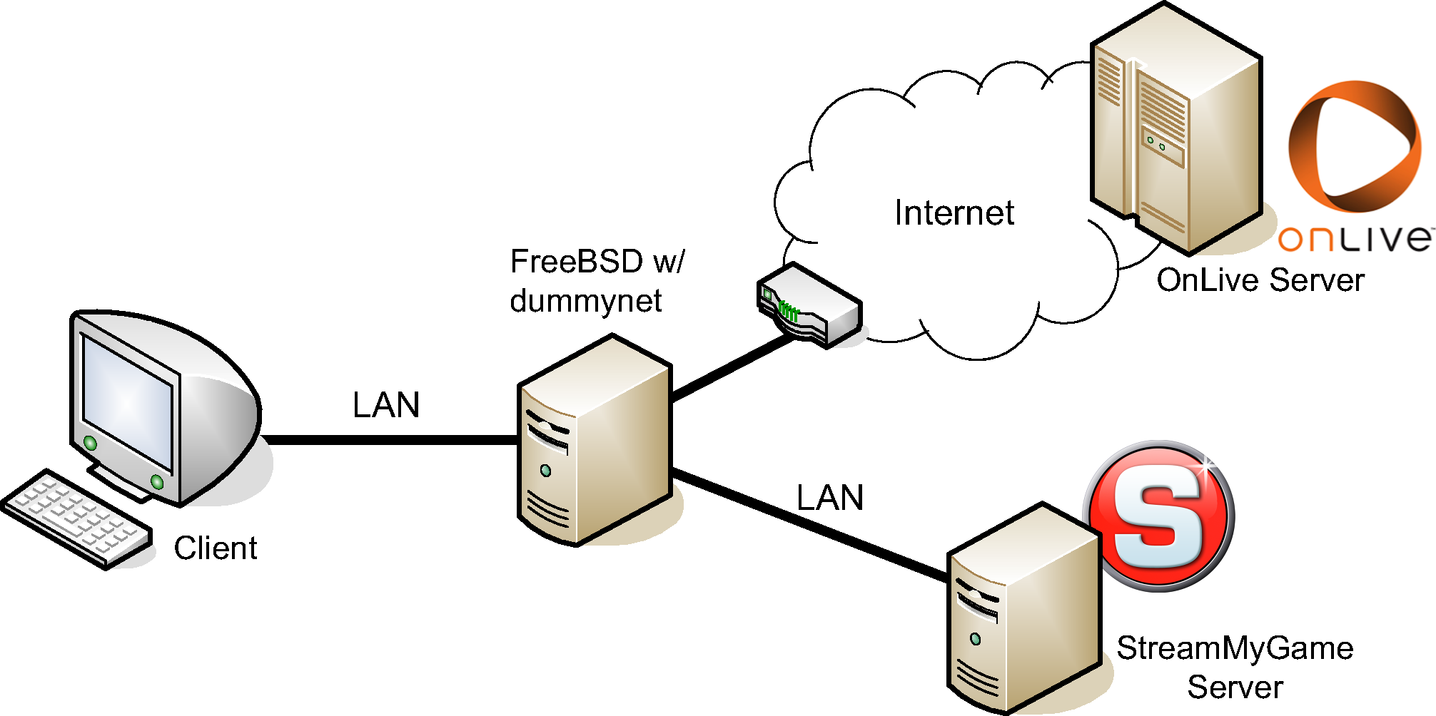
Be visual
Use images! Get the attention of your audience (We at IDLab are easily bored, but we images!)
For example, do not describe your experiment set-up, but show it

Slide 53
Be visual
Avoid tables
Latency (ms) | SubGHz | 2.4GHz | 5GHz
Algorithm 1 | 3 | 9 | 12
Algorithm 2 | 5 | 11 | 14
Algorithm 3 | 5 | 17 | 30

Slide 54
Be visual
Latency (ms)
Frequency band

Slide 55
Be visual
Title
Latency (ms)
X-axis name
Y-axis name
Frequency band
Legend

Slide 56
Be visual
If you have to use a table, make it visual. Guide your audience to the correct values.
Latency | SubGHz | 2.4GHz | 5GHz
Algorithm 1 | 3ms | 9ms | 12ms
Algorithm 2 | 5ms | 11ms | 14ms
Algorithm 3 | 5ms | 17ms | 20ms

Slide 57
Be visual
If you have to use a table, make it visual. Guide your audience to the correct values.
Latency | SubGHz | 2.4GHz | 5GHz
Algorithm 1 | 3ms | 9ms | 12ms
Algorithm 2 | 5ms | 11ms | 14ms
Algorithm 3 | 5ms | 17ms | 20ms

Slide 58
Be visual
If you have to use a table, make it visual
Guide your audience to the correct values
Latency | SubGHz | 2.4GHz | 5GHz
Algorithm 1 | 3ms | 9ms | 12ms
Algorithm 2 | 5ms | 11ms | 14ms
Algorithm 3 | 5ms | 17ms | 20ms

Slide 59
Outline
Slides tips
Presentation structure
Improve readibility
Be visual Speaking tips

Slide 60
Speaking tips
Speak calm Be enthousiastic Look at the audience
Avoid looking at the screen
Know what you will say It is not necessary to learn all text by heart, but you should at least know what to say
This gets easier when you practice a lot Teach your family, friends, mirror,… about your thesis

Slide 61
Outline
Practical details How to write a thesis? How to present? How to write a paper?

Slide 62
How to write a paper?
Knowing what a scientific paper should contain. And what not.

Slide 63
Outline
What is a scientific paper?
Paper structure
General writing tips
Example

Slide 64
Outline
What is a scientific paper?
Paper structure
General writing tips
Example

Slide 65
What is a scientific paper?
Papers are used by researchers to communicate research results to other researchers in the field Check http://scholar.google.com and look for your topic! Represents the current state of science Presented in conferences world-wide and shared in journals

Slide 66
What is a scientific paper?
While your thesis is an elaborate text on all the work, a scientific paper focuses on the most important contributions and results that justify your conclusions.

Slide 67
Outline
What is a scientific paper?
Paper structure
General writing tips
Example

Slide 68
Scientific paper structure
Structure is very similar to that of your thesis book
Usually you will find the following sections in a paper:
Abstract What did I do in a nutshell?
Introduction What is the problem? Why is it a problem? Etc. Look at thesis introduction ➔ be very concise! + ! overview of the rest of the paper
Related work Discussion on approaches that did similar work and how your work differentiates from this

Slide 69
Scientific paper structure (cont’d)
Algorithm/solution/… What is the paper’s contribution?
Experiment set-up How are the results measured?
Results What did you find out?
Discussion What do these results mean?
Conclusion & future work What is the take-away message and what to do next?

Slide 70
Scientific paper structure (cont’d)
Acknowledgements Who helped out?
Bibliography Citations of all the work you referred to
Appendices What did you find out?
This is a not a fixed structure, but recommended
(Some of these sections can be combined)

Slide 71
Outline
What is a scientific paper?
Paper structure
General writing tips
Example

Slide 72
General writing tips
Fundamentals of writing of a thesis apply here General writing tips of a thesis apply here Writing should be:
concise
non-redundant
clear
consistent

Slide 73
General writing tips
Fundamentals of writing of a thesis apply here General writing tips of a thesis apply here Writing should be:
concise
non-redundant
clear
consistent
Because of the limited space, this is even more important in a paper!

Slide 74
General writing tips
Fundamentals of writing of a thesis apply here General writing tips of a thesis apply here Writing should be:
concise
non-redundant
clear
consistent
+ scientifically correct! (of course, this is also a must in your thesis book)

Slide 75
Outline
What is a scientific paper?
Paper structure
General writing tips
Example

Slide 76
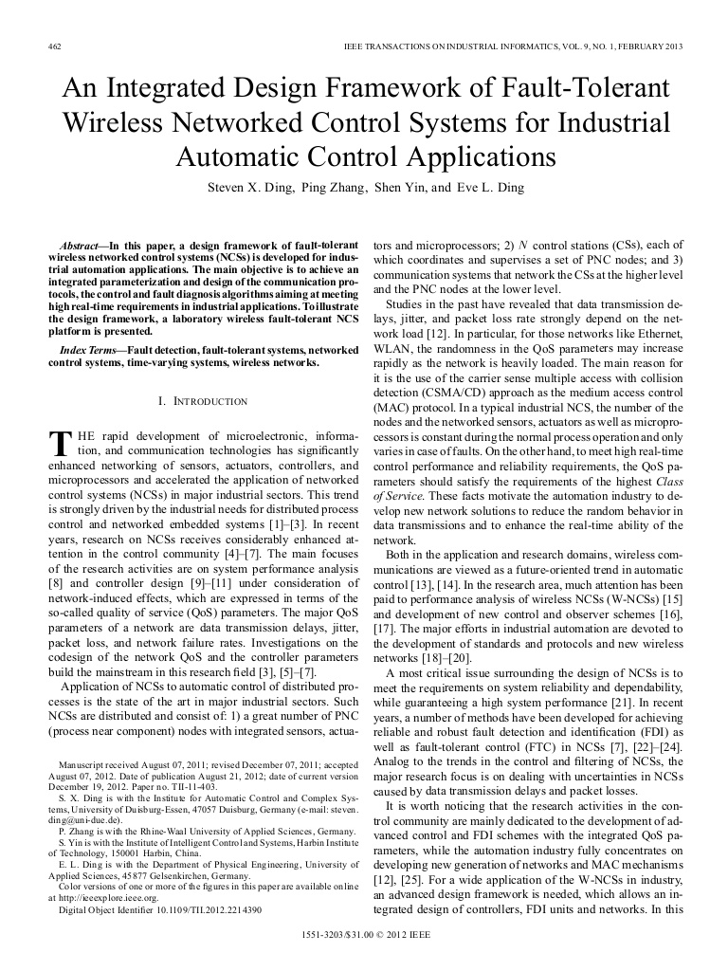

Slide 77
?

Slide 78
Interesting links
Writing concisely: http://grammar.ccc.commnet.edu/grammar/concise.htm
General writing tips and writing/presenting a thesis:
http://www.csee.umbc.edu/~mariedj/ (writing tips part)
http://www.mai.kuleuven.be/jdavis-mai-comm%20[Alleen-lezen].pdf
Verbe tenses for scientific writing:
http://services.unimelb.edu.au/__data/assets/pdf_file/0009/471294/Using_tenses_in_scientific_writing_Update_051112.pdf
Writing scientific papers: http://abacus.bates.edu/~ganderso/biology/resources/writing/HTWtoc.html

