Slide 1
Sorting Algorithms
Heer Patel, Rohan

Slide 2
Algorithams Used
Insertion sort
Heap sort
Radix sort
Merge Sort
Quick Sort

Slide 3

Sorting Algorithms
Sorting Algorithms can be compared and depends on different parameter(space, time, etc ). Here we have analyzed with time for different data size.
We have mapped time required for a algorithm to run with respect to its data size.
We have mapped different data size (array size) ranging from 0 to 1000 with different values.
Same array is passed in all the algorithms so we can check the complexity of the algorithms.

Slide 4
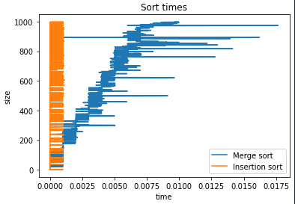
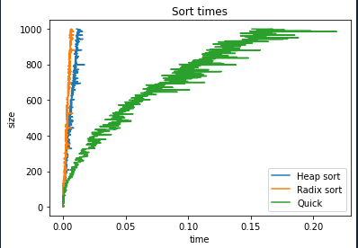
Best Case Analysis
The area in the red signifies the lowest time so we will further compare both the algorithms.

Slide 5
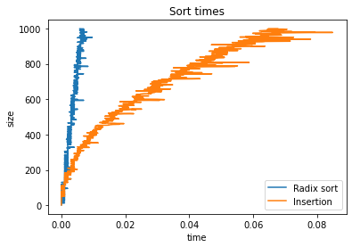
Best Case Analysis
For most of the data size Radix performs better. It takes less time in all the cases as compared to others.
Only the portion highlighted in green signifies insertion sort performs better in that case.

Slide 6
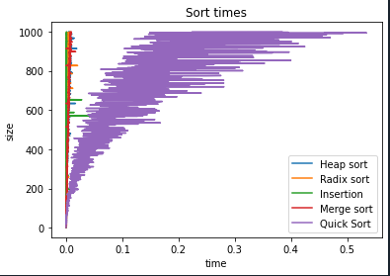
Worst Case Analysis
It takes longer time in each case because pivot keeps switching so, it is not right choice to choose Quick Sort algorithm.

Slide 7
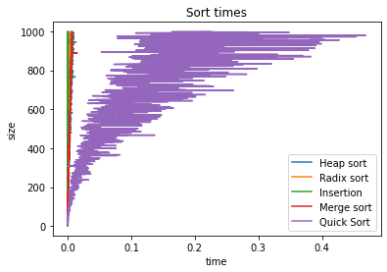
Comparison with new values
From both the above graph with different input the time complexity remains same so we can say that output is efficient and Quick sort should be avoided when time complexity is measured.

Slide 8
Conclude
For larger data set Radix sort is efficient algorithm because it requires lesser time to execute.
Even for the smaller data set, Radix is efficient along with heap sort because when we notice figure 2 graph is almost similar. Insertion sort is better for every small data size as we have notice in figure 3.
Quick sort should be avoided in most of the cases because it takes more time in all the cases.

Slide 9
Thank You

