Slide 1

CSE-5335: Presentation
Jay Ashok Patel
Hima Girishbhai Kansodariya
Heer Chirag Patel
Section: 5335-004
FALL 2021

Slide 2

PROJECT
Pages before Login

Slide 3

Introduction
Say It Right is a website about identity, the main purpose of the website is to store how the users name are pronounced, by accessing these records Students and Professor can know how to pronounce the names of all the Students in their respective classes.
Students can manage their courses, view their class schedule in which they are enrolled and register their sound of how their names are pronounced.
Professors can manage their classes, students, make announcements and view students profile i.e. view student picture and their audio recording which they have uploaded.
Advisors can create new classes of a course as per requirement, edit and update Student and course information.
Admin has access to all the data and can edit/update all the data and manages all the users i.e. Students, Professors and Advisors.

Slide 4
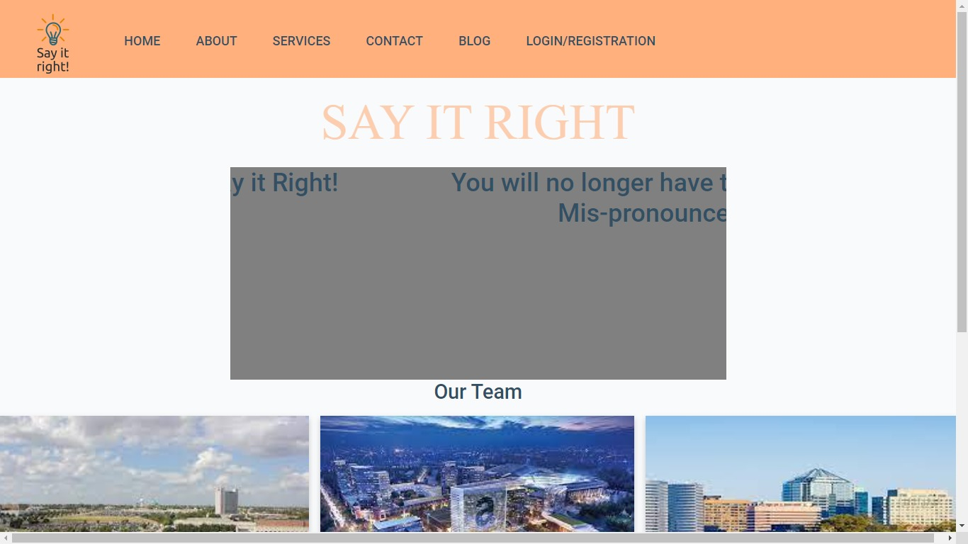
PROJECT
Page : Home
The Home Page has a slideshow that displays the currents affairs to all the users.
The navigation bar of the webpage consists the hyperlink to all the other pages of the website

Slide 5
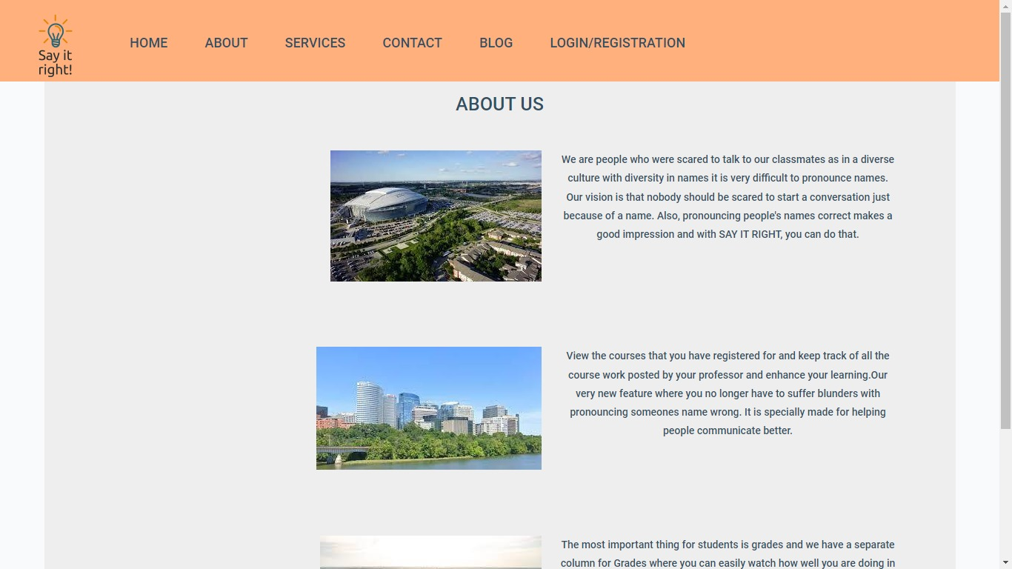
PROJECT
Page : About Us
The About Us page provides the information of the website and displays the features of the website.

Slide 6
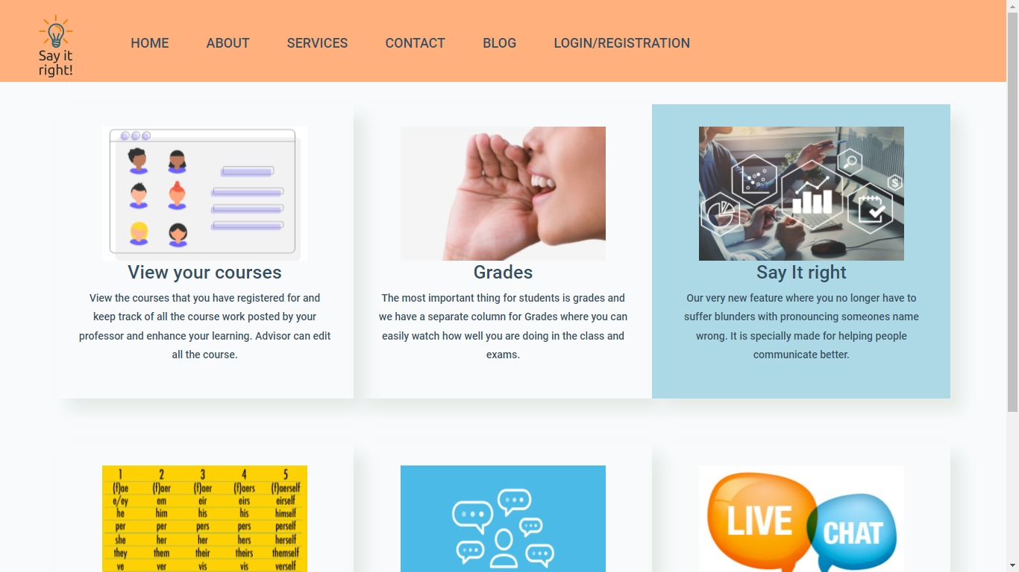
PROJECT
Page : Services
Showcases the services provided by the website.

Slide 7
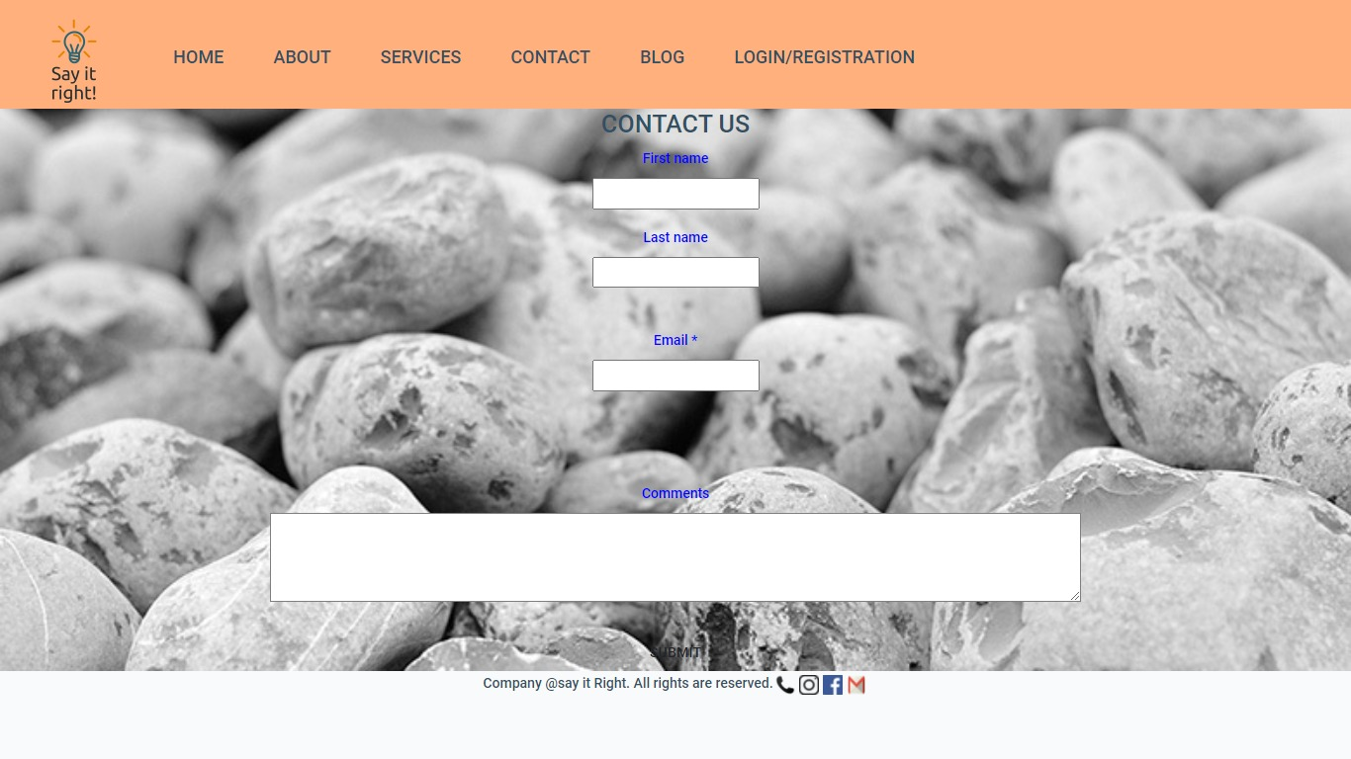
PROJECT
Page : Contact Us
Users can contact the officials regarding any information or complaints through e-mail.

Slide 8
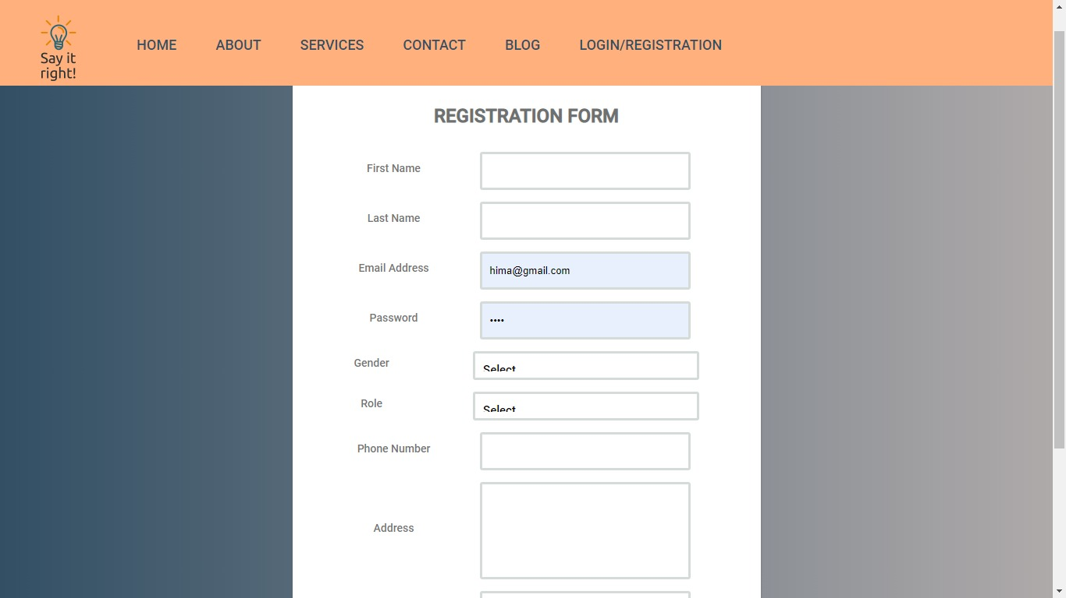
PROJECT
Page : Registration
Users can register with roles such as student, professor or advisor.

Slide 9
PROJECT
Login Landing

Slide 10
PROJECT
Page : Login Landing
After Registration user can Login In using their credentials.
We have Role based login i.e. Student can login as Student only, similarly for Admin, Advisor and Professor.

Slide 11
PROJECT
Pages after Login

Slide 12
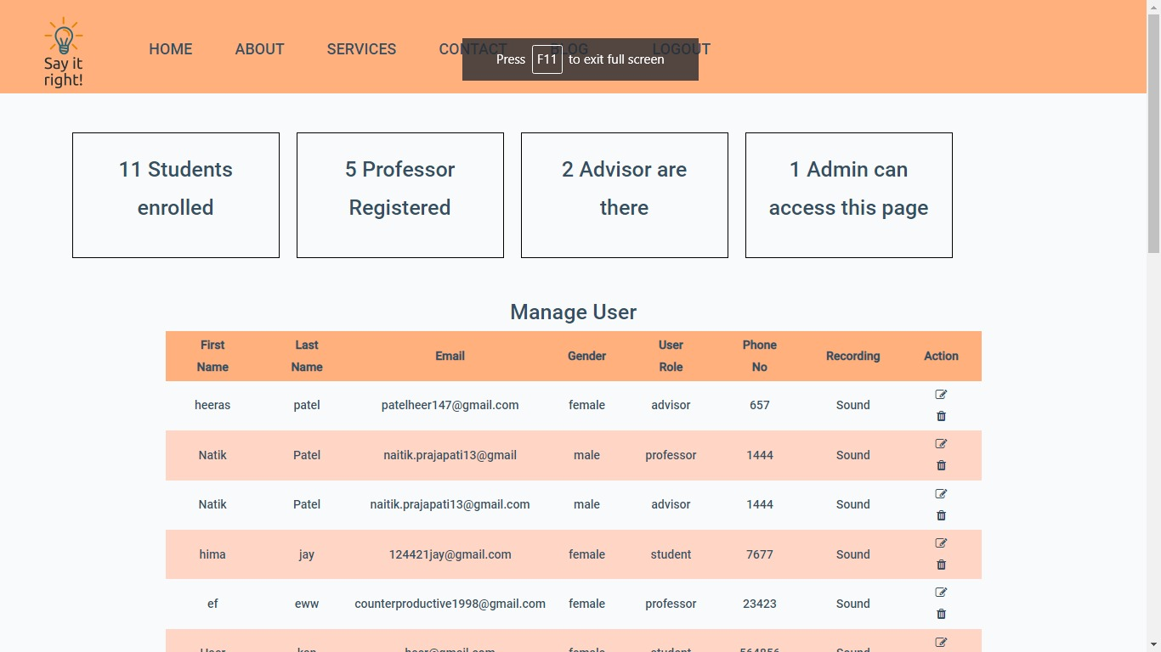
PROJECT
Page : Admin Page
After Login in as Admin, manages all the users i.e. Students, Professors and Advisors.
Admin has access to all the data and can edit/update all the data.
We have used Function based components and merged header, footer and navigation bar.

Slide 13
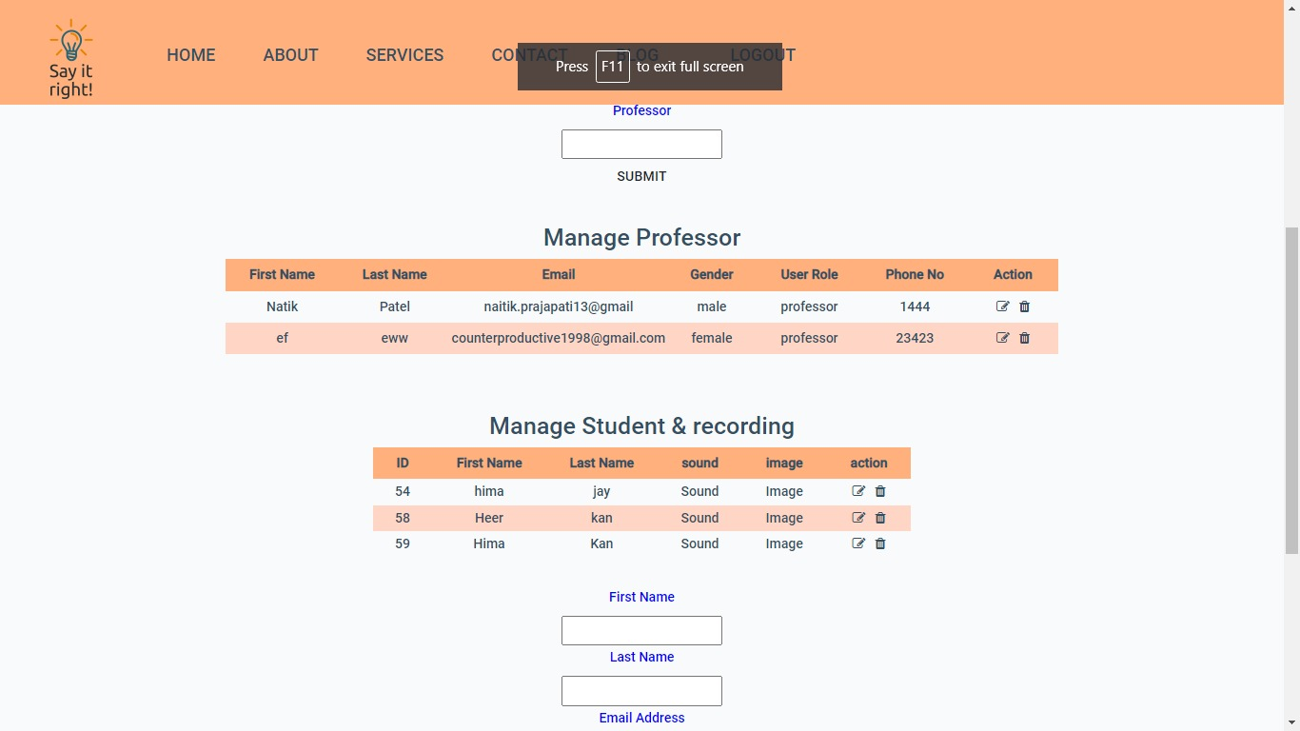
PROJECT
Page : Advisor Page
Advisors can create new classes of a course as per requirement.
Advisors can edit and update Student and course information.
We have used Function based components and merged header, footer and navigation bar.

Slide 14
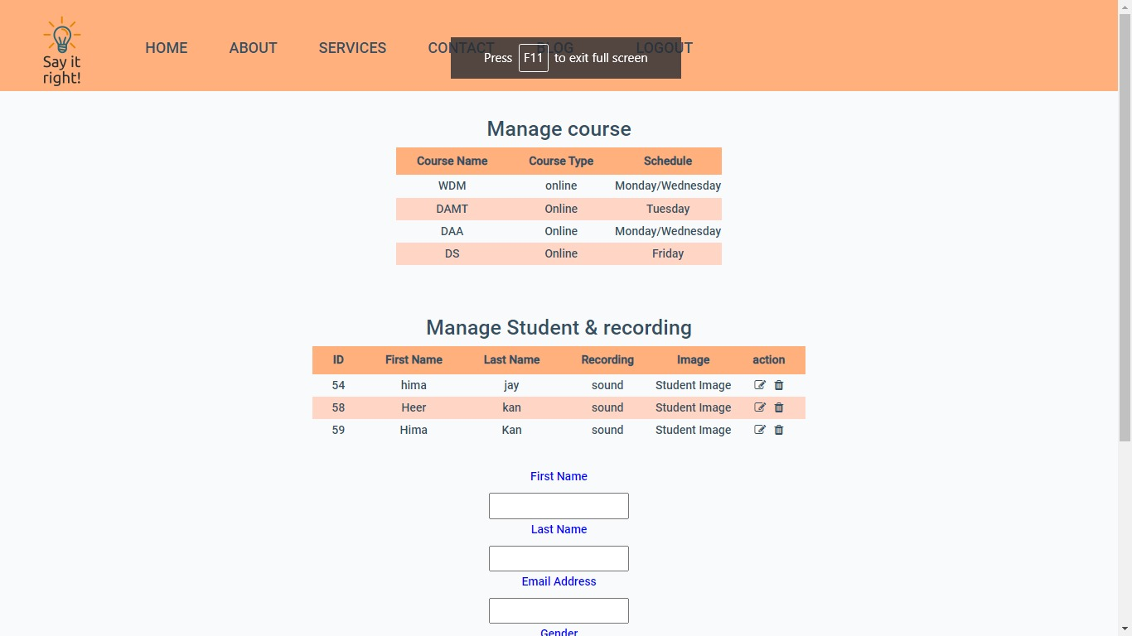
PROJECT
Page : Professor Page
Professors can manage their classes, students and make announcements.
Professors can manage submissions of the students.
We have used Function based components and merged header, footer and navigation bar.

Slide 15
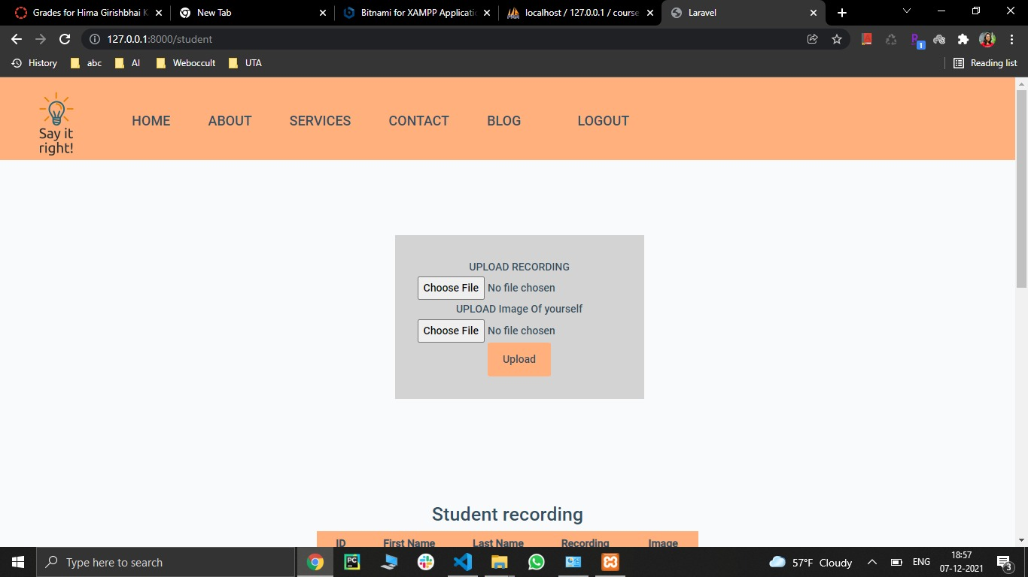
PROJECT
Page : Student Page
After Login in as student, they can view their class schedule in which they are enrolled
They can manage their profile and register their image as well as sound of how their names are pronounced.
We have used Function based components and merged header, footer and navigation bar.

Slide 16
PROJECT
Node/ Chat

Slide 17
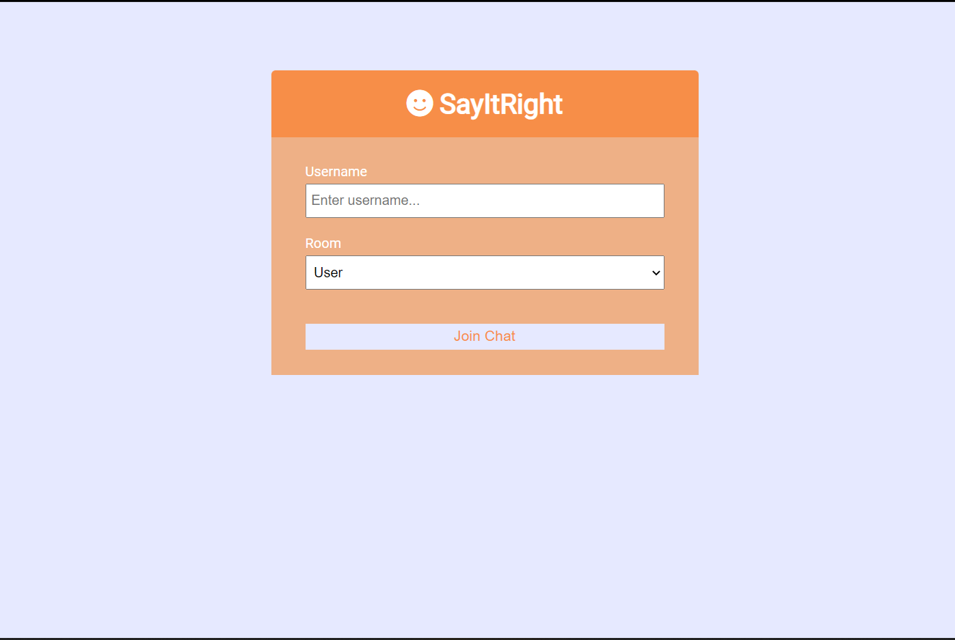
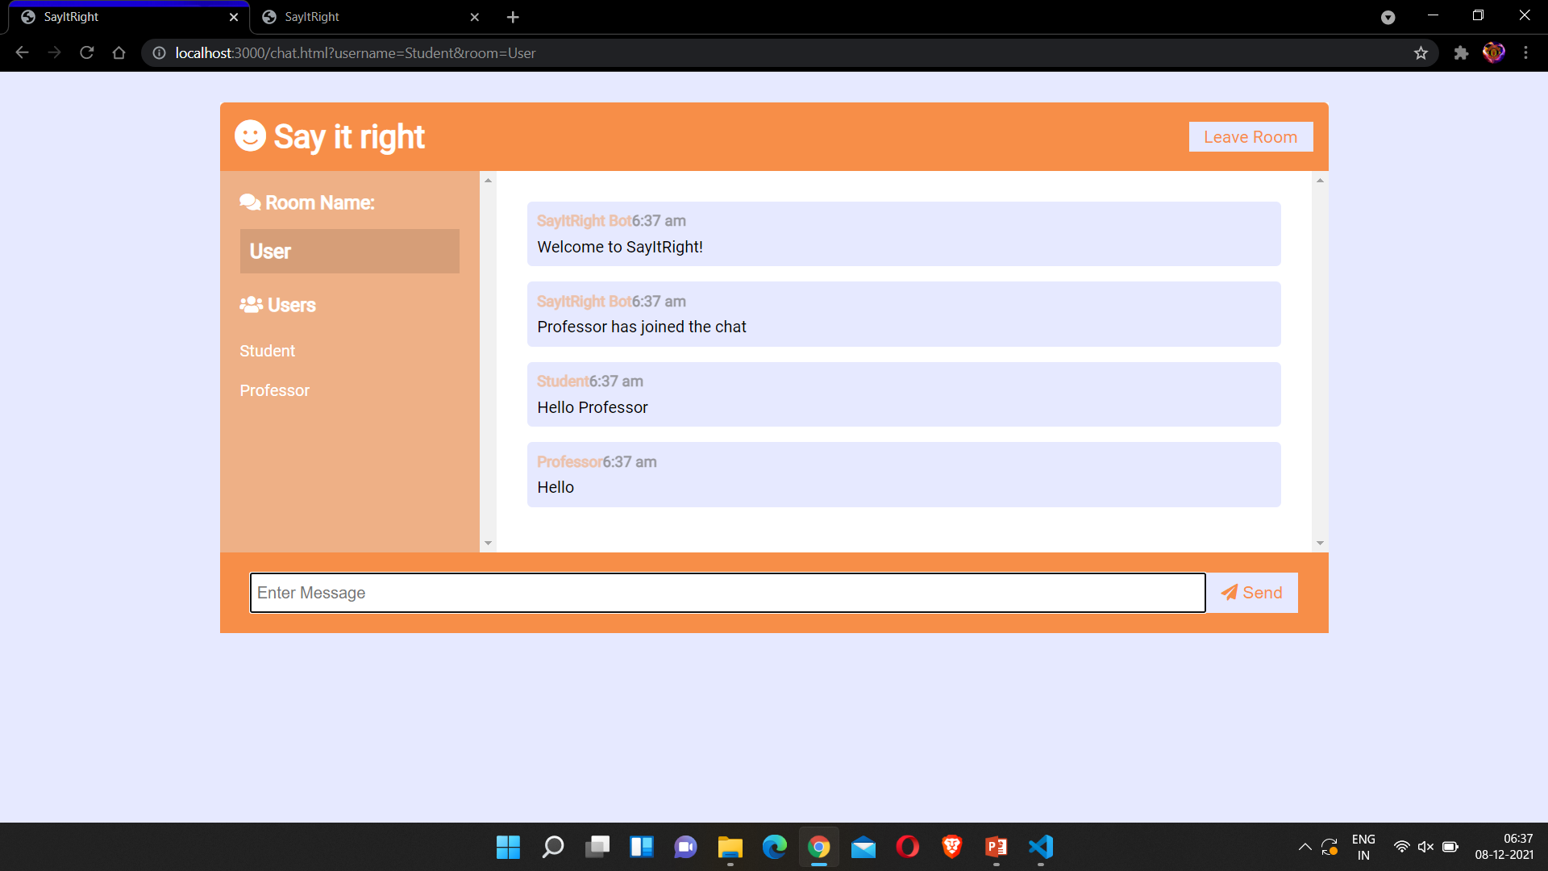
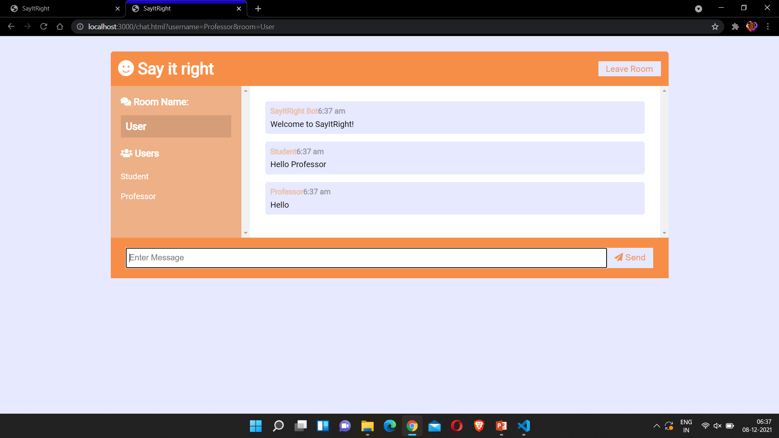
PROJECT
Page : Chat
Students can chat with Professors if they have any doubts or questions.
We have used Function based components and merged header, footer and navigation bar.

Slide 18
PROJECT
Challenges faced
Converting React components into Laravel in the Final Phase.
Learning new frameworks in the last phases in given time constraint.

Slide 19
PROJECT
Creative functionalities
List any creative functionality you may have included
How they were implemented; explain very briefly about the details
Pictures of code will serve as a plus, with markings and explanation

Slide 20
PROJECT
Improvement
Overall look and feel of the website can be improved.
We could have used Bootstrap in the last phases to improve UI of our website.

Slide 21
PROJECT
Future Addition to your Portfolio
We are planning to give Professors access to create classes online in which the Students can join in.

Slide 22

Thank You

