Slide 1
Twitter Trend Analysis
20MCB1001 John Mathew
20MCB1012 Rohan Gurubhaiye
20MCB1019 Heer Mapara

Slide 2
Abstract
Welcome to the world of Artificial Intelligence for social media stories. It has been a long time since twitter is an active Social media platform and meant for sharing ideas on issues, actions, etc. Every day a twitter user faces different kinds of data based on many fields. It is almost like a dream to analyze that huge amount of data and find the latest trend going on. Every tweet has a certain purpose and talks about a problem or discussion. By the analysis of twitter data, most of the companies can crack the code to success in today’s world,they can easily obtain information about, what is going on today. So this way, we can understand the importance of twitter trend analysis

Slide 3
Objective and Goal
To build a twitter trend analyzer that will analyze a set of tweets using AI and text-processing techniques.
The trend analyzer will work on a given set of tweets, seeded on Election Tweets to generate:
A tag cloud depicting what topics or politicians were being talked about on Twitter.
A chart showing which hashtag related to Election trended (Hashtags are words or phrases beginning with #, eg #NarendraModi
A share of voice chart to show which politicians dominated the conversation on Twitter.

Slide 4
Literature Survey
“Twitter and Research: A Systematic Literature Review through Text Mining” by Amir Karami, Morgan Lundy, Frank Webb and Yogesh K. Dwivedi
“A Comprehensive Analysis of Twitter Trending Topics” by Issa Annamoradnejad and Jafar Habibi
“Trend Analysis on Twitter for Predicting Public Opinion on Ongoing Events” by Mehul Barot
“Sensing Trending Topics in Twitter” by Luca Maria Aiello, Georgios Petkos, Carlos Martin, David Corney, Symeon Papadopoulos, Ryan Skraba, Ayse Göker and Ioannis Kompatsiaris
“Comparison of Machine Learning Approaches on Arabic Twitter Sentiment Analysis” by Altawaier, M. M., and Tiun, S.

Slide 5
Literature Survey
“Twitter Trending Topic Classification”” by Kathy Lee, Diana Palsetia, Ramanathan Narayanan, Md. Mostofa Ali Patwary, Ankit Agrawal and Alok Choudhary
“Predicting Political Mood Tendencies based on Twitter Data” by A. Hernandez-Suarez, G. Sanchez-Perez, V. Martinez-Hernandez, H. Perez-Meana,K. Toscano-Medina, M. Nakano and V. Sanchez
“A Study using Support Vector Machines to Classify the Sentiments of Tweets” by Zgheib, W. A., and Barbar, A. M.
“Twitter sentiment classification using distant supervision” by Go, A., Bhayani, R., and Huang, L
“Sentiment Analysis of Tweets using SVM” by Munir Ahmad, Shabib Aftab and Iftikhar Ali

Slide 6
Literature Survey
“Twitter Trending Topic Classification” by K.Lee, D. Palsetia, R. Narayanan, M. A. Patwary, A. Agrawal, and A. Choudhary
“Twitter Trending Topics Meaning Disambiguation” by S. Lee and B. Kang
“Mining Twitter Data: Case Studies with Trending Hashtags” by Michael Dossis, Dimitrios Amanatidis and Ifigeneia Mylona
“TweetMotif: Exploratory search and topic summarization for Twitter” by B. O’Connor, M.Krieger, and D. Ahn
“Comparing twitter summarization algorithms for multiple post summaries” by Inouye, D., and Kalita, J.K

Slide 7
Proposed Work
Extract Twitter Data using NodeXL using search for Election queries and hashtags, like #keralaelections2021, #westbengalelections2021
Generate chart metrics and network analysis from extracted twitter data
Create csv file from extracted twitter data
Extract only required columns
Sort tweets with most likes and retweets
Use TextBlob Sentiment Analysis to find percentage of tweets per sentiment
Find Twitter Trends
Use Trending Hashtags to extract tweets
Analysis of these extracted tweets

Slide 8
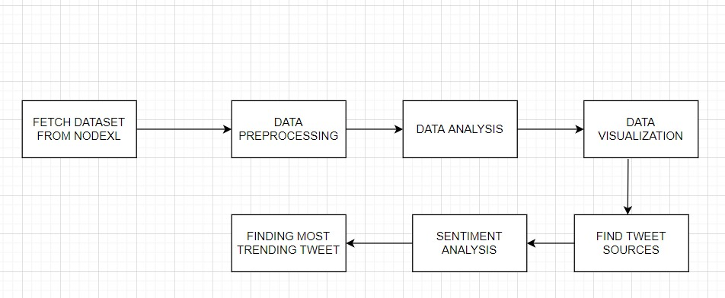

Flow Diagram

Slide 9
Dataset
We are using public tweets scraped from twitter based on trending hashtag searches, using NodeXL.
We are also using tweets directly scraped from twitter using Tweepy Python API

Slide 10
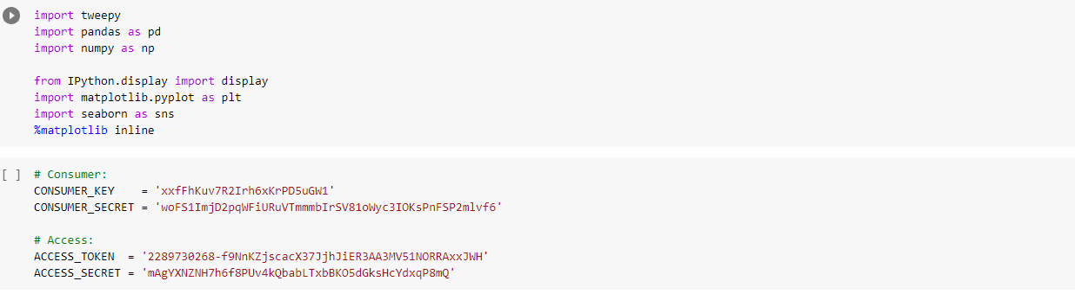
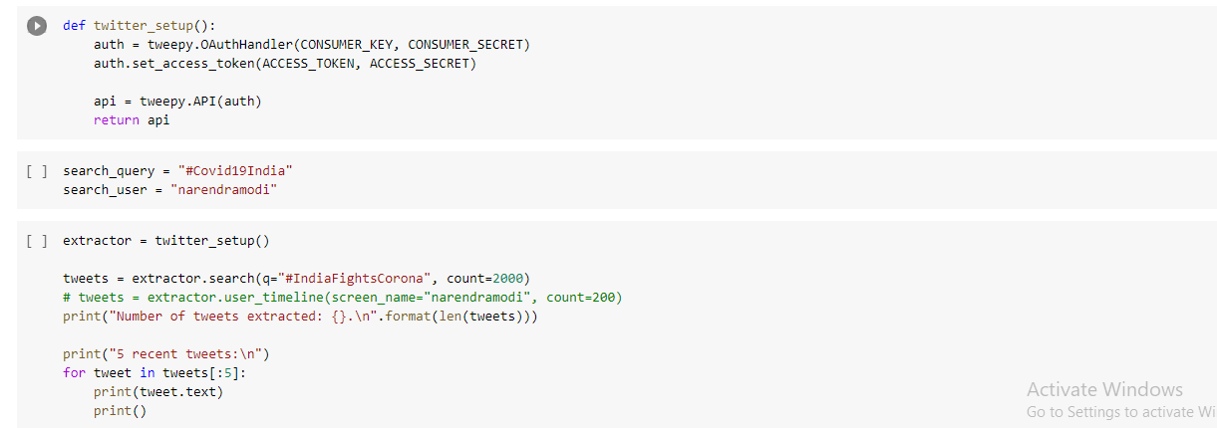

Slide 11
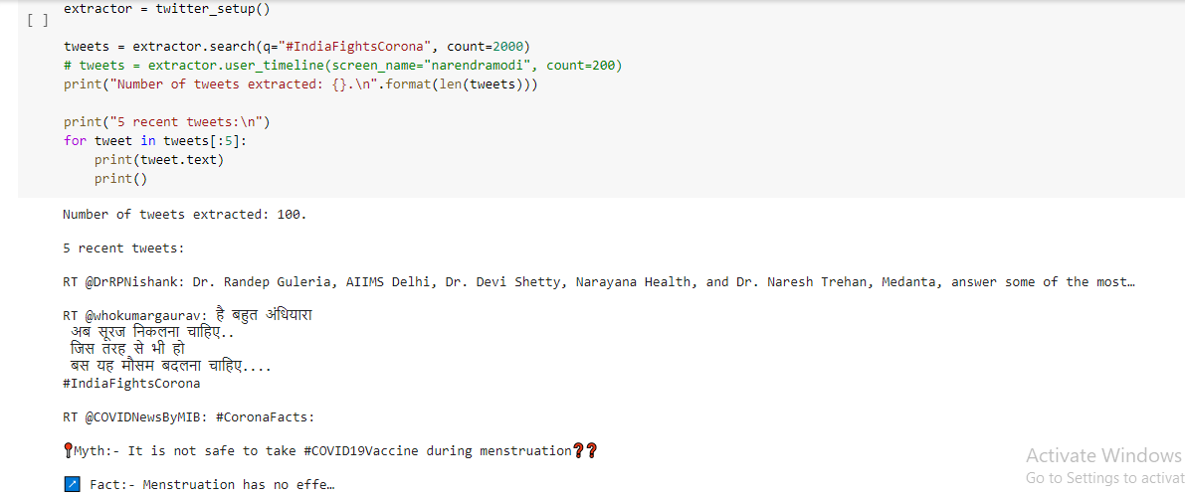

Slide 12
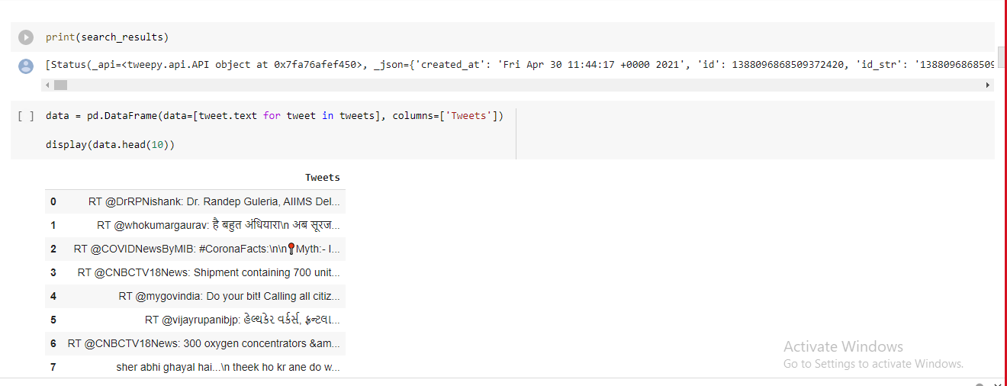

Slide 13
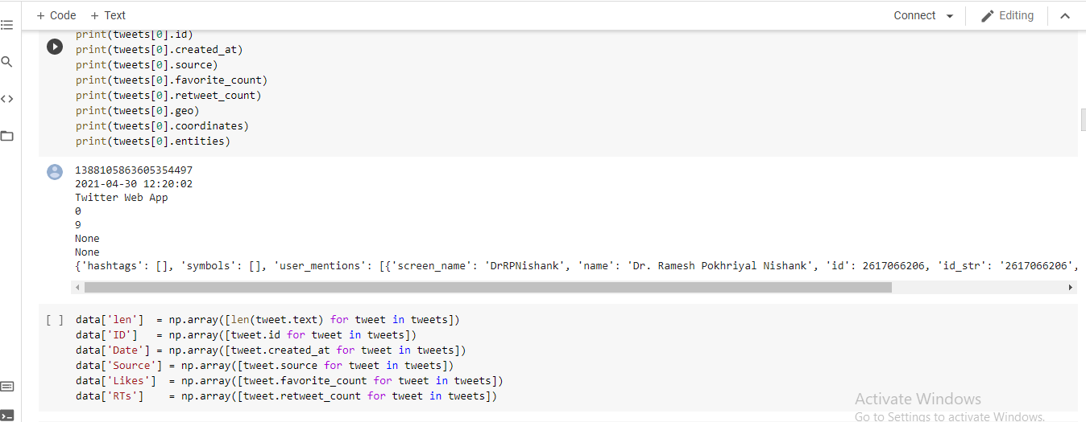

Slide 14
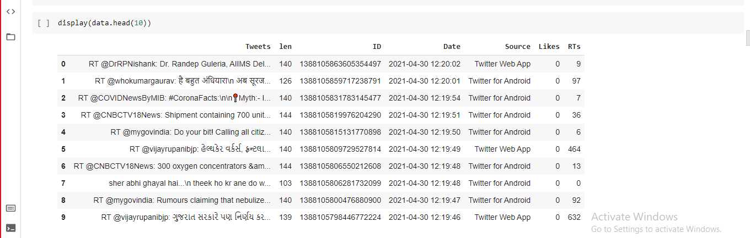

Slide 15
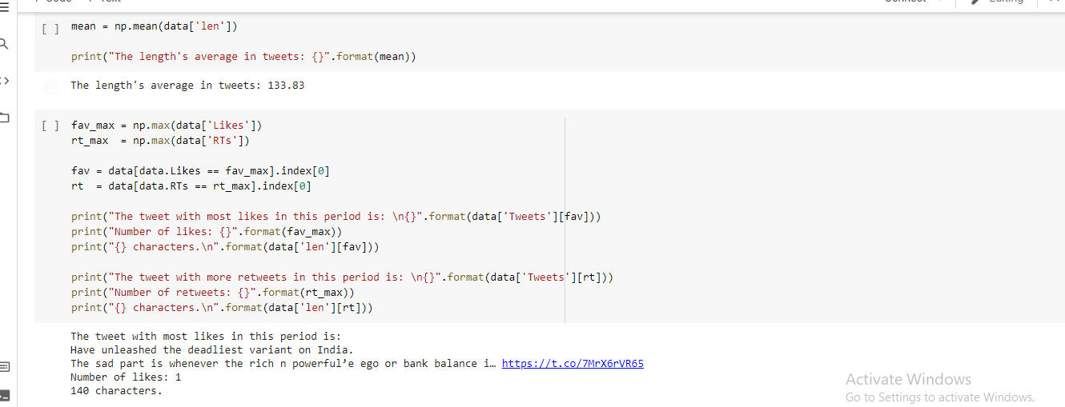
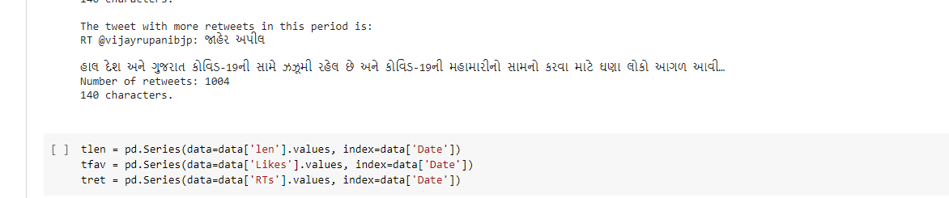

Slide 16
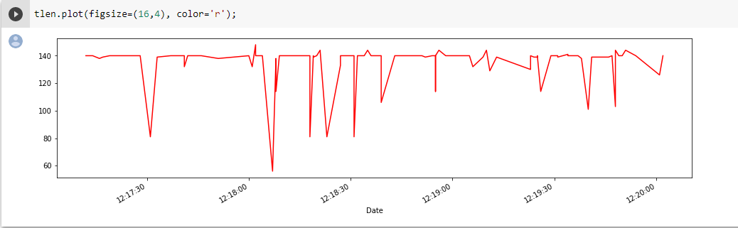
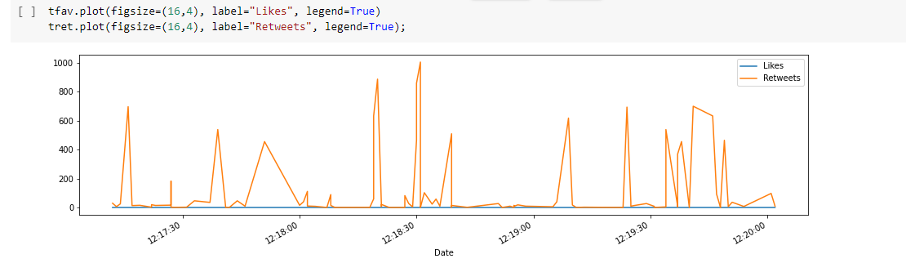

Slide 17
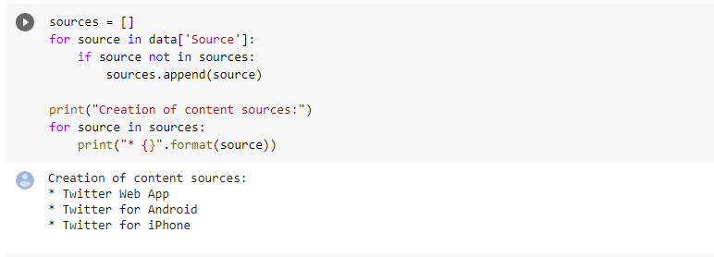

Slide 18
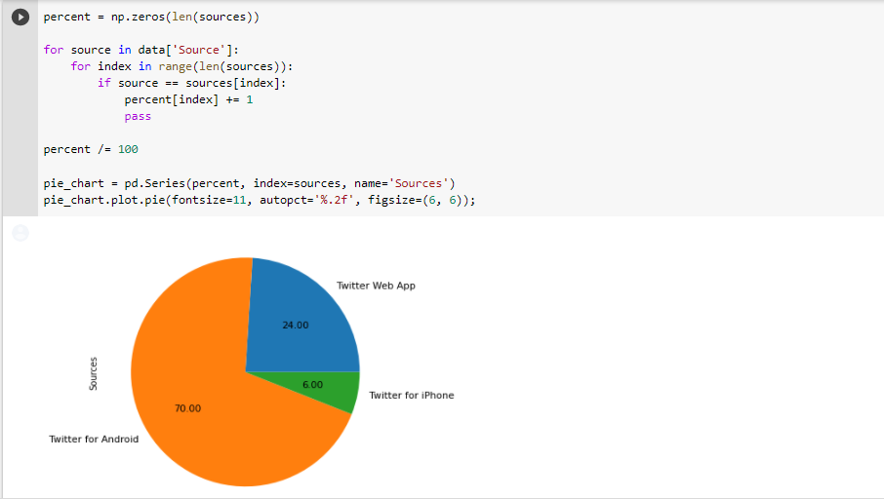

Slide 19
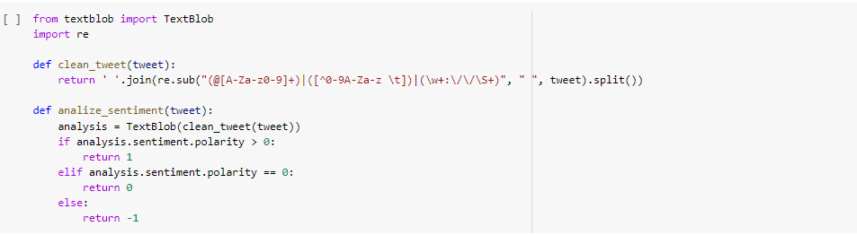
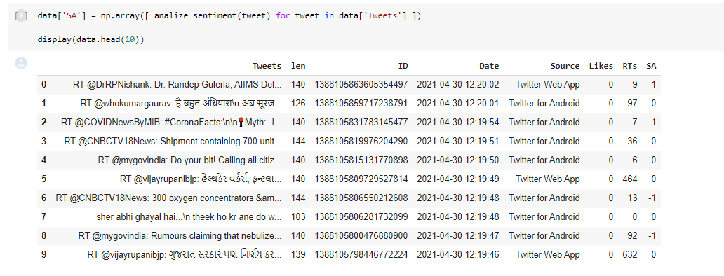

Slide 20
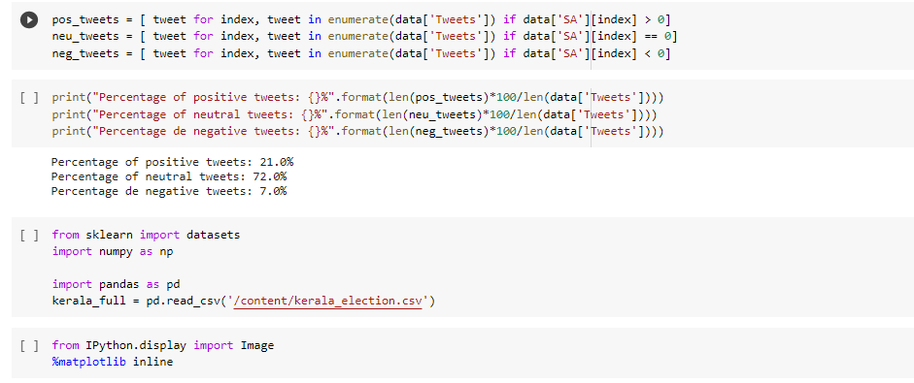

Slide 21
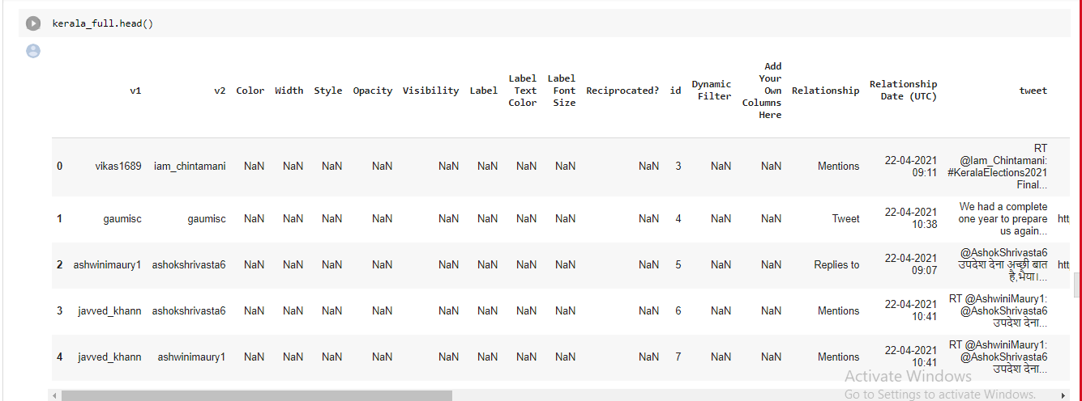

Slide 22
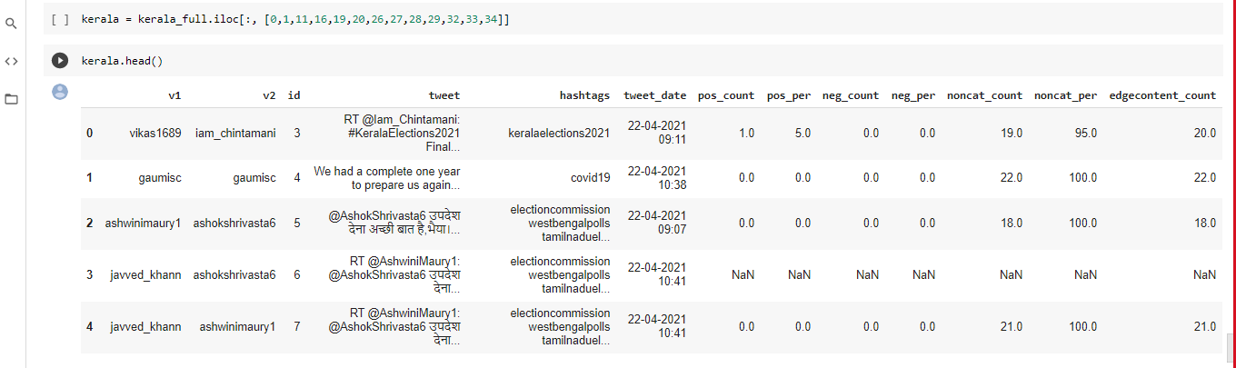

Slide 23
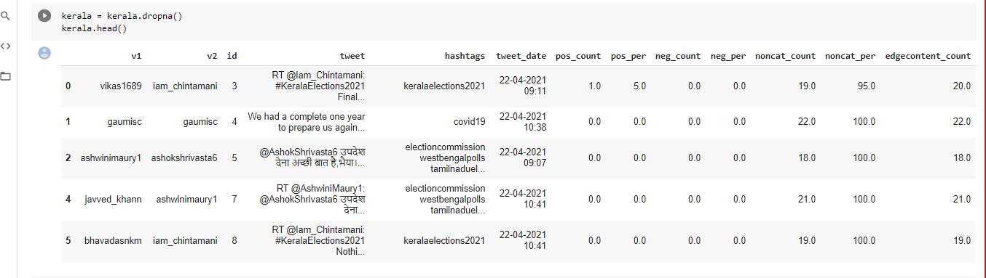

Slide 24
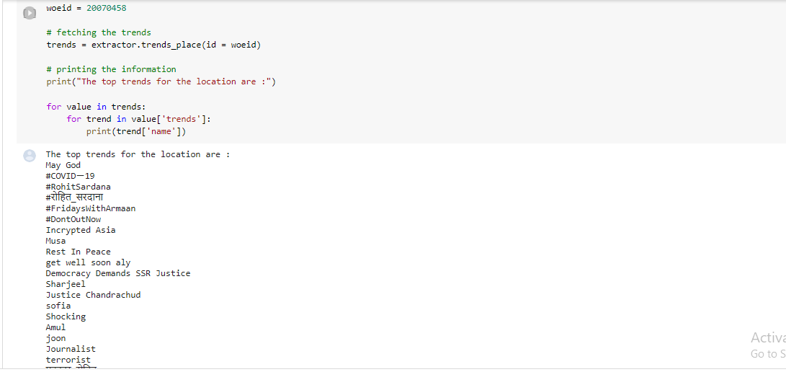

Slide 25
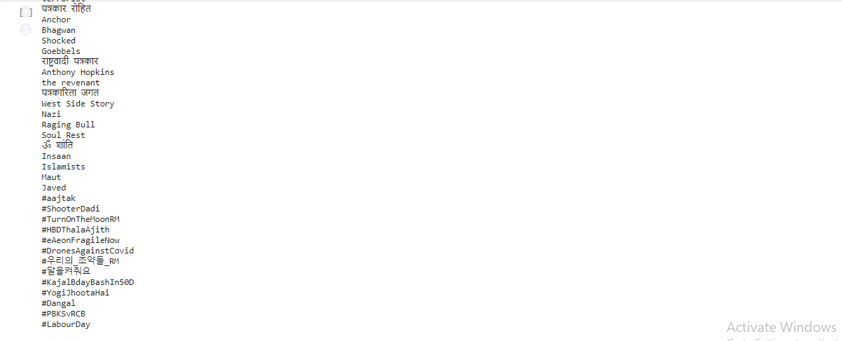

Slide 26
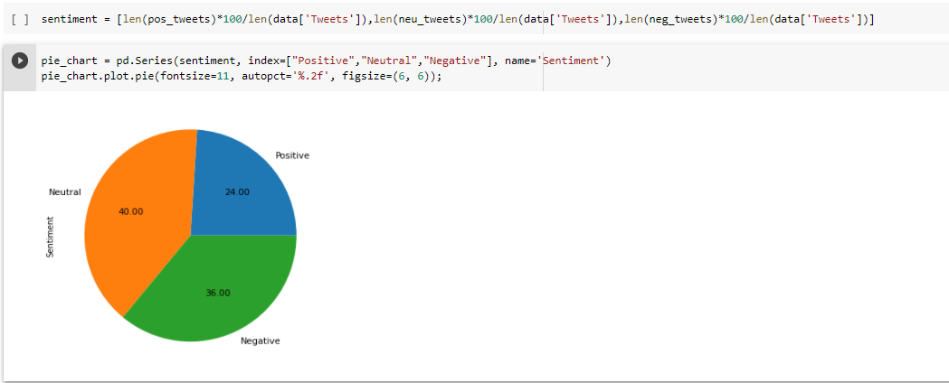

Slide 27
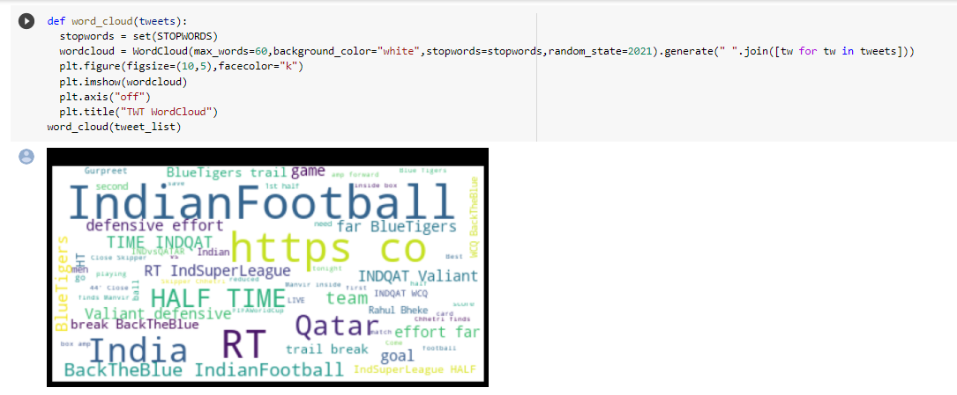

Slide 28
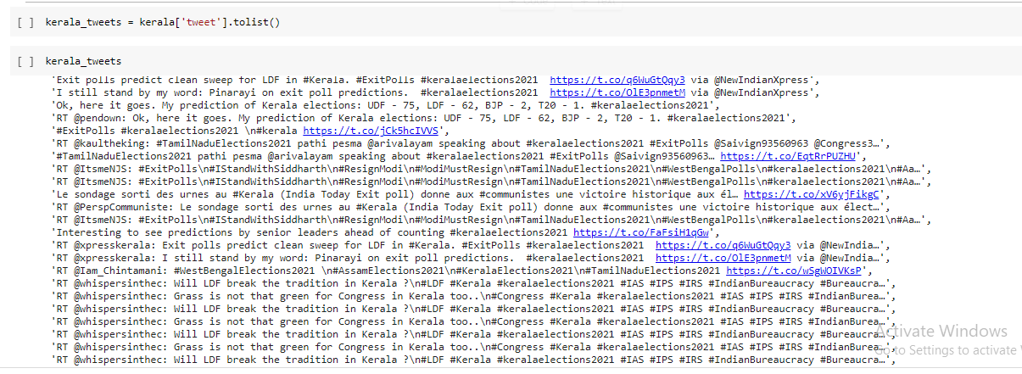

Slide 29
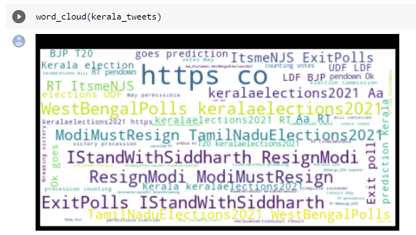

Slide 30
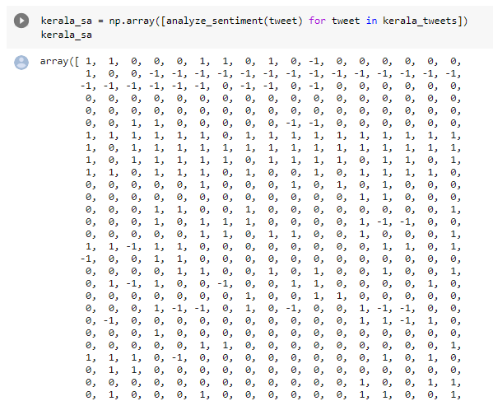

Slide 31
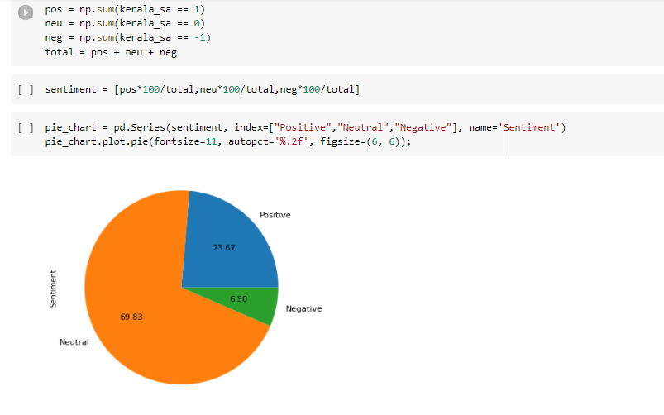

Slide 32
CONCLUSION
In this way we used NodeXL and Tweepy(Python library) to extract(Scrap) the various tweets related to different hashtags,username. After Scraping the tweets we pre processed the and mined out the important features and performed further stop words removal. We mined out the trending tweets hashtag and also dug out the most liked, retweeted tweets with respect to certain hashtags and users. We used pie charts, line plot, and Word cloud to visualize the various aspects of tweets.

Slide 33
THANK YOU

