Slide 1
Java Basic Concepts

Slide 2
Mr. M.R. Solanki
Sr. Lecturer, Information Technology,
manish_ratilal2002@yahoo.com
SBMP

Slide 3
Learning Outcomes
Students will be able to:
Examine the basic syntax and semantics of Java language i.e. data types, literals, variables, keywords, etc.
Explore various operators supported in Java.
Appraise themselves about conditional and looping statements existing in Java.
Take user inputs through key board.

Slide 4
Primitive Data Types

Slide 5
Primitive Data Types
Java defines eight primitive types of data: byte, short, int, long, char, float, double, and boolean
These primitive types(simple types) can be put in four groups:
Integers :includes byte, short, int, and long, which are for whole-valued signed numbers
2. Floating-point numbers: includes float and double, which represent numbers with fractional precision

Slide 6
Primitive Data Types
3. Characters :includes char, which represents symbols in the character set i.e. letters, numbers and special characters.
4. Boolean: includes boolean, which is a special type for representing true/false values

Slide 7
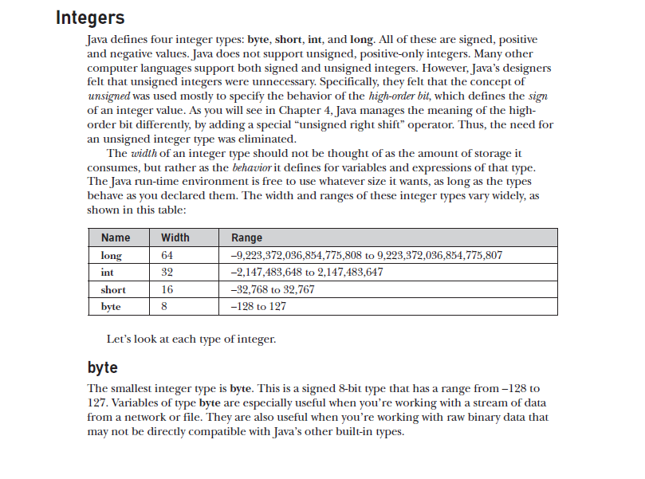
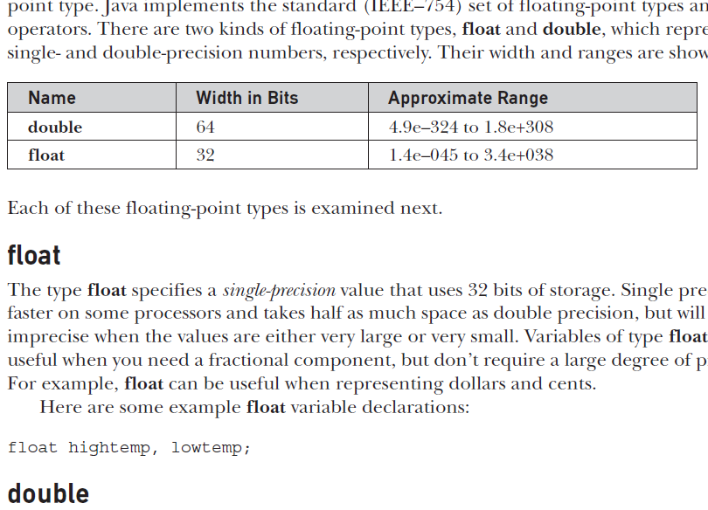
Primitive Data Types Range

Slide 8
In Java only signed types are available. ( No unsigned types like C and C++)

Slide 9
Primitive Data Types: Character
In Java, the data type used to store characters is char
In C/C++, char is 8 bits wide. Instead, Java uses 16-bits Unicode to represent char.
Unicode defines a fully international character set that can represent all of the characters found in all human languages.
It is a unification of dozens of character sets, such as Latin, Greek, Arabic, Cyrillic, Hebrew, Katakana, Hangul, and many more.
Unicode is of 16-bits so the range of a char is 0 to 65,535
There are no negative chars (like C/C++)

Slide 10
Primitive Data Types: Character
The standard set of characters known as ASCII still ranges from 0 to 127 and the extended 8-bit character set, ISO-Latin-1, ranges from 0 to 255.
// Demonstrate char data type.
class CharDemo {
public static void main(String args[]) {
char ch1, ch2;
ch1 = 88; // code for X
ch2 = 'Y';
System.out.print("ch1 and ch2: ");
System.out.print(ch1 + " " + ch2);
} }
This program displays the following output:
ch1 and ch2: X Y

Slide 11
++/-- operator with char
We can not write the following statement for characters:
char ch=‘A’;
ch=ch+1; //Error
Whereas, ch++ or ch+=1 is allowed

Slide 12
Primitive Data Types: boolean
Java has a primitive type boolean for logical values.
It can have only one of two possible values, true or false.
This is the type returned by all relational operators.
int a=5,b=7;
System.out.print(a>b); // false # in C/C++ =>0
System.out.print(a<b); // true # in C/C++ =>1
System.out.print(a!=b); // true

Slide 13
The result of the condition used in conditional and looping statements is boolean only .
If(num%2==0)
while(i<=n)
{
// stetements
}

Slide 14
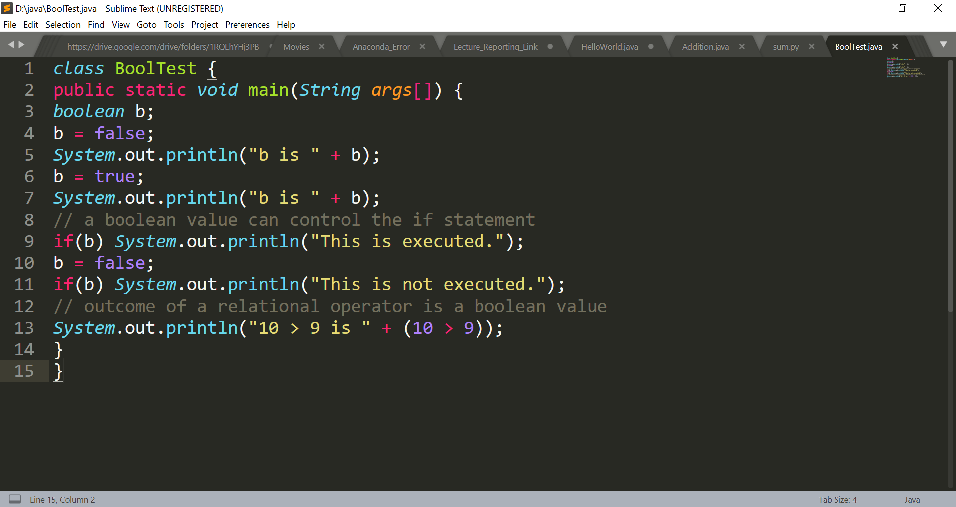
Primitive Data Types: boolean

Slide 15
Primitive Data Types: boolean
Applications :
Used by Java internally as a result of all relational operators
Can be used for flag variables having 2 possibilities i.e. 1 (true) or 0 (false)
Examples: To decide a number is prime or not, searching a number from an array.

Slide 16
Basic Building Blocks
Literals ( Constants)
integer i.e. 123, -23, 10101, etc.
floating point: 2.546, 0.00023, etc.
Character : ‘A’, ‘#’, etc.
String: “Hello” , “Java” ,etc.
Variables : Rules are same as C/C++ (except $ sign is allowed in Java)
Keywords : Reserved words i.e. class, float, if, for, etc.

Slide 17
Java Keywords
abstract
assert
boolean
break
byte
case
catch
char
class
const
continue
default
do
double
else
enum
extends
false
final
finally
float
for
goto
if
implements
import
instanceof
int
interface
long
native
new
null
package
private
protected
public
return
short
static
strictfp
super
switch
synchronized
this
throw
throws
transient
true
try
void
volatile
while

Slide 18
Type Conversion

Slide 19
Type Conversion and Casting
Java’s Automatic Conversions: (Implicit Type Casting)
When one type of data is assigned to another type of variable, an automatic type conversion will take place if the following two conditions are met:
The two types are compatible.
The destination type is larger than the source type.

Slide 20
Type Conversion and Casting
Type Compatibility:
The numeric types, including integer and floating-point types, are compatible with each other
Examples:
byte type data can be assigned to int, short and long
short type data can be assigned to int and long
int type data can be assigned to long and float
float type data can be assigned to double
No automatic conversions from the numeric types to char or boolean.
char and boolean are not compatible with each other.

Slide 21
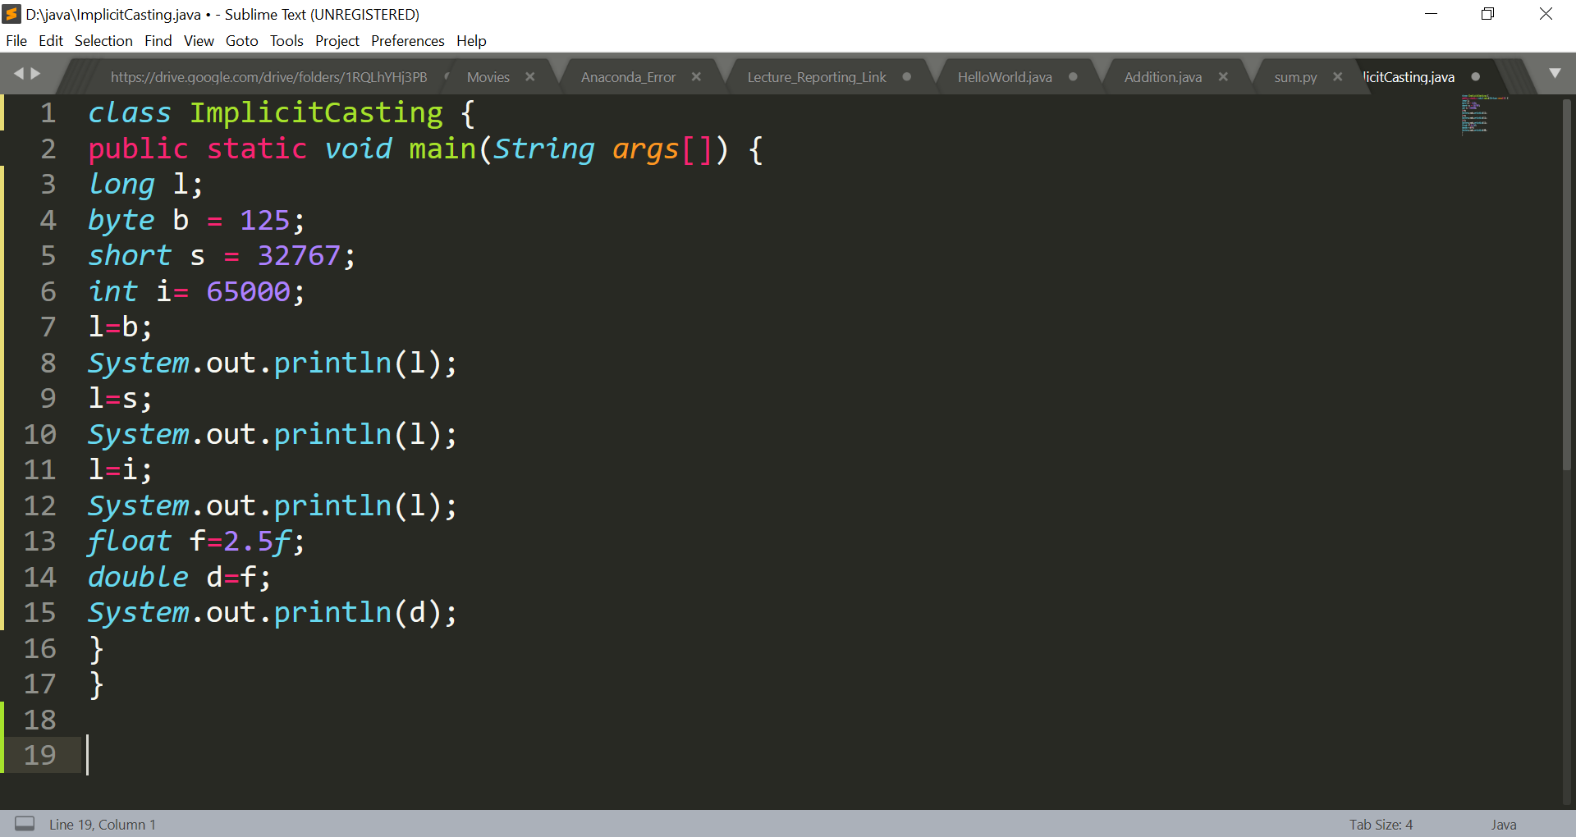
Type Conversion and Casting

Slide 22
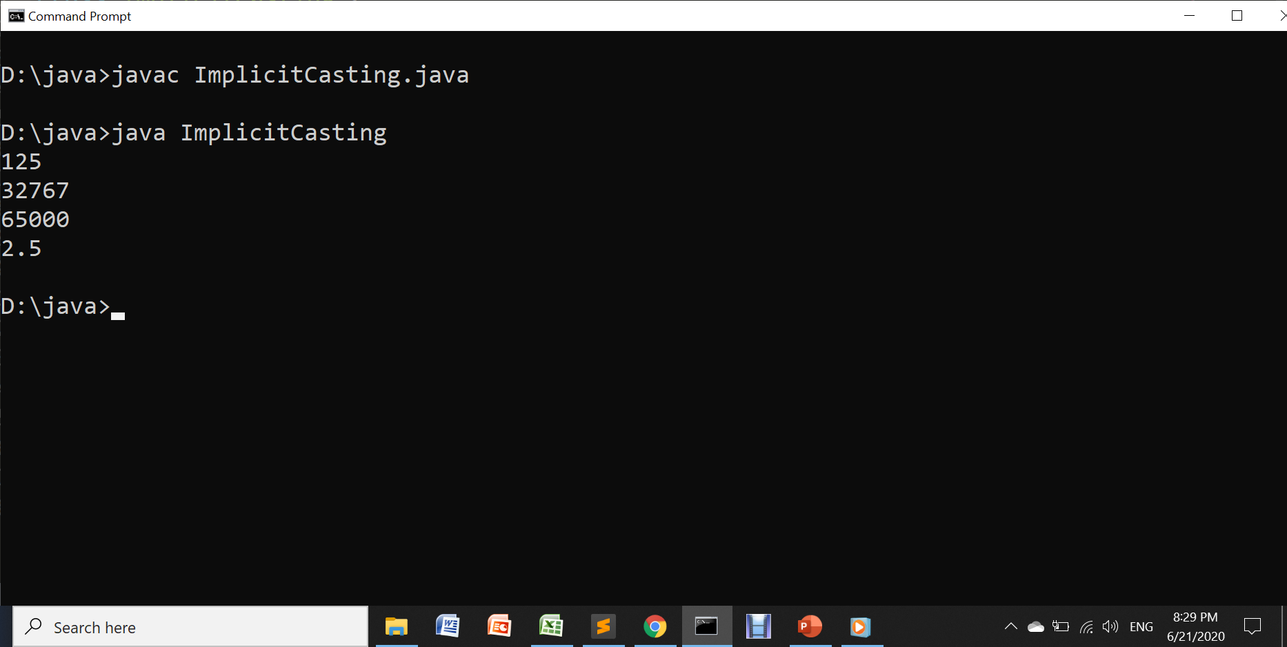
Type Conversion and Casting

Slide 23
Type Conversion and Casting
Casting Incompatible Types:(Explicit Type Casting)
What if you want to assign an int value to a byte variable?
This conversion will not be performed automatically, because a byte is smaller than an int (violation of rule 2)
This kind of conversion is sometimes called a narrowing conversion, since you are explicitly making the value narrower so that it can fit into the target type.

Slide 24
Type Conversion and Casting
Casting Incompatible Types:(Explicit Type Casting)
To create a conversion between two incompatible types, you must use a cast.
A cast is simply an explicit type conversion.
(target-type) value
Here, target-type = type to which value will be converted
Example: int a=23;
byte b;
b= (byte) a;

Slide 25
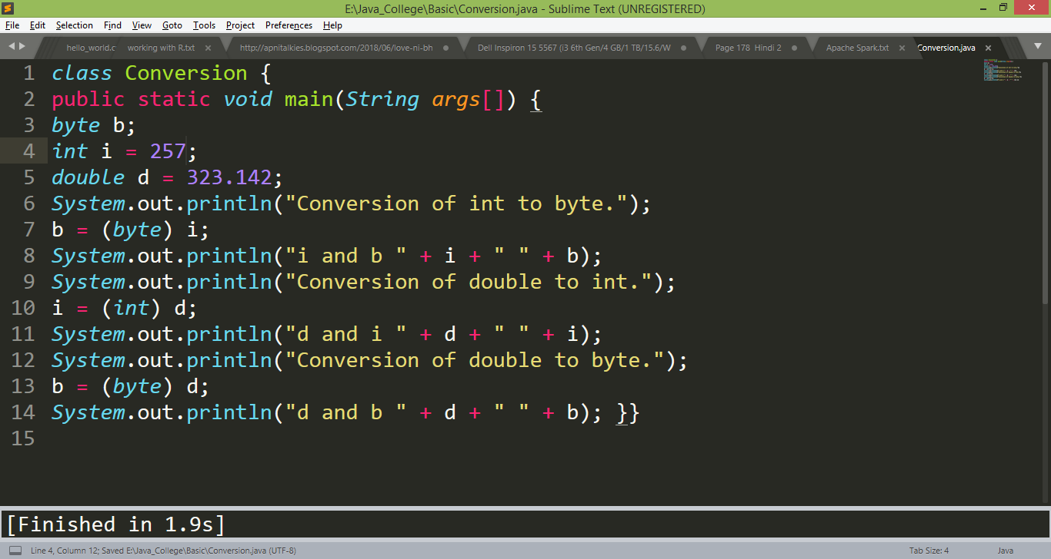
Type Conversion and Casting
Casting Incompatible Types:

Slide 26
Type Conversion and Casting
Casting Incompatible Types:
How int to byte conversion would take place?
Answer#1:
byte requires 8-bits (1 byte) storage.
byte can store : -128 to +127 values only.
While assigning int value beyond the range of target type i.e. byte:
result =value%2^{n}
n= no. of bits required for destination data type
result=257%256 (2⁸ = 256)
= 1

Slide 27
Type Conversion and Casting
Casting Incompatible Types:
How int to byte conversion would take place?
Answer#2:
byte requires 8-bits (1 byte) storage.
byte can store : -128 to +127 values only.
Represent 257 into binary form:
 |  |  |  |  |  |  | 256 | 128 | 64 | 32 | 16 | 8 | 4 | 2 | 1
 |  |  |  |  |  |  | 1 | 0 | 0 | 0 | 0 | 0 | 0 | 0 | 1
As byte can store only 8-bits the result will be 1

Slide 28
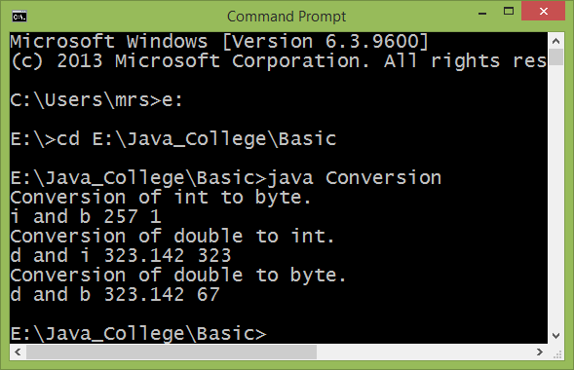
Type Conversion and Casting
Casting Incompatible Types:

Slide 29
Automatic Type Promotion in Expressions
Java performs an automatic type conversion when storing a literal integer constant into variables of type byte, short, long, or char
i.e. byte b = 125;
int i= 25678;
char ch=65535;

Slide 30
Automatic Type Promotion in Expressions
In an expression, an intermediate value will sometimes exceed the range of either operands
For example(1), examine the following expression:
byte a = 40;
byte b = 50;
byte c = 100;
int d = a * b / c;
The result of the intermediate term a * b (=2000) easily exceeds the range of either of its byte operands.
To handle this kind of problem, Java automatically promotes each byte, short, or char operand to int when evaluating an expression.

Slide 31
Type Conversion and Casting
Automatic Type Promotion in Expressions
Example2:
byte b = 50;
b = b * 2; // Error! Cannot assign an int to a byte!
Solution:
byte b = 50;
b = (byte)(b * 2);

Slide 32
In Java
Integral literals are always treated as int while evaluating expressions.
Floating point literals are always treated as double.

Slide 33
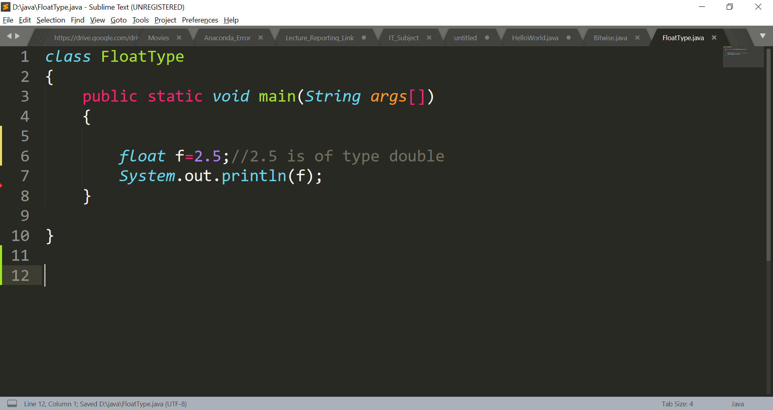
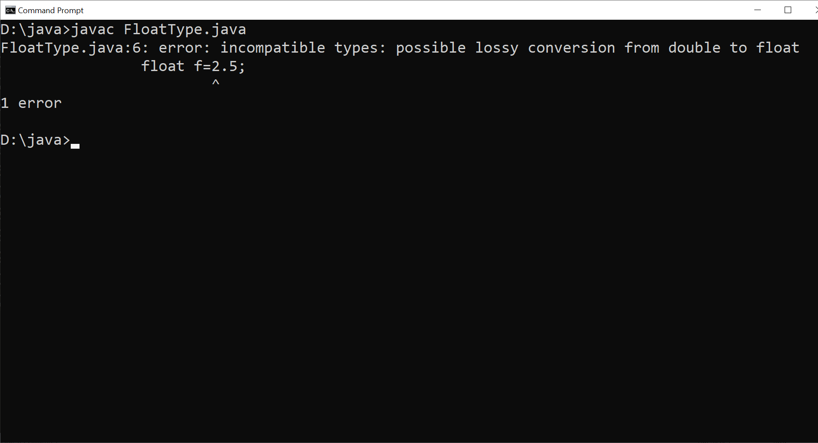
Floating point literal Error

Slide 34
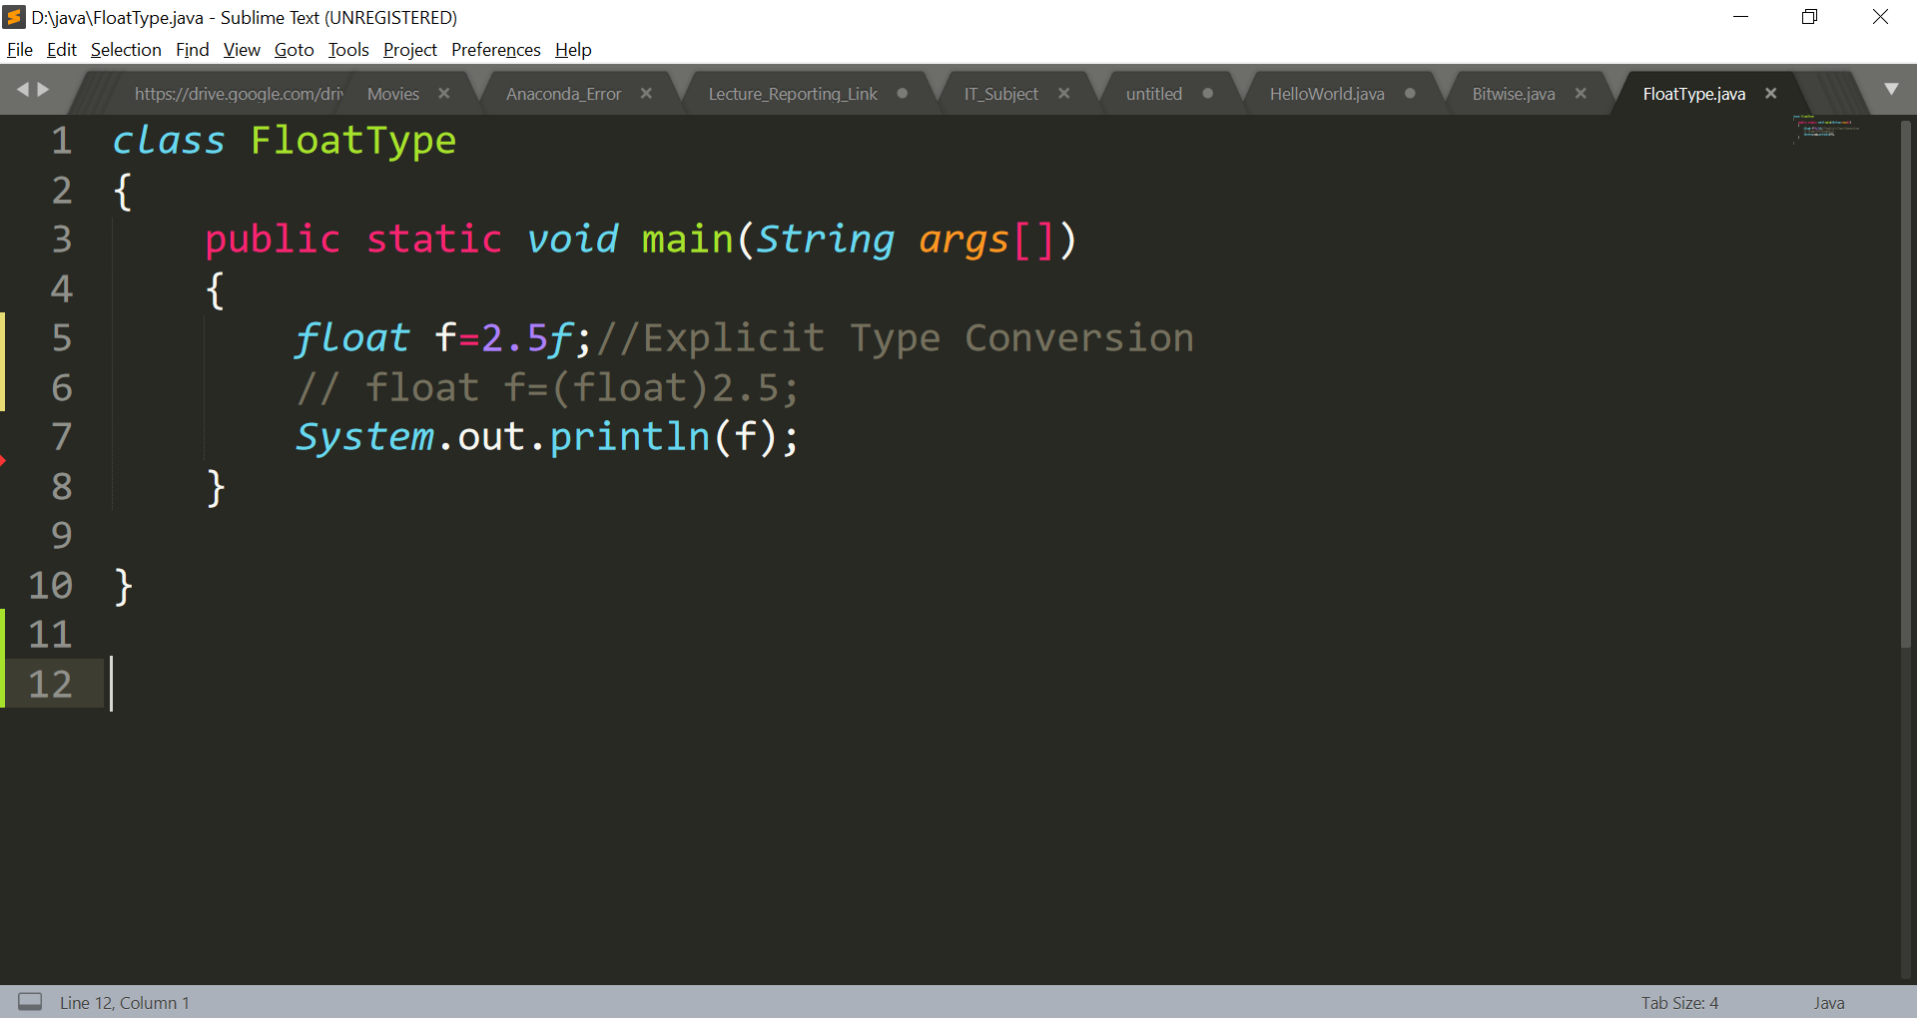
Floating point literal type casting

Slide 35
Operators

Slide 36
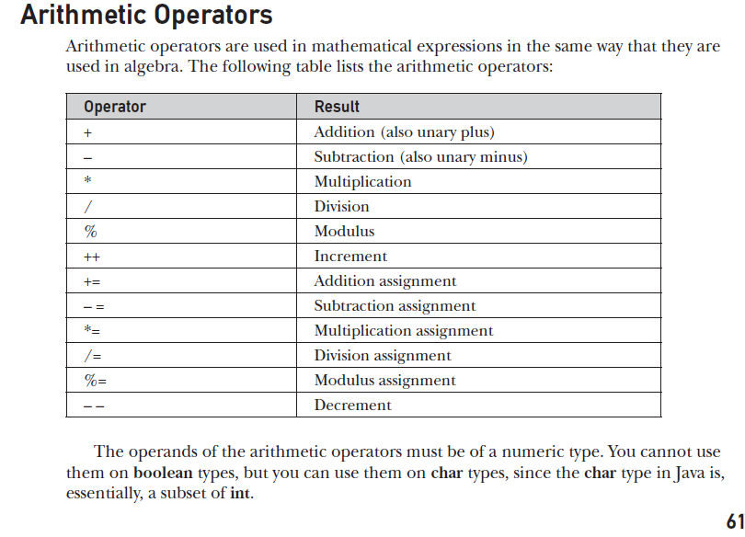
Operators
Arithmetic Operators:
Note: Modulus operator can be applied to floating-point types as well as integer types.

Slide 37
Operators
Increment/Decrement Operator:
The ++ and the – – are Java’s increment and decrement operators
They are of two types prefix and postfix (same as C/C++)

Slide 38
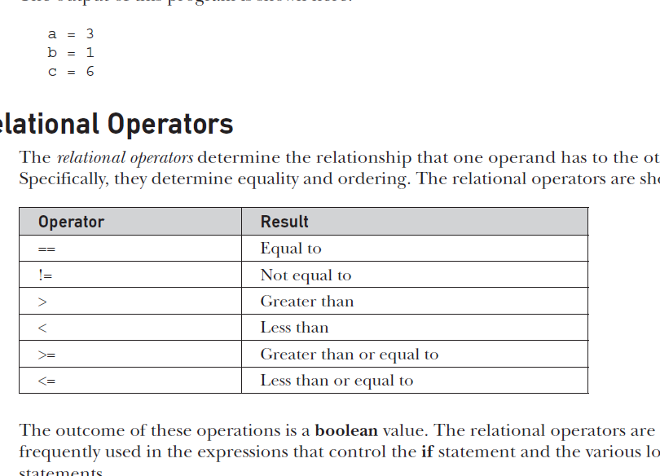
Operators
Relational Operators:

Slide 39
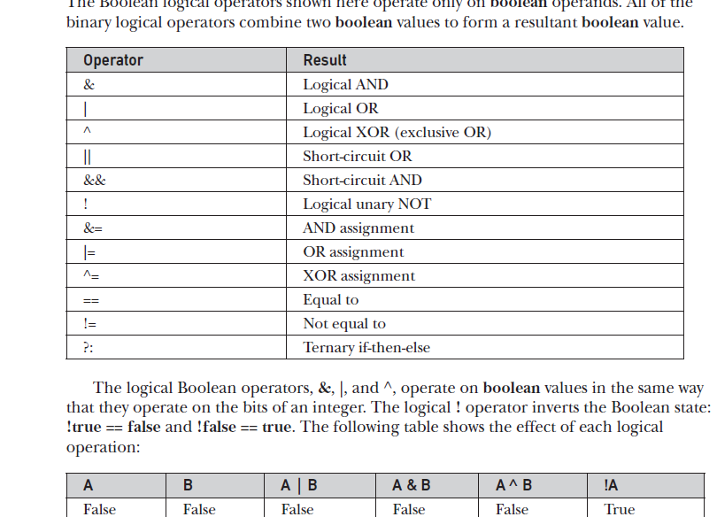
Operators
Logical(boolean) Operators:

Slide 40
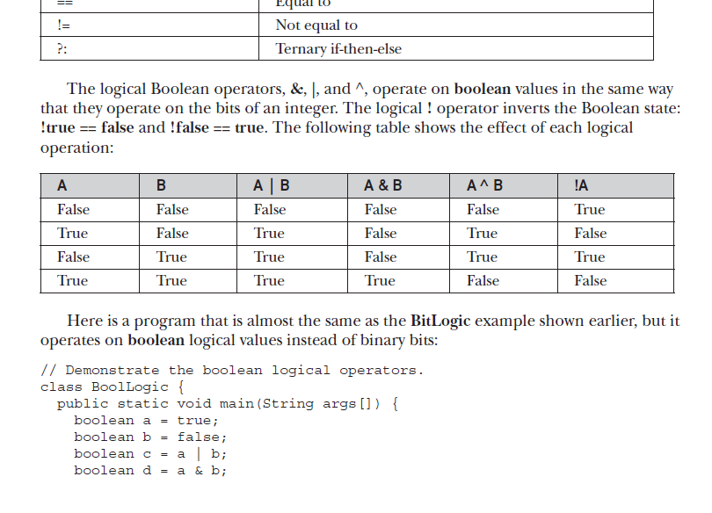
Operators
Short Circuit Logical(boolean) Operators:
The OR operator results in true when A is true, no matter what B is.
The AND operator results in false when A is false, no matter what B is.

Slide 41
Operators
Short Circuit Logical(boolean) Operators:
If you use the || and && forms, rather than the | and & forms of these operators:
Java will not bother to evaluate the right hand operand when the outcome of the expression can be determined by the left operand alone.

Slide 42
Operators
Short Circuit Logical(boolean) Operators:
Example1: if(a>b && a<c)
Example2: if (denom != 0 && num / denom > 10)
Since the short-circuit form of && is used, there is no risk of causing a run-time exception when denom is zero.
If we use conventional logical and operator, both the conditions will be evaluated.
if(a>b & a<c)

Slide 43
In Java
Logical operator = &, |
Short circuit logical operator = &&, ||

Slide 44
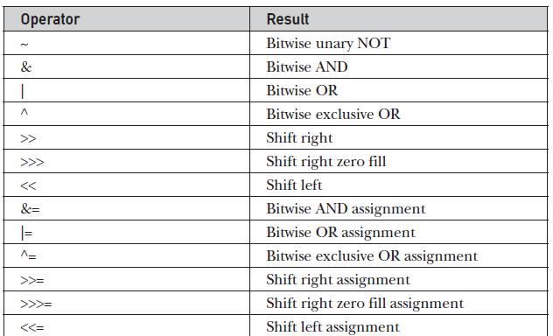
Operators
Bitwise Operators:

Slide 45
Operators
Bitwise Operators(~) : Complements every bit of the value i.e. 0 to 1 and 1 to 0 (NOT gate in Digital Electronics)
Example: byte a=5;
System.out.println(~a);
Explanation:
Note: As a is of type byte, we have to consider 1 byte data
Represent 5 into binary = 0000 0101
Bitwise NOT (~) = 1111 1010
The msb (most significant bit =1 , the number is -Ve)
Now take 2’s complement of the number= 1’s Comp. +1
= 0000 0101
+ 1
0000 0110 = -6

Slide 46
Operators
Bitwise Operators (&) : Bitwise AND operation (AND gate in Digital Electronics)
Example: byte a=5,b=4;
System.out.println(a&b);
Explanation:
Note: As a is of type byte, we have to consider 1 byte data
Represent 5 into binary = 0000 0101
Represent 4 into binary = 0000 0100
(Result of & )= 0000 0100

Slide 47
Operators
Bitwise Operators: << (shift left)
Syntax: var/val << n;
Here, n= number of times rotations
Example: byte a=5;
System.out.println(a<<1);
Explanation:
Note: As a is of type byte, we have to consider 1 byte data
Represent 5 into binary =
a<<1 =
0 | 0 | 0 | 0 | 0 | 1 | 0 | 1
0
0 | 0 | 0 | 0 | 1 | 0 | 1 | 0
Most significant bit is discarded and empty space created at Least significant bit is filled with 0

Slide 48
Operators
Bitwise Operators: >>> (shift right zero fill)
Syntax: var/val << n;
Here, n= number of times rotations
Example: byte a=5;
System.out.println(a>>>1);
Explanation:
Note: As a is of type byte, we have to consider 1 byte data
Represent 5 into binary =
a>>>1 =
0 | 0 | 0 | 0 | 0 | 1 | 0 | 1
0 | 0 | 0 | 0 | 0 | 0 | 1 | 0
1
Least significant bit will be discarded and empty space is filled with 0

Slide 49
Operators
Bitwise Operators: >> (shift right)
Most Significant bit of previous value is copied to the vacant place. Used to preserve the sign of previous value.
Example: byte a=-14;
System.out.println(a>>1);
Explanation:
Note: As a is of type byte, we have to consider 1 byte data
Represent 5 into binary =
a>>1 =
1 | 1 | 1 | 1 | 0 | 0 | 1 | 0
1 | 1 | 1 | 1 | 1 | 0 | 0 | 1
0
Least significant bit will be discarded and empty space is filled with the msb of the previous value.

Slide 50
While performing <<, value becomes double.
While performing >>, the value becomes half.

Slide 51
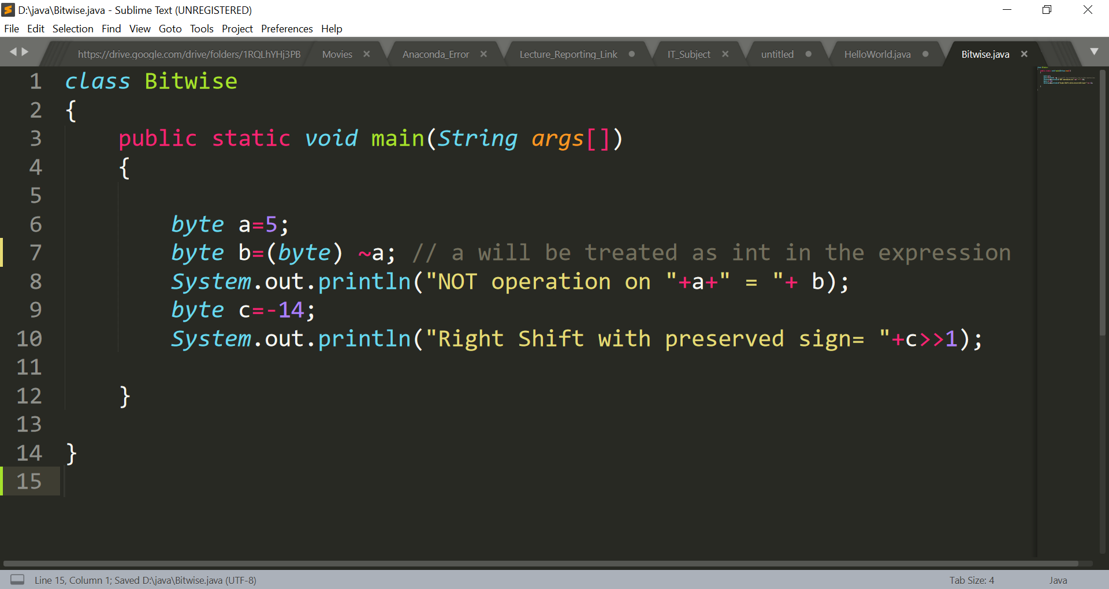
Operators

Slide 52
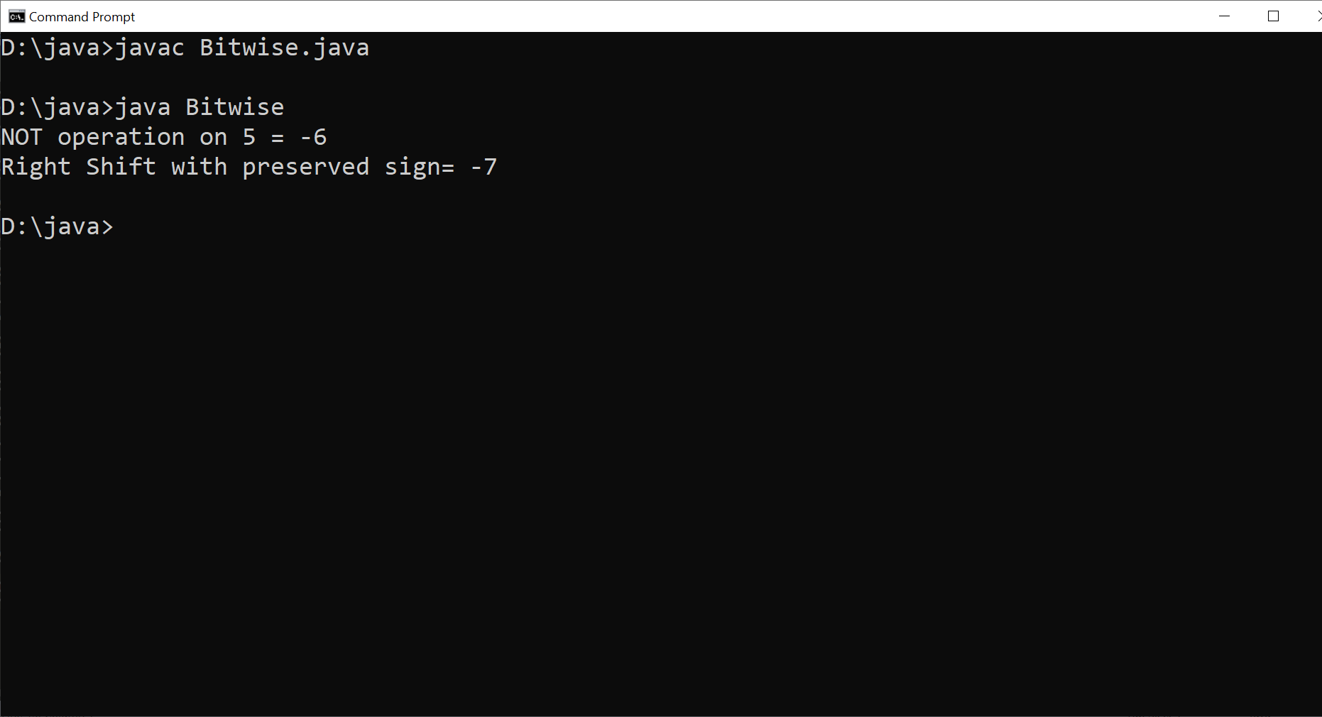
Operators

Slide 53
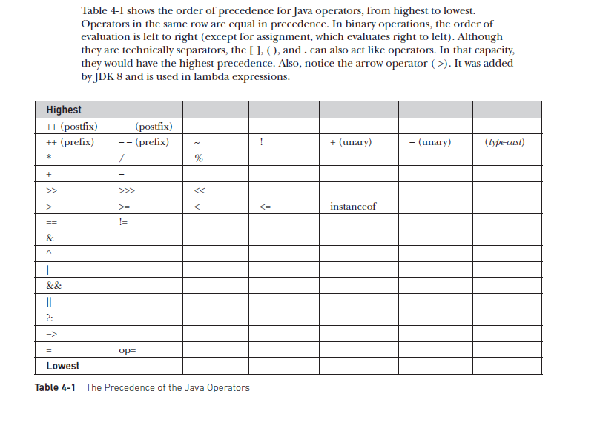
Operators
Operator Precedence:

Slide 54
Control Structures

Slide 55
Control Statements
Conditional Statements:
Simple if
If …..else
nested if
else if ladder
switch…… case
Note: We can use String in switch…..case as opposed to C/C++
Iterative Statements:
while loop
do.....while loop
for loop

Slide 56
for Loop
The for loop in Java is used when you know exactly how many times you want to execute a block of code.
for (initialization; condition; update)
{ // code to be executed repeatedly }
Initialization: Typically initializes a counter variable.
Condition: The loop continues as long as this condition is true.
Update: Increment or decrement the counter variable.
Example: Print numbers from 1 to 5
for (int i = 1; i <= 5; i++)
{ System.out.println(i);
}

Slide 57
while Loop
The while loop repeats a block of code as long as a specified condition is true.
while (condition)
{ // code to be executed repeatedly }
Example: Print numbers from 1 to 5
// Print numbers from 1 to 5 using while loop
int i = 1;
while (i <= 5)
{ System.out.println(i);
i++;
}

Slide 58
do-while Loop
The do-while loop is similar to the while loop, but it ensures that the block of code is executed at least once, even if the condition is false initially.
do { // code to be executed repeatedly }
while (condition);
// Print numbers from 1 to 5 using do-while
do
{ System.out.println(i);
i++;
}
while (i <= 5);

Slide 59
Sample Java programs demonstrating the use of loop

Slide 60
public class ForLoopExample
{
public static void main(String[] args)
{ int sum = 0;
// Using a for loop to calculate the sum of numbers from 1 to 5
for (int i = 1; i <= 5; i++)
{
sum += i;
}
System.out.println("Sum of numbers from 1 to 5: " + sum);
}
}

Slide 61
public class WhileLoopExample
{
public static void main(String[] args)
{
int i = 1;
while (i <= 5)
{
System.out.println(i);
i++;
}
}
}

Slide 62
public class DoWhileLoopExample
{
public static void main(String[] args)
{
int i = 1
do {
System.out.println(i);
i++;
} while (i <= 5);
}
}

Slide 63
Taking user input using Scanner class

Slide 64
Scanner class
In Java, there is no function i.e. scanf() or cin as available in C and C++ respectively.
One of the ways to take user input in Java is using Scanner class.
Steps to use Scanner class:
Import package java.util.Scanner or java.util.*
Create the object of Scanner class:
Scanner sc = new Scanner(System.in);
3. Invoke the appropriate method(function):
type a = sc.nextType();

Slide 65
Scanner class Methods
Method | Purpose
nextByte(), nextShort(), nextInt() and nextLong() | To read byte, short, int and long data respectively
nextFloat() and nextDouble() | To read float and double data respectively
nextBoolean() | To read boolean value
next() | To read string without space
nextLine() | To read string with space
Note: There is no method available to read char data

Slide 66
Use sc.next().charAt(0) method to read character data from the keyboard.

Slide 67
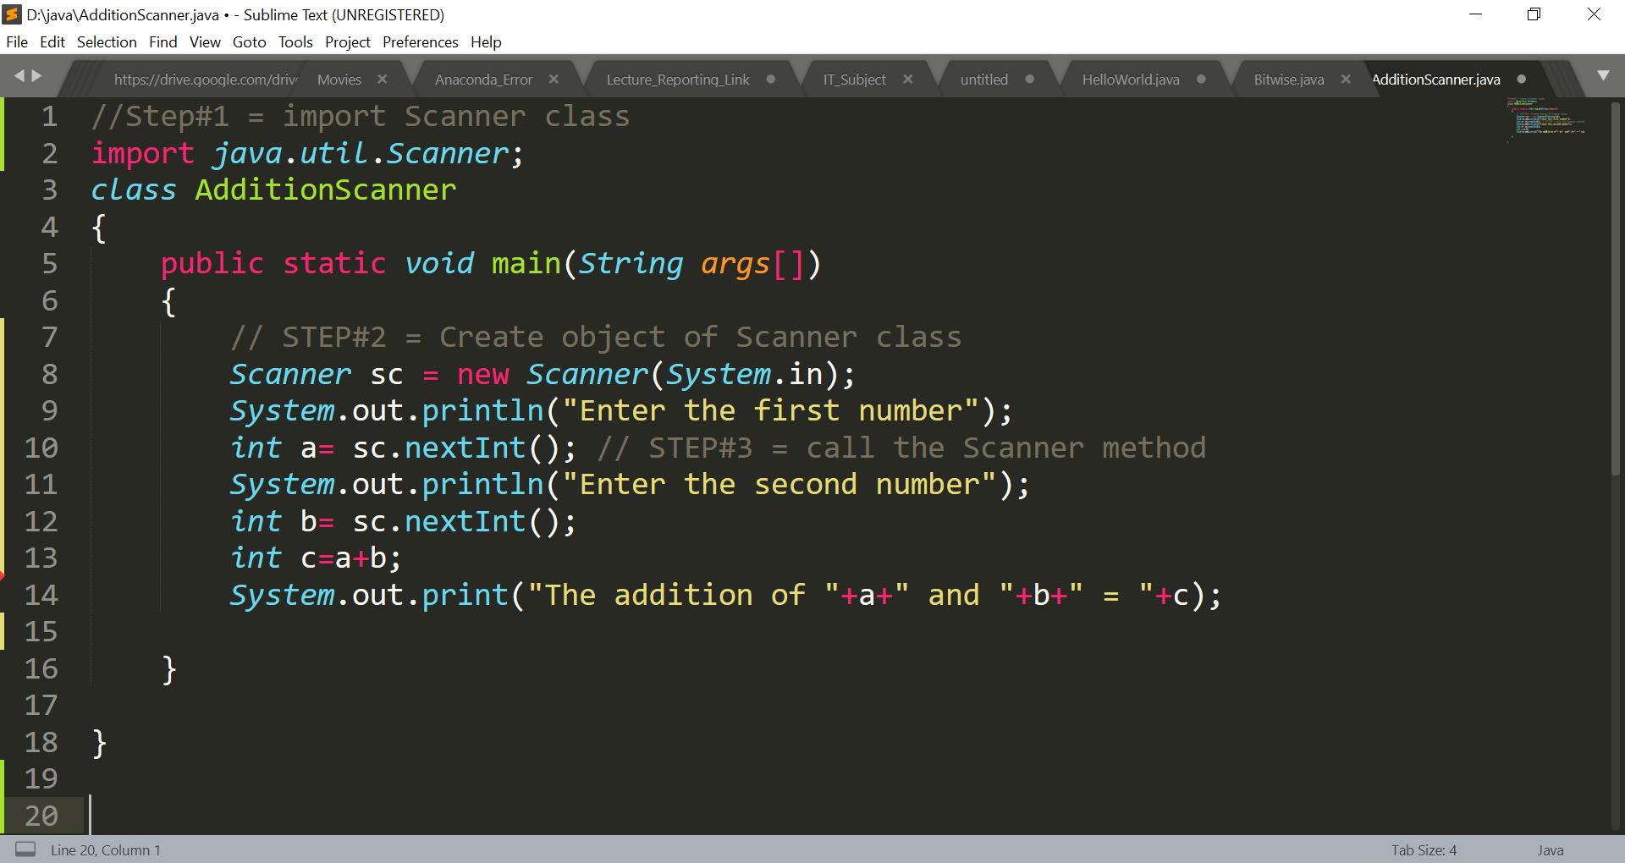
Addition of 2 numbers with user input

Slide 68
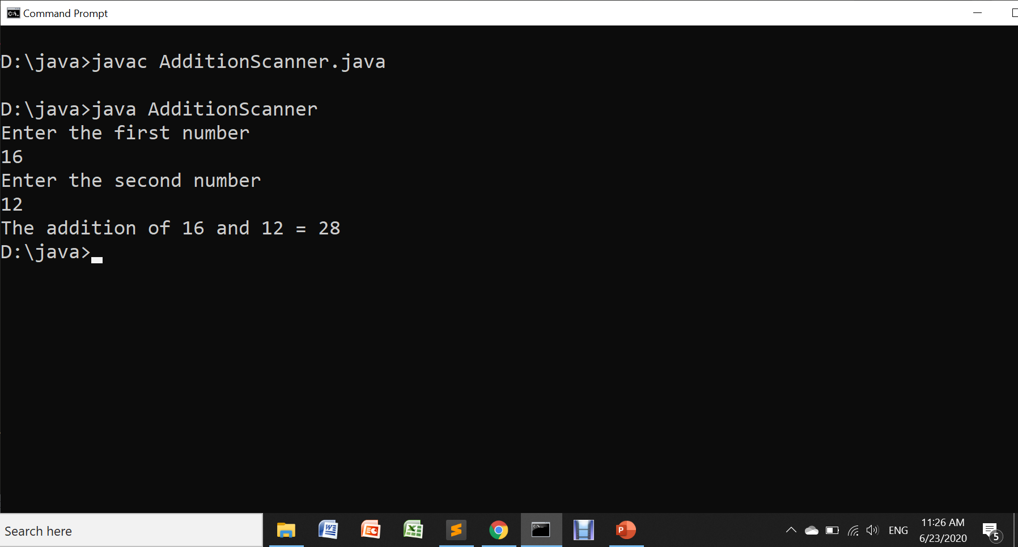
Addition of 2 numbers with user input

Slide 69
Working with Strings
String is a class in Java.
Syntax: String str_var;
Example: String str;
Initializing a string:
String str=“Hello”;
System.out.println(str);
Taking string as a user input from keyboard :
String str;
System.out.println(“Enter the String”);
str = sc.nextLine();

Slide 70
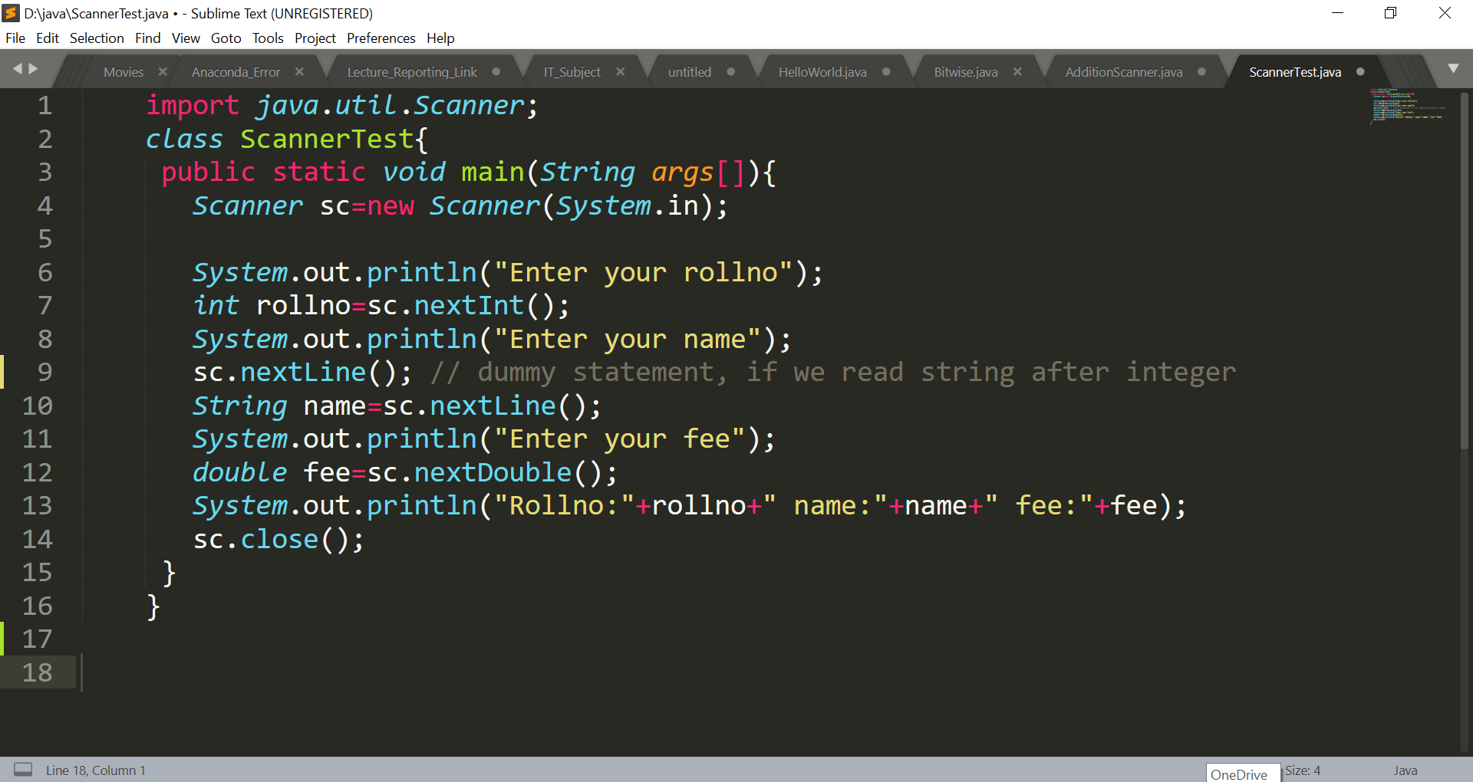
Reading different data from key board

Slide 71
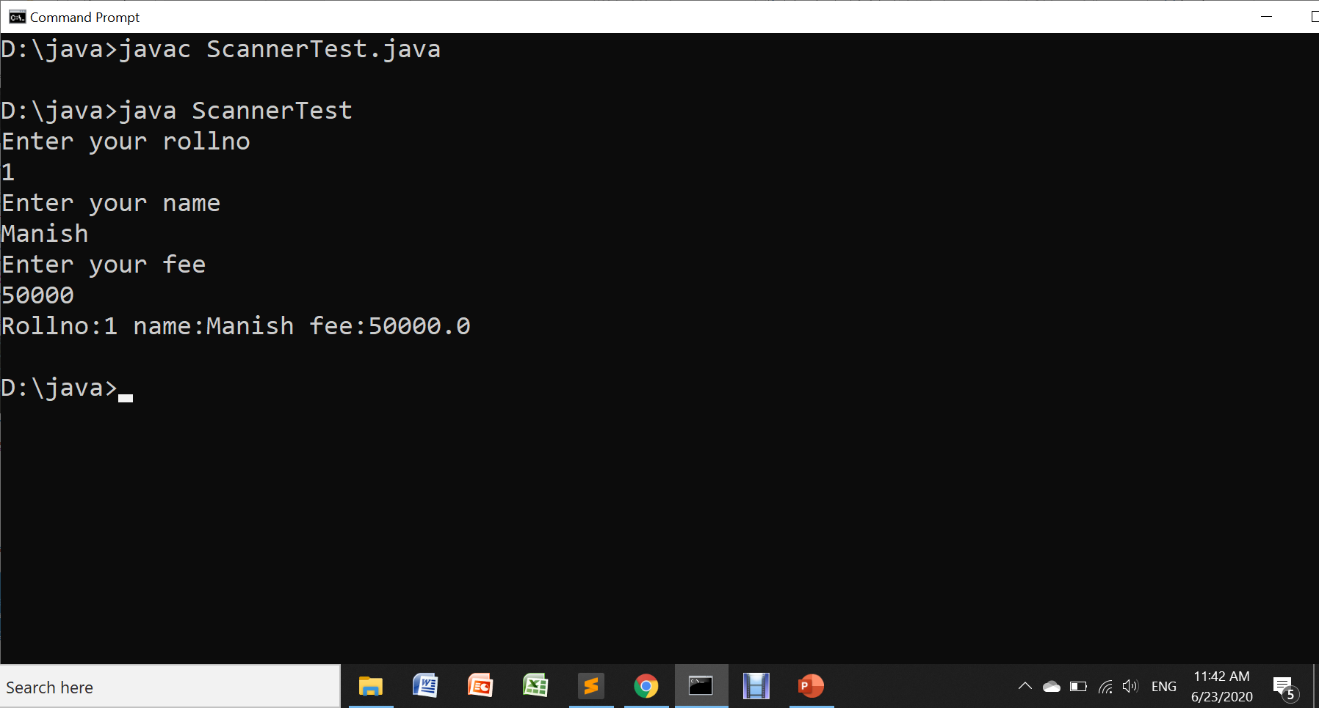
Taking User Input Through Keyboard

Slide 72
If we read a string after reading integer type data then provide one dummy statement i.e. sc.nextLine()

