Slide 1
Memory Bank of 8086

Slide 2
Why memory bank required??????
8086 Processor
1st cycle
Memory
Byte
00000
Individual memory location size is 8 bits
2nd cycle
8086 is 16 bit processor hence can access 16 bits at a time.
00001
00002
00003
00004
Hence processor will require 2 cycles to fetch 16 bits from memory.
00005
.
FFFFF
To avoid above problem memory bank concept is used. Processor can access two consecutive memory locations in one cycle.

Slide 3
Memory bank:
Even Address Memory Bank
Odd Address Memory Bank
8086 Processor
Even Memory
Odd Memory
Byte
Byte
FFFFE
FFFFF
.
.
.
.
00008
00009
00006
00007
Processor can read or write two memory locations of 16 bit in single cycle.
00004
00005
00002
00003
00000
00001

Slide 4
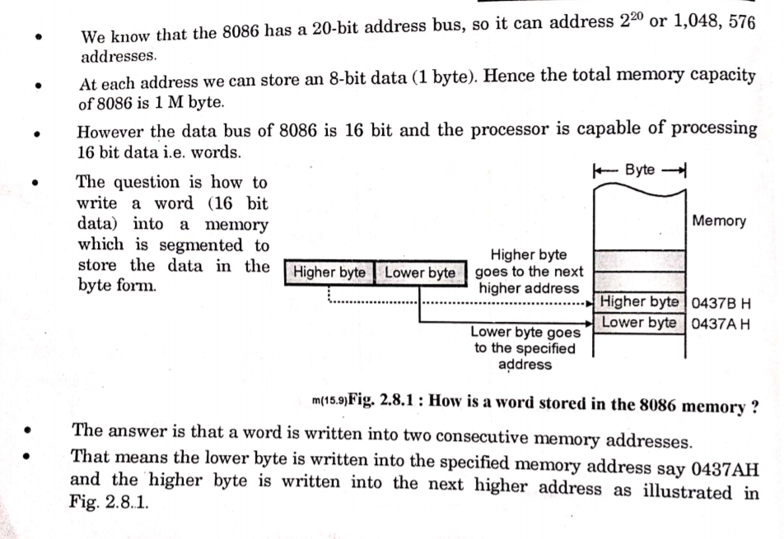
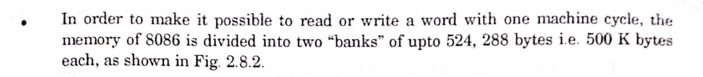

Slide 5
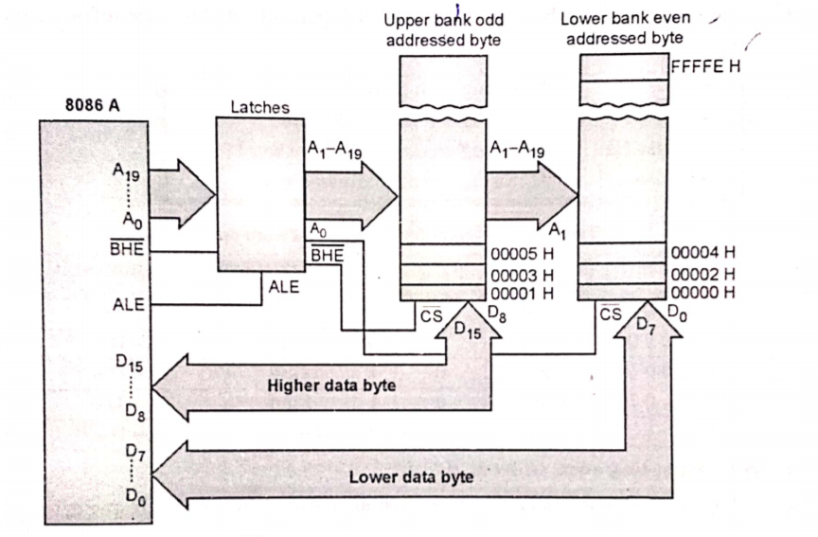
Block diagram of 8086 memory bank
BHE | A0 | Bank
0 | 0 | Both bank (16 bit)
0 | 1 | Odd (8 bit)
1 | 0 | even (8 bit)
1 | 1 | No Bank

Slide 6
To start the working of Chip, every chip has to activate.
To activate or enable particular chip there is a pin which is called as chip select .
This pin is active low, hence CS=0 will enable the chip.
Chip 1
Chip 1
CS
CS
0
1
Chip 1
Chip 1
For 8086 memory chip :
CS
CS
0
0
BHE
A0

Slide 7
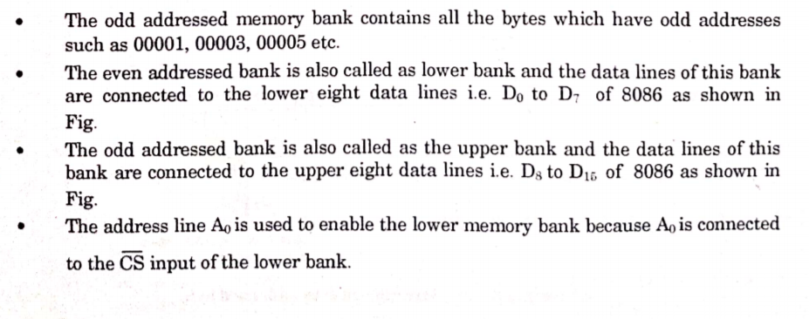
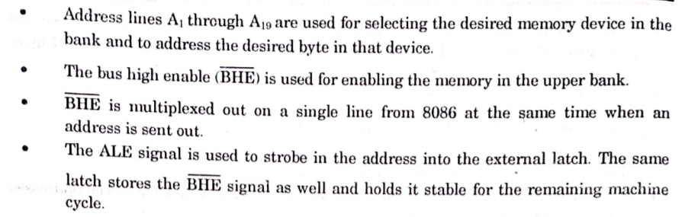

Slide 8
Different Types of memory access :
Accessing Even Addressed Byte
Accessing Odd Addressed Byte
Accessing Even Addressed word
Accessing Odd Addressed Word
Lower byte i.e. Lower 8 bits
Higher byte i.e. Higher 8 bits
All 16 bits , first lower then higher
All 16 bits , first higher then Lower

Slide 9
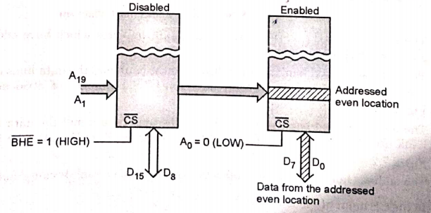
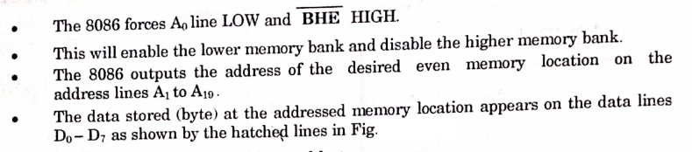
1. Accessing Even Addressed Byte
Processor wants to access 8 bits of even memory locations.
Lower byte i.e. Lower 8 bits
How many cycles are required to perform this operation ??????
ODD
Higher
EVEN
Lower
1 Cycle
Diasabled the chip
1
0
Activates the chip

Slide 10
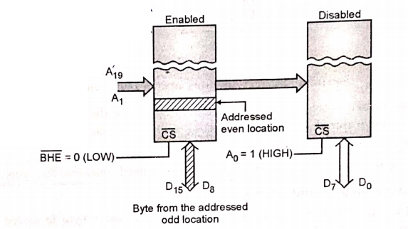
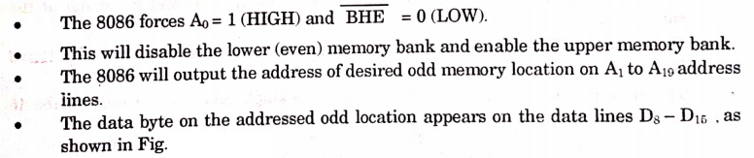
2. Accessing Odd Addressed Byte
Processor wants to access 8 bits of odd memory locations.
Higher byte i.e. Higher 8 bits
How many cycles are required to perform this operation ??????
ODD
Higher
EVEN
Lower
1 Cycle
Activates the chip
1
0
Disabled the chip

Slide 11
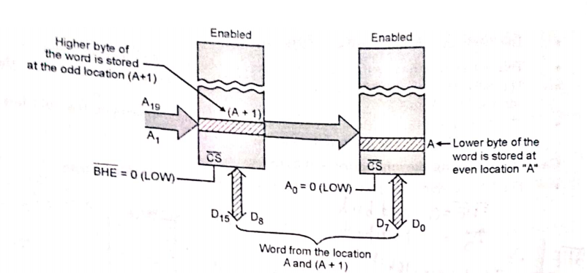
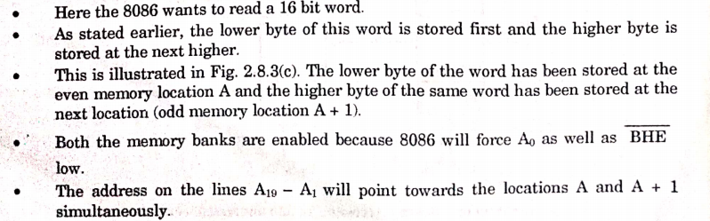
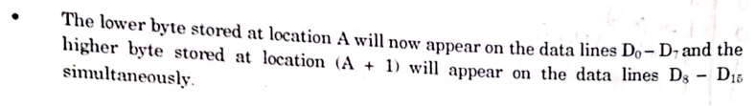
3. Accessing Even Addressed Word
Processor wants to access 16 bits of even memory locations.
All 16 bits , first lower 8 bits then higher 8 bits
2
ODD
Higher
EVEN
Lower
1
0
0
How many cycles are required to perform this operation ??????
1 Cycle

Slide 12
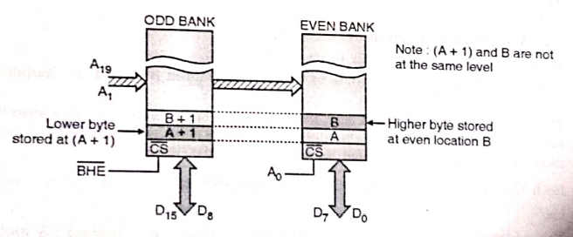
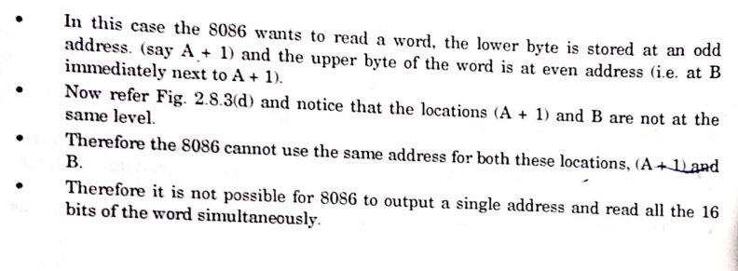

4. Accessing Odd Addressed Word
All 16 bits , first Higher 8 bits then Lower 8 bits
2
1
How many cycles are required to perform this operation ??????
2 Cycle

Slide 13
