Slide 1

GRID GUARD
Power Outage Prediction & Grid Equipment Failure Advisor
TEAM MAVERICK
COMPETITION TRACK
Heet Dadhaniya, Axit Dudhat, Aryan Jivani, Parth Vora
Bobathon · Track: AI · Use Case: U1
01
Notes:
Welcome. We are Team Maverick, and today we're presenting Grid Guard—a solution that transforms how utilities manage their most critical assets. We're competing in the AI track for Use Case U1.

Slide 2

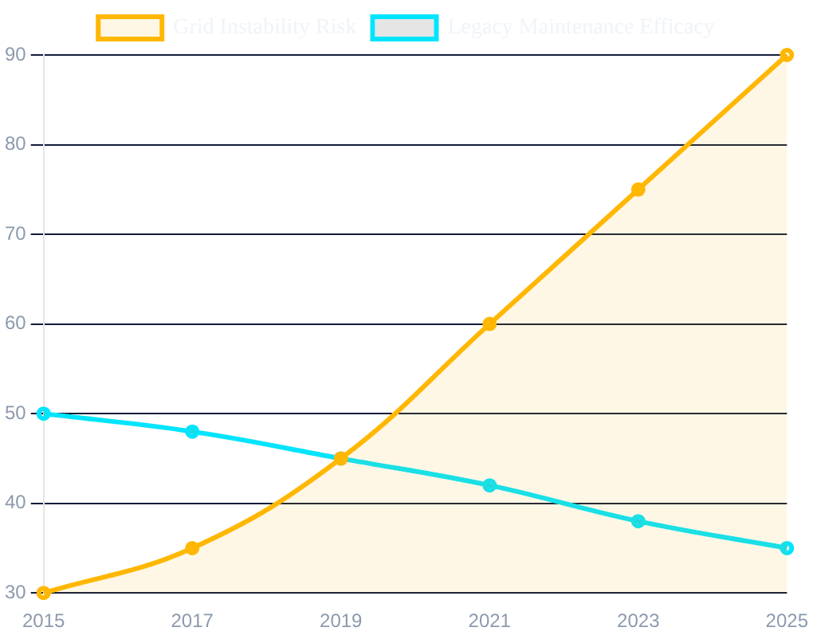
THE GRID IS SIGNALING FAILURE BEFORE IT HAPPENS
MISSED SIGNALS
Utilities run on calendar-based maintenance, ignoring condition signals already streaming from sensors into SCADA historians.
INCREASING RISK
Aging infrastructure, extreme weather events, and growing renewable loads are making the status quo dangerous.
PREDICTABLE REALITY
Signals like temperature, vibration, and partial discharge are available but unread, leading to unexpected failures.
Conceptual: Grid Reliability Risk vs. Maintenance Strategy Effectiveness
02
Notes:
The problem isn't a lack of data; it's a lack of synthesis. Utilities are drowning in sensor telemetry that sits unread in SCADA historians while they stick to rigid, calendar-based maintenance schedules that ignore the actual condition of the equipment.

Slide 3
A PREDICTABLE FAILURE STILL BECOMES AN OUTAGE
BLIND MAINTENANCE
DATA SILOS
FINANCIAL EXPOSURE
Utilities treat a degrading transformer and a healthy one identically, relying on fixed schedules rather than actual condition.
Telemetry streams into SCADA historians where it remains unread. The signals for failure are present but never synthesized.
Unexpected critical asset failure costs utilities millions in lost revenue, emergency labor, and regulatory fines.
100%
0%
$1M+
IDENTICAL TREATMENT
SIGNAL SYNTHESIS
COST PER HOUR
03
Notes:
When a transformer fails unexpectedly, the clock starts at a million dollars per hour in lost revenue and emergency costs. These failures are often predictable days in advance, yet the status quo remains reactive and dangerous.

Slide 4
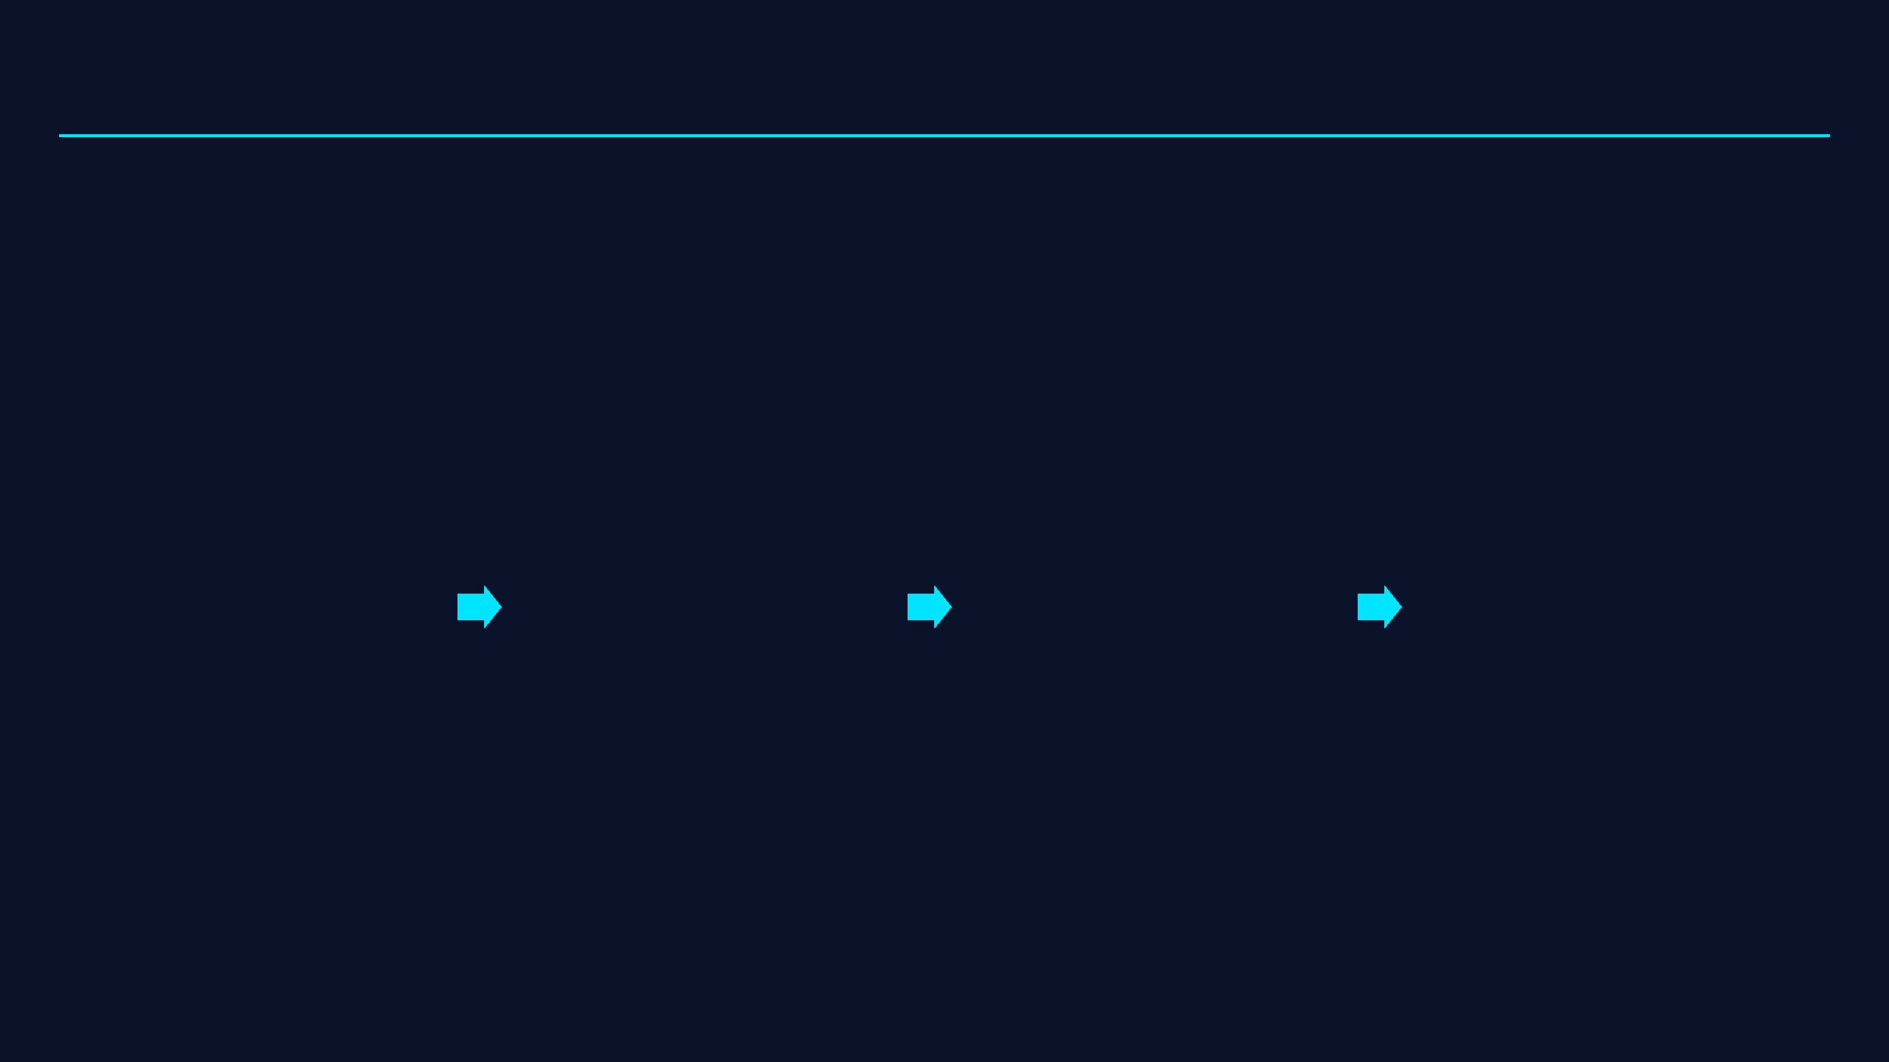
FROM RAW TELEMETRY TO FIELD-READY ACTION
STAGE 01
STAGE 02
STAGE 03
STAGE 04
FUSE
PREDICT
RANK
ACT
Sensor telemetry, weather forecasts, and historical incident records joined in a single pipeline.
Rolling feature window feeds an XGBoost classifier to output failure probability per asset.
Assets scored by grid-impact severity: probability × customers served × criticality tier.
IBM Bob synthesizes ranked data into a prioritized, plain-English maintenance and dispatch plan.
Neon Postgres
XGBoost + SHAP
Severity Engine
IBM Bob / watsonx.ai
04
Notes:
Grid Guard solves this through a four-stage workflow: we fuse telemetry and weather data in Neon Postgres, predict failure probability with XGBoost, rank by grid-impact severity, and finally, use IBM Bob to generate an actionable crew plan.

Slide 5

ONE PIPELINE, THREE OPERATOR VIEWS
DATA INGESTION
ML ENGINE
OPERATIONAL LOGIC
Neon Postgres
XGBoost Scoring
Severity Ranker
Fusing sensor telemetry, weather, and incident records.
Feature engineering and failure probability classification.
The bridge between ML output and operational reality.
INTERFACE
API LAYER
AI SYNTHESIS
Streamlit Dashboard
FastAPI
IBM Bob / watsonx
Risk map, ranked table, and maintenance plan views.
Single API call updates all operator views in real-time.
Generating plain-English maintenance and crew plans.
05
Notes:
Our architecture is built for operational reality. From data generation to a Streamlit dashboard, every step is designed to bridge the gap between complex ML outputs and the clear, ranked views that operators need to make decisions.

Slide 6
BOB EARNS ITS PLACE AT THE DECISION POINT
INPUT: STRUCTURED RISK DATA
OUTPUT: IBM BOB FIELD BRIEFING
{ "asset_id": "TX-4092", "failure_prob": 0.84, "severity_score": 9.2, "top_shap_features": [ "oil_temp_rise", "partial_discharge_count" ], "weather_context": "Severe Storm Warning", "impact": "1,200 customers" }
PRIORITY ALPHA: Immediate dispatch to Transformer TX-4092.
Model flags 84% failure probability driven by critical oil temperature rise and partial discharge spikes. Combined with the 48-hour severe storm warning, this asset poses a high risk to 1,200 customers.
ACTION: Deploy crew for immediate thermal inspection and oil sampling before storm onset.
06
Notes:
IBM Bob and watsonx.ai are the final, critical link. While deterministic code handles the heavy lifting of scoring, Bob synthesizes that data into plain-English field briefings, turning a spreadsheet of risk scores into a clear decision for the crew.

Slide 7
PROBABILITY IS NOT PRIORITY
IMPACT / CRITICALITY
MEDIUM PRIORITY
CRITICAL ACTION
SEVERITY RANKING ENGINE
High Prob / Low Impact
High Prob / High Impact
P(Failure)
× Customers Served
× Tier Criticality
MONITOR
PREVENTATIVE
A 40% failure probability on a backbone transmission asset outranks a 70% probability on a low-impact feeder.
Low Prob / Low Impact
Low Prob / High Impact
LOW PROBABILITY
HIGH PROBABILITY
07
Notes:
Crucially, we understand that probability is not priority. Our severity engine ensures that a high-impact backbone failure always outranks a lower-impact feeder risk, even if the feeder has a higher probability of failure.

Slide 8
DESIGNED TO MOVE FROM PROTOTYPE TO UTILITY
NEAR-TERM
MEDIUM-TERM
AT SCALE
Integration
Optimization
Grid Impact
Swap synthetic data for real utility SCADA feeds.
Retrain on utility-specific historical incident records.
Reduce emergency maintenance costs by flagging outages weeks in advance.
Connect live NOAA/NWS severe-weather alerts.
Tune models to local fleet and operating environments.
Improve SAIDI/SAIFI reliability metrics.
Zero structural changes required to model architecture.
Refine severity weights based on operational feedback.
Enable higher renewable utilization within safe limits.
08
Notes:
Grid Guard is ready for utility deployment. We can swap in real SCADA feeds today, retrain on specific historical records tomorrow, and ultimately scale to reduce costs and improve grid reliability across entire regions.

Slide 9
FUSE. RANK. ACT.
Grid Guard turns signals utilities already have into decisions crews can use.
TEAM MAVERICK
CONTACT / DEMO
Heet Dadhaniya, Axit Dudhat, Aryan Jivani, Parth Vora
Bobathon 2026 · Track: AI · Use Case: U1
09
Notes:
In closing, Grid Guard is about turning signals into action. Fuse the data, rank the risk, and act before the outage happens. We are Team Maverick. Thank you.

