Slide 1
Student Attendance Management System
A. D. PATEL INSTITUTE OF TECHNOLOGY
Department of Information Technology | CVM University
DBMS MINI PROJECT
Subject: Database Management System (DBMS) | Academic Year 2026–2027
Enrollment No. | Name
26D2DIT006 | Mistry Hit M
26D2DIT007 | Parmar Shrey S
12502080601040 | Rana Jaimin
12502080601045 | Patel Jayam
Notes:
SUGGESTED SPEAKER: Team Leader (Hit).
Good morning, respected faculty. We are Group ___ from the Department of Information Technology, and our DBMS mini project is the Student Attendance Management System. Let me introduce our team: [read names and roles from the table]. We will now walk you through the problem, the database design, the SQL implementation, a live demonstration and our conclusion.
TIP: Edit the team table, group number and faculty name directly on this slide.

Slide 2


Problem Statement & Motivation
Existing manual system
Proposed database system
Attendance kept in paper registers or separate spreadsheets
Searching one student's record takes time
Repeated manual percentage calculations cause errors
Hard to list defaulters or absentees for a date
Student, faculty and course data stored in linked tables
Constraints block duplicate and invalid entries
SQL calculates attendance percentage instantly
Ready reports: below 75%, daily absentees, course summary
Need: an automated, consistent attendance database that saves faculty time and flags low attendance early.
Notes:
SUGGESTED SPEAKER: Member 2 (Shrey).
In most colleges attendance is still kept in registers or separate spreadsheets. It is slow to search, percentages are calculated by hand and mistakes creep in. It is also difficult to quickly find students below 75% or who was absent on a particular day.
Our system stores everything in related database tables, blocks duplicate and invalid entries with constraints, and produces reports with simple SQL queries.

Slide 3




System Objectives & Requirements
Core objectives
System requirements
Store records
Student, faculty and course details in related tables
Component | Requirement
Hardware | Standard desktop or laptop
Database | SQLite (local database file)
Language | Python 3
Interfaces | CLI, Tkinter desktop GUI, Browser (HTML / JS)
SQL files | schema.sql, sample_data.sql, queries.sql
Editor | Visual Studio Code
Record attendance
Daily Present / Absent entry for every course
Calculate percentage
Per student and per course, automatically
Flag defaulters
Students below the 75% requirement
Keep data valid
Keys and constraints stop duplicates and bad values
Notes:
SUGGESTED SPEAKER: Member 2 (Shrey).
Our objectives are: store student, faculty and course data; record daily Present or Absent; calculate percentages; flag students below 75%; and keep the data valid using keys and constraints.
For requirements we need only a normal laptop. The database is SQLite and the application is written in Python with three interfaces: command line, Tkinter desktop GUI and a browser page.

Slide 4



System Architecture / Flowchart
Users
Interface Layer
Application Logic
Database Layer
Faculty / Admin
Mark daily attendance
View attendance reports
CLI: main.py
Tkinter GUI: gui_app.py
Browser: attendance_app.html
Python application code
75% / 65% criteria rules
SQL queries and joins
SQLite database
Students, Faculty, Courses, Attendance_Logs
Attendance summary view
Data flow: faculty marks attendance → saved after constraint checks → view calculates % → report shown
Notes:
SUGGESTED SPEAKER: Member 3 (Jaimin).
This is the high-level architecture. The faculty or admin is the user. They interact through one of three interfaces. The Python application applies the business rules and runs SQL queries. All data lives in one SQLite database with four tables and a summary view.
Flow: attendance is marked, saved only if it passes the constraints, the view calculates percentages, and the report is shown on screen.

Slide 5
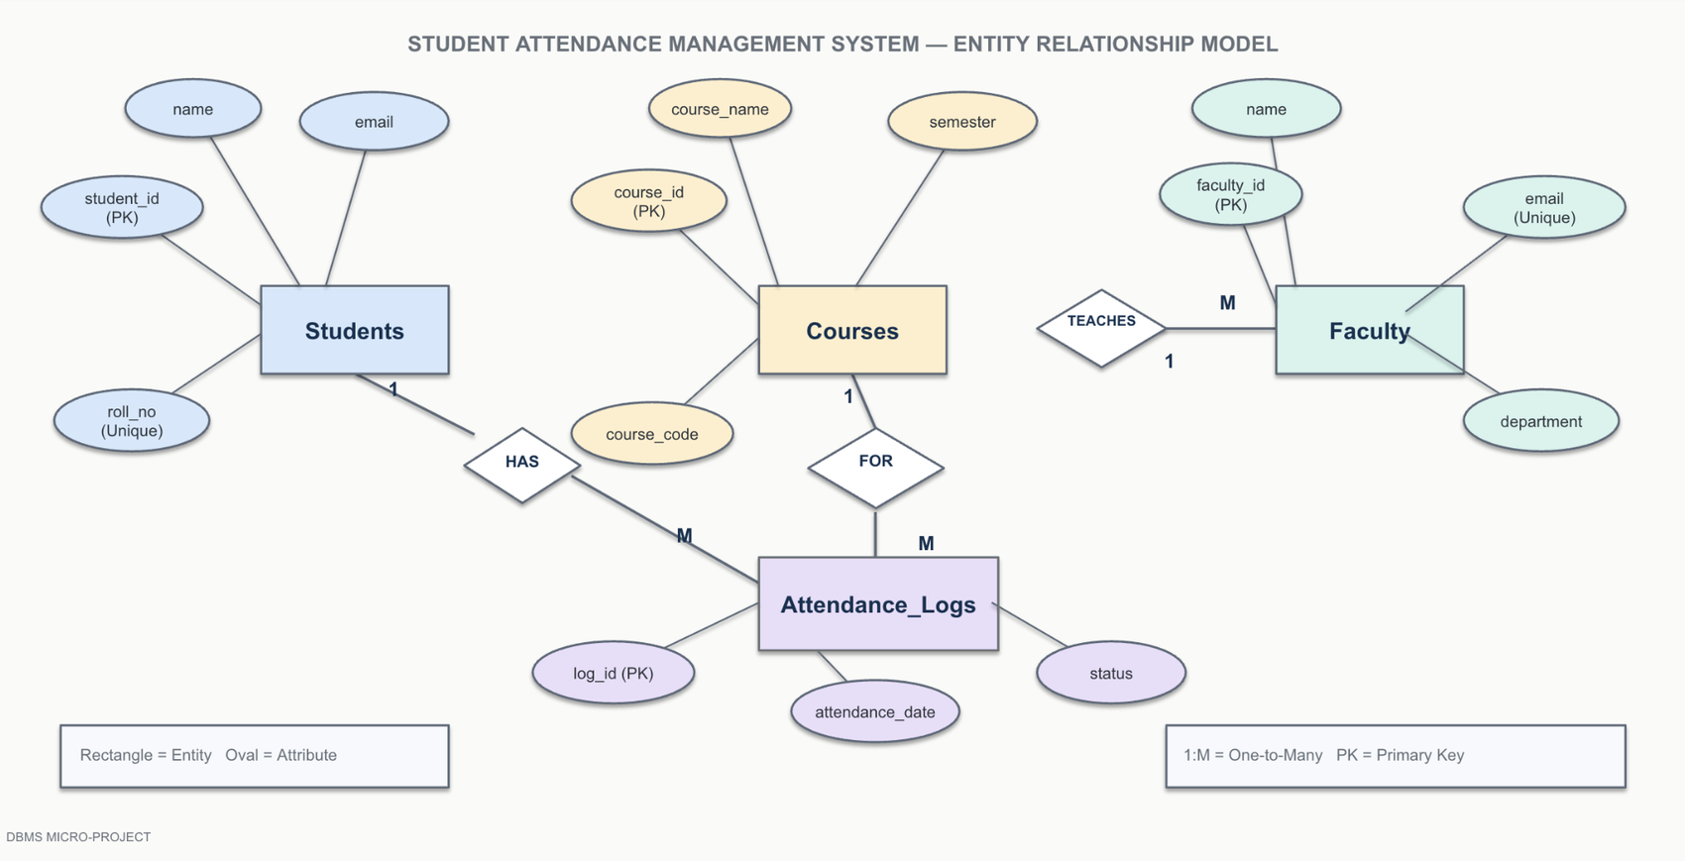
Entity-Relationship (ER) Diagram
Relationships & cardinality
Faculty 1 : M Courses
One faculty teaches many courses
Students 1 : M Attendance_Logs
One student has many entries
Courses 1 : M Attendance_Logs
One course has many entries
Notes:
SUGGESTED SPEAKER: Member 1 (Hit).
Our ER diagram has four entities: Students, Faculty, Courses and Attendance_Logs. Primary keys are student_id, faculty_id, course_id and log_id.
Relationships: one faculty teaches many courses (1:M). One student has many attendance entries (1:M). One course has many attendance entries (1:M). Attendance_Logs is the table that connects everything.

Slide 6
Relational Schema & Normalization
Students
Faculty
Courses
Attendance_Logs
student_id PK
roll_no UNIQUE
name
email
department
semester
faculty_id PK
name
email UNIQUE
department
course_id PK
course_code UNIQUE
course_name
credits
department
semester
faculty_id FK
log_id PK
student_id FK
course_id FK
marked_by FK
attendance_date
status
UNIQUE (student, course, date)
1NF
Every field holds one value
2NF
Details sit with their own key
3NF
No repeated data
One roll number and one email per student, never a list in a single field.
Student names and contacts stay in Students, not repeated in every attendance row.
Faculty and course details are separate tables; Attendance_Logs uses foreign keys instead of repeating emails or course names.
Notes:
SUGGESTED SPEAKER: Member 1 (Hit).
The ER model maps to four tables. PK is a primary key and FK a foreign key. Courses points to Faculty through faculty_id. Attendance_Logs points to Students, Courses and Faculty, and has a UNIQUE rule so the same student cannot be marked twice for the same course and date.
Normalization: 1NF - single values in every field. 2NF - details are stored with their own key. 3NF - faculty and course details are in separate tables, so nothing is repeated unnecessarily.

Slide 7
SQL Implementation: DDL Scripts
Students table
Attendance_Logs table
CREATE TABLE Students (
student_id INTEGER PRIMARY KEY AUTOINCREMENT,
roll_no TEXT NOT NULL UNIQUE,
name TEXT NOT NULL,
email TEXT UNIQUE,
department TEXT NOT NULL,
semester INTEGER NOT NULL
CHECK (semester BETWEEN 1 AND 8)
);
CREATE TABLE Attendance_Logs (
log_id INTEGER PRIMARY KEY AUTOINCREMENT,
student_id INTEGER NOT NULL,
course_id INTEGER NOT NULL,
marked_by INTEGER NOT NULL,
attendance_date TEXT NOT NULL,
status TEXT NOT NULL
CHECK (status IN ('Present', 'Absent')),
FOREIGN KEY (student_id) REFERENCES Students(student_id),
FOREIGN KEY (course_id) REFERENCES Courses(course_id),
FOREIGN KEY (marked_by) REFERENCES Faculty(faculty_id),
UNIQUE (student_id, course_id, attendance_date)
);
Courses table
CREATE TABLE Courses (
course_id INTEGER PRIMARY KEY AUTOINCREMENT,
course_code TEXT NOT NULL UNIQUE,
course_name TEXT NOT NULL,
credits INTEGER NOT NULL CHECK (credits > 0),
department TEXT NOT NULL,
semester INTEGER NOT NULL
CHECK (semester BETWEEN 1 AND 8),
faculty_id INTEGER NOT NULL,
FOREIGN KEY (faculty_id) REFERENCES Faculty(faculty_id)
);
PK & FK
Every row is unique and linked to valid records
UNIQUE
No duplicate attendance for the same student, course and date
CHECK
Status only Present or Absent; semester 1 to 8
Notes:
SUGGESTED SPEAKER: Member 2 (Shrey).
These are the DDL scripts. Students has a unique roll number and a CHECK that semester is between 1 and 8. Courses links to Faculty with a foreign key. Attendance_Logs is the main table: status can only be Present or Absent, three foreign keys keep records valid, and a UNIQUE rule on student, course and date stops duplicate entries.
The full project also has the Faculty table, indexes and the v_attendance_summary view.

Slide 8
SQL Implementation: Queries (DML)
1 Attendance summary (view)
2 Students below 75%
Total classes, attended, % and eligibility status
Defaulter list, lowest percentage first
SELECT roll_no, student_name, course_code,
total_classes, classes_attended,
percentage, criteria_status
FROM v_attendance_summary
ORDER BY roll_no, course_code;
SELECT roll_no, student_name, course_code,
percentage, criteria_status
FROM v_attendance_summary
WHERE percentage < 75
ORDER BY percentage;
3 Absentees on a selected date (JOIN)
4 Faculty and assigned courses (JOIN)
Joins three tables to list who was absent
Which faculty member teaches which course
SELECT s.roll_no, s.name,
c.course_code, al.attendance_date
FROM Attendance_Logs al
JOIN Students s ON s.student_id = al.student_id
JOIN Courses c ON c.course_id = al.course_id
WHERE al.status = 'Absent'
AND c.course_code = 'IT501'
AND al.attendance_date = '2026-10-23';
SELECT f.name AS faculty,
c.course_code, c.course_name
FROM Faculty f
JOIN Courses c ON c.faculty_id = f.faculty_id
ORDER BY f.name;
Notes:
SUGGESTED SPEAKER: Member 3 (Jaimin).
Query 1 reads from the view v_attendance_summary, which calculates total classes, classes attended and percentage using aggregate functions. Query 2 filters that view to show students below 75%. Query 3 joins Attendance_Logs, Students and Courses to list absentees for a date. Query 4 joins Faculty and Courses.
A view stores a reusable SELECT, not a copy of the data.

Slide 9
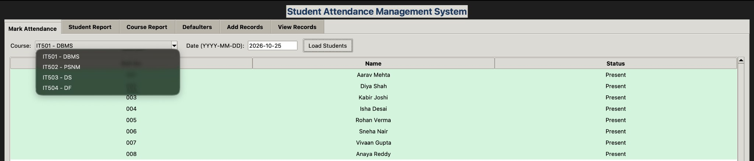
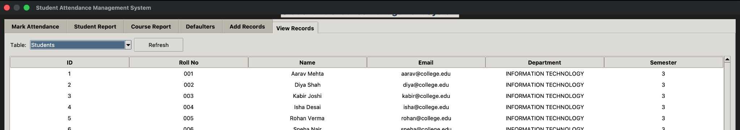
Demonstration: Interfaces & Stored Data
Desktop GUI: Mark Attendance
Choose course and date, load students, toggle Present / Absent and save.
Command-line menu
main.py: mark attendance, run reports and add records from a numbered menu.
Database snapshot: Students table
Sample data: 8 students, 4 courses, 3 faculty, 12 days of attendance.
The CLI and desktop GUI share one SQLite database; the browser version keeps its own data in the browser.
Notes:
SUGGESTED SPEAKER: Member 3 (Jaimin) - run the live demo.
DEMO STEPS: (1) python3 main.py to show the menu. (2) Open python3 gui_app.py, go to Mark Attendance, pick a course and date, Load Students, toggle a student Absent, Save Attendance. (3) Open View Records to show the populated Students table.
If the live demo fails, use these screenshots.

Slide 10
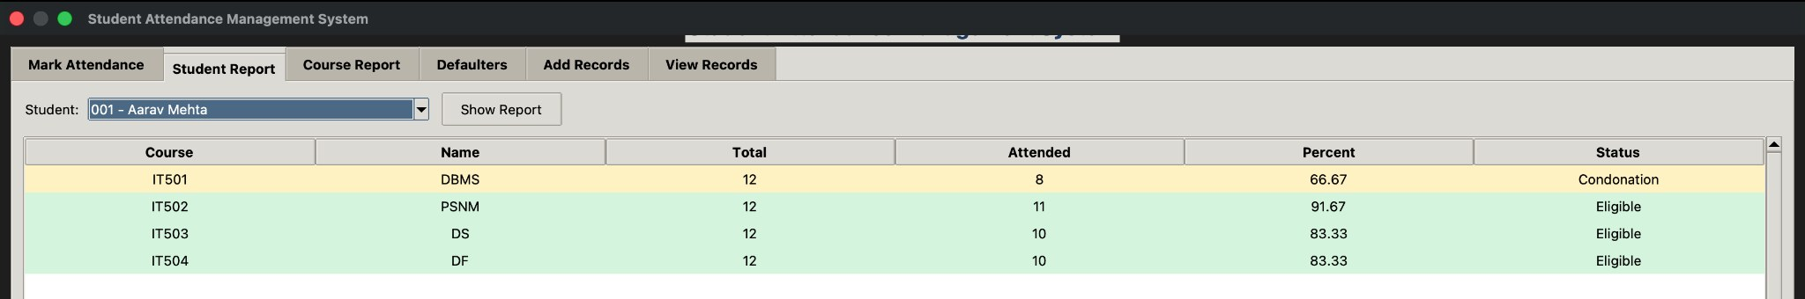
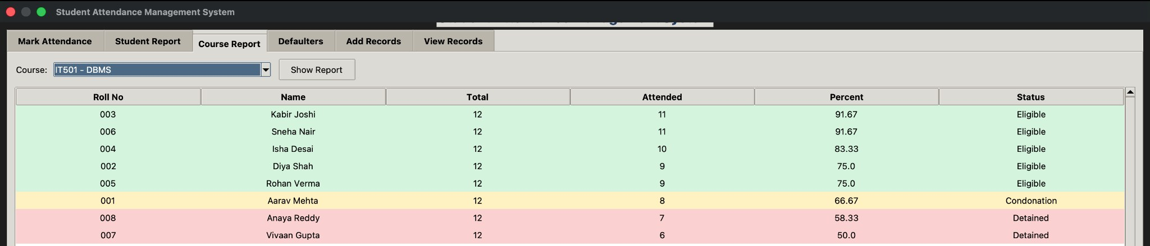
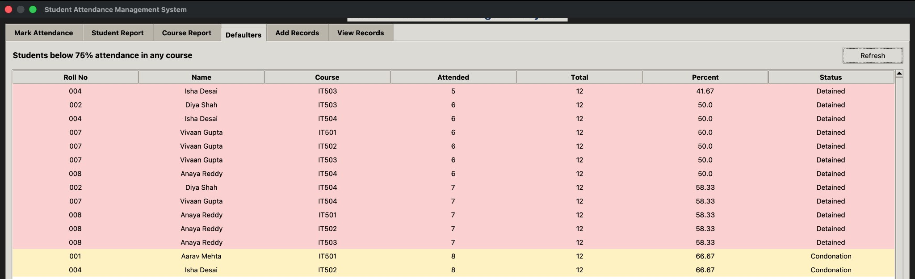
Demonstration: Attendance Reports
Student report
Course-wise total, attended, % and status for one student.
Course report
Every student of a course with percentage and status.
Defaulter list
All students below 75% in any course. Status rules below are sample project rules.
Eligible: 75% or more
Condonation: 65% to below 75%
Detained: below 65%
Notes:
SUGGESTED SPEAKER: Member 4 (Jayam).
These are the report screens. The Student Report shows one student's attendance in every course. The Course Report lists all students of a course. The Defaulters tab lists everyone below 75% in any course.
Rows are colour-coded: green is Eligible (75% or more), amber is Condonation (65% to below 75%) and red is Detained (below 65%). These are sample project rules and should be matched to the official college policy.

Slide 11







Conclusion & Future Scope
Future scope
What we achieved
Login roles for admin, faculty and students
Attendance entry linked to the timetable
Designed four related tables with primary and foreign keys
Enforced rules with UNIQUE and CHECK constraints
Normalized the design up to 3NF
Built SQL reports for percentages, defaulters and absentees
Delivered CLI, desktop and browser interfaces
PDF / Excel reports by course, semester and date
Alerts for students nearing the minimum
Audit logs of who changed a record
MySQL version and regular backups
Notes:
SUGGESTED SPEAKER: Member 4 (Jayam).
In summary, we built a relational database that stores student, faculty and course data, records daily attendance with strong constraints, and produces attendance reports using SQL. We applied DDL, DML, joins, aggregate functions, views, constraints and normalization.
Future scope: login roles, timetable integration, PDF and Excel export, low-attendance alerts, audit logs, and a MySQL version with backups.

Slide 12

Thank You
Questions & Answers
Mistry Hit M
26D2DIT006
Parmar Shrey S
26D2DIT007
Rana Jaimin
12502080601040
Patel Jayam
12502080601045
Notes:
Thank the faculty and invite questions.
LIKELY QUESTIONS: What is a primary key vs a foreign key? Why 3NF? What does UNIQUE(student_id, course_id, attendance_date) prevent? What does the view v_attendance_summary do? Why SQLite? How would you extend it to many users?

