Slide 1




Single image super resolution
Enhancing image quality for diverse application
Amit Nareshkumar Bhasita Arnika Kaithwas
Heet Mayurbhai Dave Shubhashish Shukla Suvam Mukhopadhay Yashil Jogi

Slide 2









Introduction
RIMBERIO
Single-Image Super-Resolution (SISR) enhances low-resolution images, playing a crucial role in applications like medical imaging, surveillance, and multimedia, where visual clarity is essential.
Despite advancements, existing methods struggle with preserving fine details, adapting to diverse image types, and maintaining computational efficiency, making it challenging to achieve high-quality super-resolution across real-world scenarios.
Super-Resolution

Slide 3


Problem statement
Existing Super-resolution models struggle with loss of fine details, high computational costs, poor generalization, and unrealistic degradation assumptions. Many rely on bicubic downsampling, which fails to replicate real-world degradations, leading to suboptimal performance. Additionally, Transformer-based models, though powerful, are computationally expensive, limiting their practicality. There is a need for a lightweight, efficient, and generalized super-resolution approach that preserves details, adapts to diverse image types, and works effectively in real-world conditions.

Slide 4


Key Contributions
Feature Extraction in LR Space reduces computational cost.
Sub-Pixel Convolution Layer learns upscaling filters for efficient HR reconstruction.
Real-Time Performance 10× faster than SRCNN.
Real-Time Single Image and Video Super-Resolution Using an Efficient Sub-Pixel Convolutional Neural Network
CNN-based approach with convolutional layers in LR space.
Sub-pixel convolution rearranges feature maps into HR space using a periodic shuffling operator
Training on ImageNet & benchmark datasets (Set5, Set14, BSD500, Xiph HD videos).
Methodologies
Traditional SR methods upscale images before feature extraction, leading to increased computation and inefficiencies in bicubic interpolation and deconvolution; hence, a real-time, high-quality SR method for images and videos is needed.
Results
Accuracy: +0.15dB (Images), +0.39dB (Videos) over SRCNN.
Speed: 4.7ms per Image, 0.038s per 1080p frame

Slide 5

Accelerating the Super-Resolution Convolutional Neural Network
SRCNN suffers from high computational cost due to bicubic interpolation and slow inference speed due to large filter sizes and a single wide mapping layer.
FSRCNN
No Bicubic Interpolation: Learns directly from the original LR image
Hourglass Network Structure: Efficient shrinking → mapping → expanding layers Deconvolution (Upsampling) at the End: Reduces computation
Smaller Filters and Deeper Network: Improves speed without losing quality
Key Results
40× faster than SRCNN-Ex with superior image quality
FSRCNN-s achieves real-time performance (≥ 24 FPS) on a CPU Outperforms SRCNN & state-of-the-art models on PSNR.

Slide 6


Enhanced Deep Residual Networks for SISR(EDSR & MDSR)
Architecture
EDSR: 32 residual blocks (256 filters), PixelShuffle for x2, x3, x4 upscaling.
MDSR: Single model for multi-scale (x2, x3, x4) with shared feature extraction.
Uniqueness
No Batch Normalization: Reduces memory usage (~40%).
Residual Scaling: Stabilizes training for deeper networks.
Multi-Scale Efficiency: One model handles multiple upscaling factors.
Limitations
High GPU Demand: Requires substantial memory for large models.
- .Limited Generalization: Optimized for bicubic degradation, struggles with real-world data.
Results
x2 Upscaling (DIV2K): 35.03 dB (EDSR) vs. 33.66 dB (VDSR).
x4 Upscaling (Set5): 32.62 dB (EDSR+) – State- of-the-art performance.
Efficiency: MDSR achieves high performance with fewer parameters (8M vs. 43M).

Slide 7
Image Super-Resolution Using Very Deep Residual Channel Attention Networks
Architecture
Input: Low-resolution image.
RIR Module: Deep Residual Groups (RG) with Channel Attention (CA).
Output: High-resolution image via PixelShuffle.
Uniqueness
400+ Layers: Deeper network with skip connections.
Channel Attention: Focuses on important features for better texture.
Limitations
High GPU Usage due to deep architecture.
- Slow Inference with increased model depth.
Complex Training Process requiring specialized techniques for stability.
Results
x4 (Set5): 32.63 dB – Improved fine-detail reconstruction.
x2 (Set5): 38.27 dB – Outperforms EDSR & RDN.
Sharper Textures, Less Blurring, better object recognition (Top-1 error: 0.393).

Slide 8
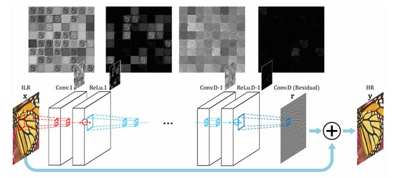
Accurate Image Super-Resolution Using Very Deep Convolutional Networks
Architecture
In architecture d layers where layers except the first and the last are of the same type: 64 filter of the size 3x3x64, where a filter operates on 3x3 spatial region across 64 channels (feature maps)
The first layer operates on the input image. utilize 20 weight layers (3x3 for each layer). The last layer, used for image reconstruction,
consists of a single filter of size 3x3x64
Limitations
with depth of networks, parameters increase. minimizing mean squared loss.
Uniqueness
By cascading small filters many times in a deep network structure , contextual information over large image regions is exploited in an afficient way.
Accuracy
achieve high accuracy of 27.32 PSNR on B100 data which overcomes SRCNN.

Slide 9
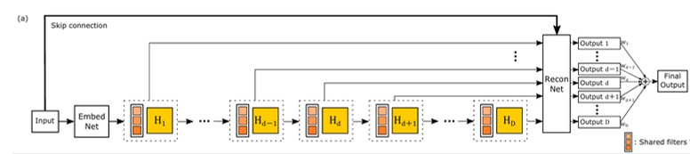
Deeply-Recursive Convolutional Network for Image Super-Resolution
Uniqueness
increasing recursion depth can improve performance without introducing new parameters for additional convolutions.
Architecture
architecture consists of three sub-networks: embedding, inference and reconstruction networks.
The embedding net takes the input image(grayscale or RGB) and represents it as a set of feature maps.
Inference net is the main component that solves the task of super-resolution . Analyzing a large image region is done by a single recursive layer .
reconstruction network combines outputs from each recursion and generates final output.
Limitations
Despite parameter efficiency, DRCN requires substantial computational resources. Training with 16 recursions took six days on an NVIDIA Titan X GPU, limiting accessibility for researchers without high-end hardware.
Accuracy
achieve high accuracy of 32.17 PSNR on Urban100 dataset which overcomes SRCNN .

Slide 10
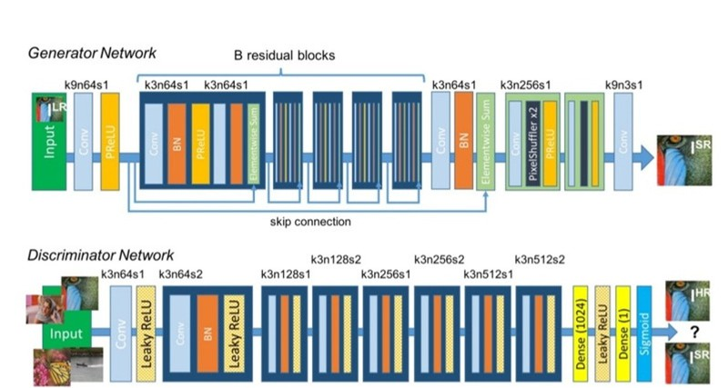
SRGAN: Photo-Realistic Single Image Super-Resolution Using GANs
Architecture
Generator: Deep ResNet-based architecture with skip connections and uses sub-pixel convolutions for upscaling instead of deconvolution.
Discriminator: CNN-based binary classifier distinguishing real vs. generated images and uses LeakyReLU activation and batch normalization.
Loss Functions: Content Loss (VGG feature-based) and Adversarial Loss (GAN-based)
Limitations
Lower PSNR & SSIM (compared to PSNR-oriented methods like EDSR).
Hallucinates incorrect textures, leading to artifacts.
Training instability due to adversarial loss.
Uniqueness
First GAN-based approach for super-resolution. Uses perceptual loss (VGG-based) instead of pixel-
wise loss (MSE).
Generates high-frequency textures, improving realism.
Outperforms traditional methods in perceptual quality.

Slide 11
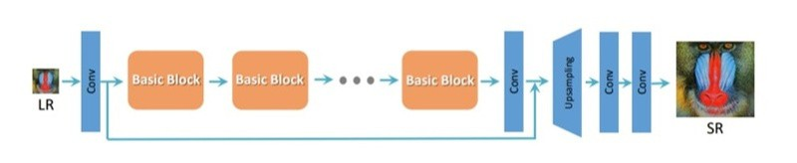
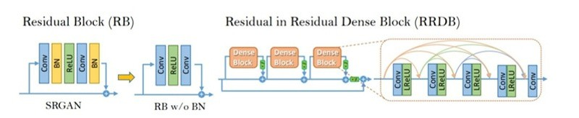
ESRGAN: Enhanced Super- Resolution GAN
Architecture
Generator uses RRDB (no BN), is deeper than SRGAN (23 blocks), and employs residual scaling with smaller initialization.
Discriminator: Uses Relativistic GAN (RaGAN) which predicts relative realism, not just real vs. fake.
Loss Functions: Improved Perceptual Loss uses VGG features before activation (better texture and brightness consistency) and Adversarial Loss (RaGAN-based) which recovers fine textures.
Limitations
Lower PSNR compared to PSNR-based methods (e.g., RCAN, EDSR).
Higher computational cost & memory usage. Can hallucinate incorrect details in some cases.
Uniqueness
Sharper & more realistic textures than SRGAN. Removes Batch Normalization, avoiding artifacts.
Uses Relativistic GAN (RaGAN) for better discriminator learning.
Higher perceptual quality → Won PIRM2018-SR Challenge.

Slide 12
SwinIR: Image Restoration Using Swin Transformer.
Architecture
SwinIR uses the Swin Transformer as a backbone.
Hierarchical feature extraction process using shifted windows for self-attention.
3 main stages: Shallow Feature Extraction (SFE), Deep Feature Extraction (DFE) with Swin Transformer Blocks, and High-Resolution Reconstruction (HRR).
Residual connections are used to enhance gradient flow and preserve details.
Limitations
Shifted window mechanism introduces complexity in implementation.
Slower than simpler CNN models in inference.
Uniqueness
Hierarchical feature extraction captures both local and global image features.
Strong generalization to different image restoration tasks like denoising, super-resolution, and compression artifact reduction.
Accuracy
Achieves state-of-the-art results on multiple benchmarks, including DIV2K, Set5, and Urban100.
Outperforms other models in PSNR(Peak Signal to noise ratio) and SSIM(Structural Similarity Index Measure) by up to 0.45dB.

Slide 13
Efficient Super-Resolution Transformer(ESRT)
Architecture
ESRT integrates a Lightweight CNN Backbone (LCB) with a Lightweight Transformer Backbone (LTB)
To reduce the computational burden, LCB uses certain downsampling operations within CNN.
The LTB comprises Efficient Transformers (ET) that utilize an Efficient Multi-Head Attention (EMHA) mechanism to minimize GPU memory usage.
A convolutional upsampling layer reconstructs the high-resolution image.
Limitations
While more efficient than some Transformer- based models, ESRT still demands substantial computational resources, which could be a limitation for deployment on devices with limited capabilities
Uniqueness
Utilizes self-attention mechanisms for capturing long-range dependencies in images.
Adaptive positional encoding improves the model's ability to handle different scales.
Enhanced feature aggregation using skip connections and residual learning.
ESRT has fewer parameters than SwinIR, making it significantly smaller and lightweight.
Accuracy
SwinIR generally achieves slightly higher PSNR and SSIM than ESRT across all datasets.

Slide 14
Frequency-aware Transformer
What It Does
Breaks down image features into high-frequency (textures, edges) and low-frequency (global structure) and processes them separately using Transformers.
Uniqueness
Focuses on frequencies (high vs low) to recover sharper textures and refine structures.
Limitations
Struggles with noisy real-world images; still needs good GPUs for large datasets.
How well it performs
Produces sharper textures than older methods like SRCNN and SwinIR; great PSNR/SSIM scores.

Slide 15
Light Field Image SR with Transformers
What It Does
Uses Transformers to enhance resolution in light field images (multi-view images captured from different angles).
Uniqueness
First to use Angular + Spatial Transformers for light field data; preserves angular consistency across views.
Limitations
Only works for light field data; needs accurate preprocessing (aligned input views).
How well it performs
Outperforms traditional methods on PSNR/SSIM; ensures consistent views across angles.

Slide 16
Our Proposed Approach and Improvements
1
Input Image
Input: A low-resolution (LR) image.
This image will undergo feature extraction to obtain meaningful information
4
Dual Attention Mechanisms
Purpose: Enhance feature representations using two types of attention mechanisms:
Channel Attention : Emphasizes important channels by adaptively recalibrating feature responses.
Spatial Attention : Refines spatial feature maps to focus on crucial regions of the image
2
CNN Backbone
Purpose: Extract local features using a lightweight CNN. Key Operations:
Residual Blocks for preserving information through skip
connections.
Depthwise Separable Convolutions to reduce computational cost.
Dense Skip Connections to facilitate better gradient flow.
5
Feature Fusion
Purpose: Combine channel and spatially enhanced features. This fuses multi-scale features from the previous stages for better reconstruction.
3
Lightweight Transformer Block
Purpose: Capture global contextual information using a simplified self-attention mechanism.
Key Operations:
Self-Attention for understanding global relationships between pixels.
Feed-Forward Network (FFN) for feature refinement. Positional Encoding to retain spatial relationships.
6
Realistic Degradation Simulation
Purpose: Simulate real-world image degradations for robust model training.
Degradations Include: Gaussian Noise, Blur Kernels, Atmospheric Haze

Slide 17




Progress Till Now
Completed literature review and analyzed state-of-the-art methods for Single-Image Super-Resolution (SISR).
Finalized the architectural design, integrating CNN Backbone, Lightweight Transformer Block, and Dual Attention Mechanisms.
Selected suitable datasets DIV2K for training and benchmarking.
Defined loss functions using a combination of pixel-wise loss,
perceptual loss, and total variation loss.

Slide 18
Final Deliverables for the Project
01
Model Implementation
Implement CNN Backbone and Lightweight Transformer Block.
Start developing channel and spatial attention mechanisms.
02
Performance Evaluation
Benchmarking results using standard datasets ( e. g., Set 5 ,
Set 14 ) .
03
Comparative Analysis
Comparison of results with
existing state- of- the- art models using PSNR and SSIM.

Slide 19
Project Timeline
Week 1
Week 2
Week 3
Week 4
Week 5
Integrate the realistic degradation pipeline. Implement CNN Backbone.
Work on spatial and channel attention mechanisms
Implement the multi- component loss functions and set up training pipelines.
Evaluate and conduct comparisons with existing models, and perform final optimizations.
Prepare reports, create a well- documented codebase, and finalize the project presentation.

Slide 20
Thank you!

