Slide 1
nope
Put it down.
How I built a hardware startup with AI
A pre-launch case study. Idea to product, brand, app and plan in days.

Slide 2
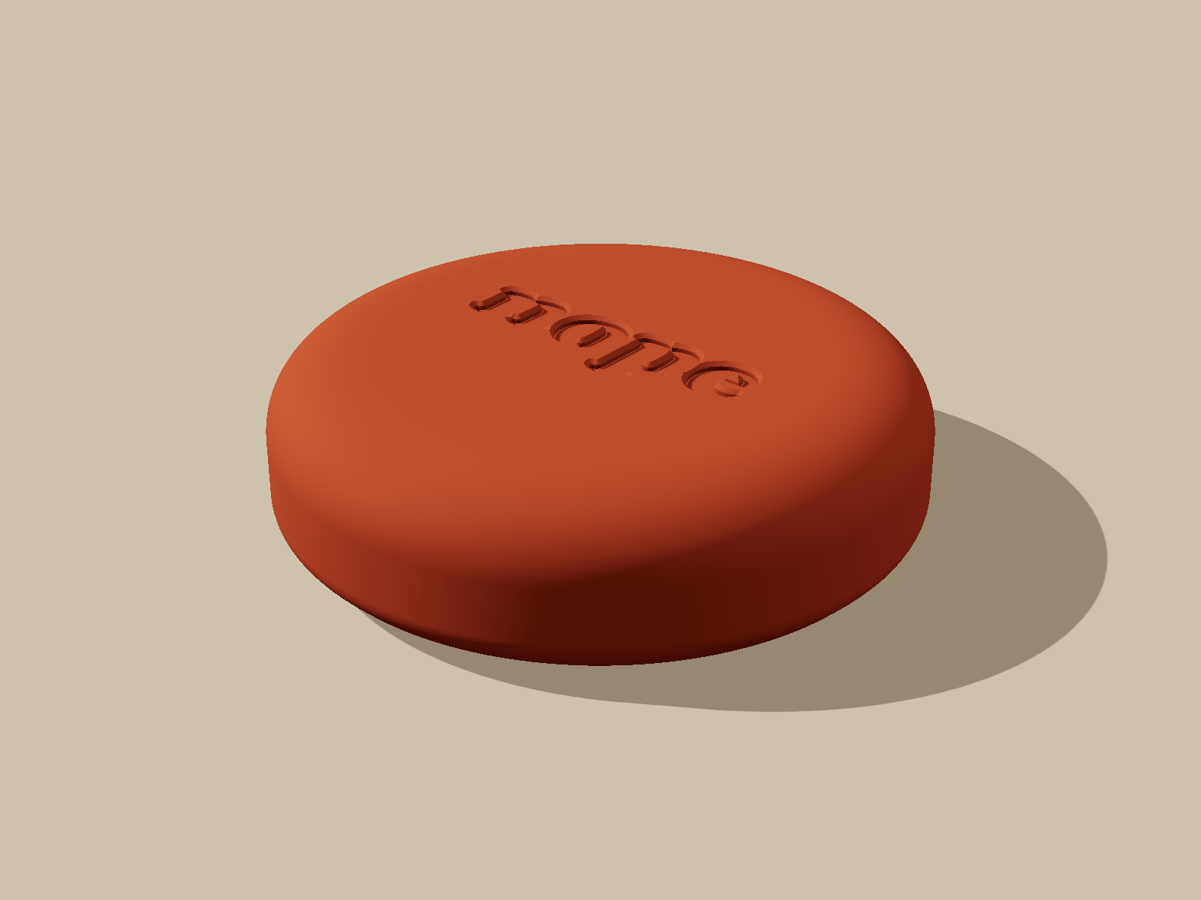
The idea
Phones are built to be hard to put down. nope is a palm-sized puck. Tap your phone on it and your distracting apps lock. Tap again to unlock.
Rs 1,999. One time. No subscription. 30 day refund.

Slide 3
Copy the model, not the brand
Proven
Gap
Move
A US brand sells a similar block. Strong demand and a viral reel prove people want friction.
Reel comments: too pricey for India, and "it is just an NFC chip". Local price and local story win.
Own name, own look, own price. Android first, because India is Android.
Every claim about competitors is marked as a claim, not a fact.

Slide 4
What got built
Android app
The product
Brand and site
Expo and React Native. Native Kotlin blocker. NFC pairing, rescue code if locked out, setup doctor.
3D printed pebble case 64 x 16 mm, bayonet cap, hidden NFC sticker. Designed in code.
Charcoal and saffron. Name, logo, tagline, waitlist site, legal pages, ad creatives.
Finance
Legal and ops
Strategy
Unit economics workbook. About Rs 977 per order before ads.
India compliance checklist, support macros, shipping and refund playbook.
Go to market, 14 day OKRs, risk register, kill criteria.

Slide 5
An AI C-suite, one founder
CEO
CEO
CTO
CFO
CMO
CPO
CLO
COO
CCO
CSO
Creative
Each role is an AI agent with a brief. They report to the CEO agent, who reports to me. I make the final call on price, name, colours and spend.
The agent personas and numbers are hypotheses to test, not market data.

Slide 6
Validate before spending
Test the tap
Test demand
Then scale
3 real phones first. If the tap fails, stop. Cost: about Rs 0.
Rs 1,000 waitlist ad. Free signals first. No payment page until legal is clear.
Break-even ad cost per order about Rs 725. Target Rs 400. Written kill criteria if it misses.
Total planned spend to learn the truth: under Rs 10,000.

Slide 7
Honest status
Built
Next
Not yet
app, case design, brand, site, plan, finance model
phone test, print order, waitlist ad
customers, revenue, proof it works on real phones
No fake traction. The point is how fast a founder plus AI can get from idea to a testable business, with the risks written down.

