Slide 1
nope
Put it down.
Review pack for the MD
Everything that needs your yes, your input or your eyes. Wed 11 Nov 2026.

Slide 2
Where we stand
Rs 0
0
1,999
14 days
revenue today
customers, nothing tested on a real phone yet
price in Rs, locked
plan to prove tap works and a stranger pays
CEO verdict
Not profitable yet and cannot be by tomorrow. Fastest honest path: prove the tap in 7 days, prove a stranger pays in 14 days, spend at most Rs 8,600 of your Rs 10,000 to find out.

Slide 3
Your 5 approvals
# | Approval | Cost | By
A1 | Pay the print order after Instinct shows the quote (2 bodies, 3 caps, 1 coupon strip, 2 old pucks) | Up to Rs 1,500 | Now
A2 | Domain getnope.in, 25 mm NTAG213 stickers, felt pads, bumpers | Up to Rs 1,500 | Now
A3 | Rs 1,000 Meta hook test, only if the phone test passes and page is waitlist only | Rs 1,000 | Fri 13 Nov
A4 | Before customer money: read employment contract, business bank or UPI account, one CA call | About Rs 1,000 | Account by Tue 17 Nov
A5 | Second Rs 5,000 (pilot kit, CA call, Play fee) only if Gate G1 passes | Rs 4,600 | Mon 16 Nov
Notes:
Ads beyond the Rs 10,000 (Step 2, Rs 3,000 to 4,000) need a fresh yes on Fri 20 Nov.

Slide 4
Questions only you can answer
Seller address
WhatsApp number
Business UPI or QR
Business address or home address on the site and invoices? Needed for legal pages.
Business number for support and the waitlist button.
No personal UPI ID. Needed before any payment page opens.
Employment contract
Trademark search
iPhone timing
Read it (20 min). Check side business and IP clauses before any customer money.
Founder runs it. Needs OTP login, fee Rs 4,500 per class.
Android first. Apple needs a paid developer account, decide after Gate G1.

Slide 5
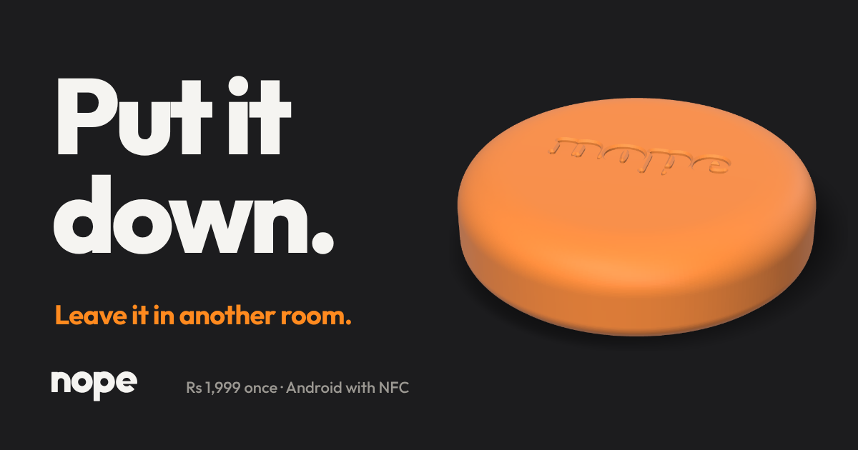
Website: fill before going live
Site is built but not published. Waitlist mode, no payments.
Placeholders to fill: WhatsApp number, business UPI and QR image (upi-qr.png missing), Meta Pixel ID, form backend, domain, founder name, seller details.
Legal pages written: privacy, refund, shipping, terms. Need seller details inserted.
Do not quote Brick price in any ad. Sources conflict (Rs 5,700 vs US$59).
Never claim it cannot be bypassed.

Slide 6
Phone test today (Gate G0)
What to do
Pass means
Install the standalone APK on 3 phones (Samsung, Xiaomi or Realme, one on Android 13+). Pair a sticker, tap to lock, tap to unlock. Try through the 2.4 mm printed skin. Note the restricted settings step on Android 13+.
Tap reads reliably on all 3 phones. Setup completes without help. Then Rs 1,000 hook test and G1 funding unlock. Fail means stop and fix before spending.

Slide 7
Top risks
Risk | Why it matters | Test
Tap unreliable on real phones or through case | If it fails nothing else matters | Wed 11 and Mon 16 Nov
Android 13+ restricted settings wall | Can kill activation of the first 50 | Wed 11 Nov
Ad cost above Rs 725 per order | Break-even ceiling, scale target Rs 400 | Fri 20 Nov first number
Play Store policy on accessibility | Strict mode must stay off in Play builds | After G1
Legal: contract, GST, trademark | Blocks taking customer money | Before 18 Nov

Slide 8
Next 14 days
Date | Milestone
Wed 11 Nov | Gate G0: tap test on 3 phones
Thu 12 Nov | Free demand signals start
Fri 13 Nov | Rs 1,000 Meta waitlist test, if G0 passed
Mon 16 Nov | Gate G1, second Rs 5,000 decision
Wed 18 Nov | Earliest Rs 199 refundable reservations
Fri 20 Nov | First real ad cost number, Step 2 decision

