Slide 1


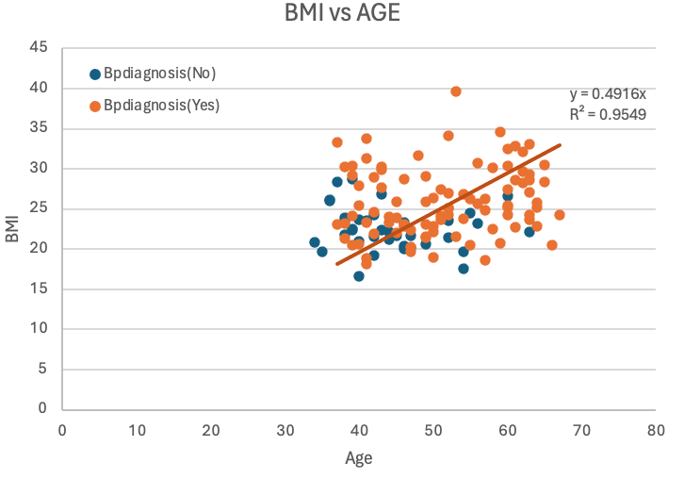
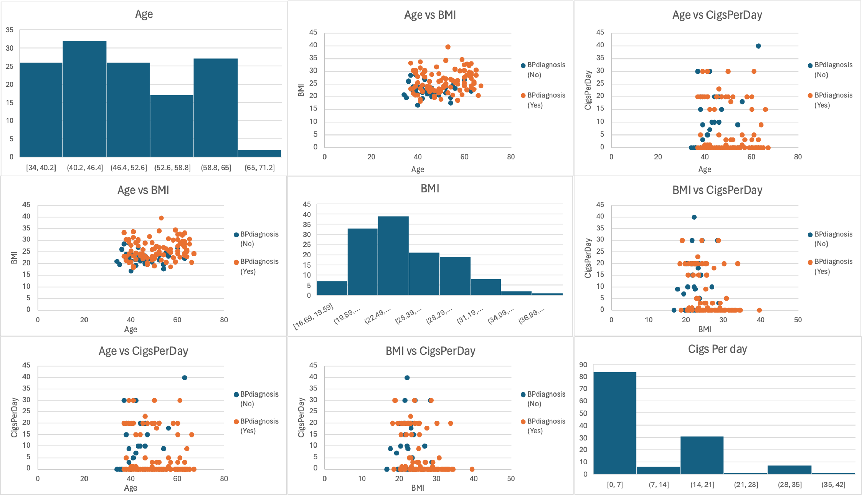
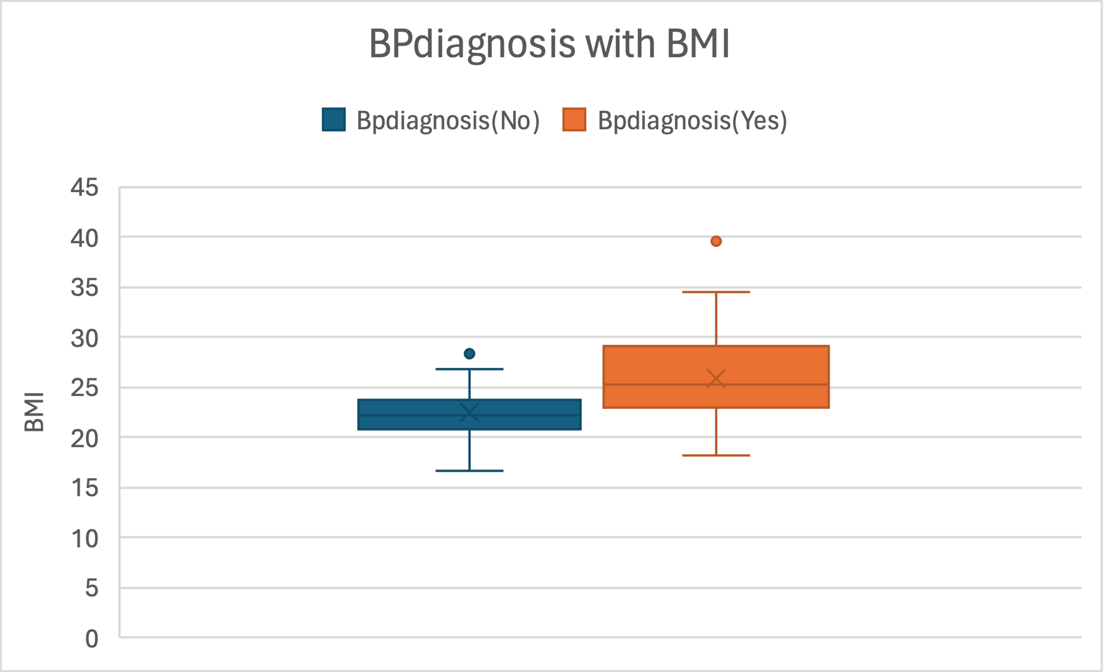
Analysis of BP1 data
Heeyeon Yoon
Introduction
Methods
Results
Conclusions
Figure 1: Rates of individuals with HYP for each Gender
HYP levels were approximately 11% higher in females compared to males
Figure 6: Result of t-Test (between Cigarettes per day and BMI)
Figure 8: Linear regression model for age and BMI
Figure 4: A Scatterplot Matrix for comparative analysis
A Scatterplot Matrix that illustrates the two categories (BP diagnosis No/Yes) for three numeric variables (Age, BMI, Cigarettes per day)
NULL Hypothesis:
“There is no association between the number of cigarettes smoked per day and BMI ”
Conclusion:
The number of cigarettes smoked per day increases, BMI also tends to increase.
Additionally, according to Figure 8, as both BMI and age increase, there is a higher likelihood of receiving a positive blood pressure diagnosis.
Figure 2 : Cigarette consumption by gender
P-value is small, specifically 1.2366E-33. Since the value is less than 0.05, the null hypothesis is rejected
Females tended to smoke more cigarettes per day on average than males
References
Kumari, K. and Yadav, S. (2018). Linear Regression Analysis Study. Journal of the Practice of Cardiovascular Sciences, 4(1), pp.33–36. doi:https://doi.org/10.4103/jpcs.jpcs_8_18.
Oja, H. (1983). Descriptive statistics for multivariate distributions. Statistics & Probability Letters, 1(6), pp.327–332. doi:https://doi.org/10.1016/0167-7152(83)90054-8.
Omvik, P. (1996). How smoking affects blood pressure. Blood Pressure, [online] 5(2), pp.71–77. doi:https://doi.org/10.3109/08037059609062111.
Primatesta, P., Falaschetti, E., Gupta, S., G. Marmot, M. and R. Poulter, N. (2001). Association Between Smoking and Blood Pressure. Hypertension, [online] 37(2), pp.187–193. Available at: https://www.ahajournals.org/doi/epub/10.1161/01.HYP.37.2.187 [Accessed 21 Aug. 2000].
Wilhelmsen, L. (1996). Smoking and Blood Pressure. Blood Pressure, 5(2), pp.69–70. doi:https://doi.org/10.3109/08037059609062110.
Figure 5: Average BMI according to the results of BP diagnosis
Figure 7: Result of correlation coefficient for all the variables
Figure 3 : Average HYP & BP diagnosis by daily cigarette consumption
This matrix displays the highest correlation between HYP and age, and the lowest correlation between gender and age
Individuals with higher BMIs tended to have more positive BP diagnosis on average
proportional relationship between HYP and BP diagnosis

