Slide 1

Welcome to the West Monroe
16:9 PPT Template
Instructions
Instruction pages:
02
03
04
05
06
07
08
10
11121314
New functionality
Slide layouts
Preloaded text styles
Text hierarchy and adjustment
Color palettes
Data visualization palette types
Data visualization palette usage
Graphic element usage
Highlight adjustment
Cropping images
Guide alignment
Conversion to the new template
This template is a starting point for PowerPoint presentations.
The following slides are a mix of instructions and example content. The first section includes technical instructions and “how-to” information. They are followed by example content slides.
Please refer to these slides whenever you need assistance and if you’re using this template for the first time, we recommend reviewing the instructions thoroughly.
DO NOT alter master pages in the PowerPoint template.
If additional layouts or designs are needed for your presentation, please reference the supplemental PowerPoint materials provided in Brand Compass and Templafy.
If additional adjustments are needed to the master template, reach out to the Brand Team for assistance.

Slide 2
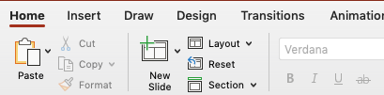
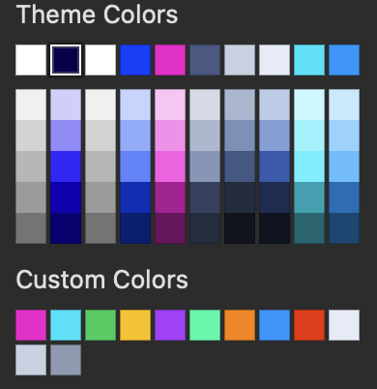

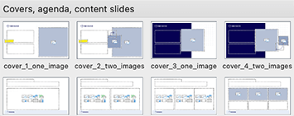
New functionality: Preloaded layouts and color palettes
Instructions
  Preloaded layouts
Page layout options are preloaded in the “New Slide” drop down menu.
Designs include covers, dividers, agenda, statement pages, specialty slides, and a variety of content pages in various formats. Choose which layout meets your content the best.
A “how-to” instructions page on how to use the different layouts is included on the following slides.
  Color palettes
The primary brand color palette, Categorical Data Vis colors, and Deemphasis Data Vis colors are preloaded in the drop down menu under ”Theme Colors” and “Custom Colors”.
The Accent and KPI palettes are included, with the palettes above, below the artboard for use with the eyedropper tool.

Slide 3
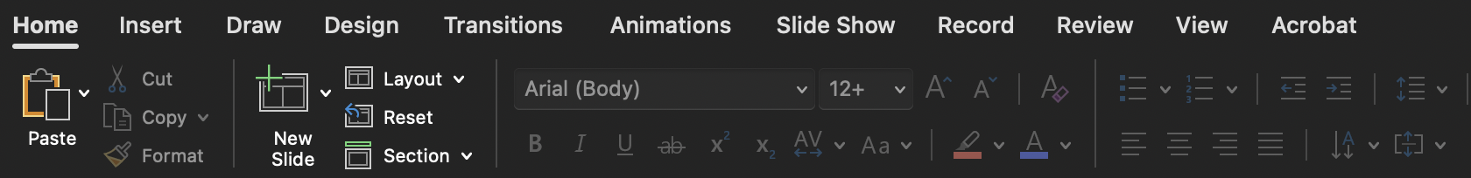
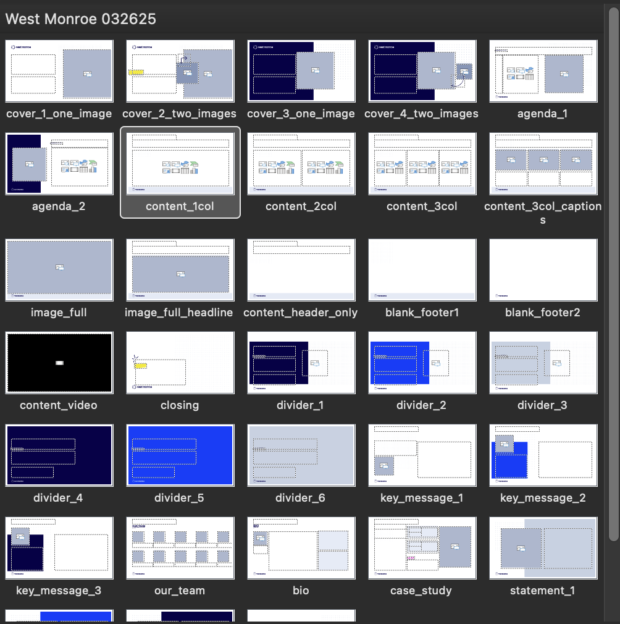
Slide layouts
Instructions
Slide layouts options
A variety of slides are available for you to choose from when building a PPT presentation. As you build slides you can choose which layout best fits your content.
  Under the Home tab, click the arrow to the right of the “New” button to reveal the options.
  Clicking your choice will bring up the page layout.
  A variety of covers, dividers, and content slides are available to build your presentation, with variations of each.
  An example layouts section is included after the instructions for usage guidance and visual examples of each layout. Before finalizing your presentations, delete any example slides that are not in use.

Slide 4


Text hierarchy and adjustment
Instructions
White
White
Highlight Magenta
Medium Gray
Grounded Blue
Highlight Blue
Dark Gray
Light Gray
AA
Dark Gray
on White
Section title Eyebrow – 9pt and must be all caps
Headline – 22pt bold default and can be enlarged as high as 28pt, reduced as low as 20pt
  Subhead – 18pt bold default and can be reduced as low as 12pt. Must be 2pts larger than the body copy
body copy – 15pt normal or bold default and can be reduced as low as 10pt. Must be 2pts smaller than the subhead
Legal – 9pt
Aa
Aa
Aa
Aa
Aa
Aa
Grounded Blue
on White
White on Grounded Blue
White on
Highlight Blue
White on
Highlight Magenta
Grounded Blue on
Medium Gray
Grounded Blue on Highlight Yellow•
Aa
Aa
Aa
Aa
Aa
Aa
Grounded Blue
on White
Highlight Blue
on White
Highlight Magenta on White
Dark Gray
on White
White on Grounded Blue
Highlight Magenta on Grounded Blue
Aa
Aa
Aa
Aa
Aa
Aa
White on
Highlight Blue
White on
Highlight Magenta
White on
Dark Gray
Grounded Blue on
Medium Gray
Grounded Blue on Light Gray
Highlight Blue on Light Gray
Aa
Aa
Aa
Aa
Aa
Grounded Blue
on White
Highlight Blue
on White
White on Grounded Blue
White on
Highlight Blue
Grounded Blue on Highlight Magenta
Aa
Aa
Aa
Aa
White on
Dark Gray
Grounded Blue on
Medium Gray
Grounded Blue on Light Gray
Highlight Blue on Light Gray

Slide 5
Color palettes
Instructions
  Primary palette
These are the primary brand colors used for all non-color-coded content throughout the PowerPoint template. Our brand guidelines provide more information about our brand colors.
Note: Do not use these palette colors for data visualization or color-coded content.
  Data visualization palette
These are the colors used for charts and color-coded visuals. More information about our data visualization colors can be found in our
brand guidelines.
Note: these colors cannot be used as text or for non-color-coded visual use and must always have a Grounded Blue outline and text.

Slide 6
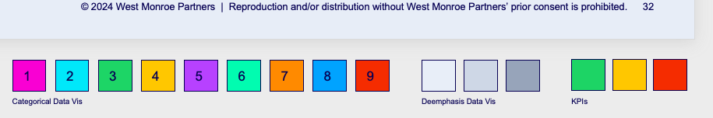

Data visualization palette types
Instructions
  Data visualization categorical palette
These are the colors used for charts and color-coded visuals. They must be used in the order in the palette, but the order can start at any color in the series.
  Data visualization deemphasis palette
These are the colors used to deemphasize parts of charts and color-coded visuals. Any colored parts used with the deemphasis palette must be from the categorical palette and used in the defined order, but the order can start at any color in the series.
  Data visualization KPIs palette
These are the colors used to identify positive, neutral, or negative parts within data visuals.
Color swatch samples below slides that can have data visualization
Color swatch samples below slides that can have data visualization
Color swatch samples below slides that can have data visualization
Note: these colors cannot be used as text or for non-color-coded visual use and must always have a Grounded Blue outline and text. More information about our data visualization colors can be found in our brand guidelines.

Slide 7
Data visualization palette usage
Instructions
  When should I use the primary brand colors?
  The shapes or proportions of visuals are not necessary to convey the information
  Color-coding is not required for comprehension
Remember to use the approved color combinations on slide 5 of these instructions for anything with text over color.
New
Subhead
Subhead
Descriptions
Subhead
Done
Approved
Descriptions
It all comes down to this
Descriptions
Subhead
Subhead
Descriptions
Descriptions
Subhead
Subhead
Removed
Committed
Descriptions
Subhead
Descriptions
Descriptions
  When should I use the data visualization colors?
  Graphs and charts where the shapes or proportions of visuals are necessary to convey the information
  Color-coding is required for comprehension
New
Done
Approved
Removed
Committed

Slide 8
Data visualization palette usage continued
Instructions
Data visualization use in PowerPoint
If displaying data that relies on the user to identify the shapes of the visual or color coding for comprehension, you must use the data visualization palette. The relationship between the outlines and colors is intentional to maintain WCAG 2.1 color contrast compliance. Please adhere to the following criteria when creating data visualization graphics:
  Do not mix the data visualization palette colors with any of the brand palette colors
  Must have at least a 1.5 pt. Grounded Blue outline
  Any text over a color or used at a smaller size should be set in Grounded Blue
  Data labels should be used whenever possible
  Do not use drop shadows
  Avoid pattern fills whenever possible
  Do not adjust or tint the data visualization colors
  Data visualization categorical examples
  Data visualization deemphasis examples
  Data visualization KPIs example

Slide 9










Graphic element usage
Instructions
Available in Templafy
Available in Templafy
Available in Templafy
  Highlight graphic
The highlight graphic can only be used on slides and content where it is prepopulated as an element on that page. Please do not copy and paste it to other pages or content.
The following slide contains usage instructions for modifying the highlight graphic to align with text. Please reference the brand guidelines for detailed highlight graphic information.
  Hand-drawn graphics
The hand-drawn graphics can only be used on slides and content where they are prepopulated as an element on that page. Please do not copy and paste it to other pages or content.
  Whiteboard grid graphic
The Whiteboard grid graphic can only be used on slides and content where it is prepopulated as an element on that page. Please do not copy and paste it to other pages or content.
  Abstract imagery
Abstract imagery may be used in any single image placeholder, but should always be used in the smaller image placeholder for any two image placeholder slide options.
If additional versions of the graphic elements are needed, reach out to the Brand Team for assistance.

Slide 10
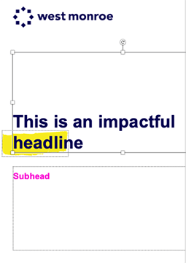
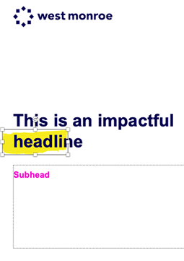
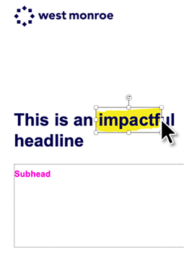

Highlight adjustment
Add your headline copy in the headline placeholder.
Select the highlight graphic that is intentionally placed to the left of the text for easy selection.
Move the highlight graphic so the left edge sits just outside the first letter of the highlighted word.
Grab the center adjustment handle on the right side of the highlight graphic and stretch it left or right to cover the entire word

Slide 11
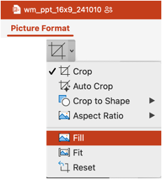




Cropping images
Instructions
After inserting an image, under Picture Format tab, select “Fill” to fill the picture frame without distorting the image.
While still under the crop tool, select one of the white square corners to scale the image larger (hold select to scale proportionately).
DO NOT adjust the black crop frames. Imagery must remain in the square placeholder shapes
By clicking in the center of image, you can move the image around inside the picture placeholder. Be sure the focal point of the photography is in frame.

Slide 12
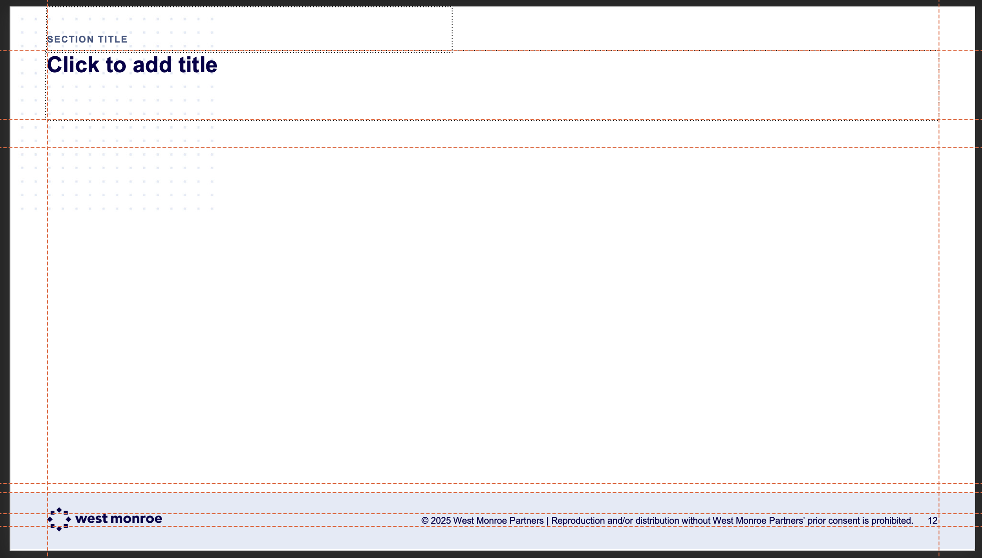
Guide alignment
Instructions
  Using guides for content alignment
Guides are established for your use. When adding your own text boxes or imagery be sure to build to the guides and align your elements when building new slides or adjusting existing layouts. You can view guides in a PPT document by following the steps below:
  At the top of the screen, go to the PowerPoint “View” tab.
  Check the box for “Guides” to turn guides on
  and off.
  Delete this Instructions page when content layout is complete.

Slide 13
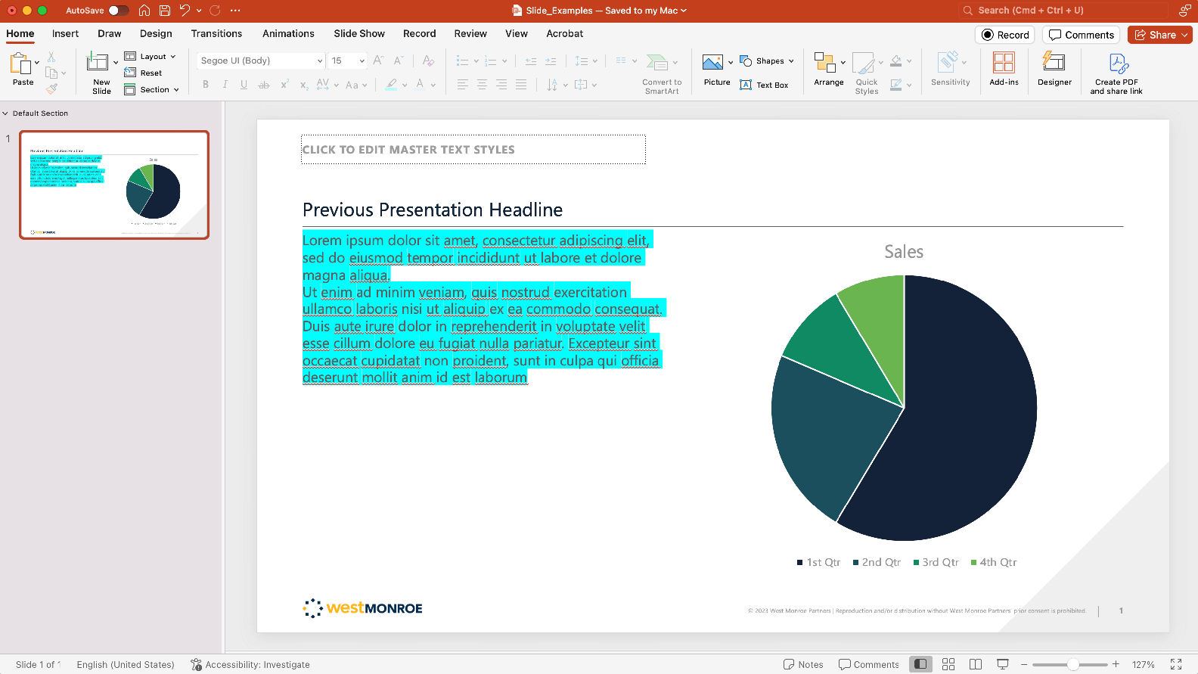
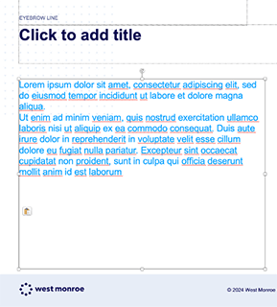
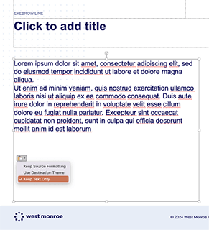

Conversion to the new template
Instructions
We recommend following these same steps for slides coverted from the November 2024 template to this March 2025 template
OR Skip these steps! FlipMySlides is still available to covert your decks to the new template: https://westmonroepartners1.sharepoint.com/SitePages/Tools-to-Help-You-with-the-Rebrand.aspx
All content needs to be transcribed into the new template. Simply applying the new template to previous designs won’t work as expected. DO NOT copy entire slides from a previous PPT and paste them into this template. To convert slides, select, copy, and paste the elements from one PPT presentation to the other. Select your text in the presentation.
In the new template, paste the content into the desired text box, and click on the format tab.
Select “Keep Text Only” to apply the preloaded fonts, colors and sizes of the new template.

Slide 14
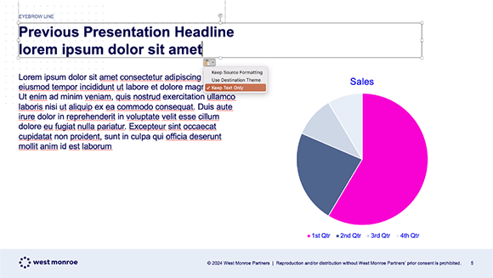
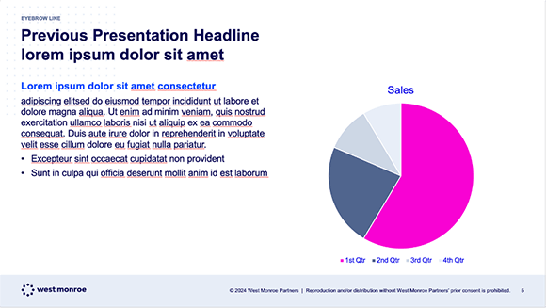
Conversion to the new template continued
Instructions
We recommend following these same steps for slides coverted from the November 2024 template to this March 2025 template
OR Skip these steps! FlipMySlides is still available to covert your decks to the new template: https://westmonroepartners1.sharepoint.com/SitePages/Tools-to-Help-You-with-the-Rebrand.aspx
Apply the same steps to copy and paste any headlines, text, body copy, callouts, etc. from the previous presentations into the new template.
Once all content is copied over, the preloaded indent styles can be applied to the paragraphs as needed (Subheads, bullets, etc.)
Charts will populate with incorrect colors. Please update them using the following chart conversion instructions.

Slide 15
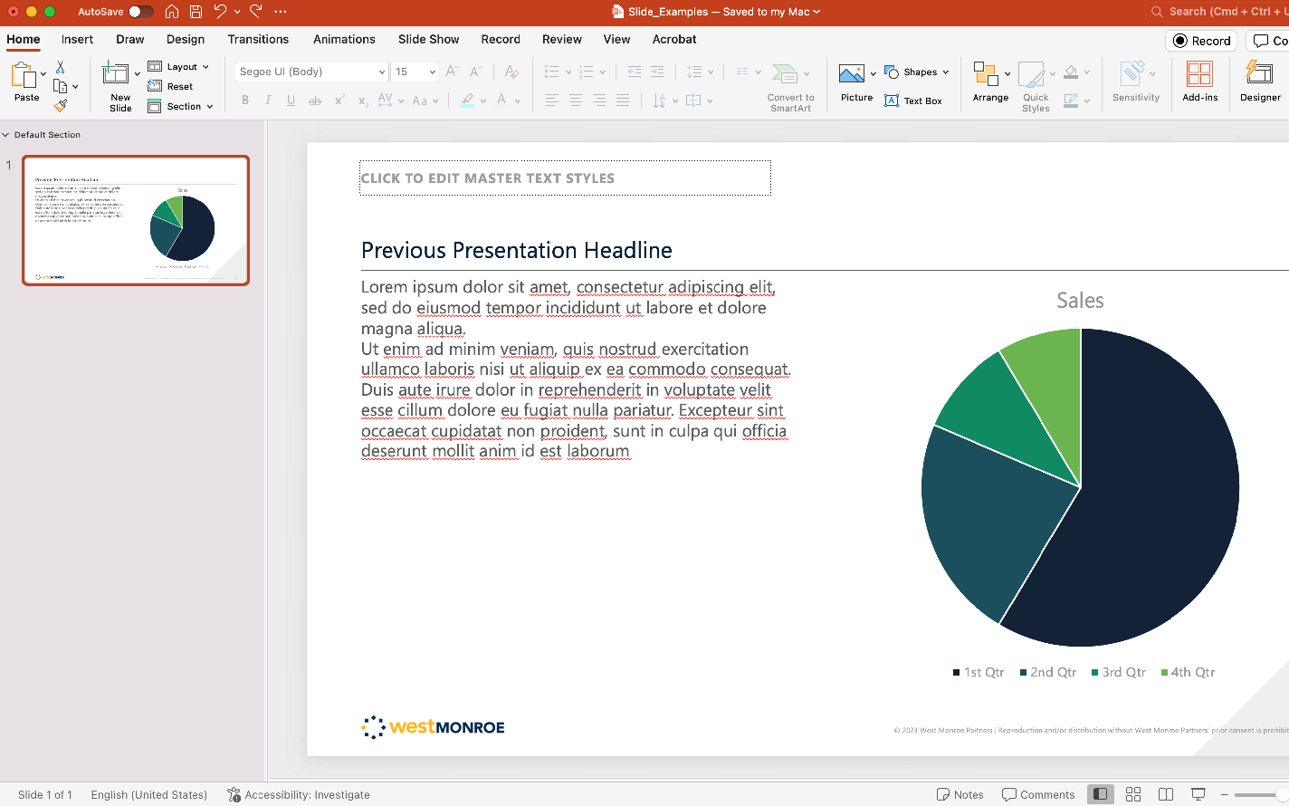
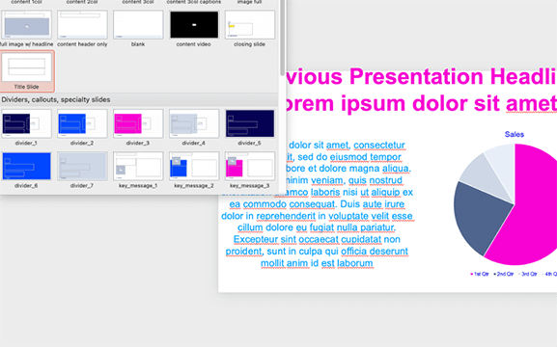
Conversion misuse
Instructions
We recommend following these same steps for slides coverted from the November 2024 template to this March 2025 template
OR Skip these steps! FlipMySlides is still available to covert your decks to the new template: https://westmonroepartners1.sharepoint.com/SitePages/Tools-to-Help-You-with-the-Rebrand.aspx
When converting old presentations, DO NOT copy entire slides from
a previous PPT and paste them into this template.
PowerPoint cannot translate the data correctly and will assign incorrect colors and random fonts to your content. It will also import incorrect master slides from the previous presentation (shown above).

Slide 16
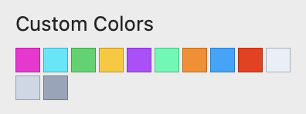

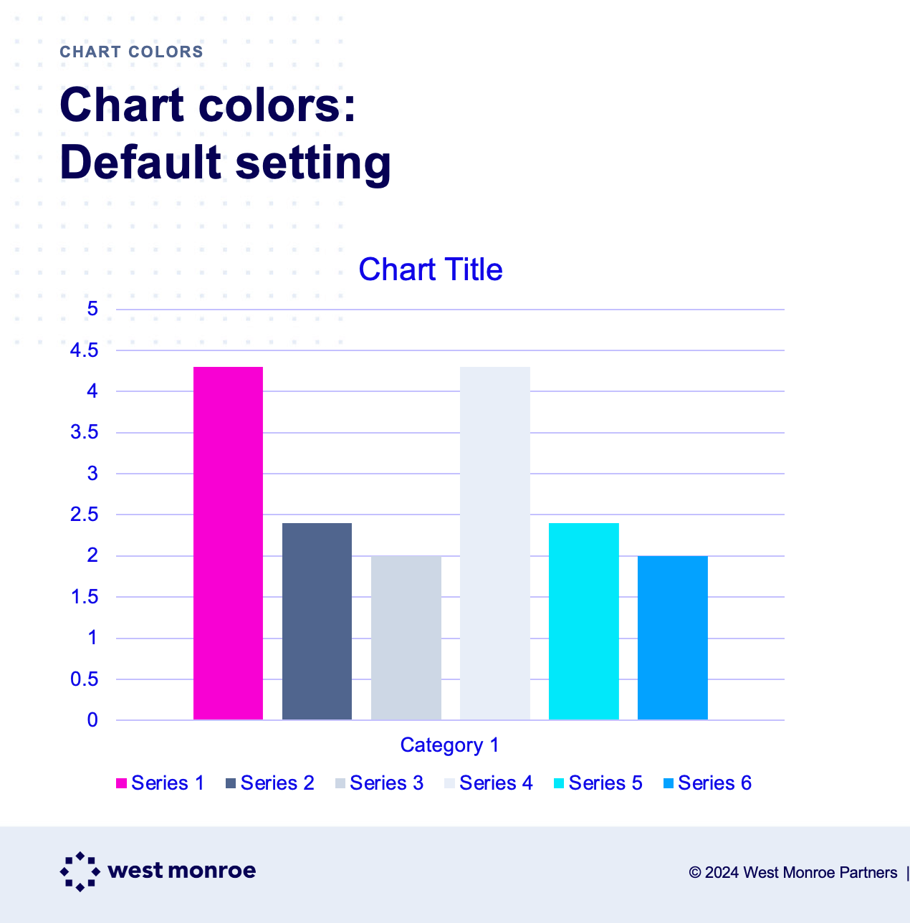
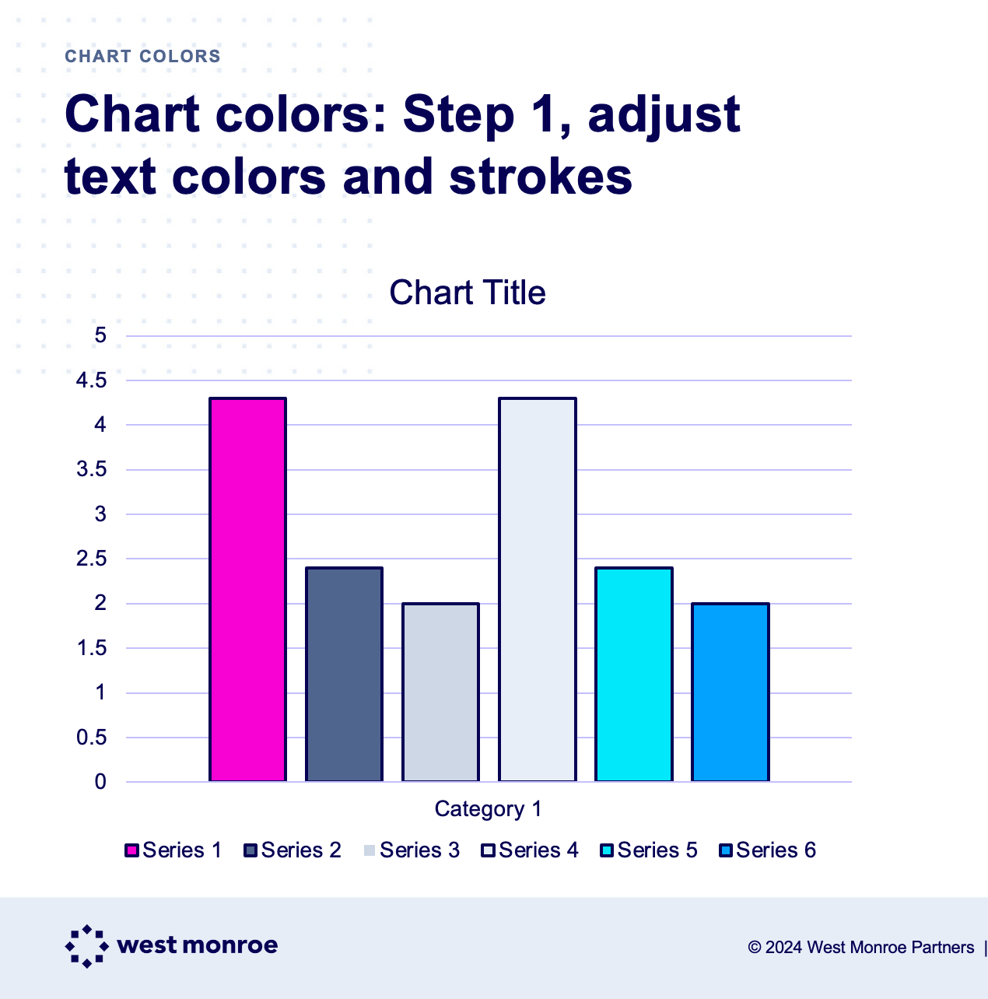
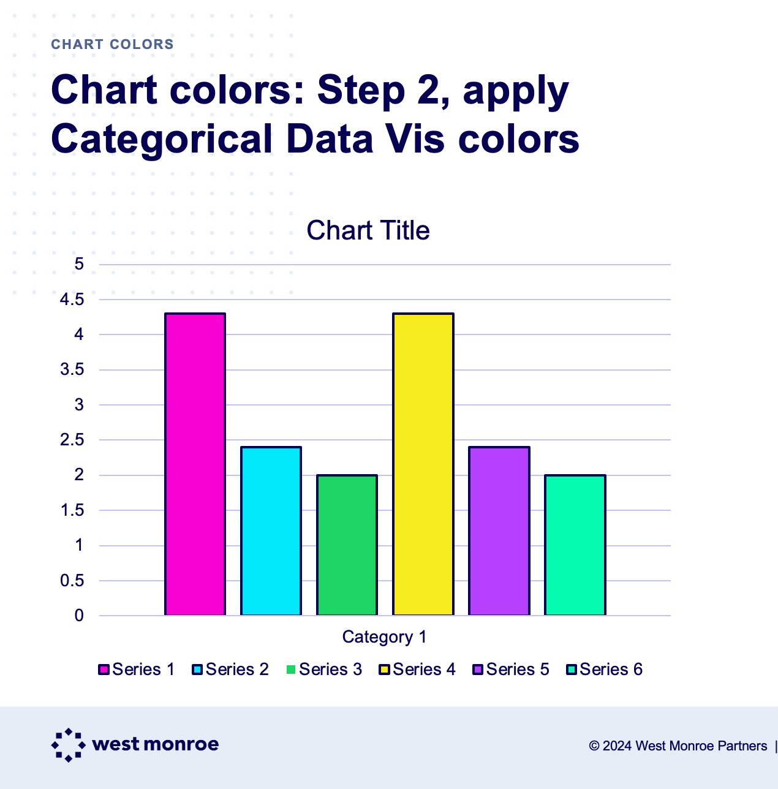
Chart conversion
Instructions
Charts that are created in this PPT use colors and text colors that load from the default brand colors in the PPT theme.
To convert to approved data vis colors, first adjust the text color in the chart to Grounded Blue, and add a 1.5pt stroke to the color bars.
Then apply the Categorical Data Vis colors (in order) that are in the drop down menu. The approved order is also shown below the artboard. You may start the order at any point in the progression.

Slide 17
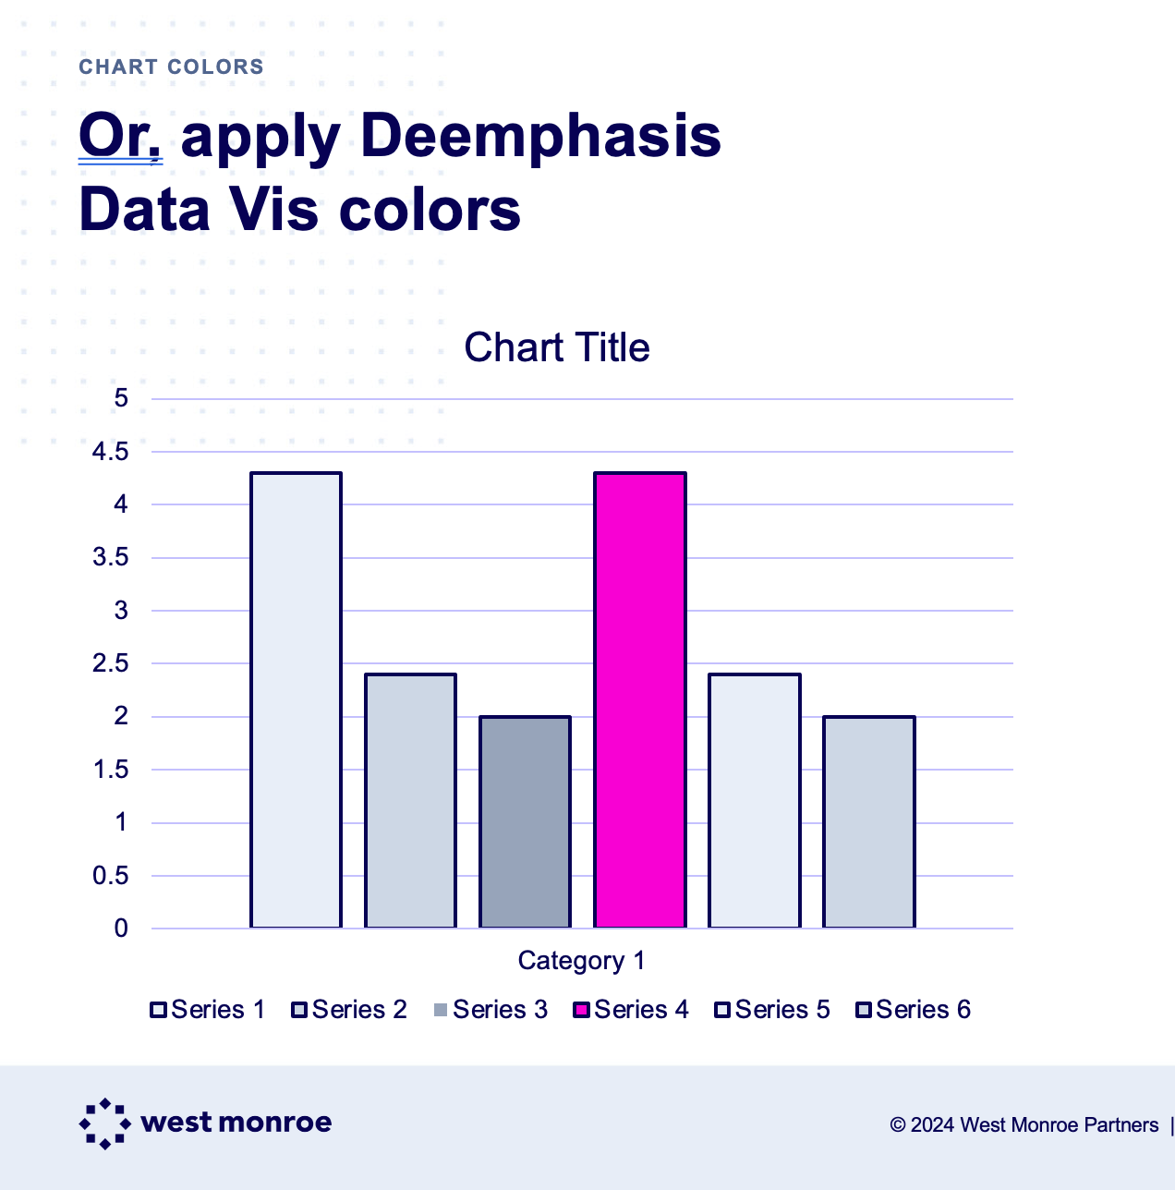
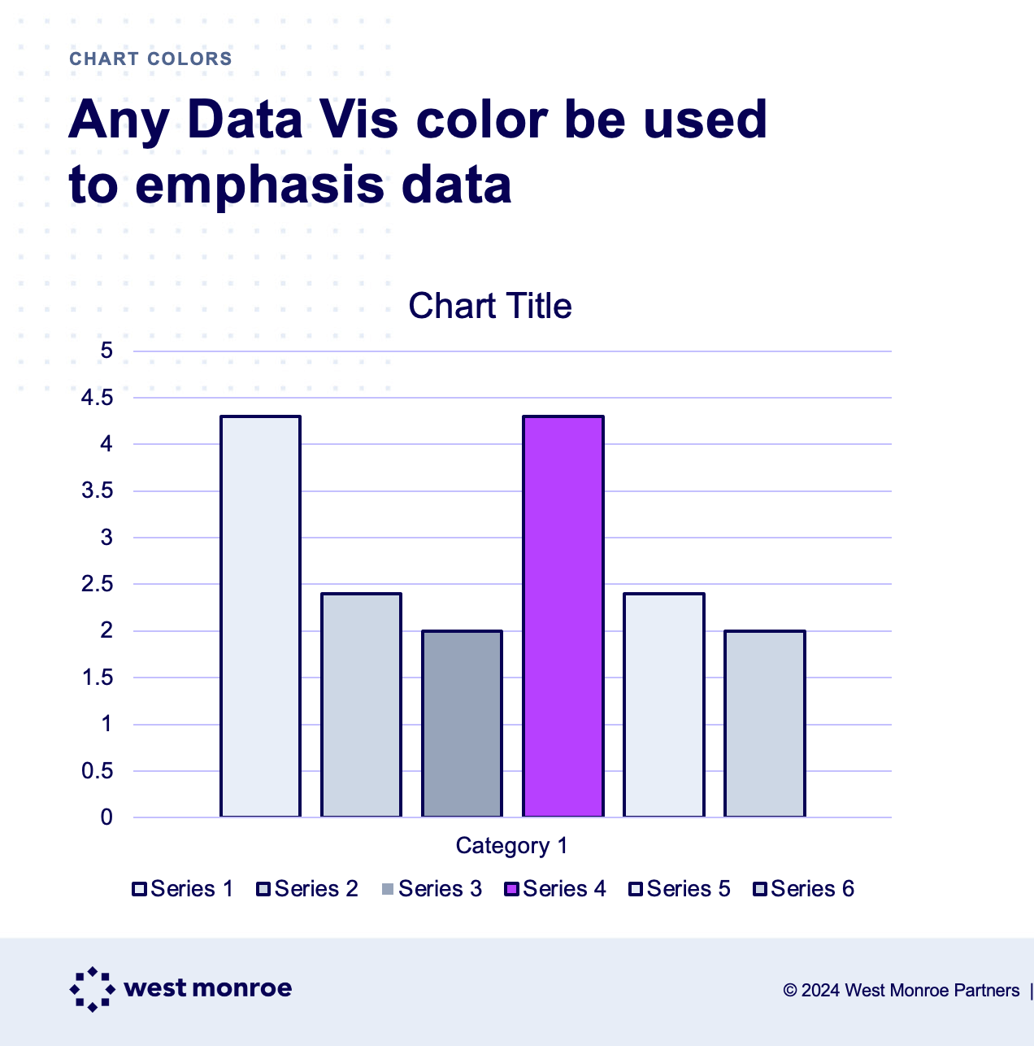
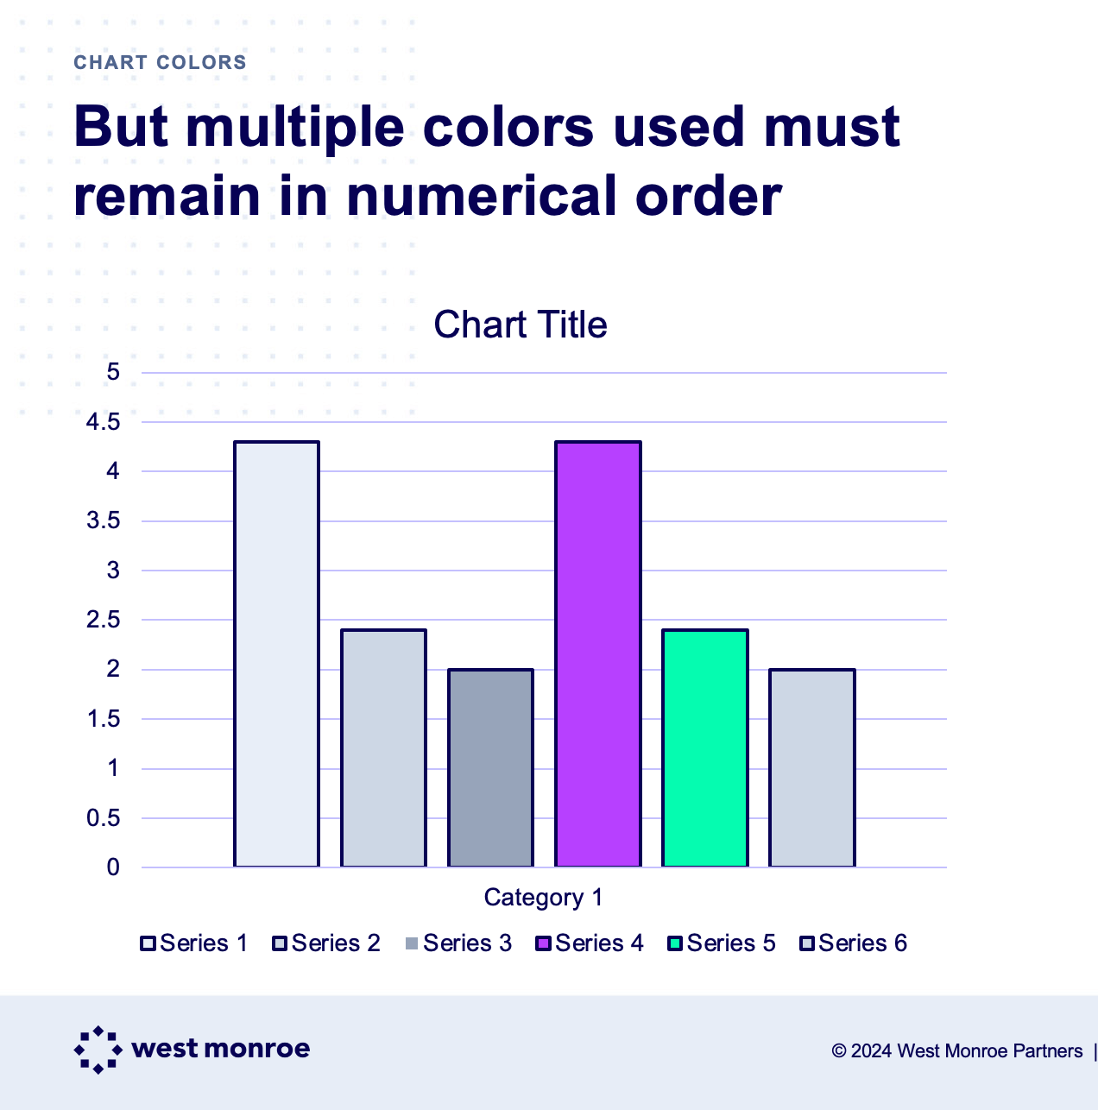
Chart conversion
Instructions
Or you can use the Deemphasis Data Vis colors to highlight individual stats.
Any of the categorical colors can be used with the grays to highlight data.
If multiple stats need to be highlighted, use colors
in the approved order shown below the artboard.

