Slide 1
CHAPTER 4
Modeling and Analysis

Slide 2
Modeling for MSS
Key element in most DSS
Necessity in a model-based DSS
Can lead to massive cost reduction / revenue increases

Slide 3
Major or Current Modeling Issues
Problem identification and Environmental analysis (which is the monitoring, scanning, and interpretation of collected information. )
Variable identification (Identification of the model's variables (decision, result, uncontrollable, etc.) is critical, as are their relationships. )
Forecasting (is essential for construction and manipulation of models because when a decision is implemented, the results usually occur in the future. )
Multiple model use (A decision support system can include several models (sometimes dozens), each of which represents a different part of the decision-making problem )
Model categories or selection (Table 4.1 classifies DSS models into seven groups and lists several representative techniques for each category. )
Model management (Models, like data, must be managed to maintain their integrity and thus their applicability).
Knowledge-based modeling (DSS uses mostly quantitative models, whereas expert systems use qualitative, knowledge-based models in their applications. Some knowledge is necessary to construct solvable (and therefore usable) models. ).

Slide 4
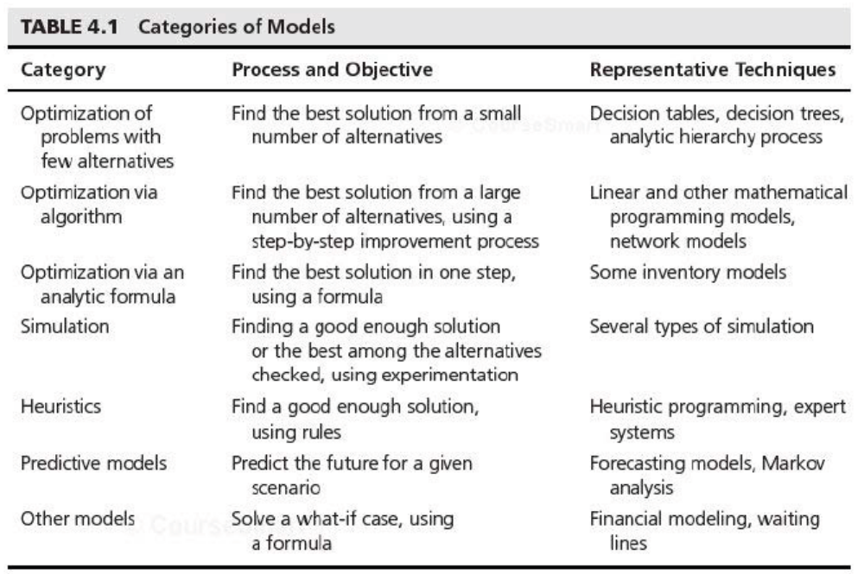
Major or Current Modeling Issues

Slide 5
Static and Dynamic Models
Static Analysis
  Single snapshot (take a single snapshot of a situation. During this snapshot everything occurs in a single interval. For example, a decision on whether to make or buy a product is static in nature).
Dynamic Analysis
  Dynamic models
  Evaluate scenarios that change over time
  Time dependent
  Trends and patterns over time
  Extend static models
  A simple example is a 5-year profit-and-loss projection in which the input data, such as costs, prices, and quantities, change from year to year.

Slide 6
Treating Certainty, Uncertainty, and Risk
Part of Simon's decision-making process described in Chapter 2 involves evaluating and comparing alternatives, during which it is necessary to predict the future outcome of each proposed alternative. Decision situations are often classified on the basis of what the decision-maker knows (or believes) about the forecasted results. Customary, we classify this knowledge into three categories (Figure 4.2), ranging from complete knowledge to total ignorance. These categories are:
Certainty
Risk
Uncertainty

Slide 7
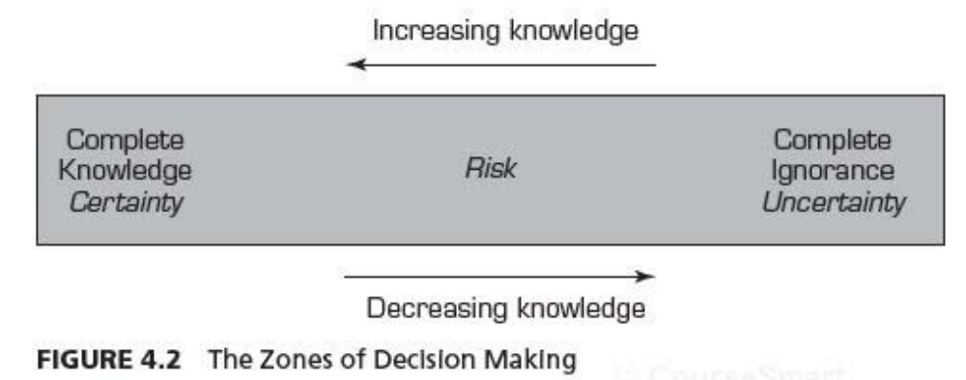
Treating Certainty, Uncertainty, and Risk

Slide 8
Treating Certainty, Uncertainty, and Risk
DECISION-MAKING UNDER UNCERTAINTY
In decision-making under uncertainty, the decision-maker considers situations in which several outcomes are possible for each course of action. In contrast to the risk situation, in this case the decision-maker does not know, or cannot estimate, the probability of occurrence of the possible outcomes. Decision-making under uncertainty is more difficult because of insufficient information. Modeling of such situations involves assessment of the decision-maker's (or the organization's) attitude toward risk.
DECISION-MAKING UNDER RISK (RISK ANALYSIS)
A decision made under risk" (also known as a probabilistic or stochastic decision-making situation) is one in which the decision-maker must consider several possible outcomes for each alternative, each with a given probability of occurrence.

Slide 9
MULTIPLE GOALS, SENSITIVITY ANALYSIS, WHAT-IF, AND GOAL SEEKING
MULTIPLE GOALS
The analysis of management decisions aims at evaluating, to the greatest possible extent, how far each alternative advances management toward its goals. Unfortunately, managerial problems are seldom evaluated with a single simple goal like profit maximization. Today's management systems are much more complex, and one with a single goal is rare. Instead, managers want to attain simultaneous goals, some of which may conflict Different stakeholders have different goals. Therefore, it is often necessary to analyze each alternative in light of its determination of each of several goals. For example, consider a profit-making firm. In addition to earning money, the company wants to grow, develop its products and employees, provide job security to its workers, and serve the community.

Slide 10
MULTIPLE GOALS, SENSITIVITY ANALYSIS, WHAT-IF, AND GOAL SEEKING
SENSITIVITY ANALYSIS
A model builder makes predictions and assumptions regarding the input data, many of which deal with. the assessment of uncertain futures. When the model is solved, the results depend on these data. Sensitivity analysis attempts to assess the impact of a change in the input data or parameters on the proposed solution (the result variable).
The two types of sensitivity analyses are automatic and trial-and-error.

Slide 11
MULTIPLE GOALS, SENSITIVITY ANALYSIS, WHAT-IF, AND GOAL SEEKING
WHAT-IF ANALYSIS
What-if analysis is structured as What will happen to the solution if an input variable, an assumption, or a parameter value is changed? Here are some examples:
• What will happen to the total inventory cost if the cost of carrying inventories increases by 10 percent?
• What will be the market share if the advertising budget increases by 5 percent?

Slide 12
MULTIPLE GOALS, SENSITIVITY ANALYSIS, WHAT-IF, AND GOAL SEEKING
GOAL SEEKING
Goal seeking analysis calculates the values of the inputs necessary to achieve a desired level of an output (goal). It represents a backward solution approach. Some examples of goal seeking are:
• What annual R&D budget is needed for an annual growth rate of 15 percent by 2005?
• How many nurses are needed to reduce the average waiting time of a patient in the emergency room to less than 10 minutes?

