Slide 1
QoS Enabled Error Control for Multicasting Video Over IP
DOMAIN :
NETWORKING

Slide 2
Team Details
Team No: T24
Guide name: Vijayalaxmi M
Team members: Abhishek Mudaraddi 01FE16BCS006
Aishwarya Ratkal 01FE16BCS016
Akshay Hegde 01FE16BCS021
Amruta Meti 01FE16BCS028

Slide 3
Introduction
Multicasting is similar to broadcasting, but only transmits information to specific users. It is used to efficiently transmit streaming media and other types of data to multiple users at one time.
The simple way to send data to multiple users simultaneously is to transmit individual copies of the data to each user. However, this is highly inefficient, since multiple copies of the same data are sent from the source through one or more networks.
Multicasting enables a single transmission to be split up among multiple users, significantly reducing the required bandwidth.
Multicasting has several different applications. It is commonly used for streaming media over the Internet, such as live TV and Internet radio. It also supports video conferencing and webcasts.

Slide 4
Motivation
In traditional communication modes the way to send data to multiple users simultaneously was to transmit individual copies of the data to each user. This is highly inefficient, since multiple copies of the same data are sent from the source through one or more networks.
Multicasting enables single transmission to be split up among multiple users, significantly reducing the required bandwidth.
The issues to tackle in multicasting include quality of service, error and traffic control, heterogeneity.

Slide 5
Literature Survey
Year and Publication | Author | Description
2016, IEEE | Joseph C. Pasquale, George C. Polyzos, Vachaspathi P. Kompella | The paper presents the problems associated with multicast communication for multimedia group applications, such as video-conferencing. In particular, when these applications have continuous media I/O components (e.g., audio and video) which must be communicated to a group of receivers, unique problems arise. It discusses a number of issues, including routing, resource reservation, error control, heterogeneity, and hierarchical coding.
2017,IEEE | Dongyan Xu, Baochun Li, Klara Nahrstedt | In this paper they addressed the bursty and location dependent characteristics of wireless channel errors, and proposed QDEC, a QoS-Directed Error Control scheme for wireless video multicast. Through analysis and simulation, they showed that QDEC has the following key properties: (1) high error recovery rate for QoS-essential video frames, (2) excellent scalability, (3) high transmission efficiency, and (4) no QoS degradation for receivers who observe no channel error
2018,IEEE | Sachin Agarwal | They have presented several quality related statistics of a large scale P2P video multicast session. Our analysis confirms the high network resource requirements of P2P video multicast systems and also highlights the advantage of using P2P technology to deliver niche content World-wide. Our key finding is that the quality of P2P video multicast over best effort IP networks is not comparable to QoS-enabled IP multicast. In particular, we observed substantial degradation in video playback quality and significantly slower channel tune-in times.

Slide 6
Problem Statement
The aim of the project is to build a OTT like platform for efficient video streaming over Internet Protocol using multicasting to provide better Quality of Service, implement error control algorithms and analyse it.

Slide 7
Objectives
To create a Multicast video Application using Socket Programming
To simulate the multicast application on Mininet with the same topology.
To implement FEC, FEC_retrans algorithm on the Multicast algorithm and simulate the same on mininet.

Slide 8
Steps in Multicast video application:
First of all, client will send a join request to the server to join the multicast group.
After that Server will provide list(the list containing the videos), site info to the client through TCP.
Then whichever station it selects from the list, it is connected to that station.
All the stations are sending data, irrespective of client is connected or not.
Whenever receiver connects to a particular station, it starts receiving live-streaming videos from that station.
Used Media player: ​ffplay​. All videos at station side is converted using ffmpeg to make it streamable.

Slide 9
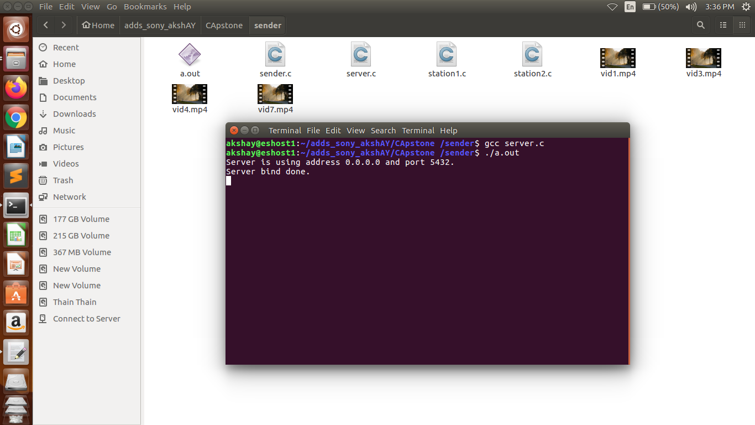
Execution of Server.c file
Client to Server: TCP a. TCP is used for one to one connection from client to server and it is used for station info and site info
Files: Server is running on port no 5432 and having the ip address 0.0.0.0

Slide 10
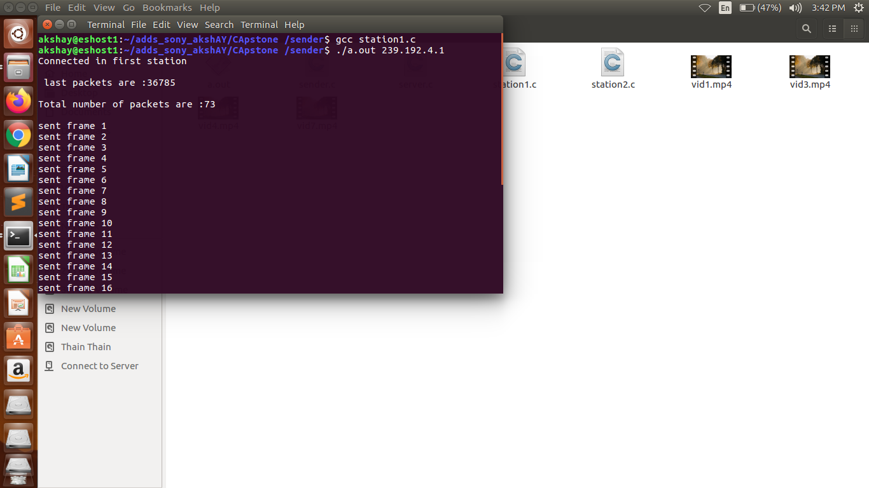
Station1.c
Here this file contains the videos to be sent and it sends the video frames one by one printing the total number of packets ,then it keeps on sending the frames until the connection is closed
Ip address of station1 is 239.192.4.1

Slide 11
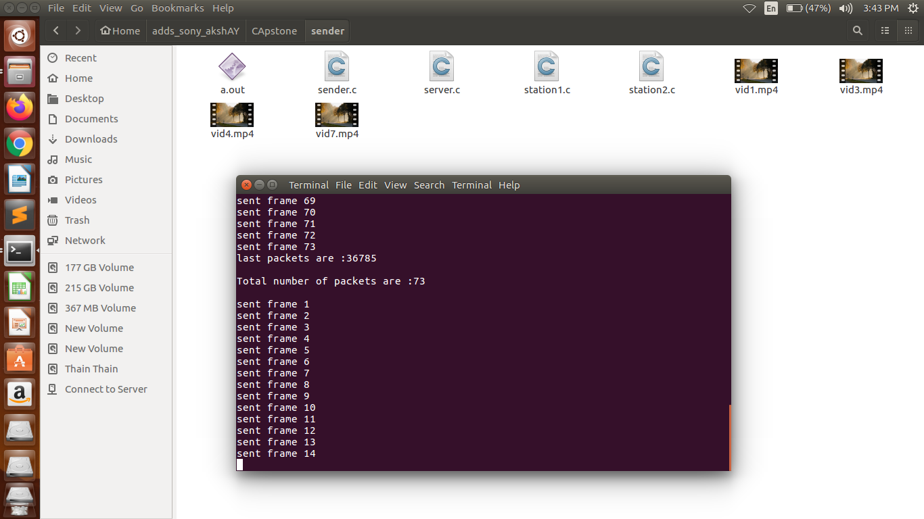
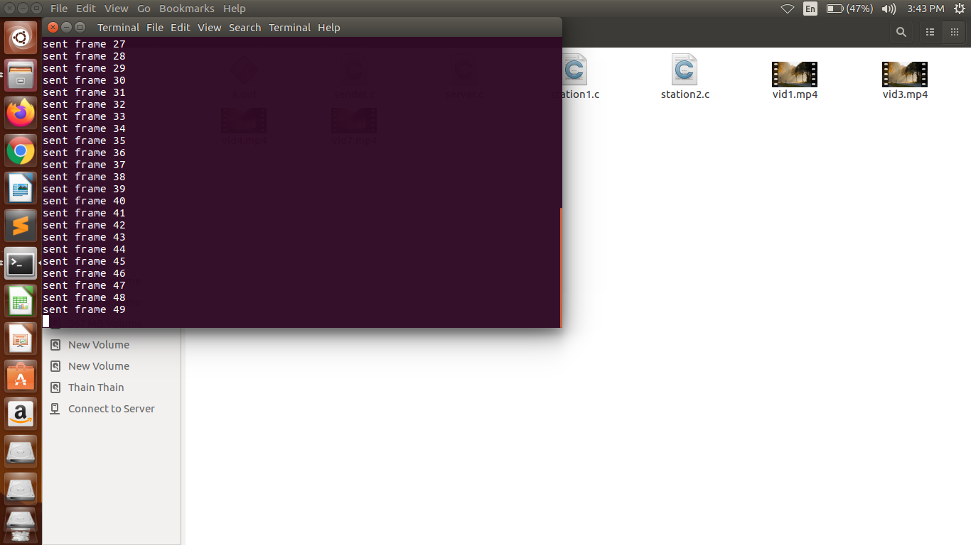

Slide 12
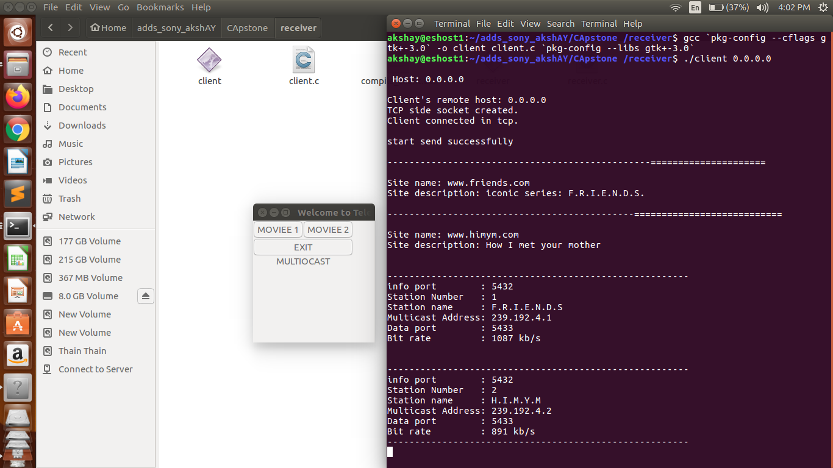
Client.c
Sender to Receiver: UDP a. UDP is used to send multicast live-streaming videos from sender to all receivers who joined multicast group. For the creartion of GUI we have used a inbuilt library called GTK with header file #include<gtk.h>

Slide 13
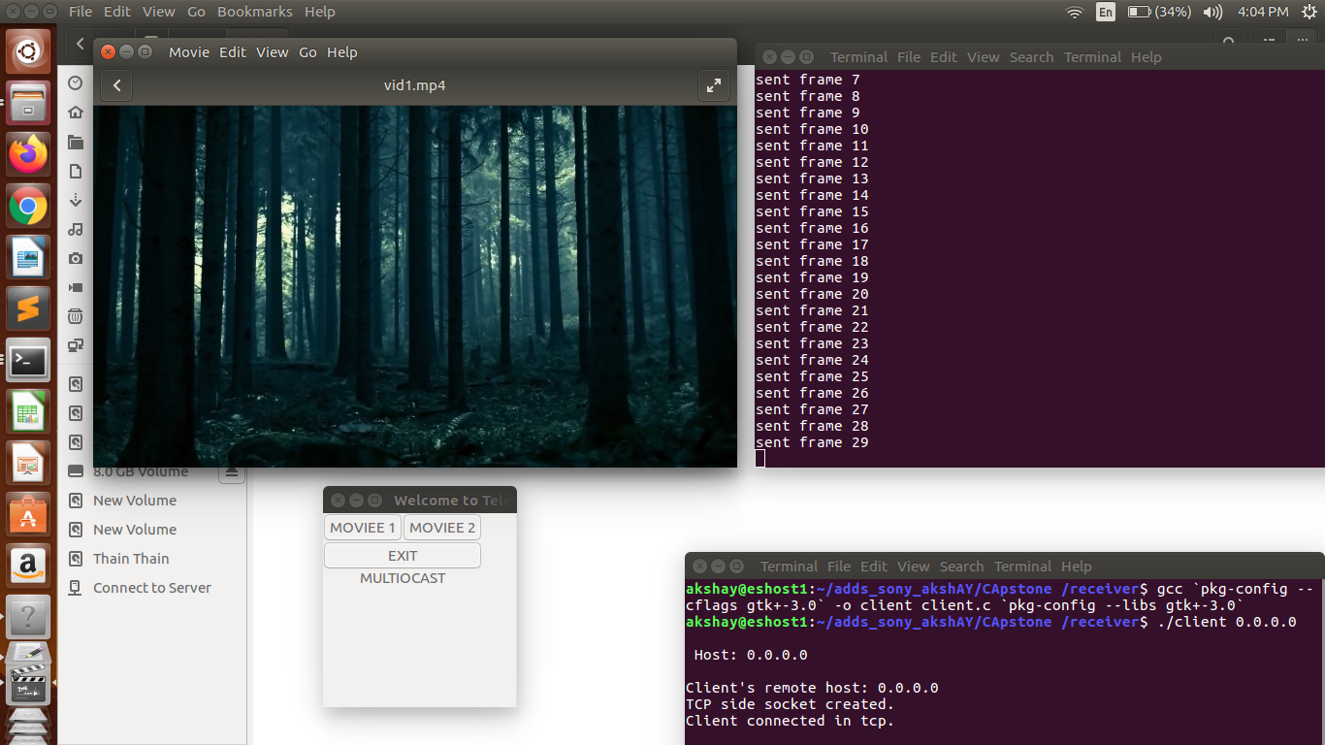
Reciever.c file is executed by the client.c file
The reciever.c file contains command to convert the video file which is in mp4 to mpeg format
command : ffmpeg -i inputfile.mp4 -f mpegts streamable_output.mp4

Slide 14
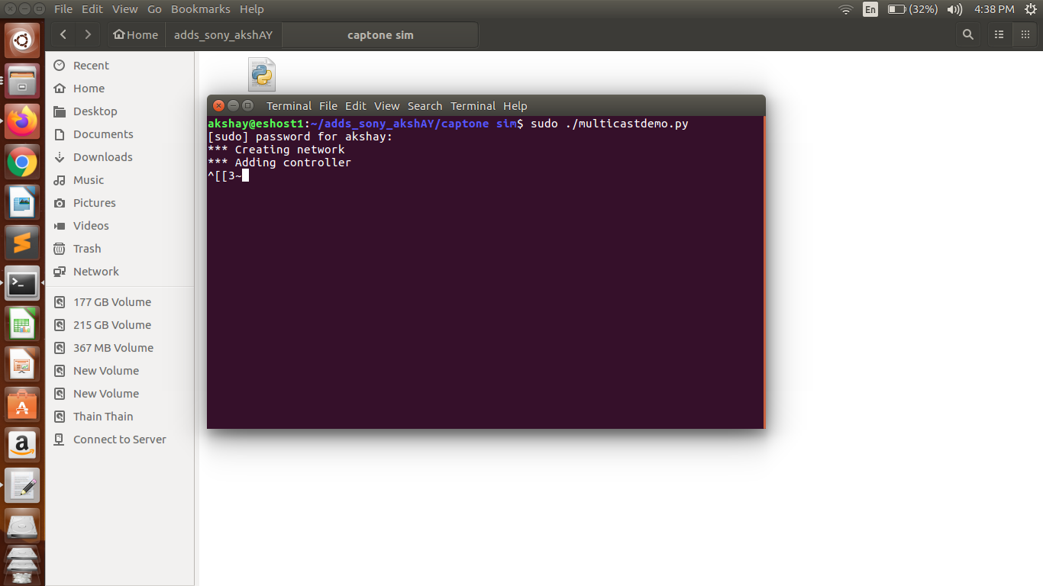
Simulation in Mininet
We used mininet to simulate the multast application where in we had r0 h1 h2 h3 as the nodes.
We had a custom topology of 3 nodes h1 h2 h3

Slide 15
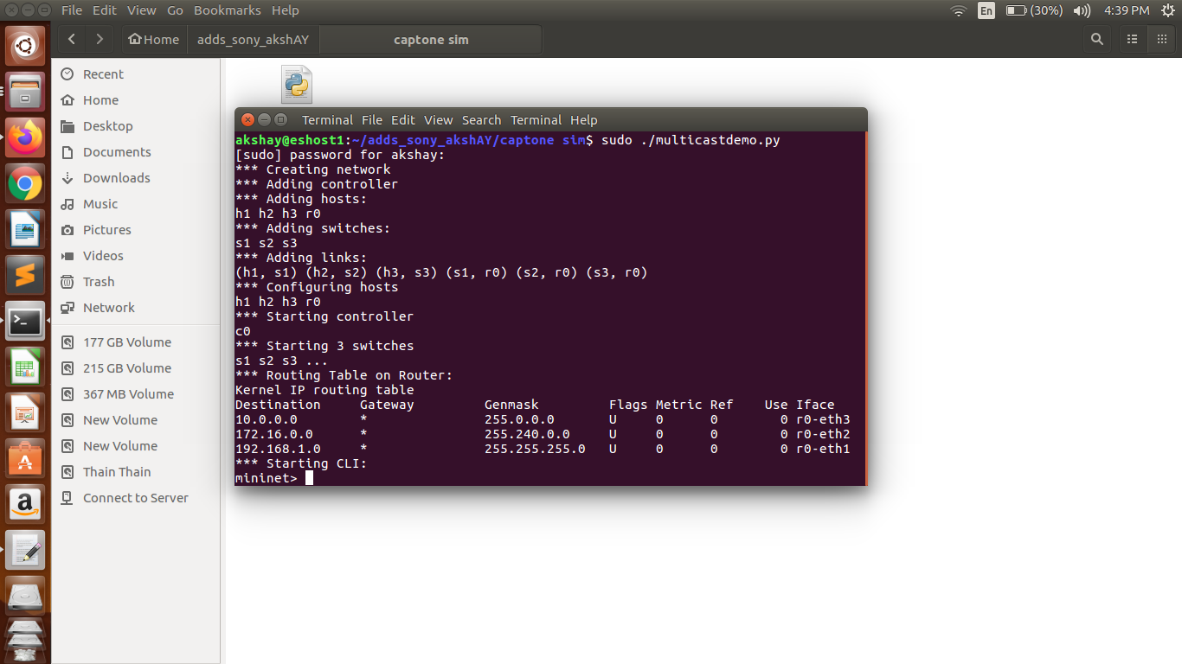

Slide 16
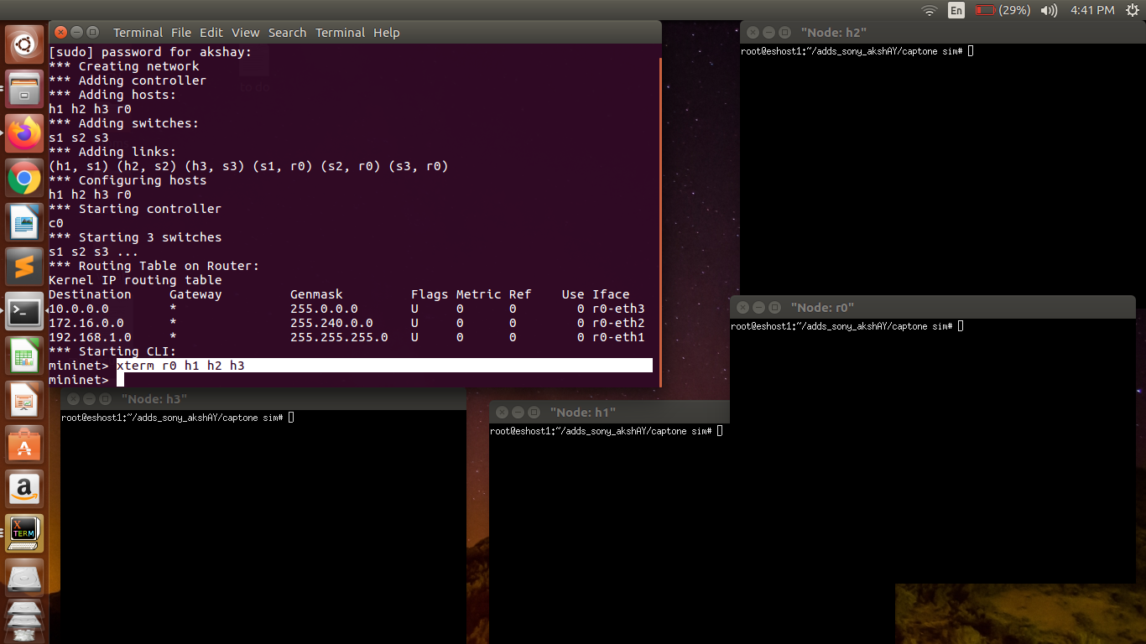
Using xtern r0 h1 h2 h3 we create three terminal nodes ,h1 h2 h3 acting as video requesting nodes.
The routing table is also shown below

Slide 18
References
https://www.researchgate.net/publication/2909797_The_Multimedia_Multicasting_Problem
https://www.google.com/url?sa=t&rct=j&q=&esrc=s&source=web&cd=4&ved=2ahUKEwigtoqavN3nAhXQbSsKHdvxD-cQFjADegQIChAB&url=https%3A%2F%2Fwww.cs.purdue.edu%2Fhomes%2Fdxu%2Fpubs%2FICCCN99.pdf&usg=AOvVaw1NY_rM4k6oZrwxUAYkP92l
https://ieeexplore.ieee.org/document/4559096
https://techterms.com/definition/multicasting

Slide 19
Thank You

