Slide 1

Structuring your web apps via
Training Session #8:
Architecture & Server side workflow

Slide 2
Agenda
Introduction to JavaScript catalyst
Introduction to Backbone frameworks
Server side workflow
Root resources

Slide 3
Introduction to JavaScript Catalysis
Following are the top level components that have been used mostly with JavaScript based enterprise projects:
Name (Most recommended) | Type | Requirements | Alternative available
Backbone | Library | Provide software architecture pattern | Angular, Knockout, Ember
Underscore | Library | Backbone heavy dependence | Lo-Dash
Handlebars | Library | Templating system | Mustache, Hogan
Modernizr | Library | HTML5 support detection | html5shiv
jQuery | Library | Backbone light dependence, DOM manipulation. | Zepto
JSON2 | Library | JSON support for older browsers | N/A
Require | Library | Asynchronous Module Definition (AMD) | Curl.js, Loader.js
QUnit | Library | JavaScript unit testing | Mocha
Moment | Library | Date-time manipulation | N/A
Bootstrap | Framework | Responsive design | Foundation
NodeJS | Console | CLI for running apps on local server | NginX, Apache 2.X
* N/A: Not Available.

Slide 4
Introduction to Backbone frameworks
Following are the framework that has been used mostly with JavaScript based enterprise projects:
Backbone Stack - RESTHUB
Marionette
  Better then RESTHUB
  Simple then Chaplin
Chaplin

Slide 5
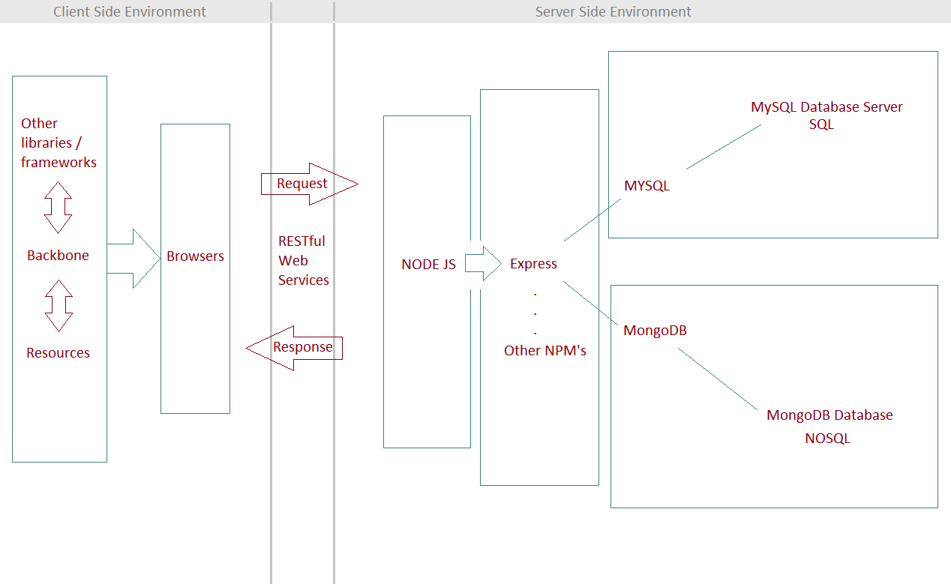
Introduction to Server side workflow

Slide 6
Root resources
https://github.com/hegdeashwin/Backbone/tree/master/Training-Session-6
  Presentation slide.
  Documentation in PDF format.
  Thank you.

