Slide 1
Understanding Innovation Indices: Statistical Properties and Macroeconomic Linkages
Scott W. Hegerty, Ph.D.
Distinguished Professor of Economics, NEIU
World Economy Research Institute
October 24, 2025

Slide 2
Main idea: Examine the Global Innovation Index
Some questions:
How does the GII behave over time? → in CEE/Poland?
Where is it most/least stable?
Which countries are ranked highest/lowest?
Is it different from merely knowledge? Related to other indices?
Is it related to growth?

Slide 3
Main idea: Methods
Construct annual time series for as many countries as possible
Examine stability in levels and ranks
Look at relevant subcomponents → Comparisons to GII?
Compare to other measures (such as SII)
Growth correlations

Slide 4
Data
Global Innovation Index: From WIPO website (separate spreadsheets)
Files combined; only ones with all years used
Subindices: Examine and compare
Correlations:
Macro variables (growth)
Summary Innovation Index

Slide 5
GII Index:
217 countries (2013-2022), some blanks→ 116 with all years (2013-2024)
Subcomponents: 154 total (Not all complete) (An example: "Global Innovation Index: Madrid system trademark applications by country of origin" )
Focus on Knowledge Creation, Knowledge Diffusion, Knowledge Absorption

Slide 6
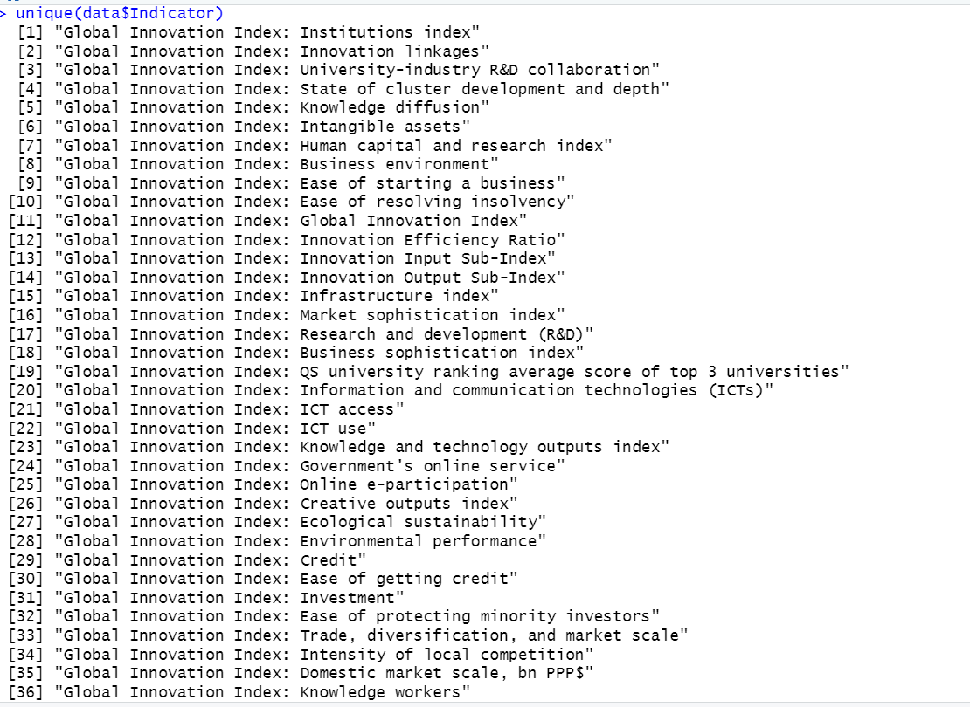
Subcomponents
Some examples:

Slide 7
Subcomponents as an alternative measure
Knowledge Creation by itself (is this similar to the index?)
Three Knowledge variables combined as new index
Principal Components Analysis: → New index from three components → Linear combination that maximizes variance (Basic results: eigenvalues >1, factor loadings)

Slide 8
Statistical Measures
Ranks, levels (scores), variation, stability
Mean, SD: Summary statistics
Coefficient of Variation (SD/mean)
Focus on CEE and Poland
Correlations with GDP growth

Slide 9
Results: Principal Components
Indices generally not correlated with GII
CEE evaluated specifically

Slide 10
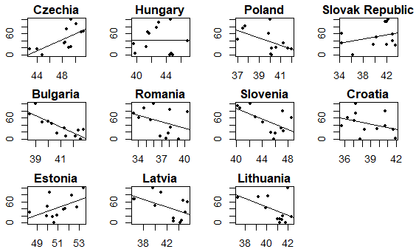
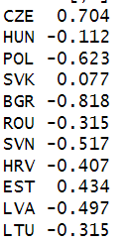
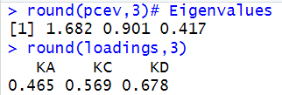
Results: PCA vs. GII, CEE
Correlations: GII and PCA
Example: Poland’s eigenvalues/loadings

Slide 11

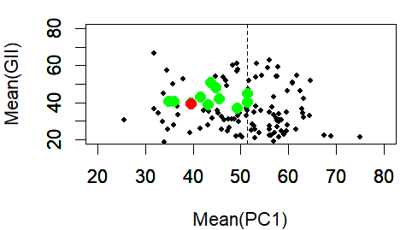
Results: Principal Components vs. GII
Green = CEE Red = Poland

Slide 12
Mean vs. CV
Larger means -> lower variation
Innovation leads to stability?
Poland: Right in the middle (GII) but low mean/high variance for PCA

Slide 13
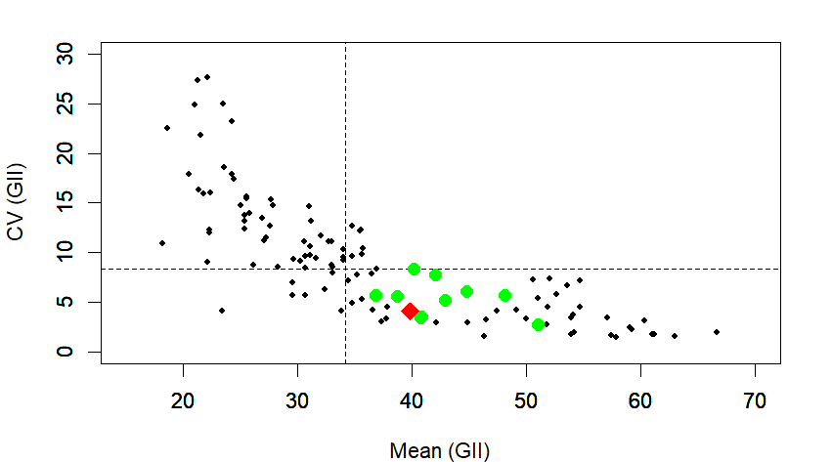
Mean vs. CV (GII)
Green = CEE Red = Poland

Slide 14
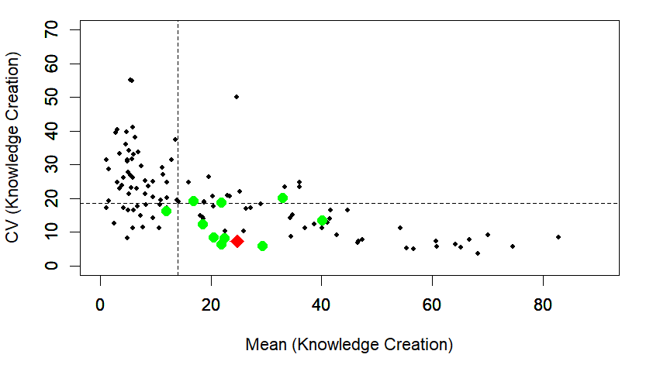
Mean vs. CV (Knowledge Creation)
Green = CEE Red = Poland

Slide 15
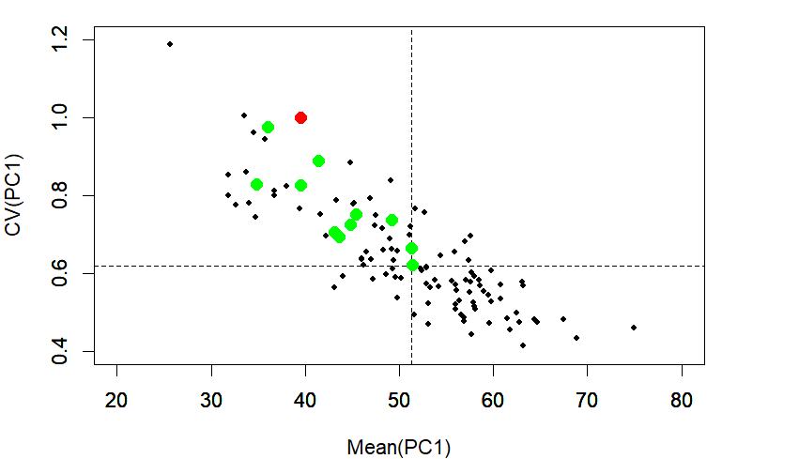
Mean vs. CV (PCA)
Green = CEE Red = Poland

Slide 16
Stability in Scores
Movement is not that large in the grand scheme of things
But can still isolate some big drops or increases
Using ranks also can help quantify this

Slide 17
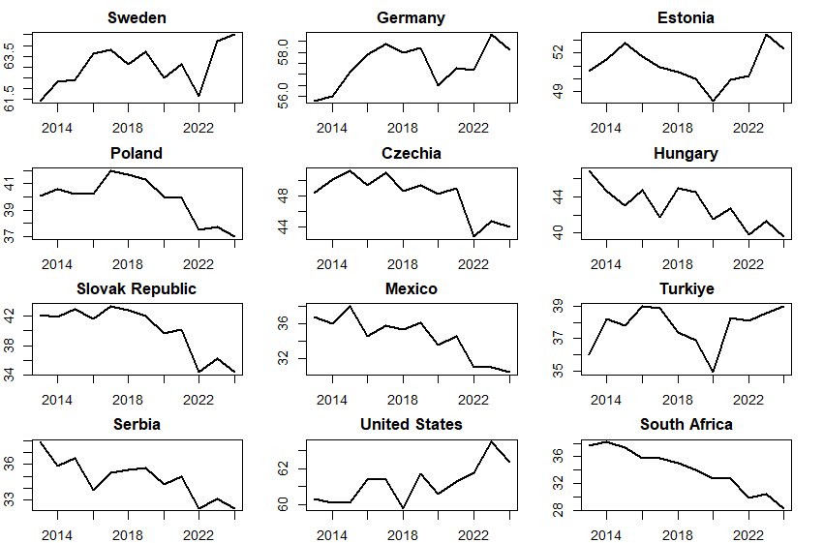
Values (zoomed in)

Slide 18
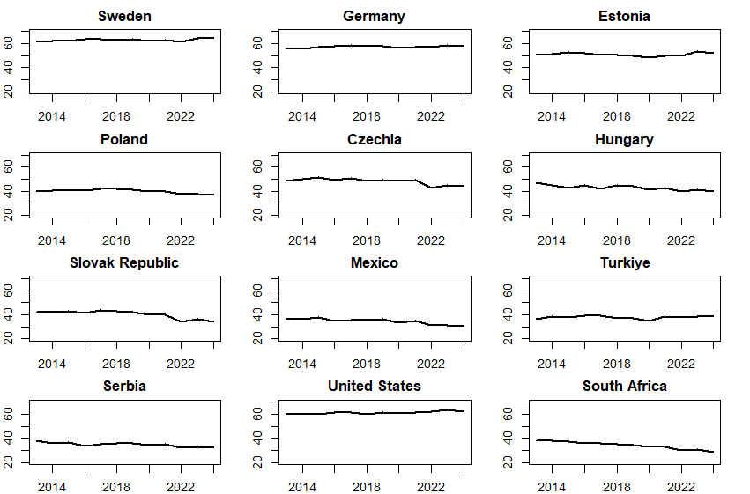
Values (zoomed out)

Slide 19
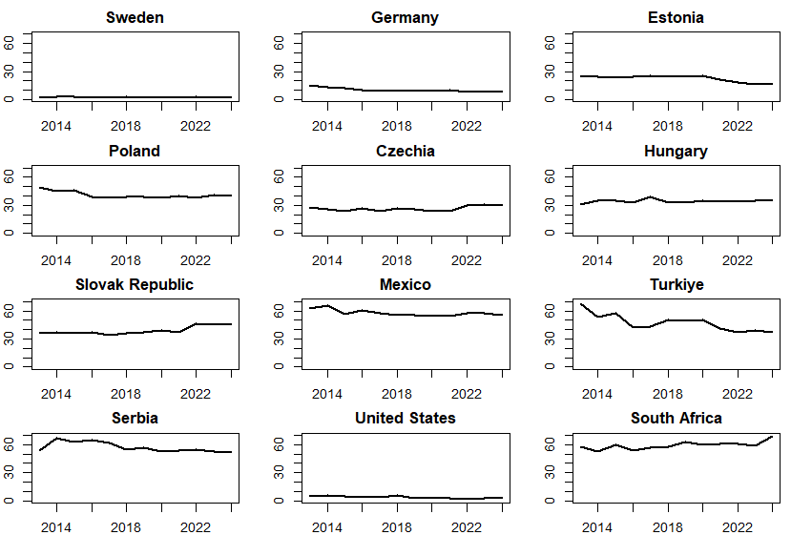
Ranks (low = high innovation)
Mean = 41

Slide 20
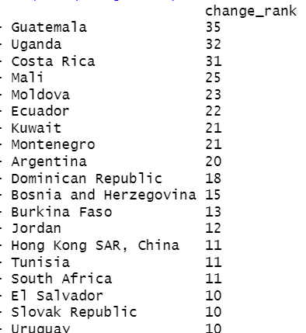
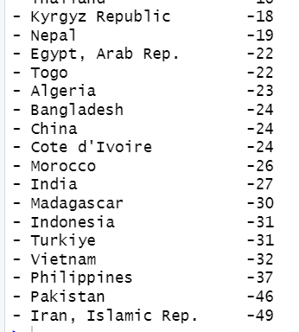
Biggest changes in ranks

Slide 21
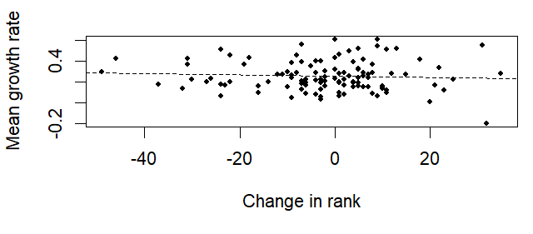
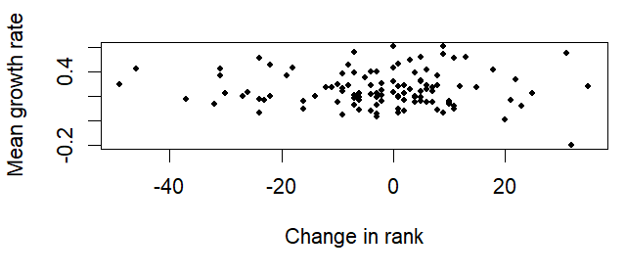
Relationship between rank change and average GDP growth
Spearman correlation = -0.047

Slide 22
Main findings
Interesting descriptive analysis: Index components Which countries have highest/lowest overall ranks Changes over time
Mean/variation relationship Relative position of CEE and Poland
Lack of Correlations: GII and PCA (also GII and SII) GII and growth

Slide 23
Conclusion
Innovation and stability are related
The GII is a unique measure that is difficult to replicate
Poland and CEE are in the “middle” for various criteria
Little connections between innovation growth
Next steps: Case studies: Leaders/laggards (worldwide), CEE
Formal analysis of macro linkages

Slide 24
Thank you!
S-Hegerty@neiu.edu

