Slide 1

Understanding Innovation Indices: Statistical Properties and Macroeconomic Linkages
Scott W. Hegerty, Ph.D.
Distinguished Professor of Economics, NEIU
World Economy Research Institute
October 23-24, 2025

Slide 2
Main idea: Examine the Global Innovation Index
Some questions:
How does the GII behave over time? → in CEE/Poland?
Where is it most/least stable?
Which countries are ranked highest/lowest?
Is it different from merely knowledge? Related to other indices?
Is it related to growth?

Slide 3
Main idea: Methods
Construct annual time series for as many countries as possible
Examine stability in levels and ranks
Look at relevant subcomponents → Comparisons to GII?
Compare to other measures (such as SII)
Growth correlations

Slide 4
Data
Global Innovation Index: From WIPO website (separate spreadsheets)
Files combined; only ones with all years used
Subindices: Examine and compare
Correlations:
Macro variables (growth)
Summary Innovation Index

Slide 5
GII Index:
217 countries (2013-2022), some blanks🡪 116 with all years (2013-2024)
Subcomponents: 154 total (Not all complete) (An example: "Global Innovation Index: Madrid system trademark applications by country of origin" )
Focus on Knowledge Creation, Knowledge Diffusion, Knowledge Absorption

Slide 6
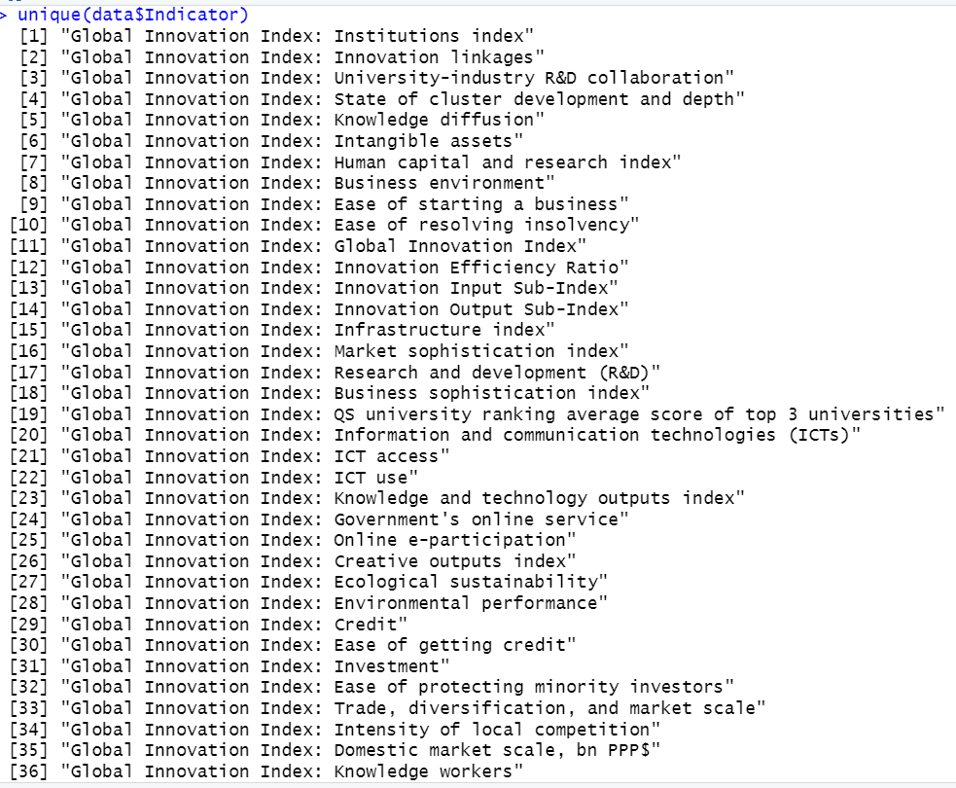
Subcomponents
Some examples:

Slide 7
Subcomponents as an alternative measure
Knowledge Creation by itself (is this similar to the index?)
Three Knowledge variables combined as new index
Principal Components Analysis: → New index from three components → Linear combination that maximizes variance (Basic results: Eigenvalues > 1 , factor loadings)

Slide 8
Statistical Measures
Ranks, levels (scores), variation, stability
Mean, SD: Summary statistics
Coefficient of Variation (SD/mean)
Focus on CEE and Poland

Slide 9
Correlations
Summary Innovation Index (SII), 46 countries European Innovation Scoreboard
GDP growth, all 116 countries World Bank data

Slide 10
Results: Principal Components
Indices generally not correlated with GII
CEE countries evaluated specifically

Slide 11
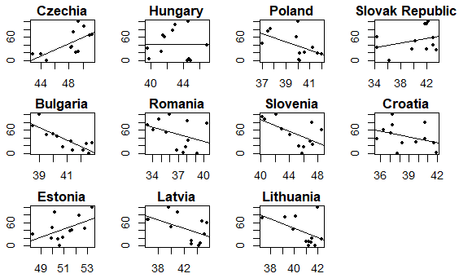
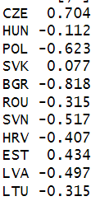
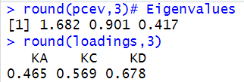
Results: PCA vs. GII, CEE
Correlations: GII and PCA
Example: Poland’s eigenvalues/loadings

Slide 12

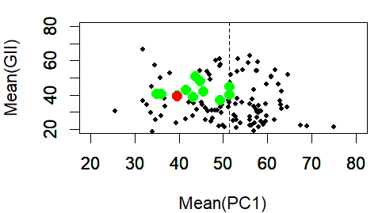
Results: Principal Components vs. GII
Green = CEE Red = Poland; means over all years

Slide 13
Mean vs. CV
Larger means -> lower variation
Innovation leads to stability?
Poland: Right in the middle (GII) but low mean/high variance for PCA

Slide 14
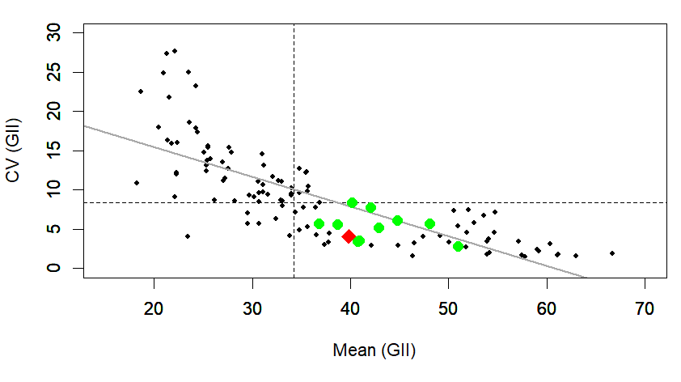
Y = 23.04 -0.379X, R2 = 0.591
Green = CEE Red = Poland

Slide 15
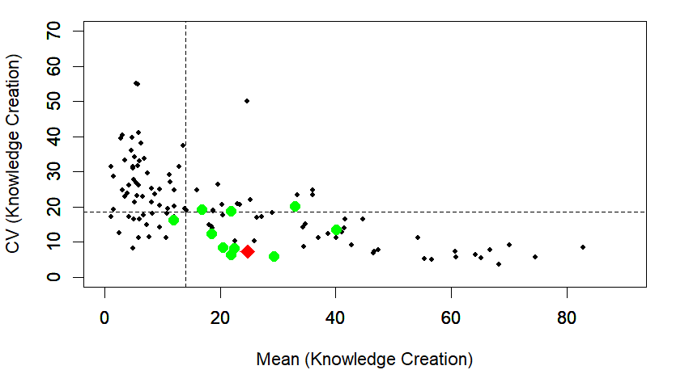
Mean vs. CV (Knowledge Creation)
Green = CEE Red = Poland

Slide 16
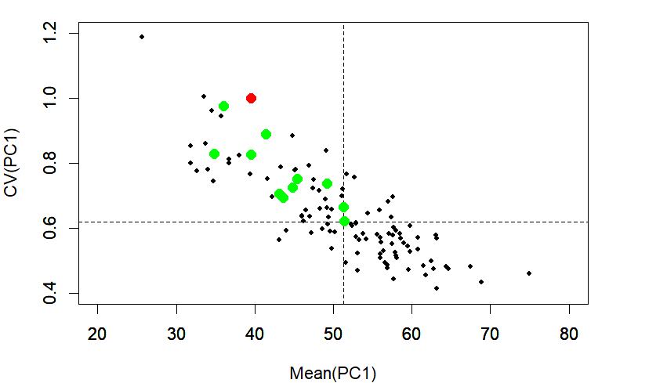
Mean vs. CV (PCA)
Green = CEE Red = Poland

Slide 17
Stability in Scores
Movement is not that large in the grand scheme of things
But can still isolate some big drops or increases
Using ranks also can help quantify this

Slide 18
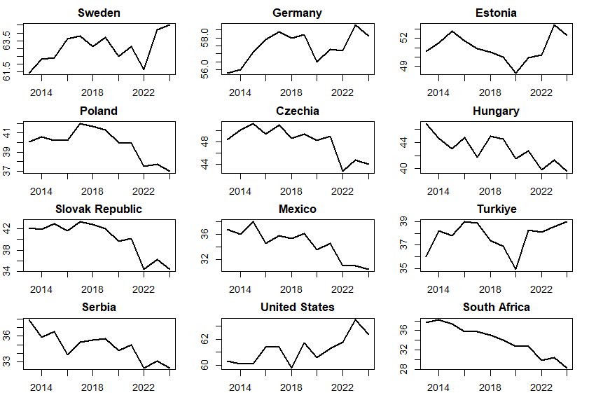
Values (zoomed in)

Slide 19
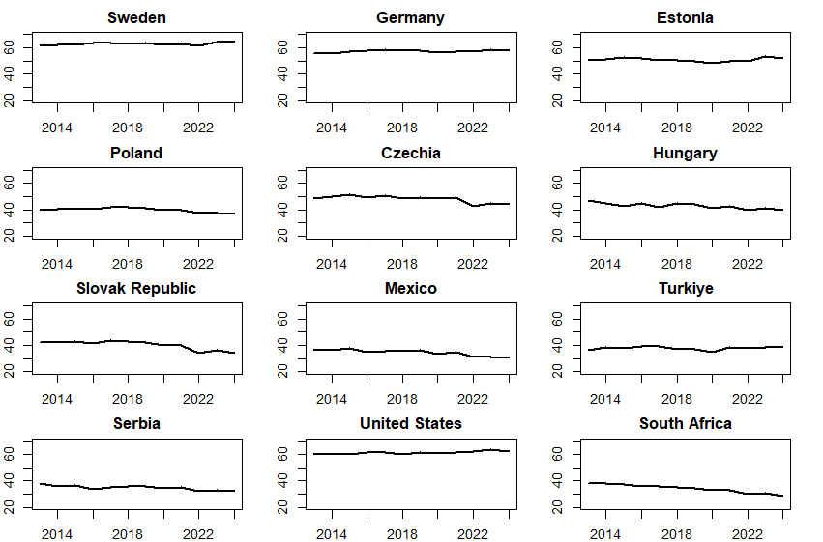
Values (zoomed out)

Slide 20
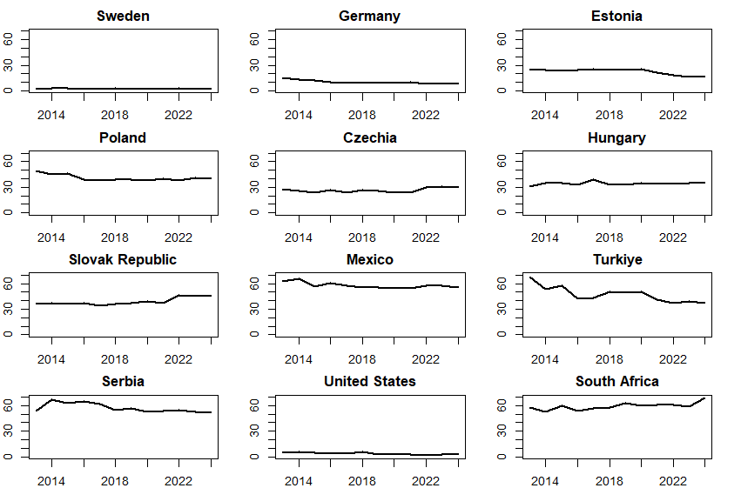
Ranks (low = high innovation)
Mean = 41

Slide 21
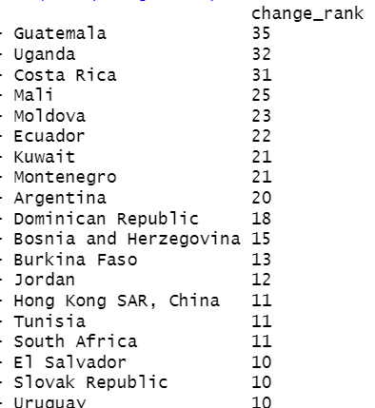
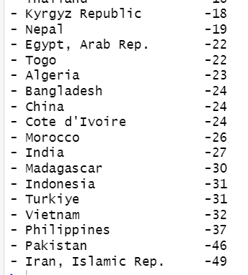
Biggest changes in ranks
Deteriorations vs. improvements

Slide 22
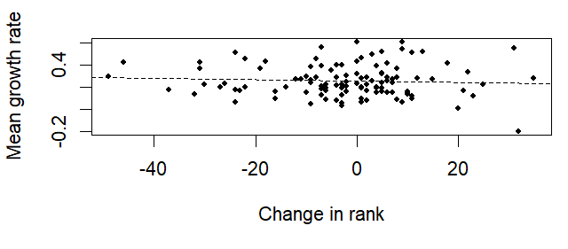
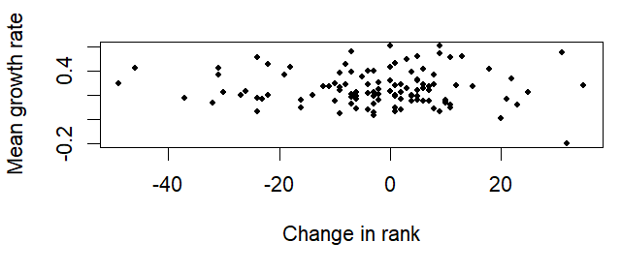
(no) Relationship between rank change and average GDP growth
Spearman correlation = -0.047

Slide 23
Main findings
Interesting descriptive analysis: Index components Which countries have highest/lowest overall ranks Changes over time
Mean/variation relationship (innovation -> Stability)
Relative position of CEE and Poland (in the middle of the pack_
Lack of Correlations: Among GII, PCA, SII Between GII and growth

Slide 24
Conclusions
Innovation and stability are related
The GII is a unique measure that is difficult to replicate
Poland and CEE are in the “middle” for various criteria
Little connections between innovation growth
Next steps: Case studies: Leaders/laggards (worldwide), CEE
Formal analysis of macro linkages

Slide 25
Thank you!
S-Hegerty@neiu.edu

