Slide 1



Are Rents Excessive in the Central City?: A Geospatial Analysis
the presentation is financed by NAWA
The presentation is financed by NAWA
Scott W. Hegerty
Department of Economics
Northeastern Illinois University

Slide 2
Introduction
Structure of U.S. “Central Cities”
Rent, housing stock, income, demographics
High rents, low property values
Outside owners find opportunity
Desmond (2016) book “Evicted”; + other papers = exploitation?
This study: Calculates and maps rent/property value ratio
Correlations with socioeconomic variables
Models using spatial regression methods

Slide 3
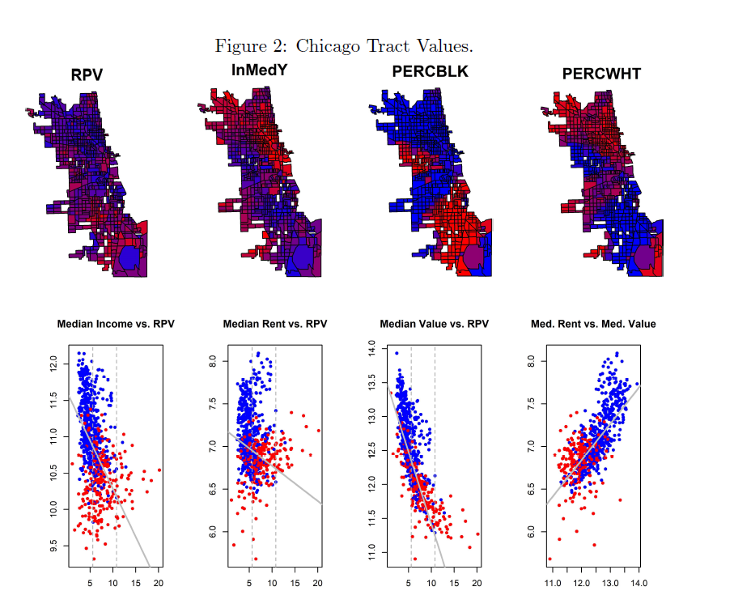

Slide 4
Previous Studies
Haugen and Heins (1969): Black residents paid higher rent than Whites, particularly where there was a large increase in the non-White % population
Grether and Mieszkowski (1974): Structural and neighborhood characteristics explain a large share of these differences
Ihlanfeldt and Mayock (2009): Evidence of discrimination against Black and Asian residents in Florida
Bayer et al. (2017): > 2m home sales, find that Black and Hispanic residents paid more for housing

Slide 5
Previous Studies
Desmond and Wilmers (2019): calculate the ratio of rents to property values
Maintenance costs and risk (both non-payment of rent and turnover among renters) → why rents do not fall proportionally with property values
Quantile regression estimation for Milwaukee shows that in the poorest neighborhoods, losses to landlords are high

Slide 6
This Study
Calculates RPV (Rent-to-Property Value) ratios for U.S. cities and Metropolitan Statistical Areas (MSAs)
Incorporates spatial characteristics (mapping census tracts for major U.S. cities, spatial regression analyses)
→ Poor neighborhoods and those with large Black populations tend to have high RPV ratios
→ Controlling for income, property values, and vacancy rates does not show that White neighborhoods suffer less exploitation
→ Evidence that “Rust Belt” cities tend to have the highest median and “extreme” values than other cities in this analysis

Slide 7
Theory
Asset prices: Based on discounted future income flows
Housing as asset = rents as income flows
Risk: Missed payments, vacant unit after moveout or eviction
Other costs: Maintenance (especially for older housing)

Slide 8
Analysis
Tract-level data from the 2019 American Community Survey (ACS 5-year estimates)
30 large U.S. cities and their metropolitan areas
RPV ratio: Median Gross Rent, 2 Bedrooms divided by Median Value (dollars), annualized by multiplying by 12:

Slide 9
Other Variables
Tract-level median income
Vacancy rate (to proxy risk)
Rental rate
Rental vacancy rate
Percentages White and Black (Majority-Black tracts are highlighted)
Four “test case” cities of Milwaukee, Chicago, Atlanta, and San Francisco
Bivariate relationships, citywide correlations are then calculated between RPV and a number of socioeconomic variables
30 cities and their MSAs

Slide 10
Distributions of Variables
Quantiles for RPV values are calculated for all cities (and their MSAs)
Cities are ranked by median RPV value, as well as the corresponding 50%, 75%, 90%, and 95% quantiles
→ Ranking: cities such as Detroit, Cleveland, and Milwaukee on one end, and Seattle and San Francisco on the other

Slide 11


Spatial Lag Regressions
y = RPV z-Scores (ZRPV)
x = (log) median income (lnMedY), the areawide (city or MSA) median property value (lnMedVal), the vacancy rate (PERCVAC), the rental rate (PERCRENT), and one measure of racial characteristics (separately)

Slide 12
Spatial Lag Regressions
ρ measures spatial autocorrelation
I is an identity matrix, and W is a spatial weights matrix
LeSage (2014): this is kept as simple as possible: W = Queen contiguity matrix of order one

Slide 13
Four Test Cases
Milwaukee, Chicago, Atlanta, San Francisco
Differences among cities
Relationships among variables

Slide 14
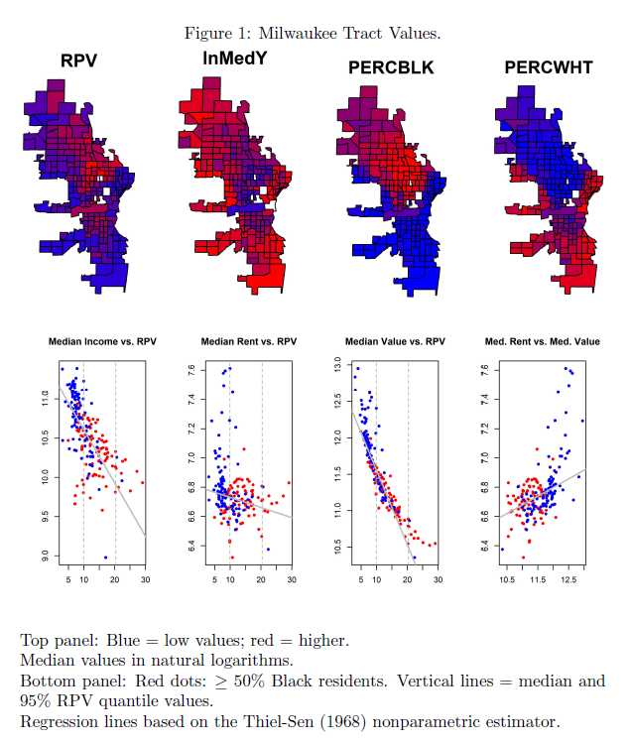

Slide 16
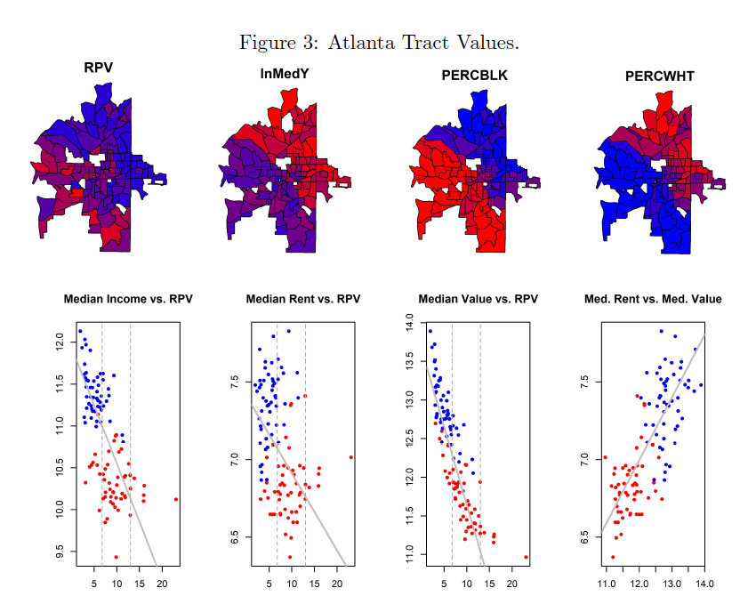

Slide 17
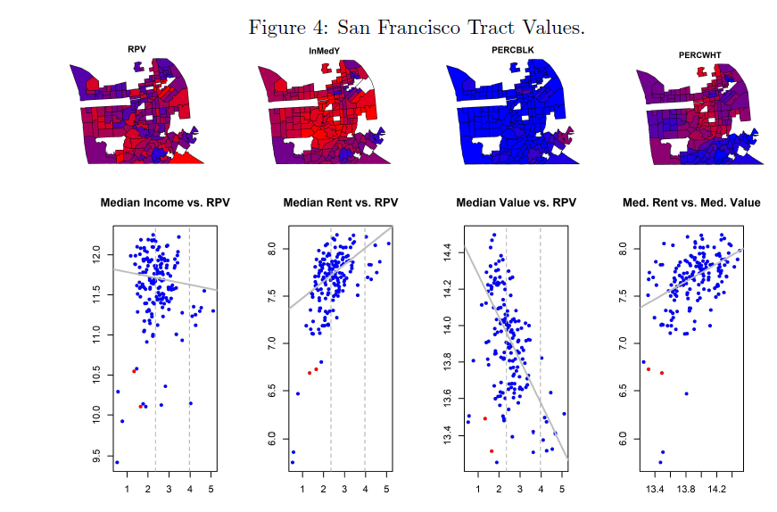

Slide 18
City-Level Correlations
Across 30 cities; also 30 MSAs
Bivariate relationships between RPV and socioeconomic variables
Scatterplots and (nonparametric) regressions

Slide 19
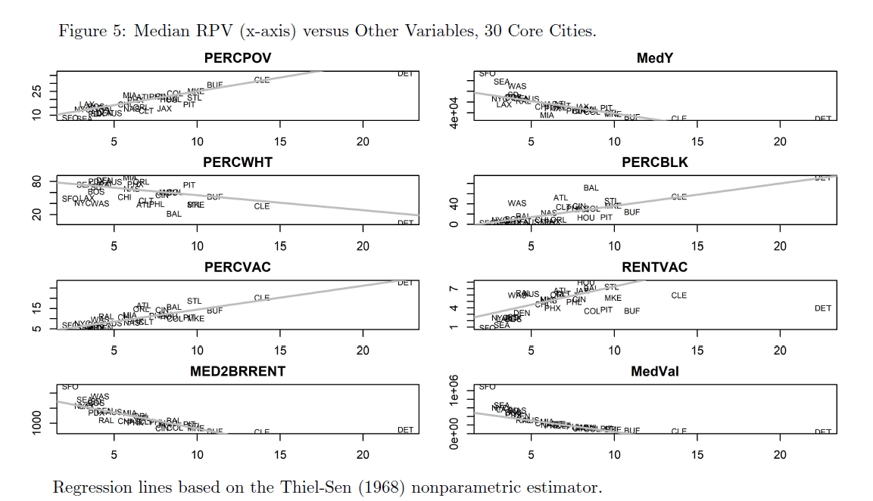

Slide 20
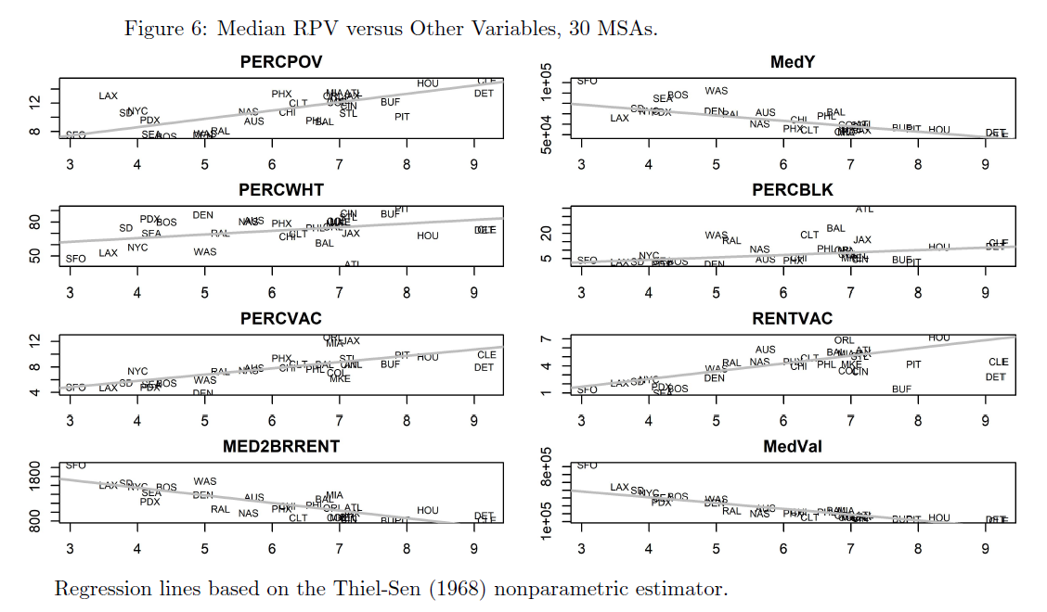

Slide 21
City-Level Quantile Rankings
“Rust Belt” Cities (Detroit, Cleveland, Buffalo, Milwaukee) highest median (and other quantiles)
Slightly different for MSAs (Houston)

Slide 22
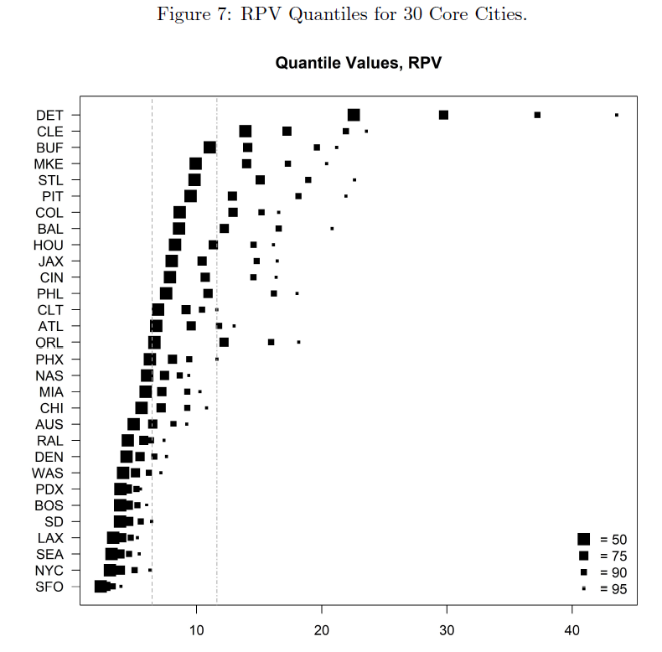
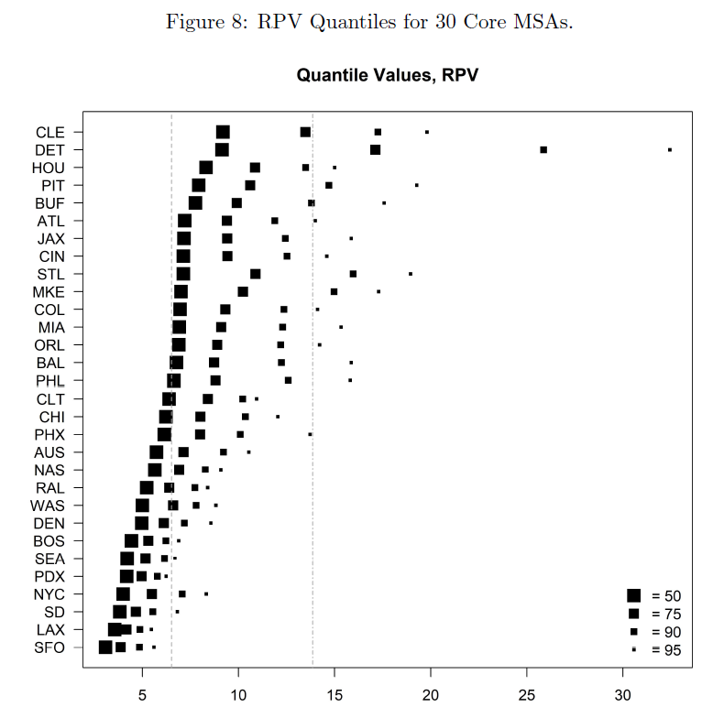

Slide 23
Spatial Regression Results
Median property values: significantly negative relationship with ZRPV for all 30 cities
→ high ratios driven by the denominator of (rent/val) while rents more stable
Median income significantly positively associated with extreme values of RPV Exception: low values for Buffalo, Columbus, Pittsburgh, St. Louis
Percentage of renters has a significantly positive coefficient in the majority of cases
The vacancy rate (risk and neighborhood conditions) → significantly positive effect in only 18 of the 30 cities Coefficients are significant for Detroit, Milwaukee, and Pittsburgh–but also Phoenix, and not Atlanta or Cleveland

Slide 24
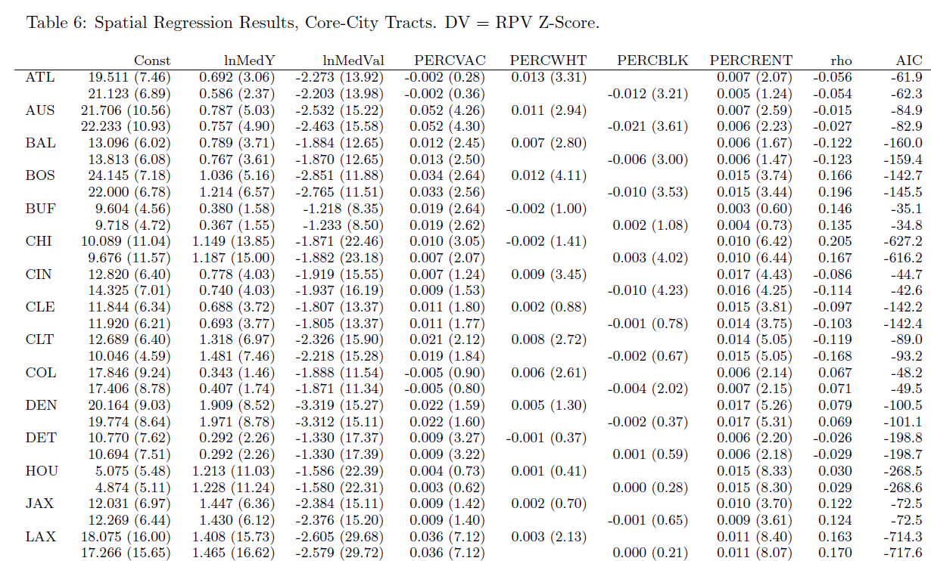

Slide 25
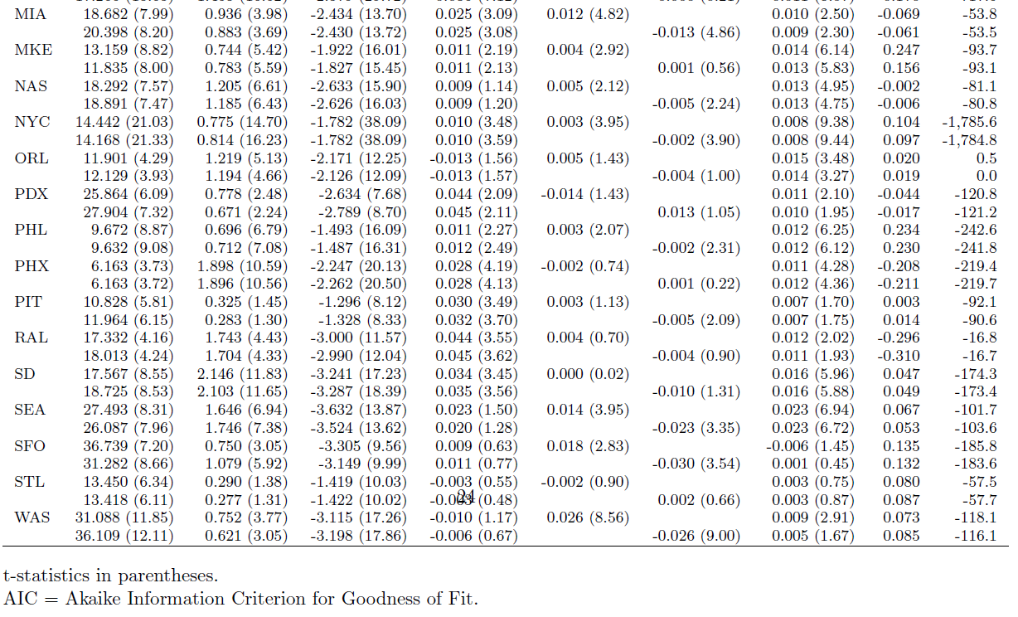

Slide 26
Main Conclusions
1) “Rust Belt”: median and “extreme” RPV values are much higher than elsewhere (versus the West Coast)
2) Whether high values of the ratio are the result of low property values rather than high rents depends on these classes of city
3) Once income, risk, and neighborhood characters are controlled for, tract-level racial makeup often has the “opposite” effect than what might be expected. → High proportions of White residents, for example, have lower RPV ratios, all else equal

Slide 27
Questions?
Thank you!
S-Hegerty@neiu.edu

