Slide 1

“Banking Deserts," City Size, and Socioeconomic Characteristics in Medium and Large U.S. Cities
Scott W. Hegerty, Ph.D.
Professor of Economics
Northeastern Illinois University
Illinois Economic Association
November 4, 2022

Slide 2
Motivation
Areas of large cities without access to services
“Food deserts,” etc.
“Banking deserts” → lack of financial access
Related problems: Lack of financial knowledge, signal of disinvestment, higher interest rates, fewer loans
But: Rural areas are deserts too → Can be smaller cities as well

Slide 3
Related Studies
Ergungor (2010), Nguyen (2019): Economic effects
Hegerty (2016, 2020, 2022)
Kashian (2018): Pop. Density; thresholds
→ 1 bank per 1-mile radius? (depends on city type)

Slide 4
This study
Examines a larger sample: 319 U.S. cities with populations greater than 100,000
Isolates areas with fewer than 0.318 banks per square mile based on distances from block-group centroids→ “Banking deserts”
Can map, look at correlations
→ Opening for further research

Slide 5
This study
2-mile vs. 1-mile radii for calculation
Distributions: Bank densities Deserts vs. Non-deserts
Associations with three variables:
Poverty, % White, % Black
Rates vs. concentrations
100 x (Desert population in poverty/Total desert population).
100 x (Desert population in poverty/City population)
City characteristics Large vs. small, specific areas

Slide 6
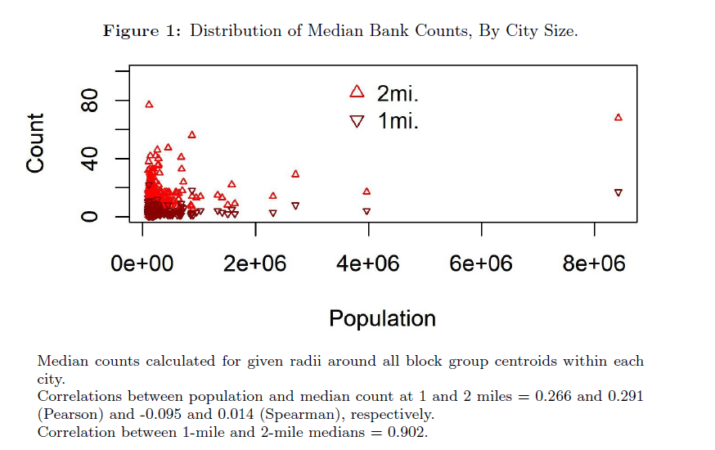
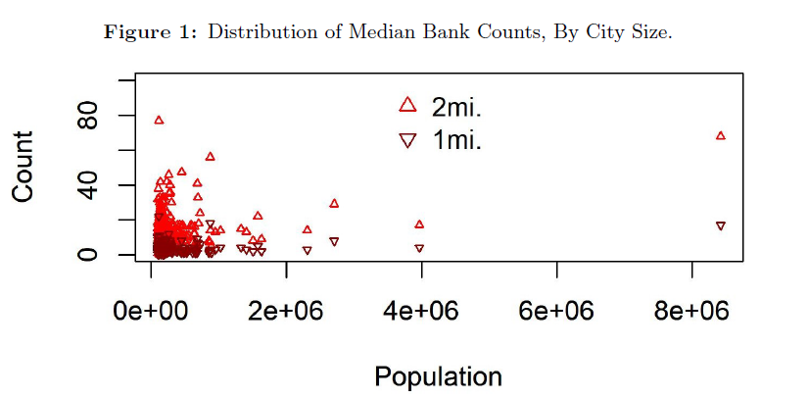

Slide 7
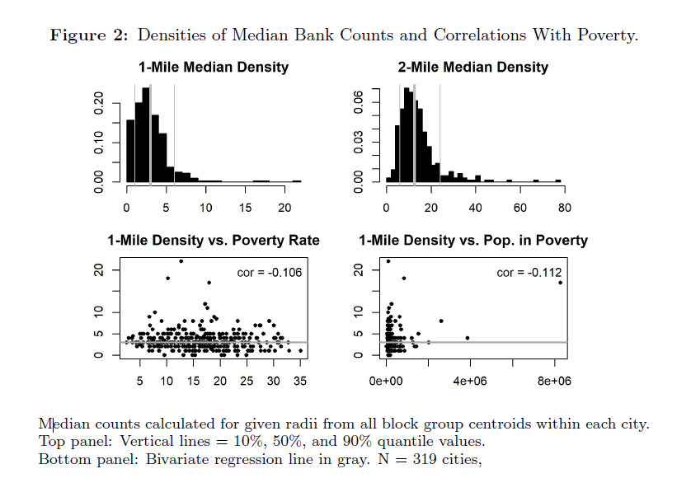
Most BG <4 banks /sq. mi Weak negative correlation with poverty

Slide 8
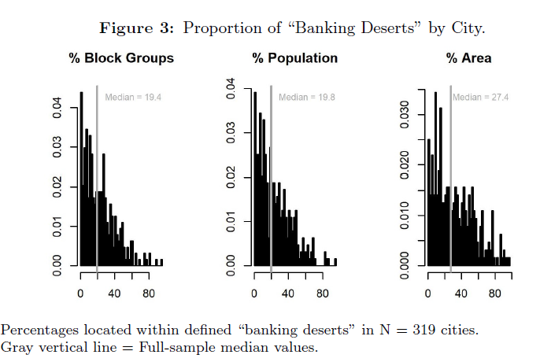
19% of BG # and pop., 27% of area

Slide 9
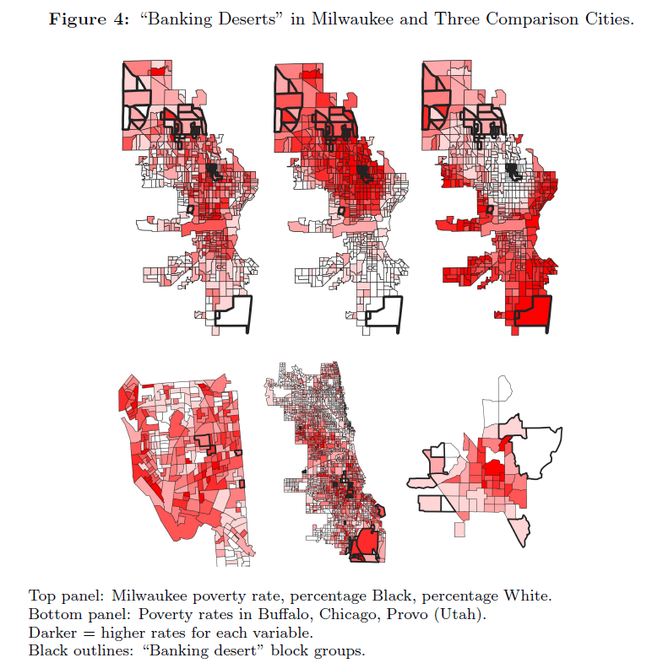

Slide 10
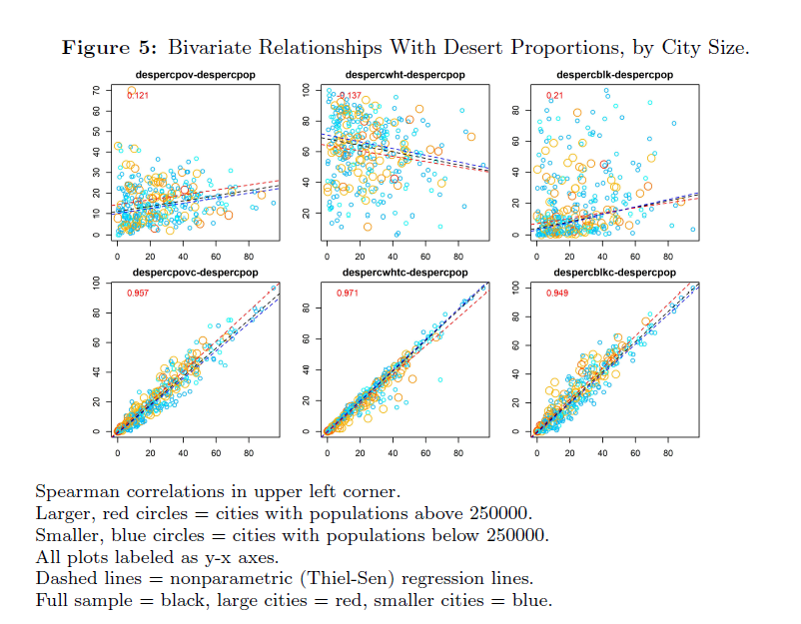

Slide 11
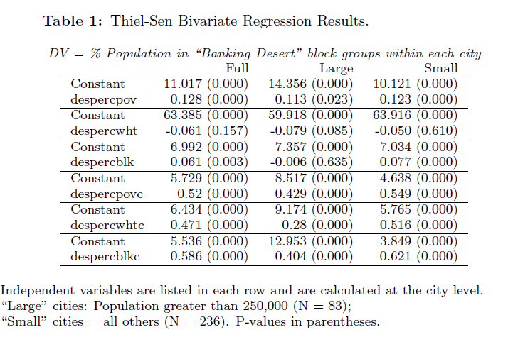

Slide 12
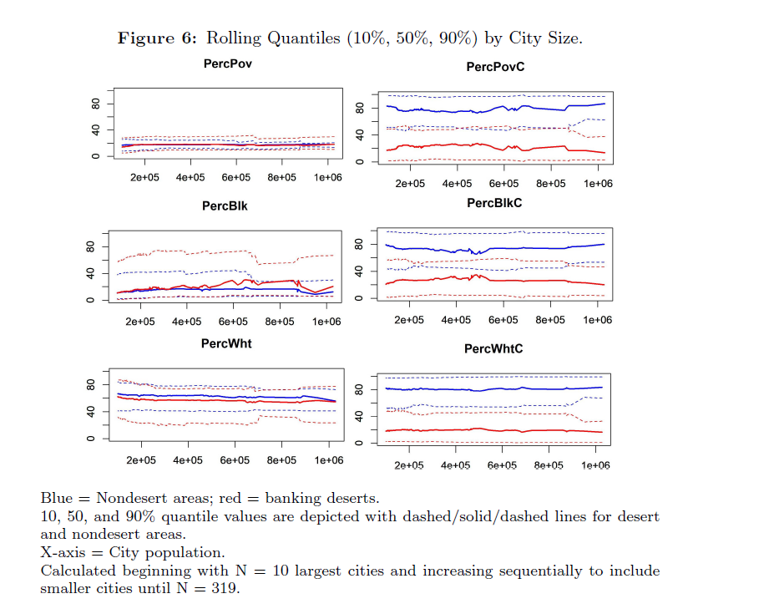

Slide 13
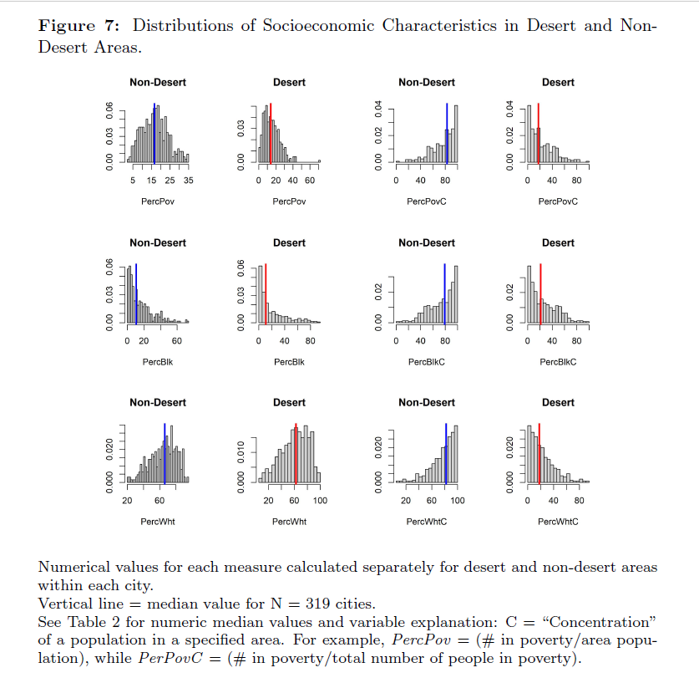
Similar medians, distributions for %s Higher values for concentrations

Slide 14
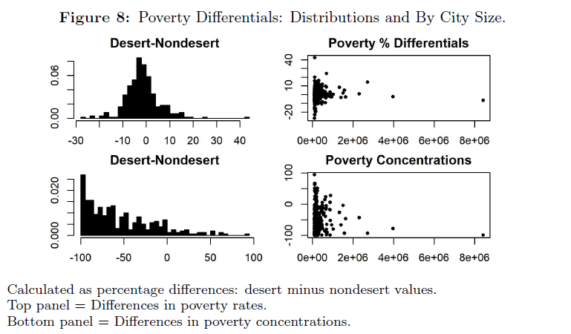
Median poverty differential is negative

Slide 15
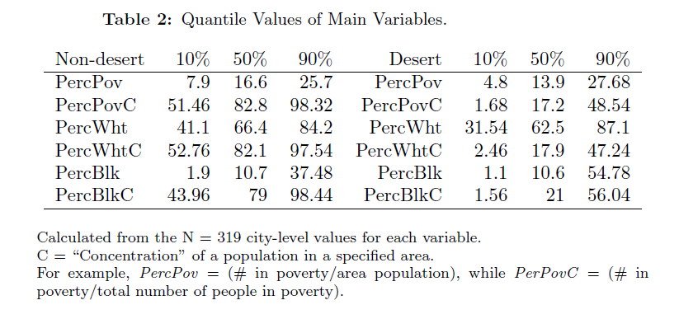

Slide 16
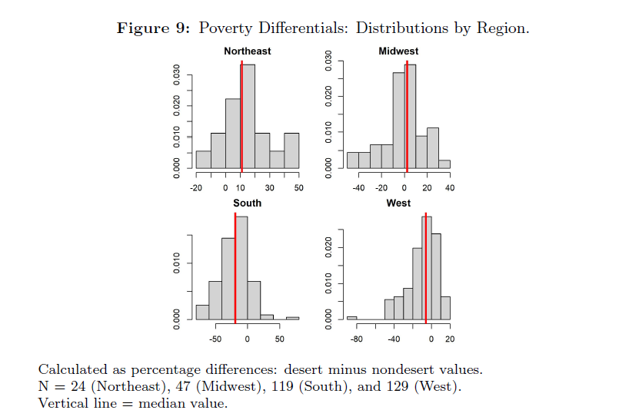
Median poverty differential positive in NE (slightly in MW); Neg. in S, W

Slide 17
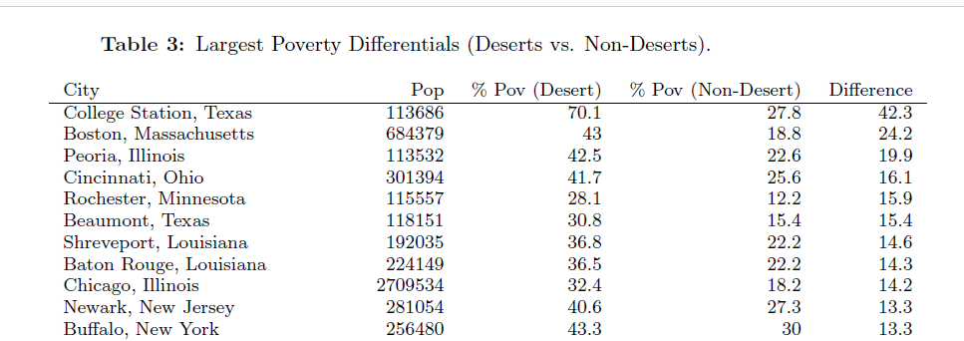
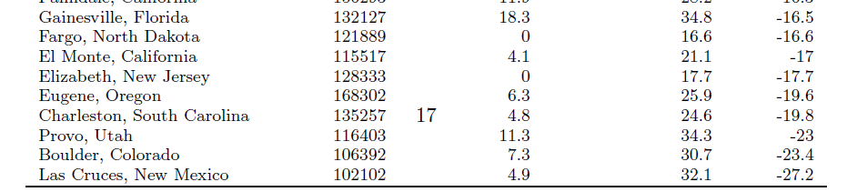

Slide 18
Overall Conclusions:
Larger study finds similar “desert” block groups as earlier studies of Chicago, etc.
→ Further extensions possible
Not much relationship between % desert and city size
Not much correlation with poverty, race (except in larger cities)
U.S. Northeast: Deserts poorer than nondeserts

Slide 19
Any Questions?
Thank you!
S-Hegerty@neiu.edu

