Slide 1


Baltic-Nordic Trade Flows, Exchange-Rate Volatility, And Structural Breaks: An Application of Nonlinear Cointegration Analysis
Scott W. Hegerty, Ph.D.
Northeastern Illinois University (USA)
Evolving Challenges in European Economies
Tallinn, Estonia
12-14 June 2022

Slide 2
Introduction
Estonia, Latvia, and Lithuania: well-known cultural, historic, and linguistic ties with their Nordic neighbors
Going back centuries; continuing through EU membership to today
Many studies on bilateral trade (exports, imports, trade balances); few on Baltic; fewer on Baltic-Nordic trade
This study: Extends work on trade balances and structural breaks → Cointegration models (linear and nonlinear)
Finds differences by country pair and by specification
Structural breaks affect performance of model

Slide 3
Some previous studies:
Bems and Jönsson Hartelius (2006) written before the Global Financial Crisis
Ketenci (2016) focuses outside the Baltic
Bošnjak et al. (2020) find hysteresis in CEE time series
Kulbacki and Michalczuk (2021) show shifts in trade patterns
Hegerty (2022a) focuses on Baltic trade outside of Europe
Hegerty (2022b) begins with structural breaks

Slide 4
This study:
1. Examines structural changes in bilateral trade → Events such as European Union accession in 2004, the 2008-2009 global financial crisis, and spillovers from Russia’s first incursion into Ukraine in 2014
2. Evaluates how such events (e.g. capital inflows in mid 2000s) are “priced into” the real exchange rate → May capture same information as breaks
3. Investigates how exchange-rate volatility and regime shifts affect these trade balances → Applies different models and specifications

Slide 5
Main hypotheses:
1) Historic partnerships/events “captured” by structural breaks
2) Events also “priced into” the real exchange rate → Will lead to redundant effects
3) Ambiguous volatility effect can be uncovered by nonlinear methods

Slide 6
Methodology:
Monthly time series for bilateral exports from the International Monetary Fund’s Direction of Trade Statistics (1993-2021); deseasonalized (if necessary) using the Census-X13 procedure
Export/import ratios for Estonia, Latvia, Lithuania and Finland, Norway, and Sweden; also comparison countries Poland, Russia, and the United States →18 bilateral trade balances total (3 x 6)
Additional variables: industrial production, consumer price indices, and nominal exchange rates (vs. USD and EUR), taken from the IMF’s International Financial Statistics
Bilateral rates via euro cross rates (1999-)

Slide 7
Methodology:
Structural breaks (changes in mean) in the trade balances are extracted using the method of Bai and Perron (1998)
Used both for informative purposes (many coincide with the GFC, for example), as well as to create dummy variables for the cointegration model
Real exchange-rate volatility is a GARCH(1,1) process, per Bollerslev (1986), with an ARMA model for log changes in real exchange rates as the underlying mean equation
Structural breaks in volatility are also calculated and compared against those found in the underlying trade balances

Slide 8
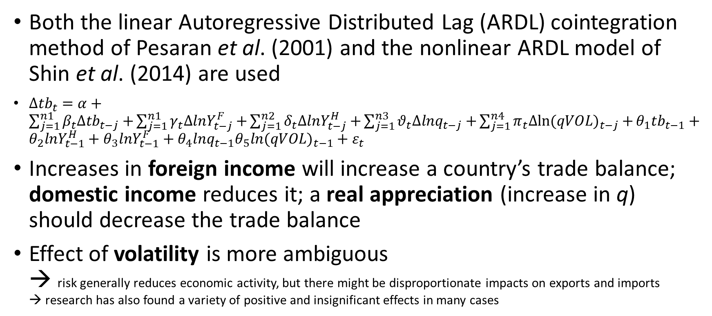
Methodology:
Both the linear Autoregressive Distributed Lag (ARDL) cointegration method of Pesaran et al. (2001) and the nonlinear ARDL model of Shin et al. (2014) are used
$∆{tb}_{t}=α+\sum_{j=1}^{n1}{β_{t}∆{tb}_{t−j}+}\sum_{j=1}^{n1}{γ_{t}∆lnY_{t−j}^{F}+}\sum_{j=1}^{n2}{δ_{t}∆lnY_{t−j}^{H}+}\sum_{j=1}^{n3}{θ_{t}∆{lnq}_{t−j}+}\sum_{j=1}^{n4}{π_{t}∆{ln(qVOL)}_{t−j}+}θ_{1}{tb}_{t−1}+θ_{2}lnY_{t−1}^{H}+θ_{3}lnY_{t−1}^{F}+θ_{4}{lnq}_{t−1}θ_{5}{ln(qVOL)}_{t−1}+ε_{t}$
Increases in foreign income will increase a country’s trade balance; domestic income reduces it; a real appreciation (increase in q) should decrease the trade balance
Effect of volatility is more ambiguous → risk generally reduces economic activity, but there might be disproportionate impacts on exports and imports → research has also found a variety of positive and insignificant effects in many cases

Slide 9
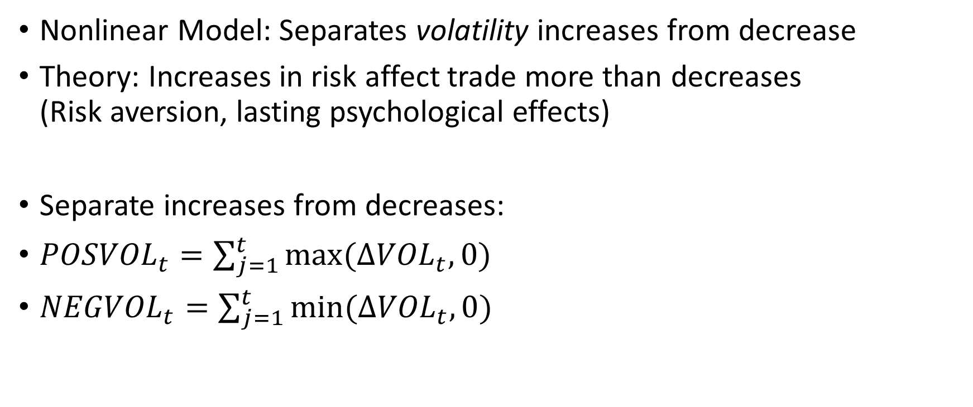
Methodology:
Nonlinear Model: Separates volatility increases from decrease
Theory: Increases in risk affect trade more than decreases (Risk aversion, lasting psychological effects)
Separate increases from decreases:
${POSVOL}_{t}=\sum_{j=1}^{t}{max⁡(∆{VOL}_{t},0)}$
${NEGVOL}_{t}=\sum_{j=1}^{t}{min⁡(∆{VOL}_{t},0)}$

Slide 10
Exchange Rates and Volatility
Appreciations, depreciations vary Appreciations vs. Nordic, fluctuation vs. U.S. and Russia
Mix of stationarity orders
Volatility “spikes” in 2008; others vary by country pair

Slide 11
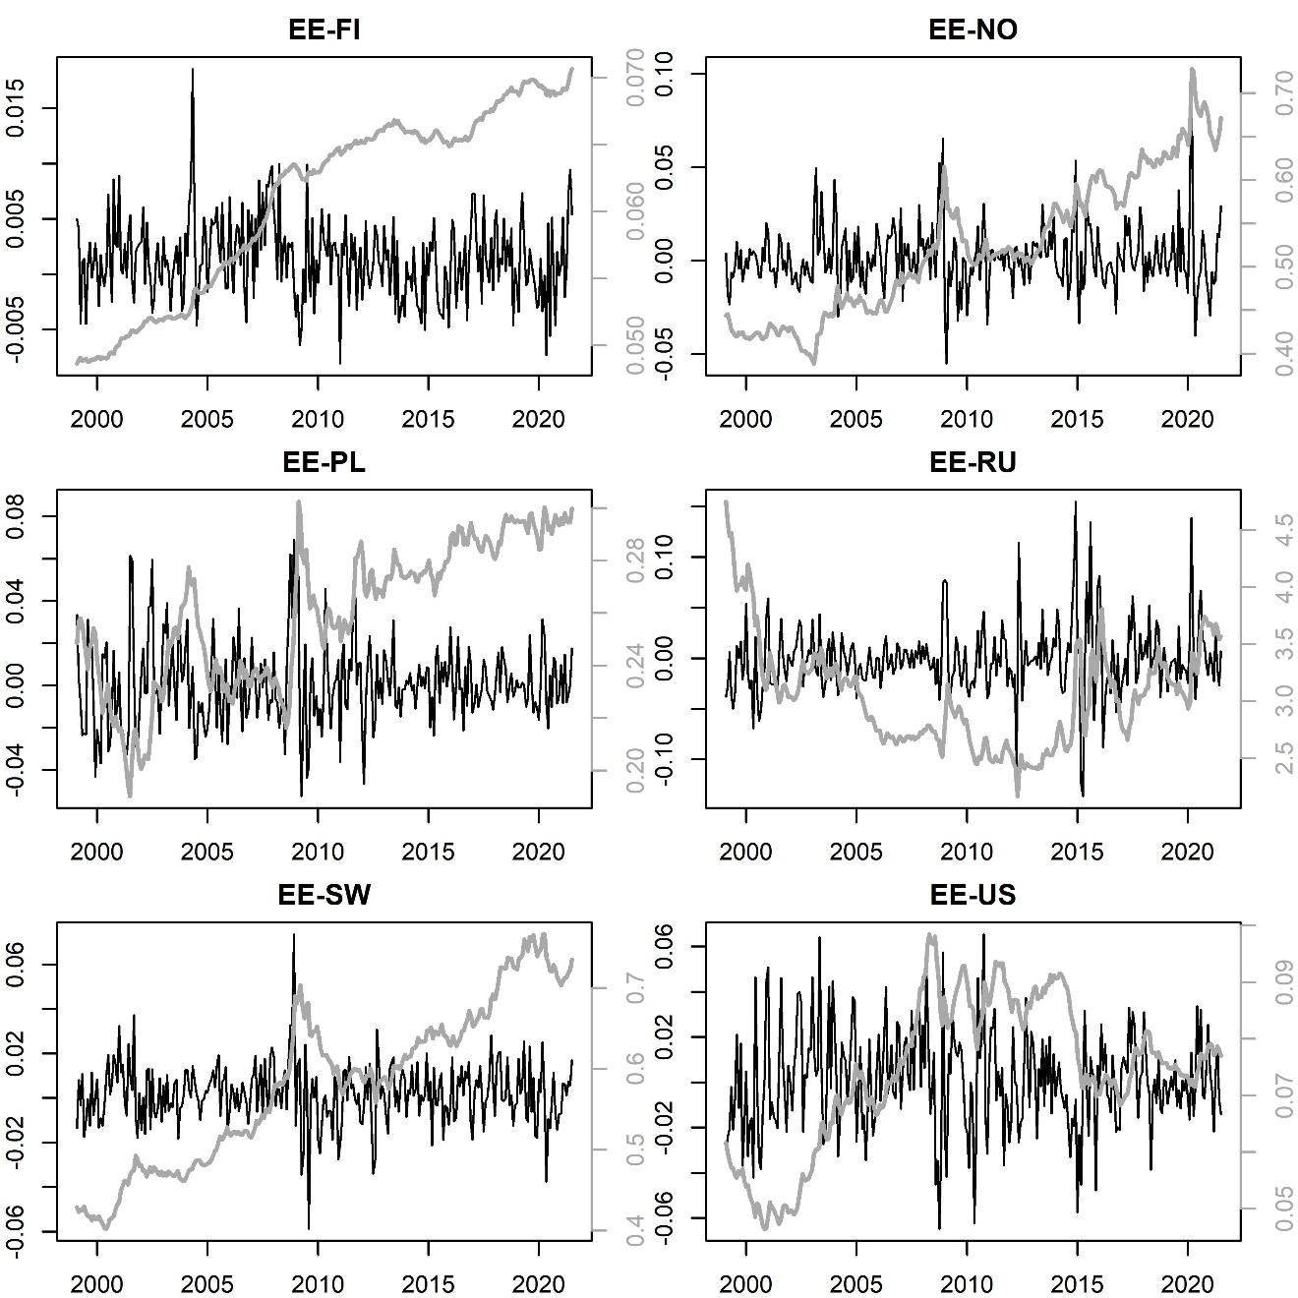
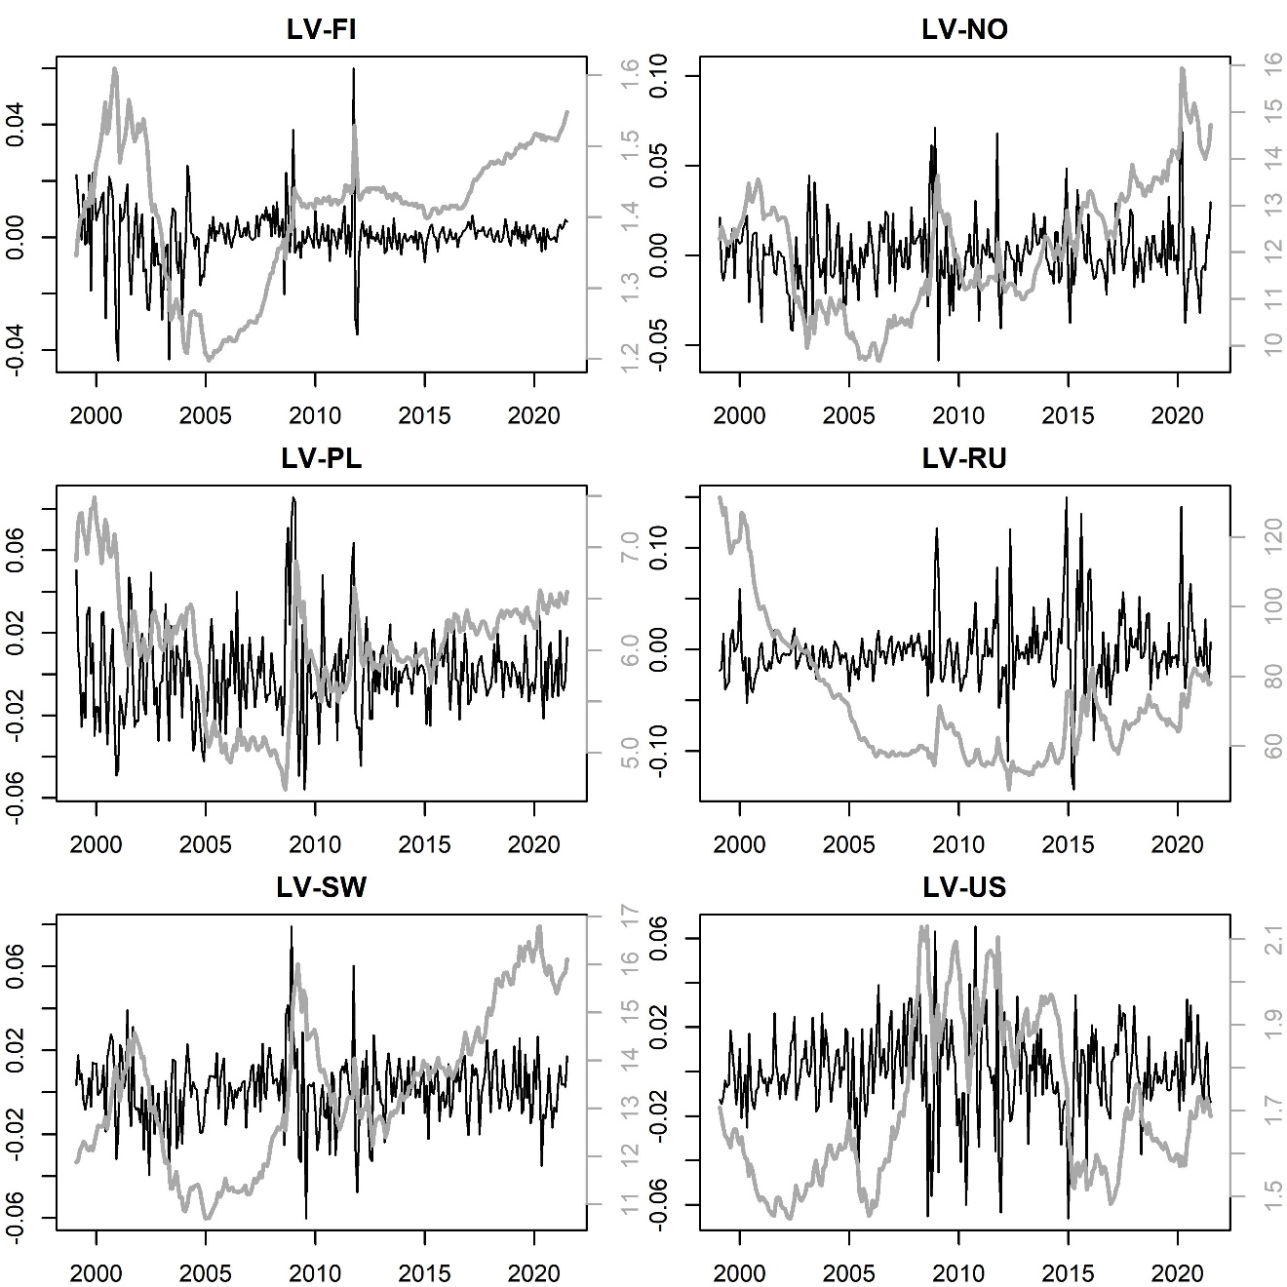
Real Exchange Rates (EE, LV)

Slide 12
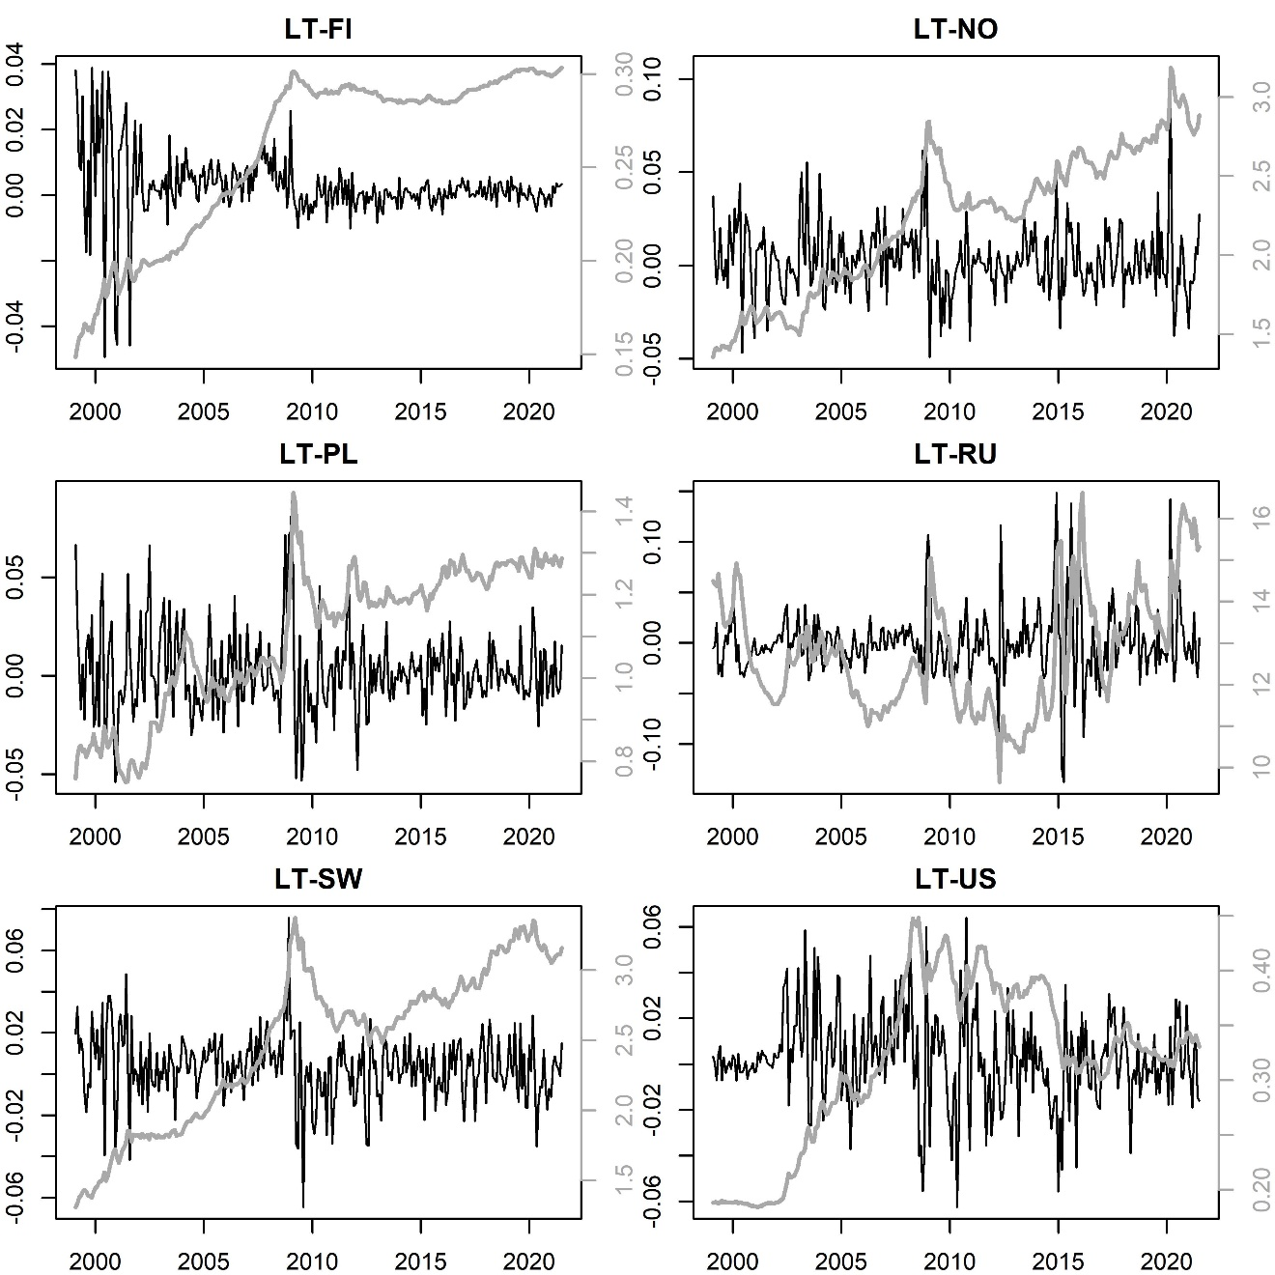
Real Exchange Rates (LT)

Slide 13
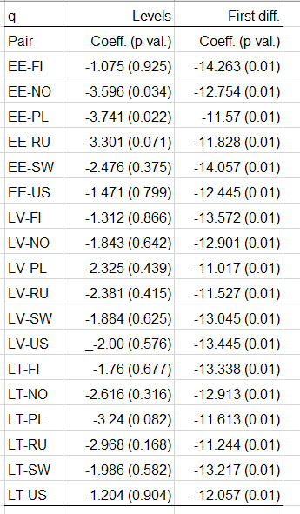
Stationarity (Real Exchange Rate, q)

Slide 14
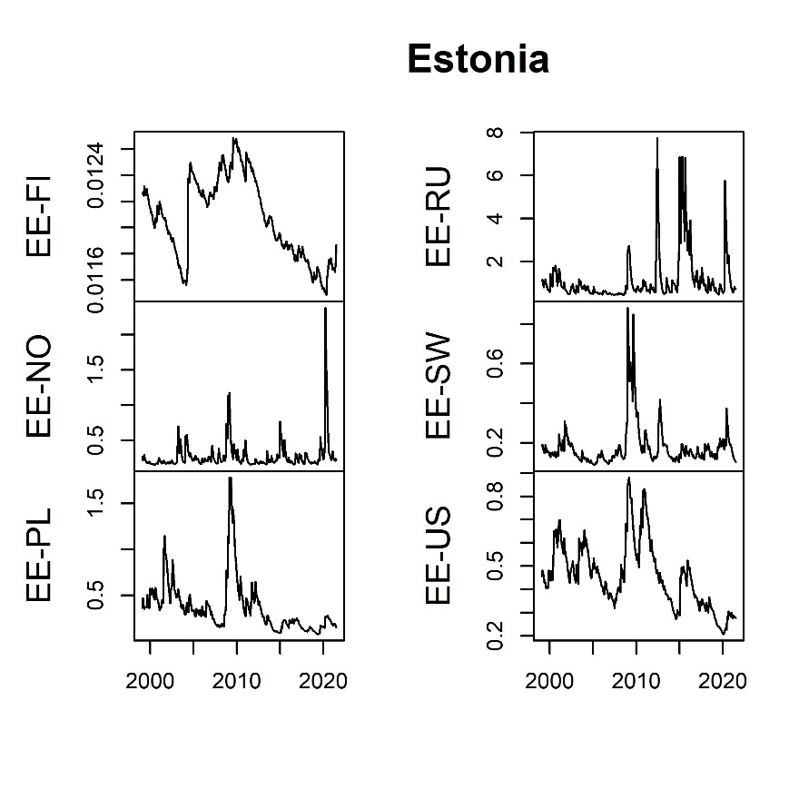
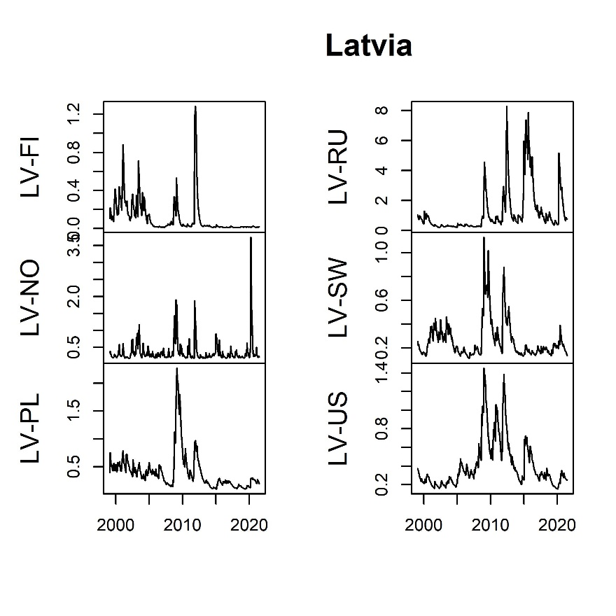
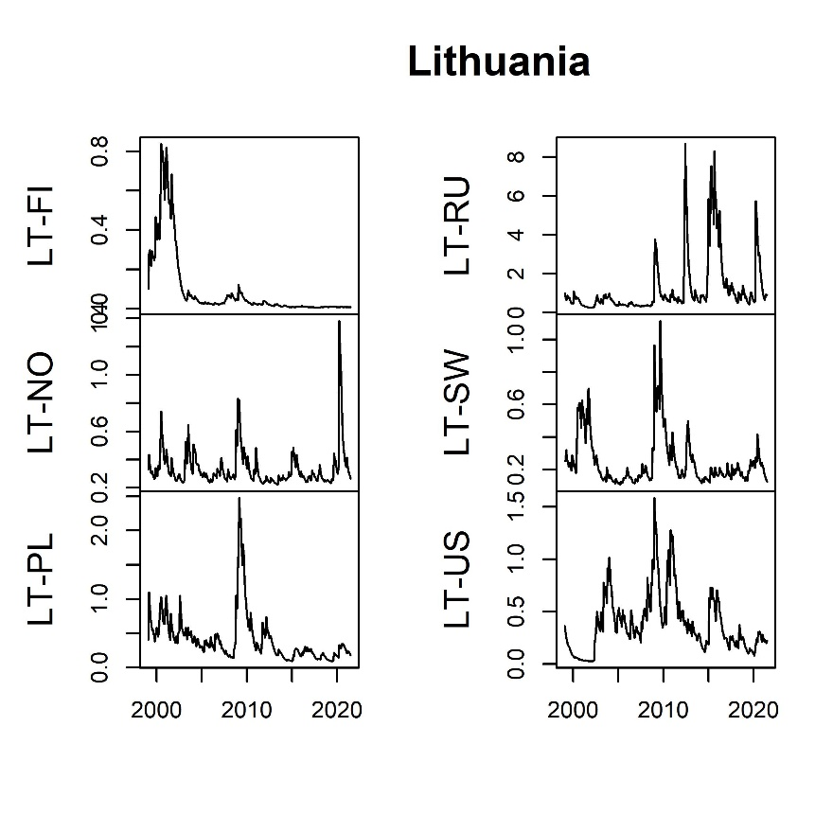
Exchange-Rate Volatility

Slide 15
Results: Structural Breaks
Structural breaks differ between trade balances and real exchange rates
Similarities: 2004 EU accession→ regime shifts in the trade balance and exchange-rate volatility for the Estonia-Finland
Additional common break for Estonia and Russia in mid-2016.
Common breaks across countries in 2008

Slide 16
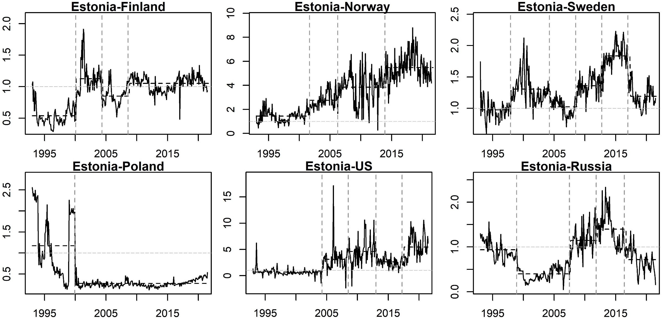
Trade Balances and Structural Breaks

Slide 17
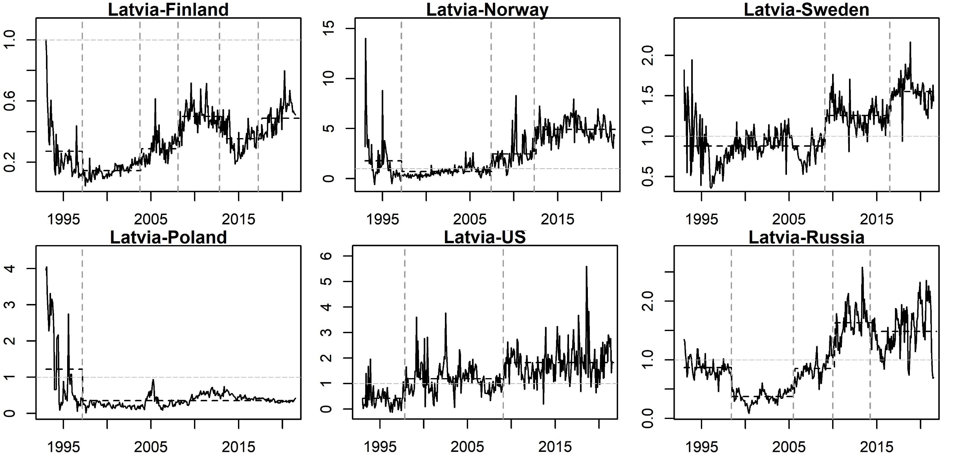
Trade Balances and Structural Breaks

Slide 18
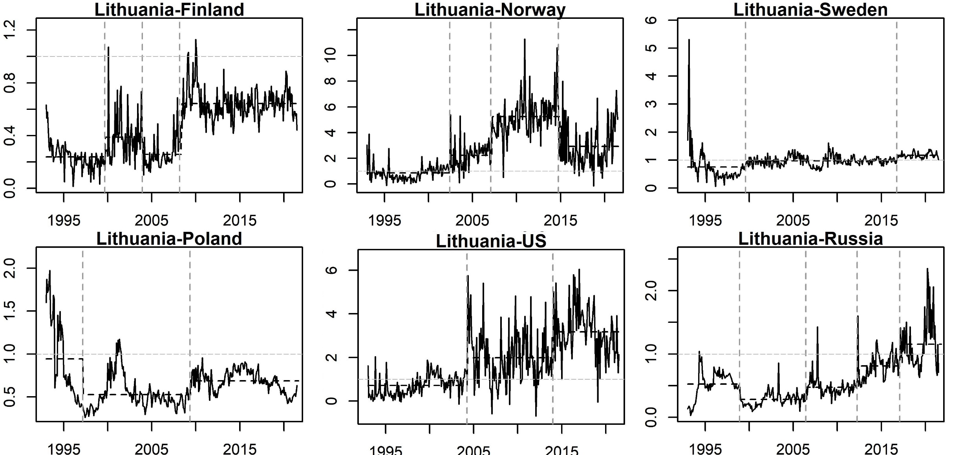
Trade Balances and Structural Breaks

Slide 19
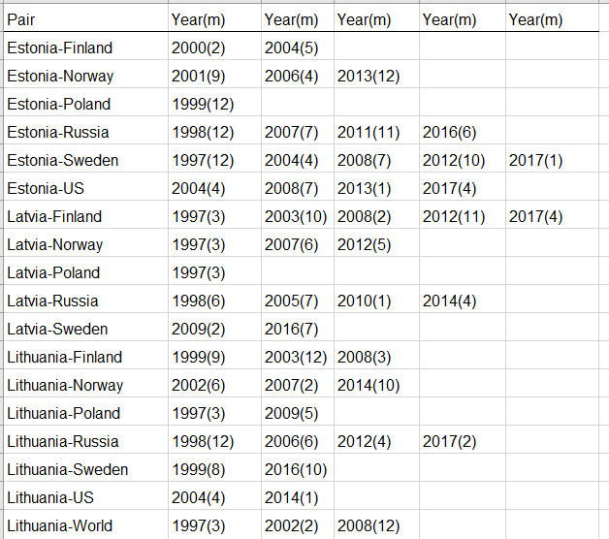
Structural Break Dates

Slide 20
Results: Structural Break Dummies
Structural-break dummies → larger F-statistic Stronger support for cointegration in both linear and nonlinear ARDL models
Real exchange rate incorporates much of the same information regarding economic shifts → Often has a more limited impact with dummies

Slide 21
Cointegration Results: Comparing Models
Most evidence of cointegration (F-test): ARDL w/dummies
Least evidence: NARDL w/o dummies
Real exchange rate significant in 4/18 cases: ARDL, w/o and NARDL w/ dummies

Slide 22
Cointegration Results: Macro Variables
Role of macroeconomic determinants (including exchange-rate volatility) is generally weak
Income and relative prices do have significant effects in some cases e.g. Domestic income: Estonia/Norway; Estonia/U.S.; Lithuania/Poland q: Estonia/Russia
“Disconnect” between F-test and coefficient significance

Slide 23
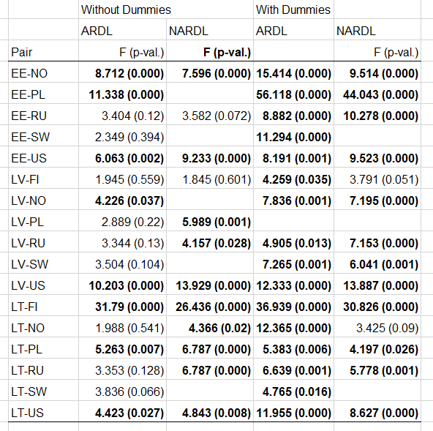
F-Test Results

Slide 24
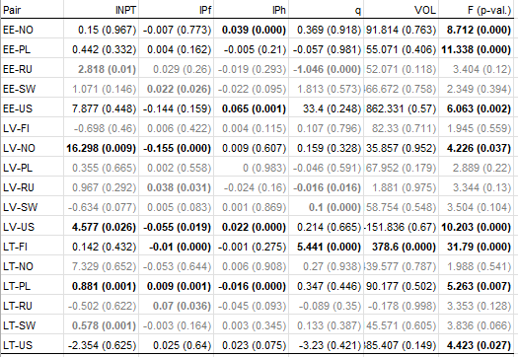
Cointegration: ARDL, no dummies

Slide 25
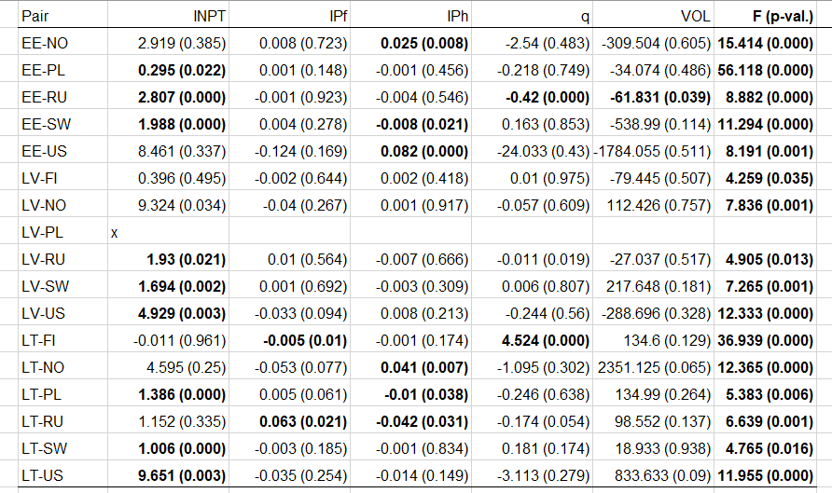
Cointegration: ARDL, w/ dummies

Slide 26
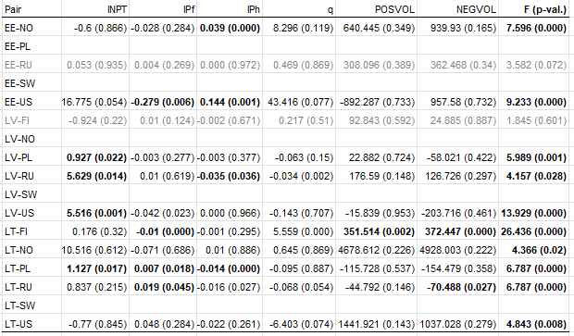
Cointegration: NARDL, no dummies

Slide 27
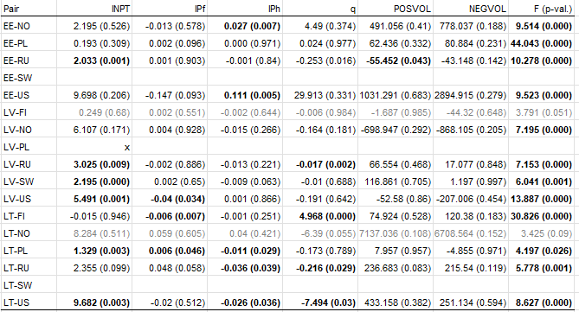
Cointegration: NARDL, w/ dummies

Slide 28
Conclusions
This study:
Looks specifically at Baltics (rather than general CEE)
Helps examine the timing and potential causes of economic change in the Baltic Sea region
Focuses on exchange-rate volatility: modeling and as a determinant of bilateral trade balances
Finds evidence of structural breaks in Baltic bilateral trade balances
Compares cointegration results between linear and nonlinear models

Slide 29
Conclusions
Findings:
Linear ARDL model performs better than NARDL
Including structural break dummies better than not including them
F test more significant than coefficients
Some significant macro effects
In general, real exchange rate and volatility not significant
Future steps: focus on q; incorporate additional variables

Slide 30
Questions?
Thank you!
S-Hegerty@neiu.edu

