Slide 1

Time-Travel with Finance: Looking out for Future You!
Scott W. Hegerty, Ph.D.
Professor of Economics
Fall 2023 TRIO Leading and Learning Week

Slide 2
Main Ideas Here
Economics as a tool for decisions
Big theme: Making good decisions over time
Have more total money by timing things right
→ Borrowing, saving, investing, interest rates

Slide 3
Economics as a Tool
Allocating resources in the best way!
Often: Where to spend your money
But also how to hire, invest…basically anything
Here: Allocating resources over time
First: some general ideas

Slide 4
Main Economics Ideas
Economics is about tradeoffs: You should be able to choose, provided you know the true costs involved
The “price” reflects this cost
If everything is fair and competitive, businesses can offer you options that give you (and them) a benefit
You can trade over time just like anything else
The price you pay (get paid) is the interest rate

Slide 5
Future You!
Basically, still you But you don’t think about them (the future is less salient today)
You can shift resources from them, or to them
You can also GROW your resources
Should you pass problems on to your future self?
Can you build up/invest in your future self?

Slide 6
The Interest Rate: What is it?
Comes as a percentage per year
“The price of money” (access to funds)
A reward for patience (penalty for impatience)
The cost and benefit of capital
Shifts spending between “now” and “later”
The “Rule of 72” : 72 / r = time to double → Compound interest 3% = doubles in 24 years, 12% = doubles in 6 years

Slide 7
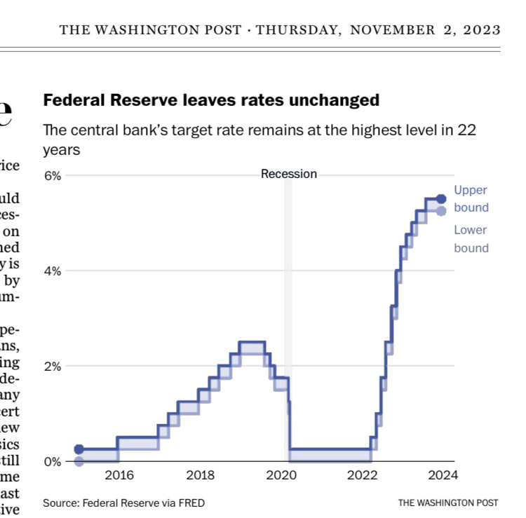
Interest rates have been rising
To slow the economy down and lower inflation
Result: Makes more sense to save, harder to borrow → More saving and less spending now than before

Slide 8
Tip #1: Save vs. Pay down debt?
It’s all the same in terms of your net worth (Assets + liabilities)
If you have $1000 in the bank and $1000 in debt, it’s still zero
Two rules: 1) Have enough savings to cover an emergency 2) Prioritize higher interest rate first
Example: 5% savings, 14% credit card, 3% student loan (You could wind up with $1050 in savings and $1140 in debt!)
What about the stock market? Retirement?

Slide 9
Thinking about Debt
Ignore psychology?
Paying down a small, high-interest debt first?
Where do student loans fit?
Saving a small amount: is it worth it?

Slide 10
Tip #2: Know your interest rate
Don’t just look at monthly payment (The math is there, just hidden) Car loans do this: 5-year loans have lower payments than 4-year loans, but you pay more total interest)
Can you get a better interest rate? Savings: Longer time Borrowing: Lower risk You want them to ask questions!

Slide 11
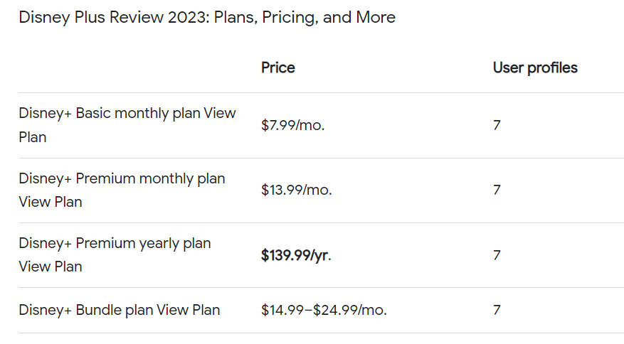
Tip #3: Other “interest rates”
Can you save a percentage per year? Be rewarded for patience?
Get 2 free months of Disney+ if you pay per year
What do businesses get?
You get more total money! (but watch out if people calculate a “monthly” rate for you)
TIP: Smooth expenses with a second checking account

Slide 12
Tip #4 Investing in the future
Rather than just moving the same money through time, you can make more money!
“Good borrowing” = increases productive capacity Education? Business loan? Car loan?
Investment vs. Consumption
Need to weigh costs/benefits (payoff vs. interest)
Borrow vs. not borrow; if you borrow you can do so smartly!

Slide 13
Future You
Has more resources because Present You thought ahead:
Didn’t push debt to Future You
Invested in education and became more productive
Maybe didn’t consume too much: saved and invested instead

Slide 14
Questions?
Thank you!
S-Hegerty@neiu.edu

