Slide 1


“Rust Belt" Across America: An Application of a Nationwide, Block-Group-Level Deprivation Index Scott W. Hegerty, Ph.D. Northeastern Illinois University
the presentation is financed by NAWA

Slide 2
Main Idea
Economic Deprivation: Multivariate Index
Captures: Income, Education, Physical Environment
Large U.S. cities? (e.g. Detroit) vs. Rural, suburban
Comparisons between measurements (math formula)
Nationwide (cities > 250K, others)
Census block groups (vs. tracts, cities, etc.)
U.S. block groups: Small units (Chicago has ≈ 3000), a few hundred people
Various statistical/modeling procedures (Including regression)
Applications for Public Health

Slide 3
Main Findings
Detroit is a unique case (95th percentile)
High levels in cities > 250K
But deprivation is found everywhere (even in places < 20K)
Cities: % of “high-deprivation” areas → tied to poverty rate, density, % White, % Black
Connections with allocating health resources

Slide 4
Previous Studies

Slide 5
Multivariate Deprivation Measures
Morris and Carstairs (1991): explain variation in health scores
Carstairs (1995), covariates w/ cancer mortality and life expectancy
Townsend (1987): 77 different components in an index for Britain
Salmond and Crampton (1998): nine components for New Zealand, including housing tenure, two measures of income, employment and qualifications, adequate living space, access to a car and a telephone, single-parent family

Slide 6
Measurement differences
Aaberge and Brandolini (2014): differences in dimensions and weights
Principal Component Analysis: (PCA), Pacione (2004): rural Scotland; Smith (2009): Detroit and Portland
Inverse standard deviation: Hegerty (2019), nationwide sample of U.S. Census tracts and largest cities
Areas studied: Bertin et al. (2014) many indices normed around urban areas
Noble and Wright (2013); Burke and Smith (2019) include rural variables (access to employment and services
Clelland and Hill (2019) little obvious bias against rural areas in Scotland

Slide 7
Methodology

Slide 8
Deprivation index construction
Four variables: % in Poverty Vacancy Rate Unemployment rate % above 25 without a High-school degree
U.S. Census (2015-2019 5-year American Community Survey)
214,807 block groups
48 contiguous U.S. states and the District of Columbia

Slide 9
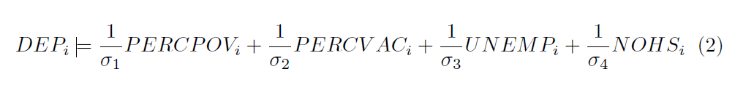
Weighting schemes
1) Principal Components Analysis (PCA): Extract common variance → Factor loadings used as weights in linear combination
2) Inverse standard deviation

Slide 10
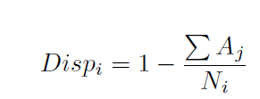
Comparing areas
National index of economic deprivation City-level measures for the 83 cities with populations above 250,000 in 2019. (Median value of all block groups in the city) City weights and National weights
Also single city values
“Dispersion” score: Aj = "low deprivation" block groups in city i that do not touch a high-deprivation block group (queen contiguity) Ni is the number of low-deprivation block
groups in city i.

Slide 11
Results: Maps

Slide 12
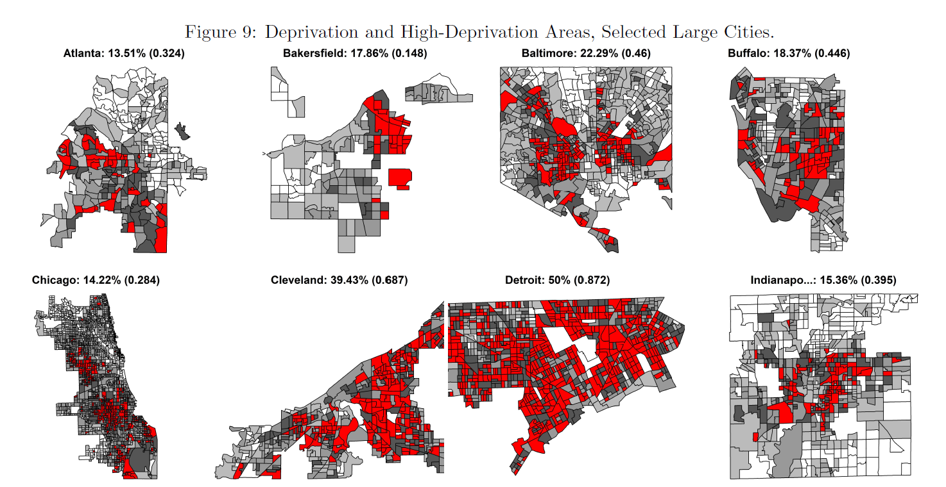

Slide 13
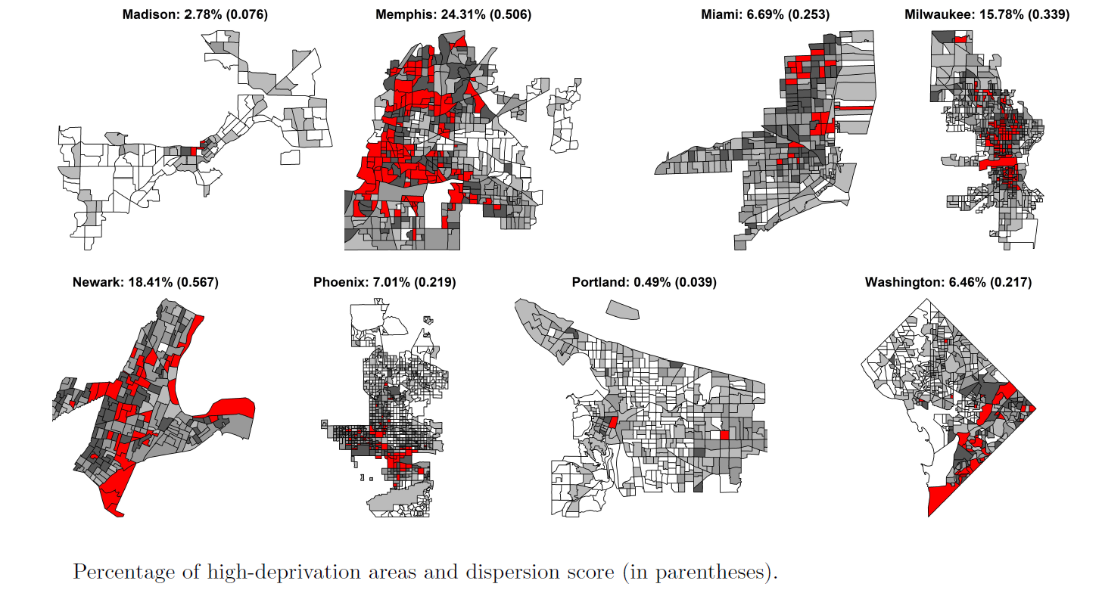

Slide 14
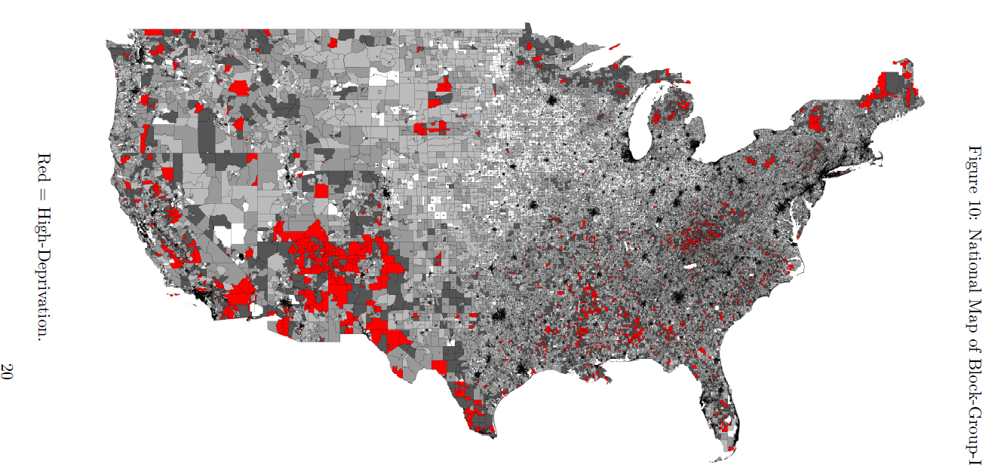
Nationwide Map

Slide 15
Results: Statistical Methods

Slide 16
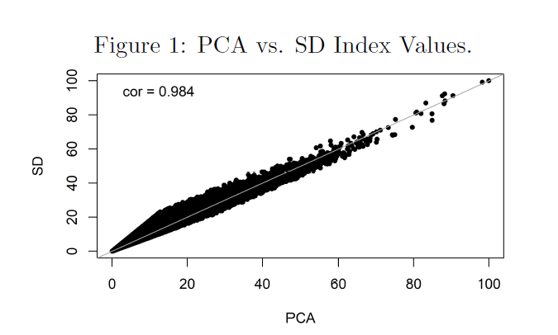
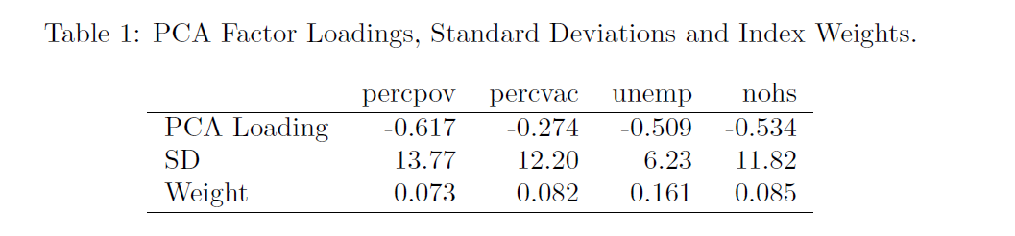
Comparing Weighting Schemes

Slide 17
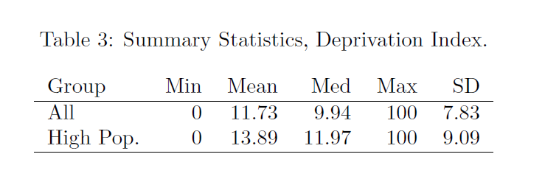
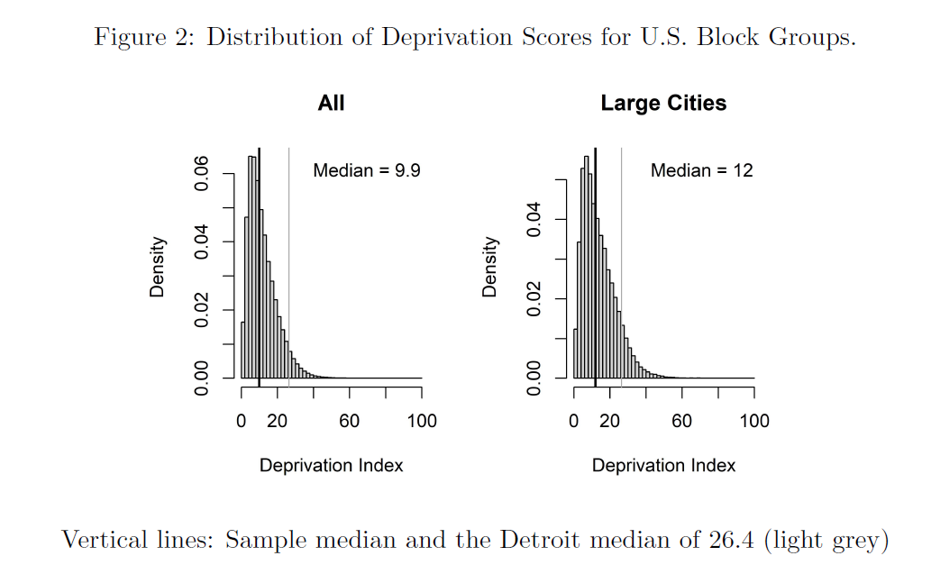
Score Distributions

Slide 18
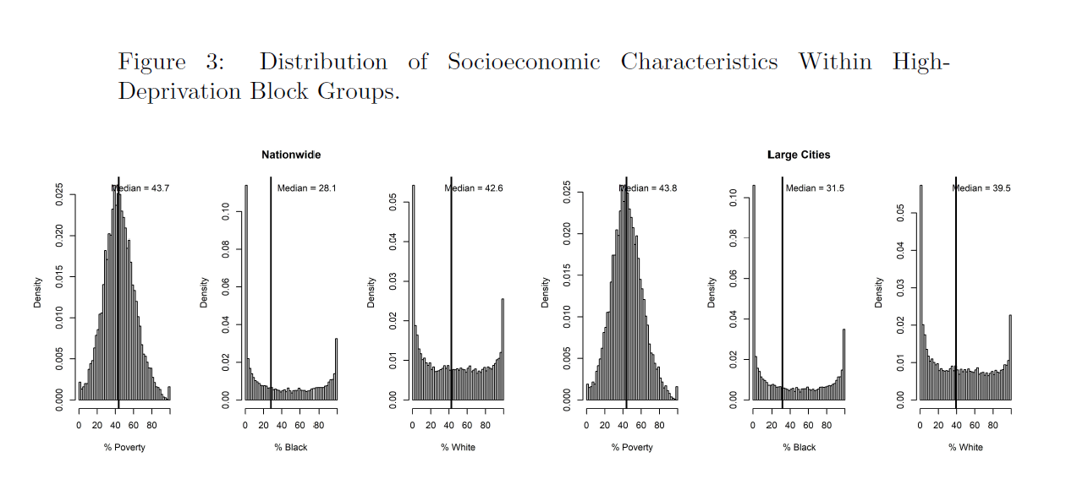
Nationwide vs. 83 large cities

Slide 19
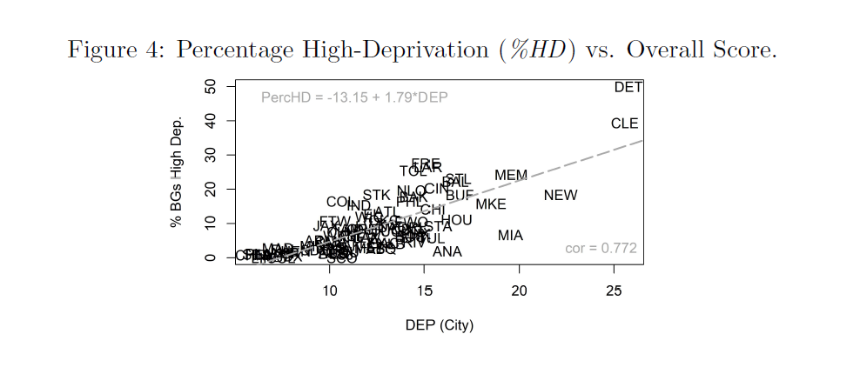
Cities with large % of high-deprivation BGs

Slide 20
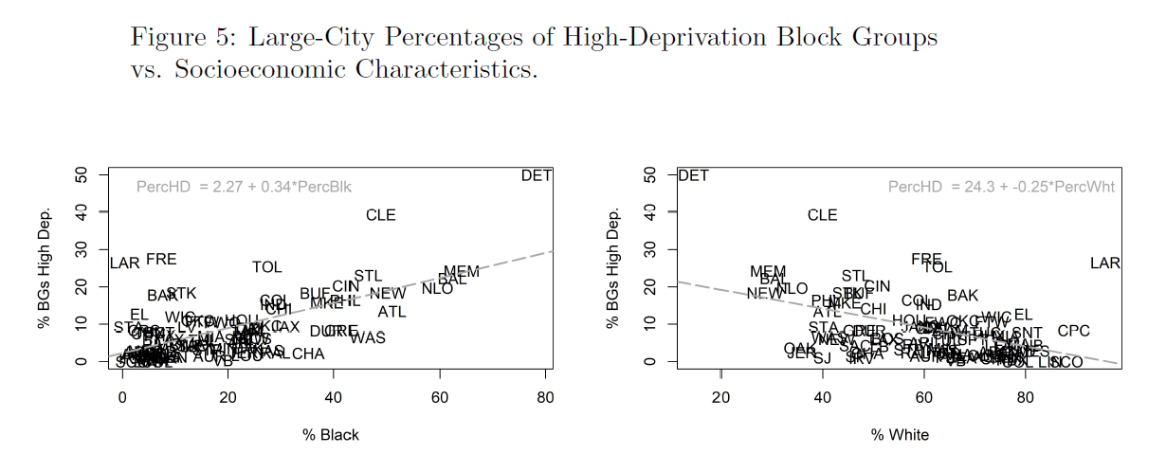
% of high-deprivation BGs vs. racial characteristics

Slide 21
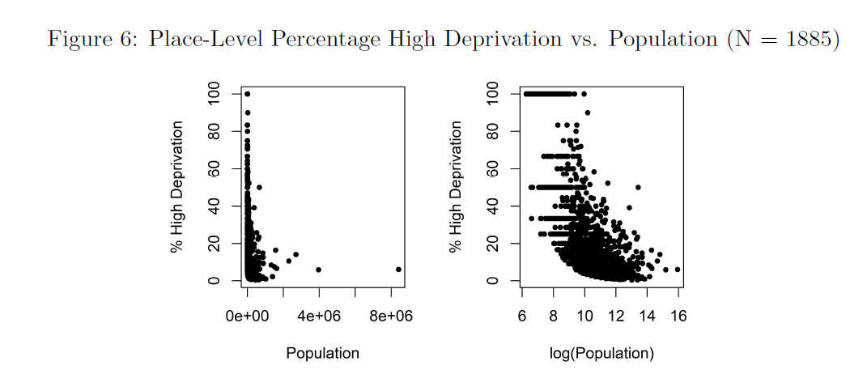
% high deprivation vs. size

Slide 22
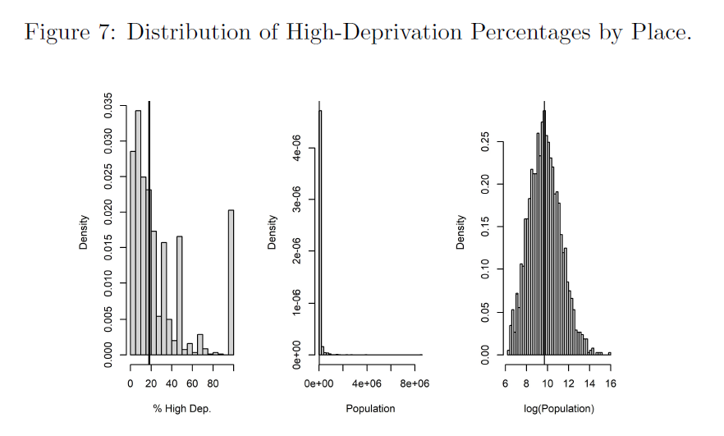

Slide 23
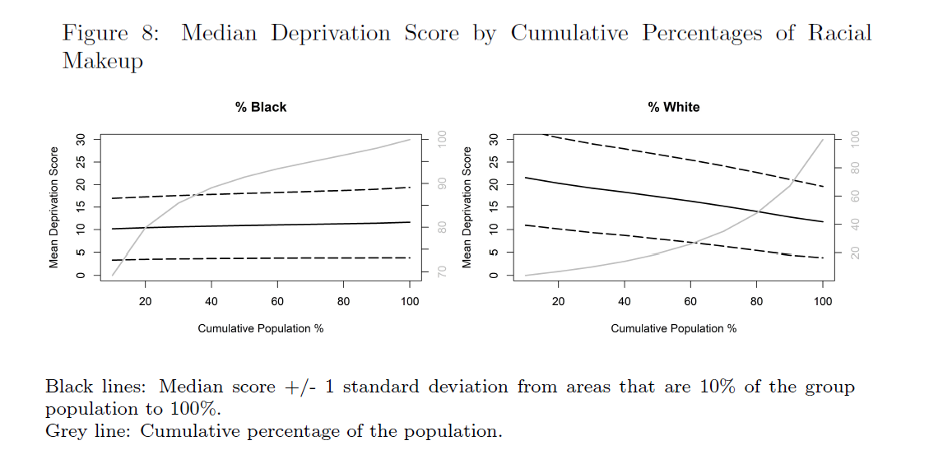
Race and Deprivation

Slide 24
Results: Regression Analysis

Slide 25
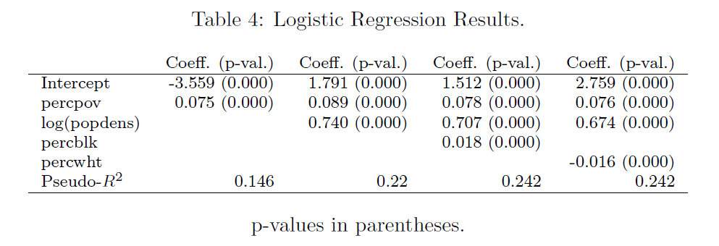
Regression: Place contains HD BGs ( = 1)

Slide 26
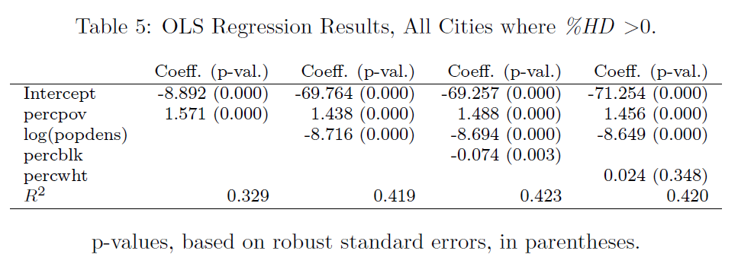
Regression: OLS w/ %HD as DV

Slide 27
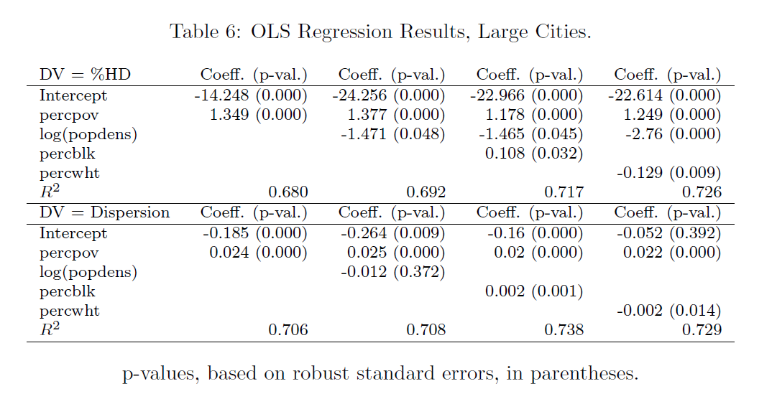

Slide 28
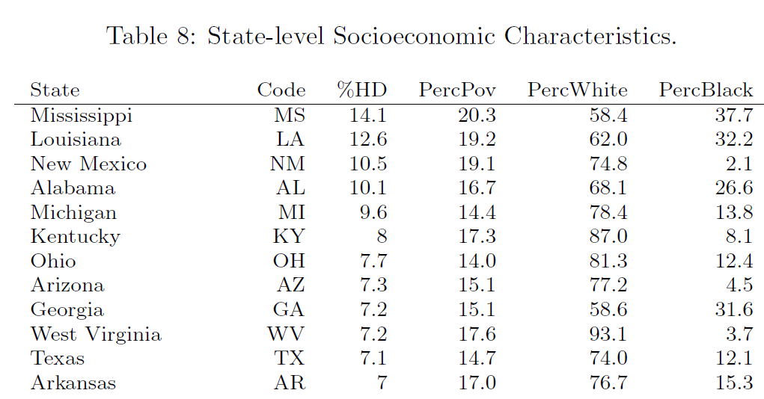

Slide 29
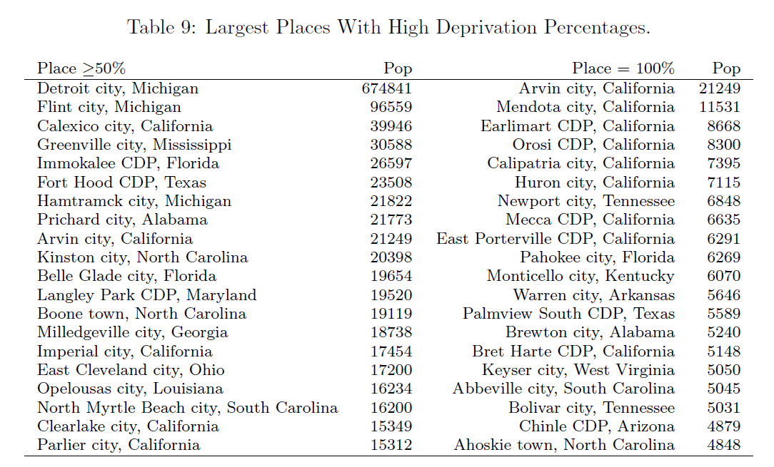

Slide 30
Conclusions

Slide 31
Interesting Results
Modeled deprivation as in index
→ High-deprivation areas and their dispersion
Detroit’s median is an accurate threshold
Large cities: High-deprivation areas mapped and modeled
→ Correlations with race, but “backward” nationwide
Deprived areas outside large cities
Public health applications: Variable in future health studies
Resource allocation toward rural areas and small cities

Slide 32
Thank you!
S-Hegerty@neiu.edu
https://arxiv.org/abs/2210.16155

