Slide 1
GES 317/417: Urban Information Systems
Prof. Scott Hegerty
Summer 2025
NEIU

Slide 2
Welcome to the course!
Introductions
Syllabus overview
Structure of the course
Structure of tonight’s class

Slide 3
Structure of the course:
Graduate (now also Undergraduate)
Main difference: Article discussion, Research paper
Weekly: Tuesday nights 1) Theory/lecture and Article discussion
2) In-class lab/exercise
3) Assignment/project work time
HYBRID: May have one-on-one meetings at convenient times
Between classes: Work on labs (6 total)
Ongoing: Work on project (due at the end) Periodic: Article assignment, writing assignment

Slide 4
Components of the course:
1) GIS skill development
2) Urban applications of GIS
3) Urban Geography concepts
4) Data analysis/Spatial statistics
5) Research skills and project development
→ Exact mix varies depending on student background and interests

Slide 5
Structure of tonight’s class
GIS and Urban Studies
Research in GIS
Urban Theory (Part 1)
GIS Walkthrough
In-class lab/data exercise

Slide 6
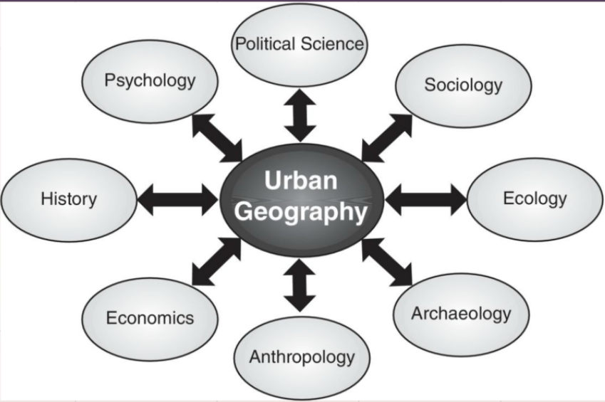
GIS and Urban Theory
Types of questions: -> “Hot spots” -> Socioeconomic questions -> Location Analysis -> Environmental Problems -> Public Health -> Paths/distance calculation
Vector/raster data
Tools: Cartography, statistics

Slide 7
Conducting a Research Project
Idea
Data collection
Project Setup
Analysis
Presentation
(All of these take longer than you think)

Slide 8
Data Sources:
Useful examples:
U.S. Census
Chicago Data Portal
Shapefiles (TIGER Line files)

Slide 9
Conducting a literature search
Good search terms
Journals and databases
Assessing a “good” journal
Following your interests
Going down the citation rabbit hole
→ NEIU Library website

Slide 10
End Goal:
A paper that:
Asks and answers a good question
Addresses the literature
Uses appropriate (GIS) tools
Makes a conclusion based on findings
Presents the information well

