Slide 1
GES 317/417: GIS and Site Selection
Prof. Scott Hegerty
Summer 2025
NEIU

Slide 2
Uses of Site Selection
Firm Location
Market Areas
Wildlife Habitats Types of inputs for each?

Slide 3
Methods of Site Selection
Least-Cost paths
Cost-Path Analysis (routes using infrastructure, various obstacles)
Multicriteria Analysis Logical/Spatial Queries → Analysis Tools
Site Suitability Boolean (Y/N) or Fuzzy Attribute Queries + Overlays

Slide 4
Laws of location science (LLS)
Church and Murray, Business Site Selection, Ch. 1
LLS1—Some locations are better than others for a given purpose.
LLS2—Spatial context can alter site efficiencies.
LLS3—Sites of an optimal multisite pattern must be selected simultaneously rather than independently, one at a time.
GIS supports via queries, modeling, other tools

Slide 5
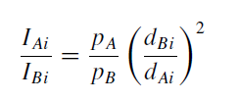
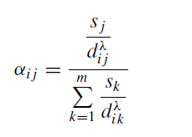
Modeling Trade Areas: Descriptive
Church and Murray, Business Site Selection, Ch. 2
Relative Sales between two sites is a function of two areas’ populations and distance (Reilly’s Law)
(Based on gravity model)
>= 3 areas: Area a function of store attractiveness and distance (Huff Model)

Slide 6
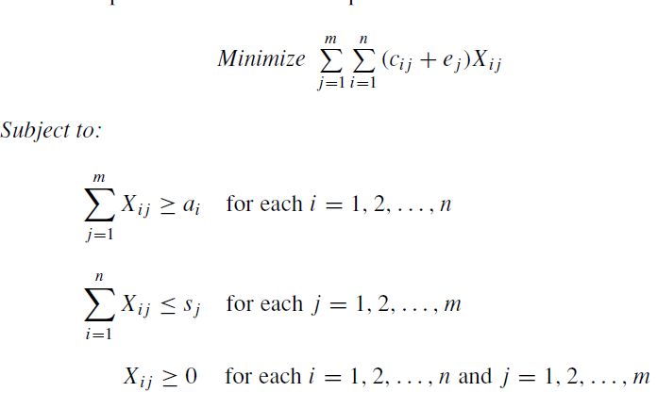
Modeling Trade Areas: Prescriptive
Cost minimization for production: Transportation Problem
Materials + Shipping cost
All demand must be fulfilled
Can’t ship more than a factory makes

Slide 7
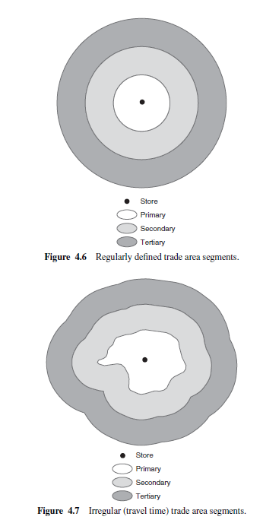
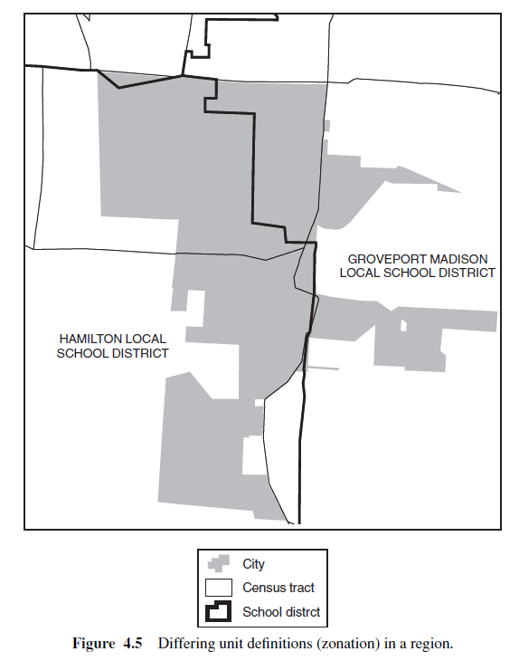
GIS and Trade Areas
MAUP Irregular Trade Areas
Scale and aggregation issues

Slide 8
Al Garni and Awasthi (2017)
GIS and Analytical Hierarchy Process
Solar Power Plant Site Location: Economic, Technical, Environmental factors
Multi-Criteria Decision-Making Model
→ 5-level sutability index

Slide 9
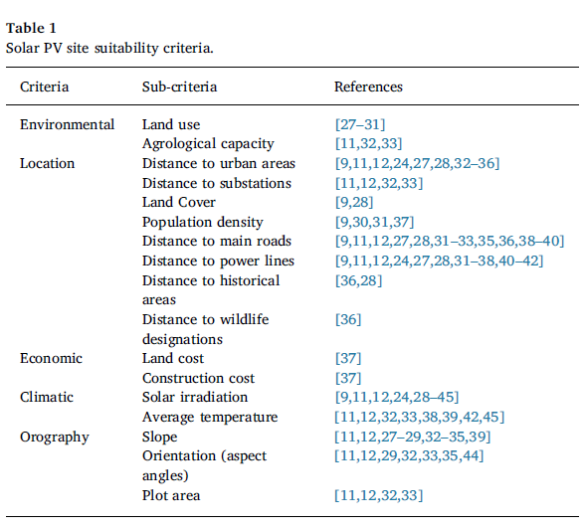
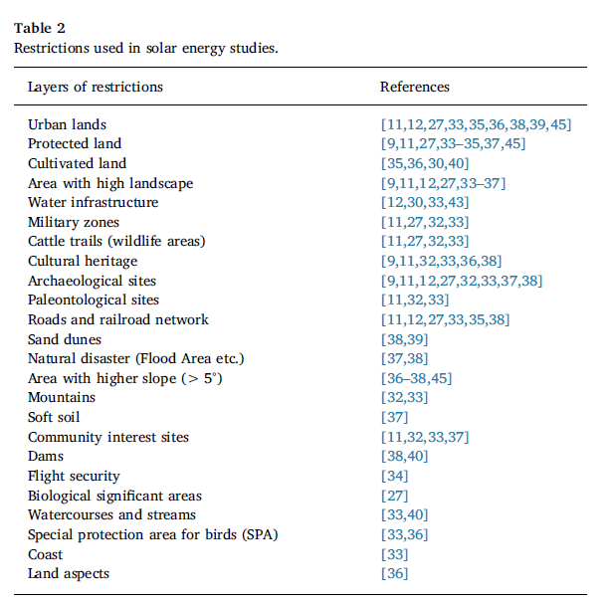
Criteria: From the literature

Slide 10
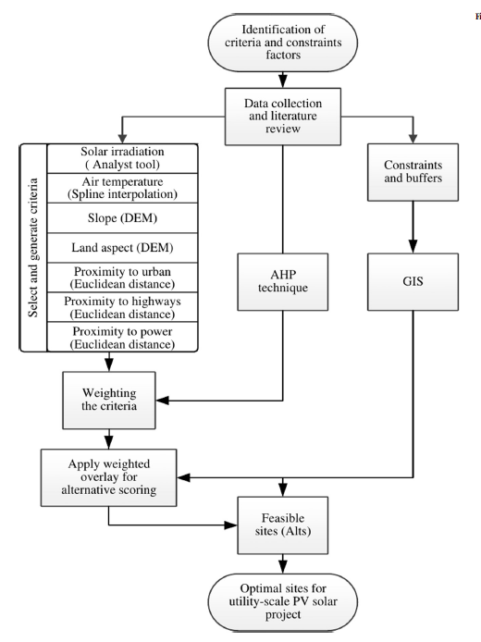
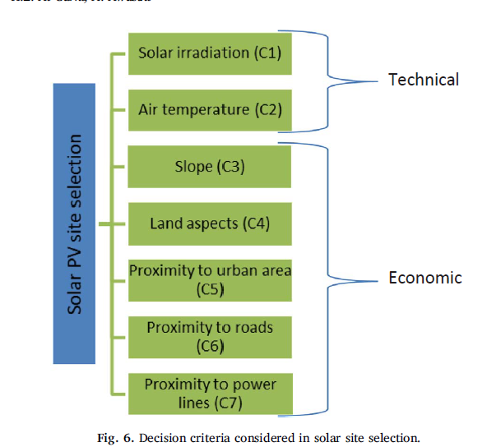
Modeling Method

Slide 11
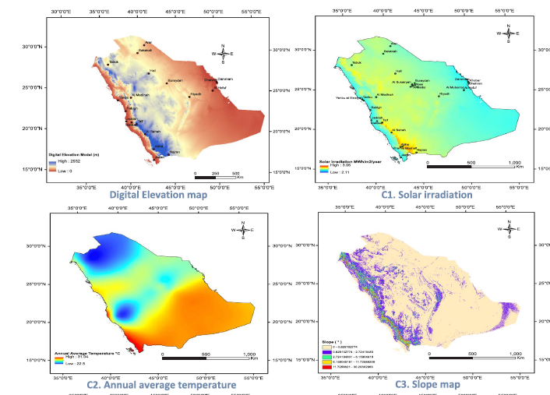
Criteria Maps

Slide 12
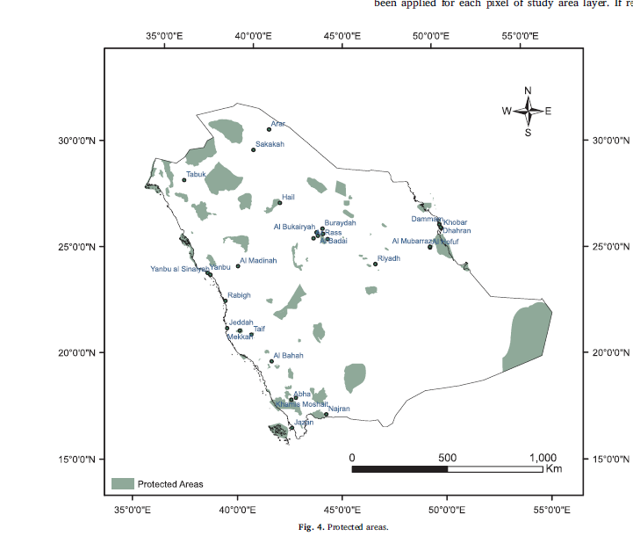
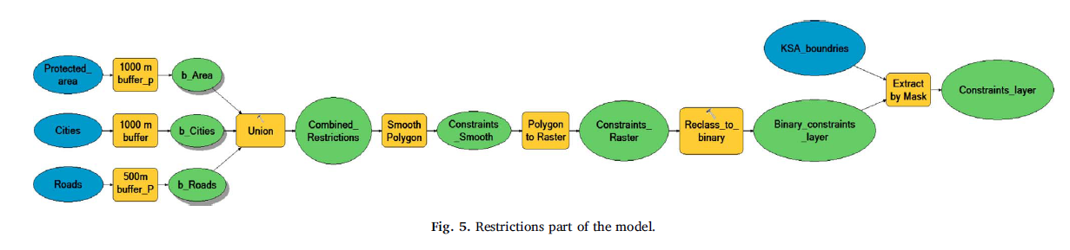
Restrictions

Slide 13
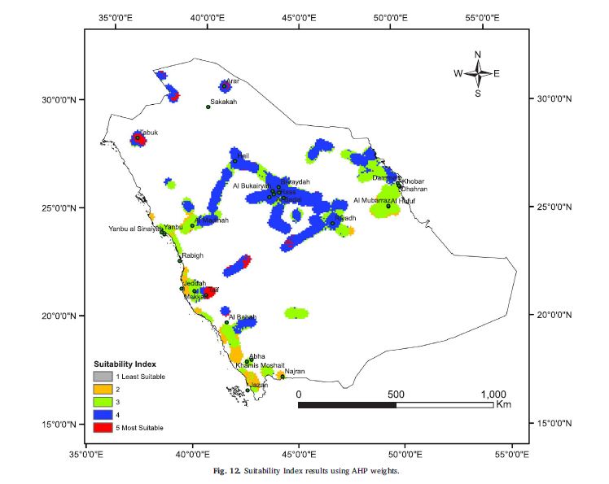
Final Results

Slide 14
A few possible methods
Can stack layers (e.g. slope, temperature, shade) → Urban: Proximity, Income, Amenities
Create a score: Multiple criteria, weighted and combined Every unit gets a score; above or below cutoff
Select from multiple criteria: Think of the Venn Diagram What areas meet them all?

