Slide 1
GES 317/417: GIS Principles II
Prof. Scott Hegerty
Summer 2025
NEIU

Slide 2
GIS Principles II
Spatial Data Transformation and Integration
Spatial Interpolation
Lab 2
Also: Geocoding demo (Daycare locations in Chicago)

Slide 3
Spatial Data Integration (Flowerdew)
Data types: dichotomous, categories, count, rank, continuous
Formats: points, lines, polygons, surfaces
Coordinate systems
Scales: resolution and extent, temporal
Error and accuracy
Incompatible areal units --

Slide 4
Data Types
Dichotomous (e.g. has diploma)
Categorical (e.g. highest degree)
Ranked
Count
Continuous (e.g. Income)
→ Examples; when would you use each of these?

Slide 5
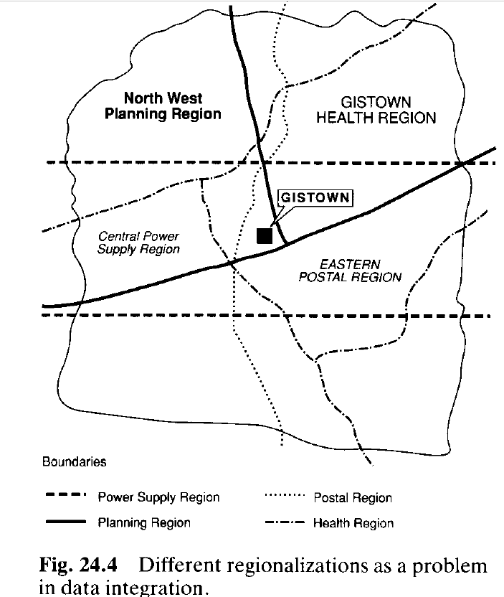
Issue in data integration: Regions

Slide 6
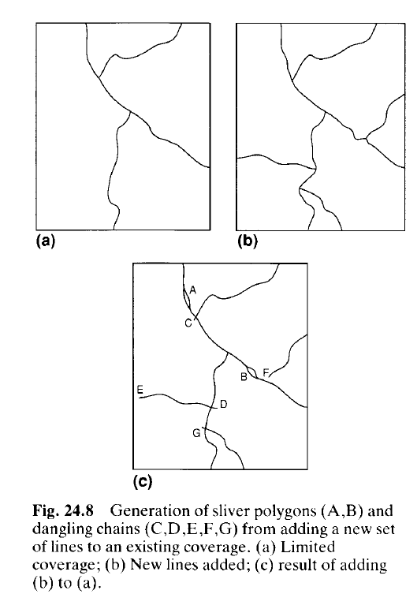
Issue in data integration: Unequal borders

Slide 7
Integrating vector and raster data
May need to re-classify
Formats: .TIFF .JPG .BMP .PNG
How do these differ: resolution vs. file size?

Slide 8
Interpolation
“Fill in the gaps”
Estimate values in unestimated areas, based on nearby estimates
Can be used for nonspatial data too (such as time series)
Example methods: Nearest neighbor (or average of nearby values) Kriging (estimating values across a continuous spatial field based on a limited number of sample points)

Slide 9
Dasymetric Mapping
Transforms data from arbitrary aggregation to area that depicts actual distribution
Population → land use (assumes even distribution)
Incorporating ancillary data and redistributing
Methods: Binary (removes uninhabited areas) Limiting Variable (such as land use) Three-class

Slide 10
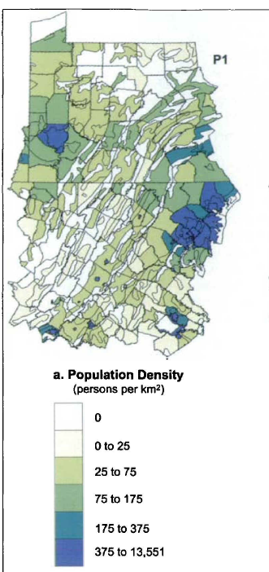
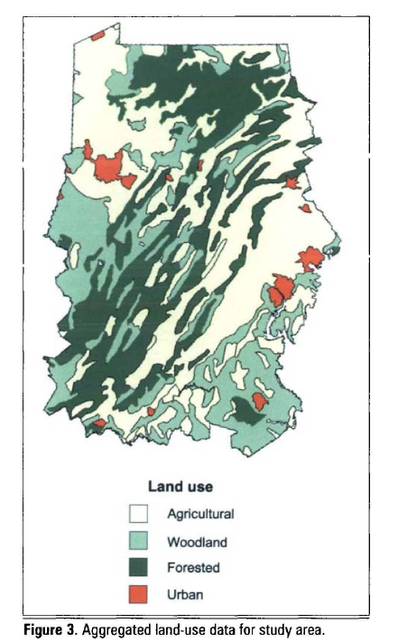
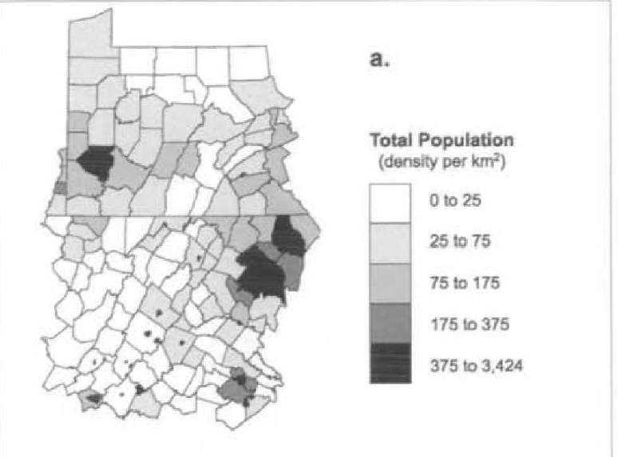
Dasymetric Mapping
“Better” than choropleth mapping?

