Slide 1
GES 317/417: GIS and Public Health
Prof. Scott Hegerty
Summer 2025
NEIU

Slide 2
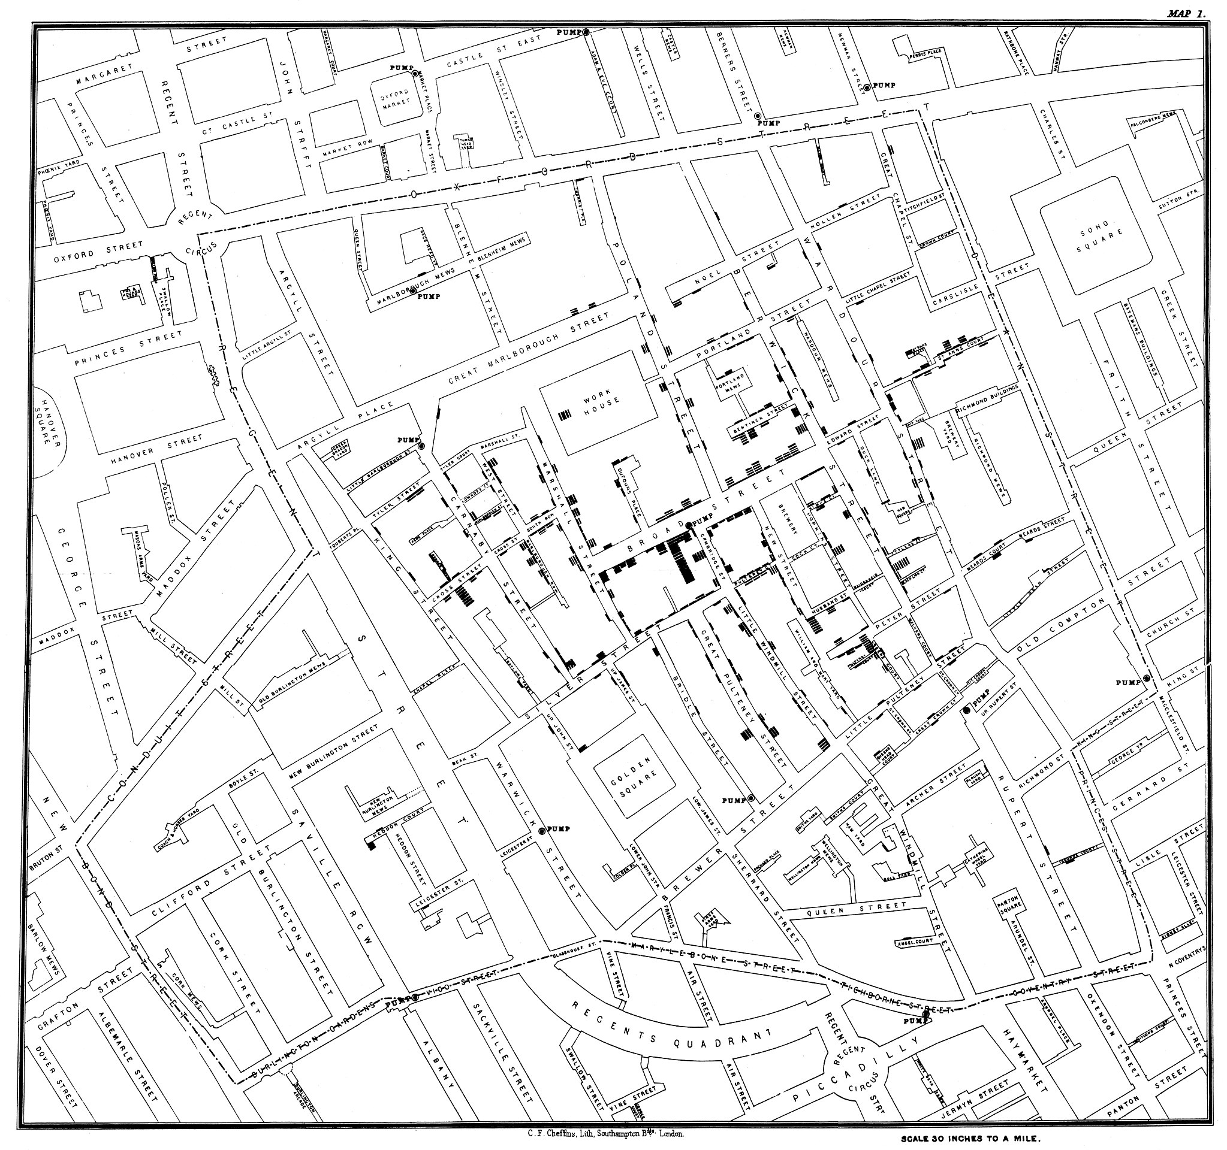
Public Health
A key application of GIS
Data, demand, outcomes
The original cholera map (Snow, 1854)

Slide 3
Public Health: Inputs and Outputs
Mapping health outcomes as variable of interest:
Chicago Health Atlas https://chicagohealthatlas.org/
(Asthma, cancer scores, opioid deaths and overdoses, etc.)
Mapping related events (ER use, mammography screening rates, hospital access)
Mapping Direct Causes (Pollution, Air quality, environmental waste sites)
Modelling cause and effect

Slide 4
Public Health: Inputs and Outputs
Everything is related!
Economic deprivation
Financial burden: Banking access, credit scores
Food, pharmacy, other deserts
“Displacement pressure” in neighborhoods (DePaul)

Slide 5
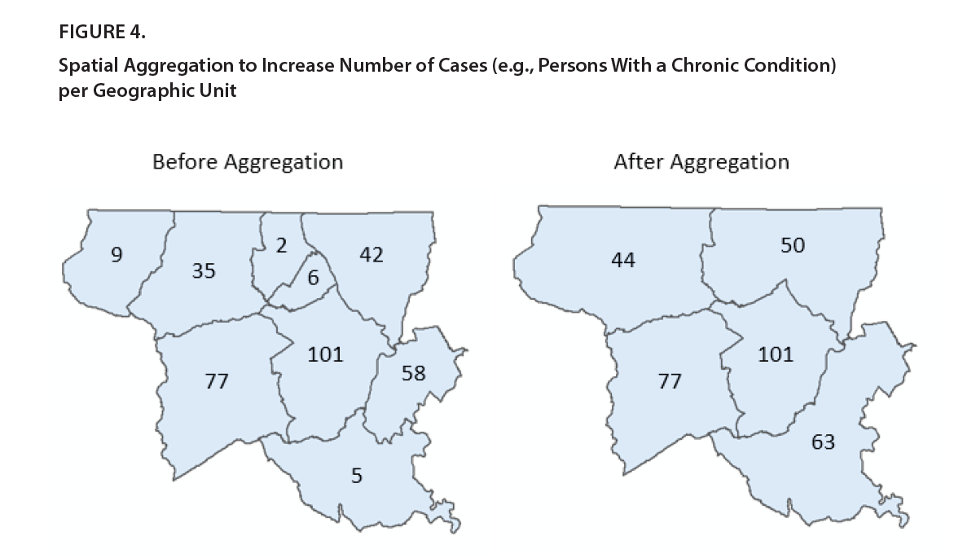
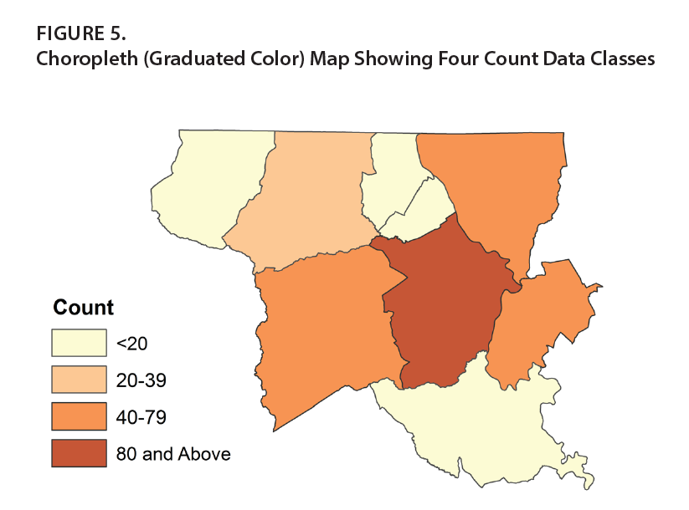

GIS as a Data Tool
De-identifying data though aggregation
Blurring using ranges

Slide 6
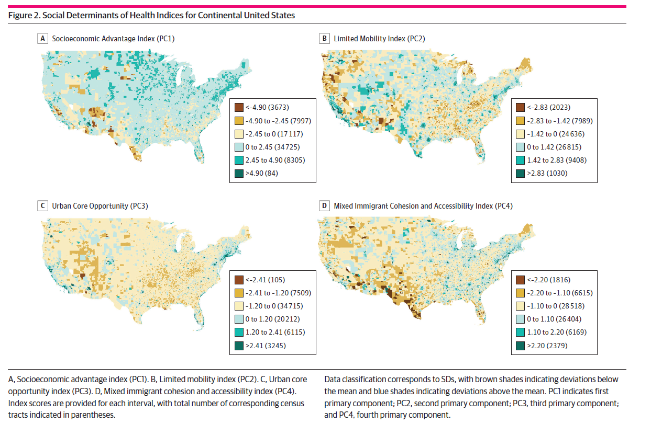
Determinants: Multivariate Indices
Kolak, 2020

Slide 7
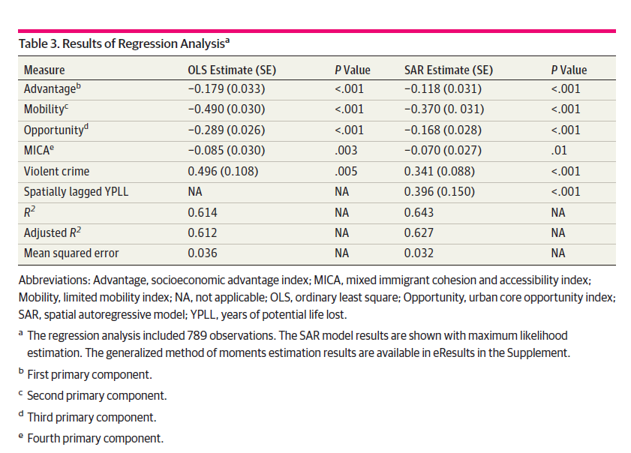
Dependent variable: Premature mortality rates in Chicago

Slide 8
Sturm and Cohen (2004): Sprawl
Measure nationwide and connect to physical/mental health Four measures:
residential density
land use mix
degree of centring
street accessibility
(and other factors)

Slide 9
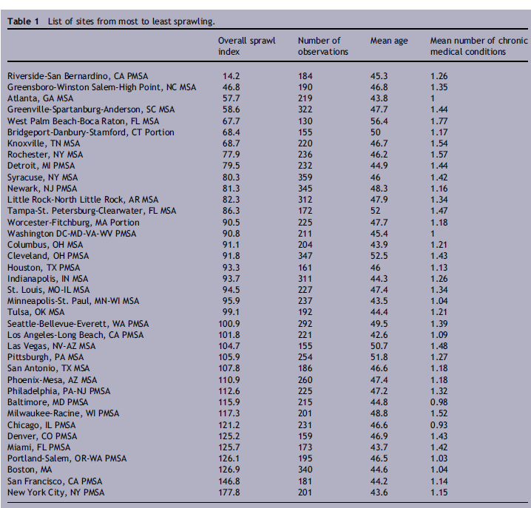

Slide 10
