Slide 1
GES 317/417: GIS Principles 1 Data . Scale . Coordinate Systems
Prof. Scott Hegerty
Summer 2025
NEIU

Slide 2
GIS Principles I:
GIS Data
Scale Issues
Coordinate Systems
In-class lab

Slide 3
GIS Data: Vector vs. Raster
Vector
Points, lines polygons
Good for socioeconomic data
Smaller filesize
Raster
Image-based
Satellite photos, etc
Good for environmental data

Slide 4
Data sources:
Vector
Census
Raster
USGS
…what else?

Slide 5
Scale:
What is it?
How does it affect data?
Modifiable Areal Unit Problem (MAUP)

Slide 6
Scale:
Relationship between a distance on a map or model and the corresponding distance on the Earth's surface
Cartographic meaning
Social meaning
What to keep vs. what to sacrifice (always a choice)

Slide 7
How does scale inform the practice of GIS?
• Cartographic scale
• Operational scale
• Spatial resolution
• Cartographic generalization
• Hierarchy theory in biophysical geography
• Social construction of scales in human geography

Slide 8
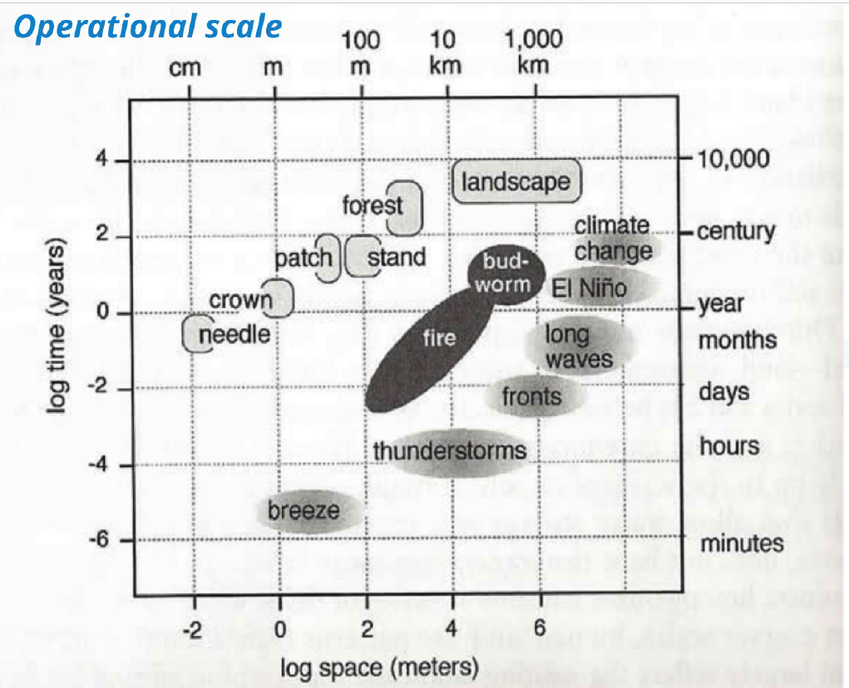

Slide 9
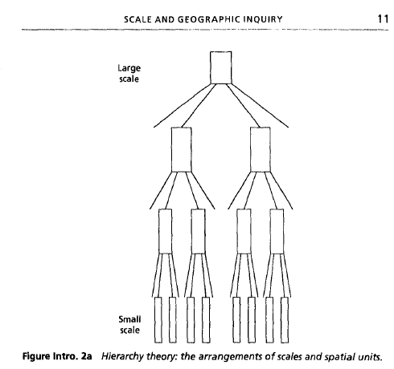
“Holons” and nested processes

Slide 10
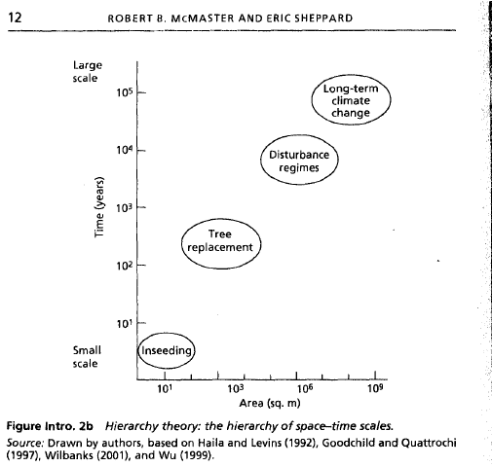

Slide 11
Modifiable Areal Unit Problem (MAUP)
Changing scale or unit boundaries changes relationships
Zoning effects: Choose boundaries?
Effects on Summary statistics, correlations, other analyses

Slide 12
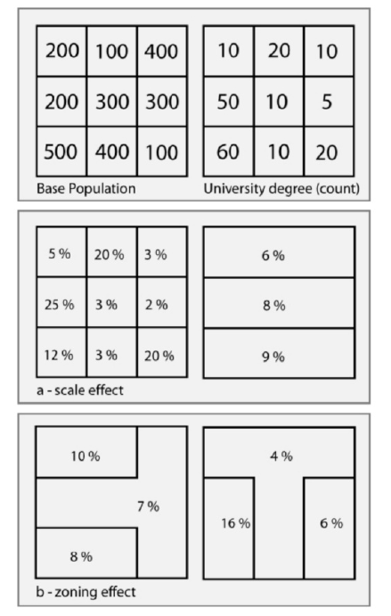
MAUP: Example
Also correlations, regression coefficients

Slide 13
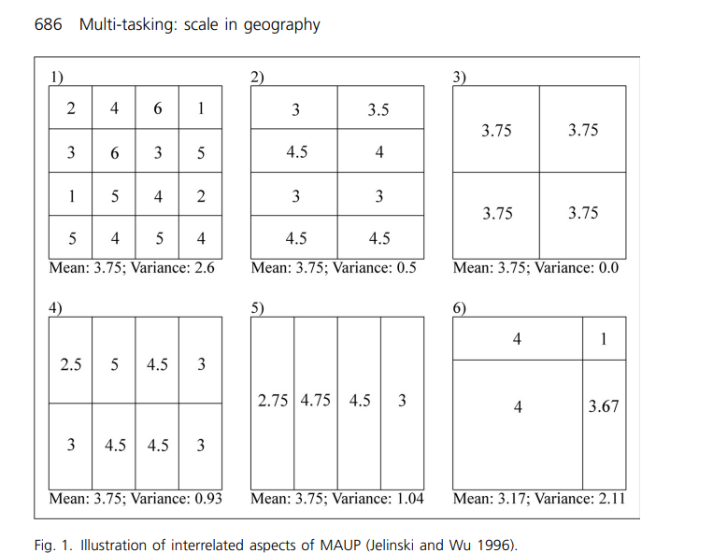
MAUP: Example
Also correlations, regression coefficients

Slide 14
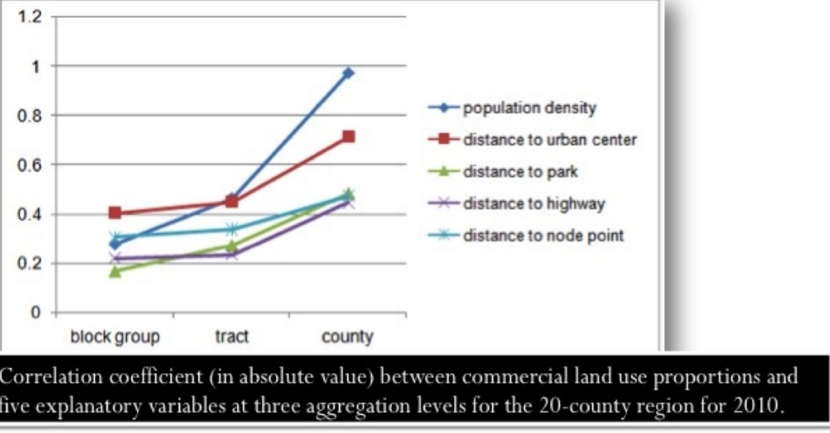

Slide 15
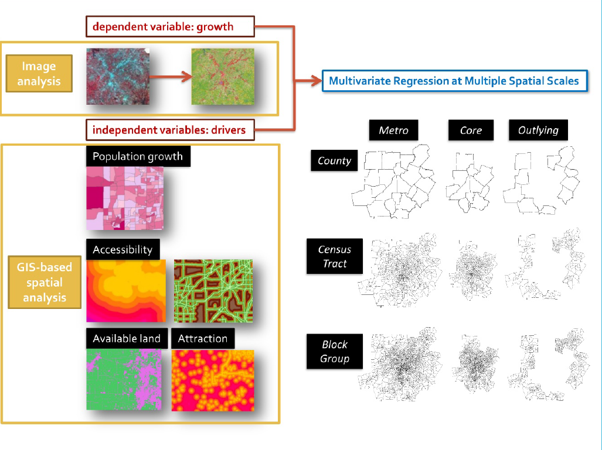

Slide 16
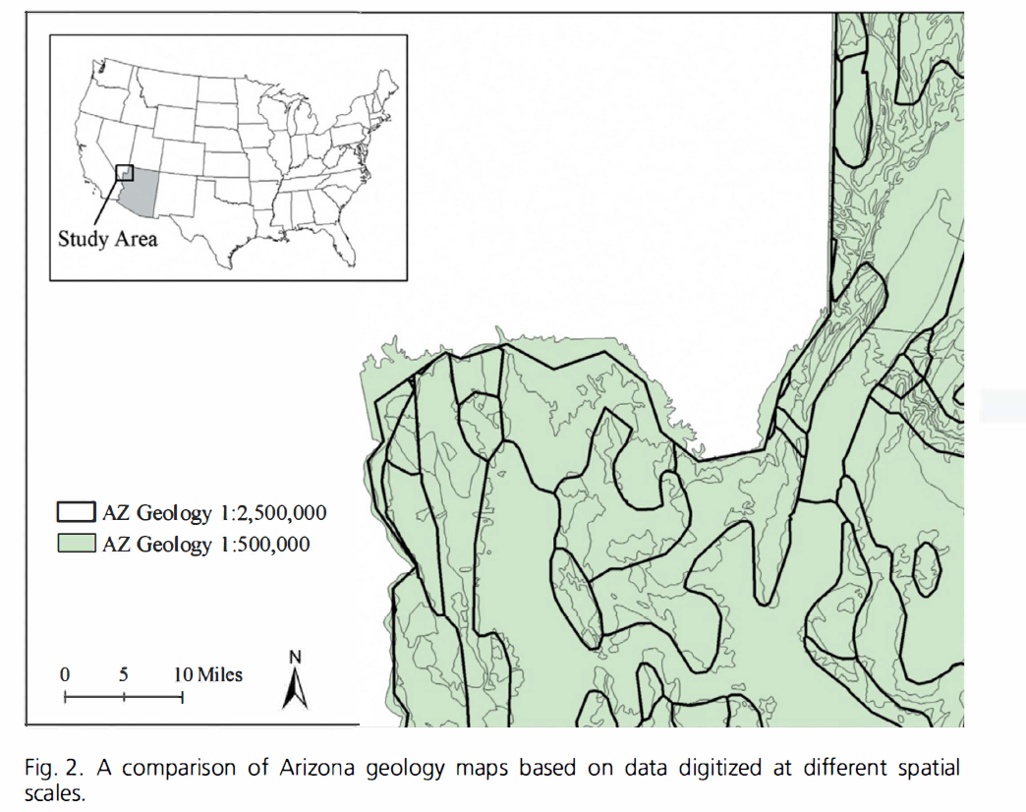

Slide 17
Projection:
Mathematical conversion: Sphere->flat
Conic, cylindrical, planar
Distortions
Shape, Area, Distance, Direction
Conformal: preserves shape
Equivalent: preserves area
Or… compromise and preserve neither

Slide 18
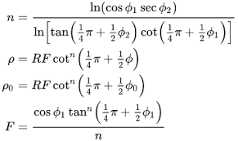
Projection:
Mathematical conversion: Sphere->flat
Spatial representation: Have to choose to keep/sacrifice
Spatial measurement
Area, distance, density
Spatial Statistics
Spatial relationships
Lambert conformal conic projection

Slide 19
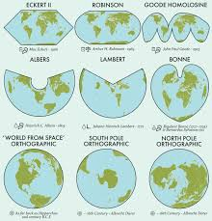
Projected Coordinate Systems:
Cities: Smaller (less distortion)
But distance/area may matter
Typical State Plane, etc. → Choose when needed

Slide 20
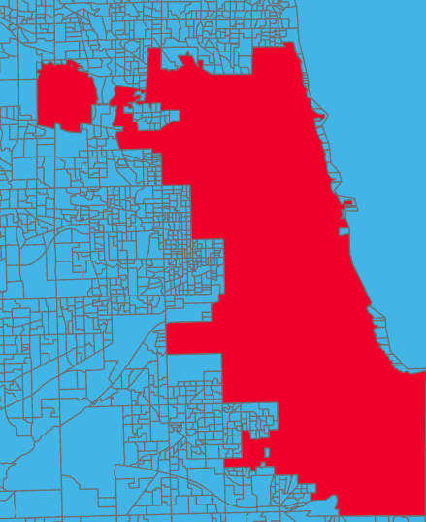
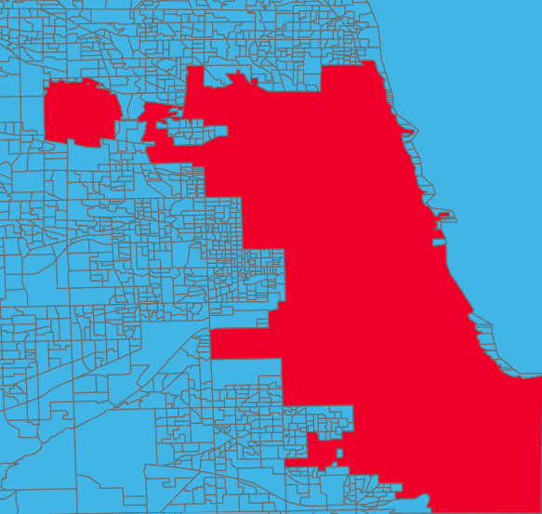
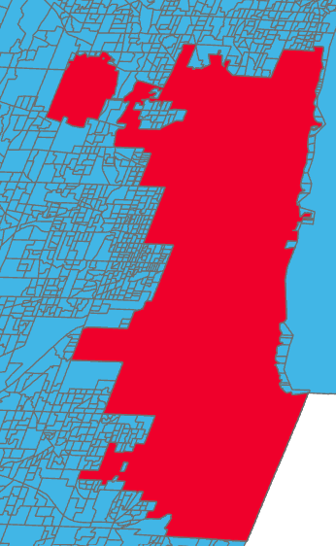
Chicago under different projections
NAD 1983 (Chicago) Mercator Winkel Tripel

Slide 21
Practical implications
Does everything line up?
Does everything calculate correctly?
Does everything look OK?

Slide 22
Projection and Scale Example: In Class
Cook County Blocks, Block Groups, Tracts…

