Slide 1
GES 317/417: GIS and Urban Environmental Problems
Prof. Scott Hegerty
Summer 2025
NEIU

Slide 2
Using GIS In Environmental Analysis
Done here: Infrastructure, Sprawl, Demographics
Also pollution, noise, air and water quality
Green areas, tree cover
Animal habitats → Satellite Imagery/Remote Sensing

Slide 3
A few examples:
Heat islands (ESRI File)
Impervious Surfaces
Light Pollution

Slide 4
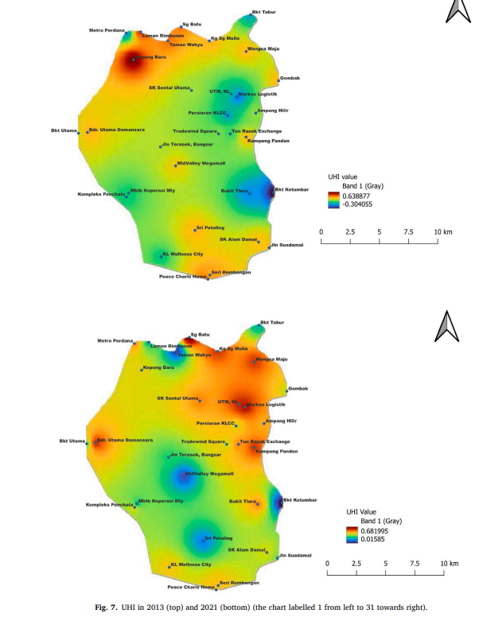
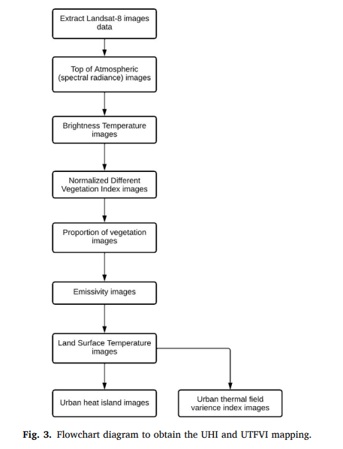
Heat Islands
Jumari et al (Paper) [Bonus]
Modeling and Mapping in Kuala Lumpur

Slide 5
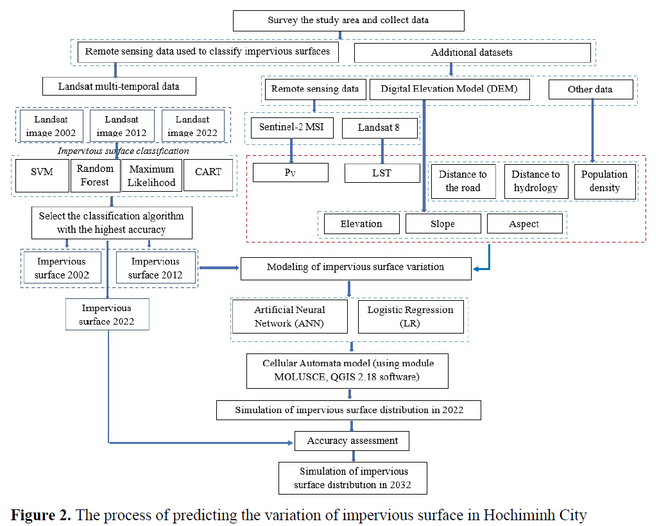
Impervious Surfaces
Trinh et al.
Modeling, metrics
→ Prediction

Slide 6
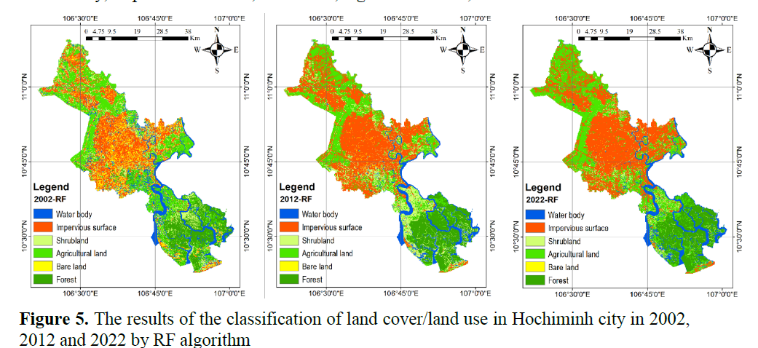
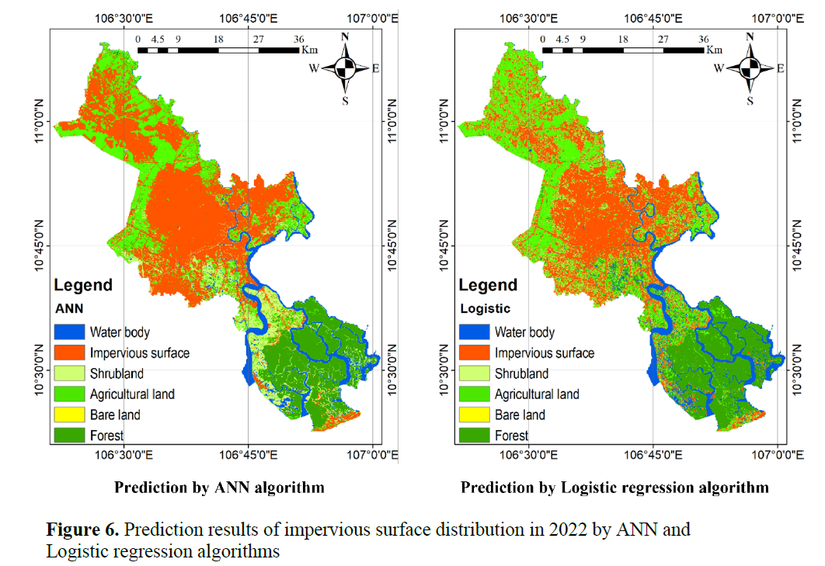

Slide 7
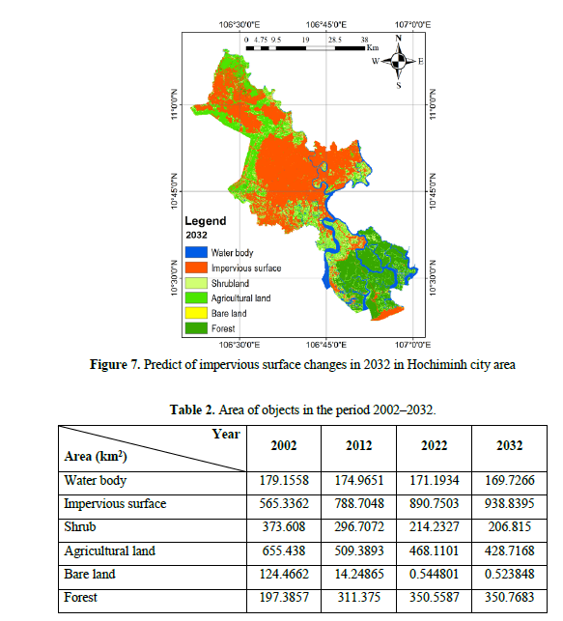

Slide 8
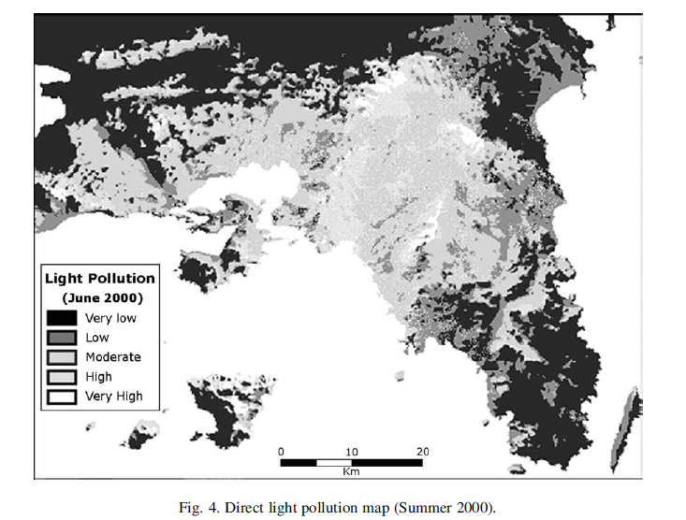
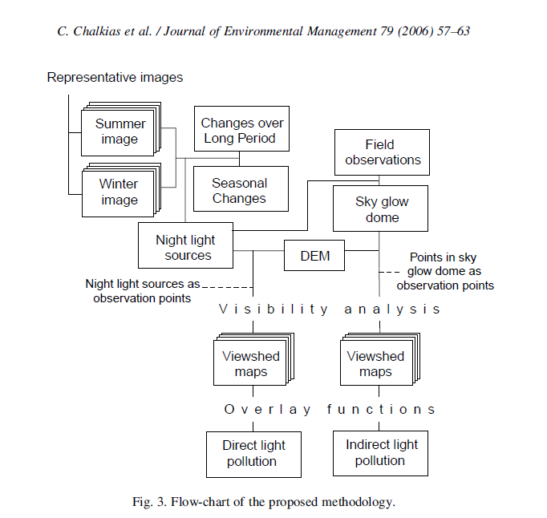
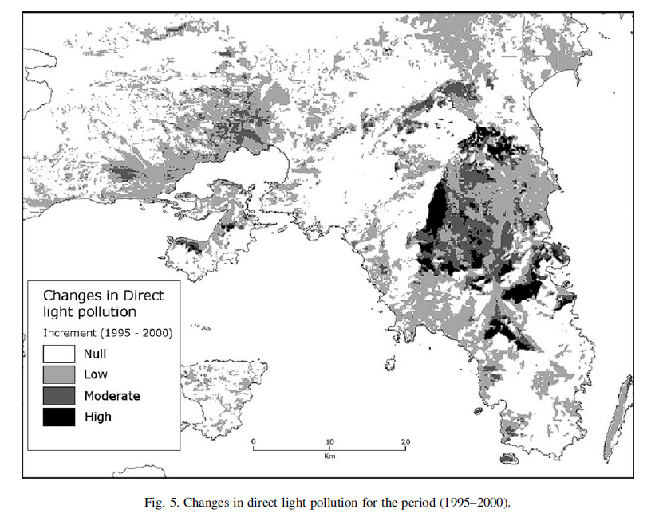
Light Pollution
Chalkias et al. (Athens) Direct and Indirect

