Slide 1
GES 317/417: Urban Theory: Land Values
Prof. Scott Hegerty
Summer 2025
NEIU

Slide 2
“Monocentric City Model”
Spatial Structure of cities
Land use and land values/land rent
Assumes that activity radiates out of a Central Business District
Commercial > Industrial > Residential
Good for 1920s, basically

Slide 3
“Monocentric City Model”
Assumes (perfect) economics: Supply and Demand!
Demand based on use Commercial > Industrial> Residential
Commuting costs: increase with distance
Costs
Distance

Slide 4
“Monocentric City Model”
Assumes a lot of (perfect) economics
Basically, commuting costs increase with distance
So values drop
Eventually the activity isn’t worth it (But something else is)
People pay more to be close
Rents (Values)
Distance

Slide 5
“Monocentric City Model”
Assumes a lot of (perfect) economics
Basically, commuting costs increase with distance
So values drop
Eventually the activity isn’t worth it (But something else is)
Value
Distance
Red-------→ ←-------Blue

Slide 6
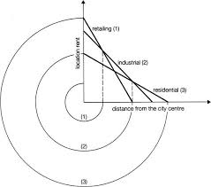
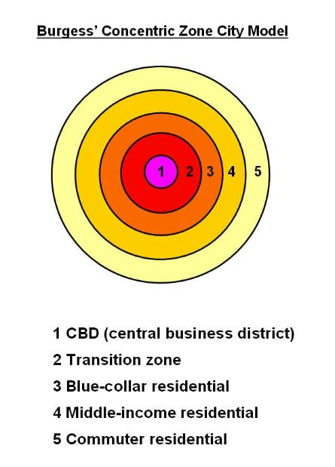
Land use in the Monocentric City

Slide 7
Changes in the Monocentric City
Leads to changes in city structure
Commuting costs
Population
Also Zoning

Slide 8
Example: Lower Commuting Cost
“Flattens” Residential curve
City expands

Slide 9
Factors of Production
Land: Physical; natural resources
Labor: Human power
Capital: Machinery/Equipment, etc.
Human capital: education
Can substitute based on costs

Slide 10
Factor substitution
Common: Labor and capital
Urban: Land and Capital
Land becomes more expensive: add more buildings!

Slide 11
Density, Land use, and technology
Common: Labor and capital
Urban: Land and Capital
Land becomes more expensive: add more buildings!
Elevators vs. highways

