Slide 1
GES 317/417: Spatial Statistics
Prof. Scott Hegerty
Summer 2025
NEIU

Slide 2
General Statistics
Description Center (mean, median) Spread (variance→ standard deviation)
Association (Formulas) Correlation
Causation Regression

Slide 3
Spatial Statistics
Every place is affected by every other place, but some more so than others
Incorporates location Varies by place Numbers affect neighbors
I found this nice explainer
https://www.unsiap.or.jp/sites/default/files/pdf/e-learning_el_material_5_agri_1507_literacy_korm3_4_country_presentation_korea.pdf

Slide 4
Spatial Weights/Spatial Lags
Time-series: Each time value is affected by past values (e.g. June 2025 affected by May 2025, or April 2025, or June 2024)
“Autocorrelation”
Geography: Each area is affected by neighbors
“Spatial autocorrelation”

Slide 5
Spatial Weights/Spatial Lags
What is a “neighbor”?
Could be distance or proximity Enters as a matrix into your calculation
BUT: If there are 10 areas, there are 45 pairs → N*(N-1)/2
What about 3,000 block groups?
LeSage (2014): Keep it simple

Slide 6
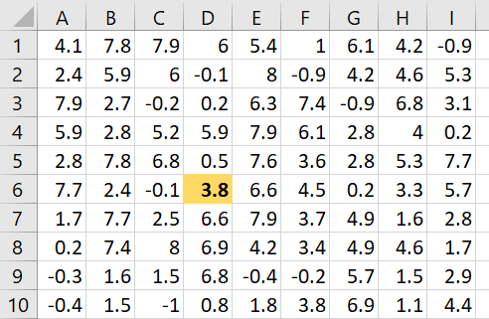
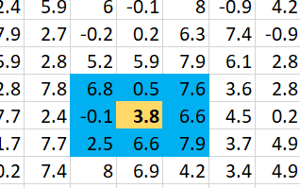
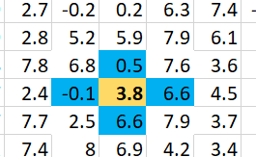
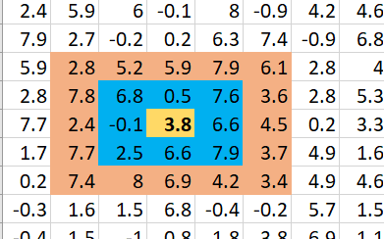
Contiguity and Order
What defines “touching”?
How many units away?
Example: “Queen” vs. “Rook”
Order 1 vs. Order 2

Slide 7
Distance vs. Contiguity
Distance: All pairs have numerical values
Contiguity: Only defined neighbors have 1, otherwise 0 (Simpler to calculate)
Some basic uses →

Slide 8
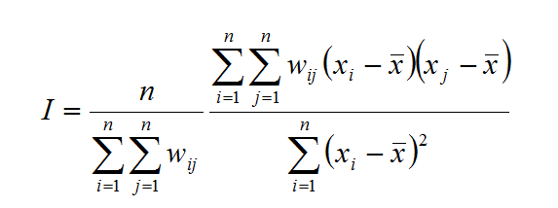
Moran’s I
Spatial Autocorrelation: Depends on Weights

Slide 9
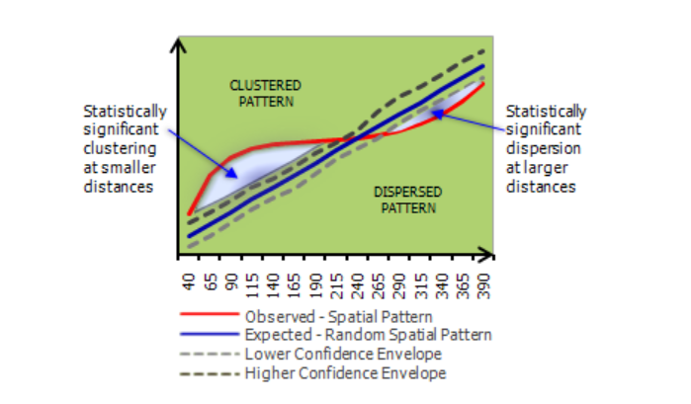
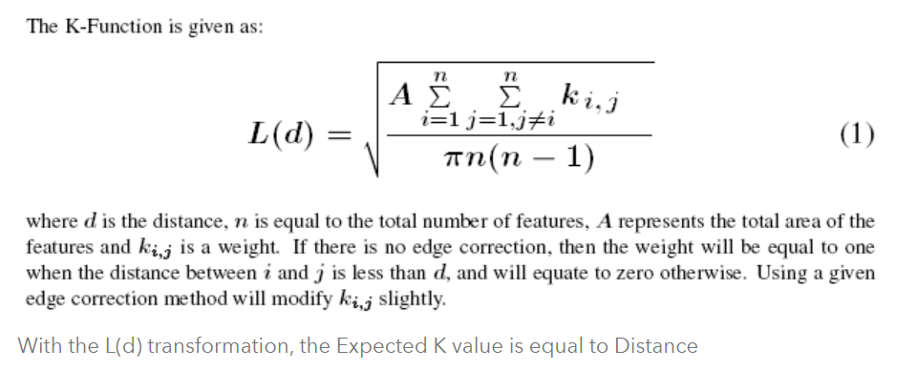
Ripley’s K
Relationship at distance bands (Multi-Distance Spatial Cluster Analysis)
https://pro.arcgis.com/en/pro-app/latest/tool-reference/spatial-statistics/h-how-multi-distance-spatial-cluster-analysis-ripl.htm

Slide 10
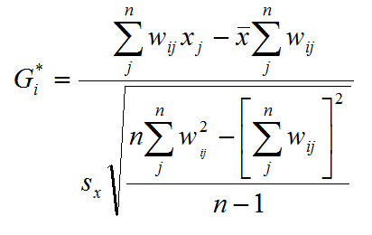
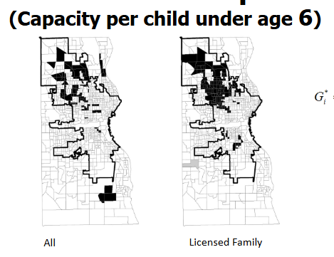
Getis-Ord (Gi*)
“Hot Spots” (High-High)
Also “Cold Spots” (Low-Low)
https://docs.google.com/presentation/d/1x_OFVeS7a3Lvbdr3WcFZhSu0nvt8W3wi/

Slide 11


Spatial Regression
Incorporates weights and correlations Various models
Spatial lag model: (vs )
https://www.accessecon.com/Pubs/EB/2019/Volume39/EB-19-V39-I1-P27.pdf

Slide 12
Always ask:
Is it spatial?
Do I need these methods?
What is the appropriate method?

